Slide 1
Gas Regional Investment Plan project
CRE
RCC meeting
TITRE
18/10/2012

Slide 2
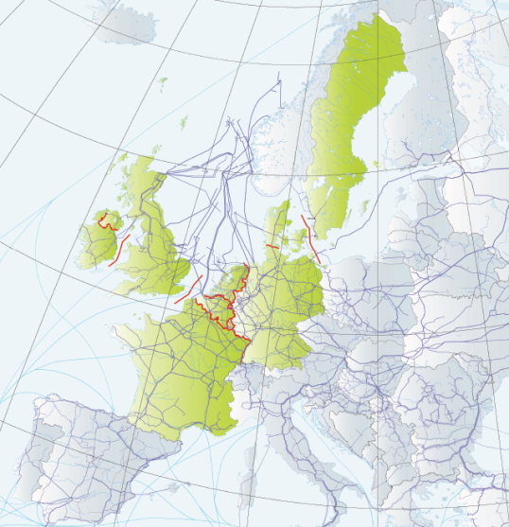
North-West Gas Regional Investment Plan 2011-2020
First GRIP for the NW region published on 21st November 2011 and presented at the last SG meeting
2 months consultation until 31 January 2012
One response from EFET: highlighting the importance of shippers’ commitments as the trigger for investment
TSOs issued a formal response : clarification of the role and scope of TYNDPs
Project gathering 15 TSOs from Belgium, Denmark, France, Germany, Ireland, Luxemburg, the Netherlands, Sweden and United Kingdom

Slide 3
The GRIP project in brief
IG meeting of Sept 2011: decision to include the evaluation and improvement of the GRIP in the 2012 work programme
Objective: Ensure that the next GRIP is most “fit for purpose”
Action taken : RCC drafted recommendations on how to enhance the GRIP process (Letter sent to Fluxys as project coordinator mid-May)
Providing for a better understanding of cross-border congestions
Carrying out an infrastructure-based analysis
Improving the interaction with stakeholders
22 June: Telco between NRAs and TSOs to discuss recommendations
Potential added value of an infrastructure-based approach leading to a deeper analysis of cross-border congestions and remedies.
Focus on giving insight on the projects of the region.
Open to changes but these will need to be consistent with the enhancement of the next EU TYNDP (2013).
Possibility for earlier involvement of stakeholders in drafting process.
Notes:
3

Slide 4
Discussion with Fluxys on 5 October 1/2
Objective: update on the process and on the recent discussions between TSOs
Meeting between TSOs – ENTSOG on 18 Oct (today) in order to discuss the following:
Finalising the composition of the regions/GRIPs & designating the project coordinator for each GRIP.
Alignment with PCI corridors apparently not a favoured option
Synergies with the EU TYNDP process:
Work on the GRIP to start in Dec 2012 (publication of EU TYNDP in Feb 2013).
If an investment gap is identified at a EU level, additional simulation could be made at a regional level, using ENTSOG modeling tool.
Finalisation of the GRIP by April : focus on regional congestions and on the infrastructure projects as part of a wider “strategy” for the NW region
Publication of the NW GRIP between July and September 2013

Slide 5
Discussion with Fluxys on 5 October 2/2
Interaction with the stakeholders:
TSOs willing to give a presentation at the next SG but only preliminary thoughts on the GRIP can be presented.
Agree with RCC suggestion to present the draft GRIP and offer the market the opportunity to react: 1 hour session on the GRIP during ENTSOG workshops?
Link with the PCIs
EU-wide list of PCIs to be adopted in spring 2013, the next GRIP will reflect these developments
Regular updates between the TSOs and RCC: Fluxys will inform project leader of the results of the meeting of 18 October.
IG meeting this afternoon: regulators asked to give a short update on the ACER deliverable on the evaluation of the GRIPs.

Slide 6
ACER opinion on the GRIPs
Overall assessment based on 3rd Package requirement for ACER to monitor the regional cooperation between TSOs.
High level opinion from ACER
Description and evaluation of content of each GRIP
Assessment of the consistency and coherence (methodology, assumptions, coherence with the TYNDP) between the GRIPs and general recommendations.
The GRI NW is the only gas region where an opinion on the GRIP was elaborated by the regulators
ACER will use RCC recommendations as an input.
The GRI NW will be presented as a good example of cooperation and dialogue between the RCC and TSOs (after the publication of the GRIP 2011-2020).
CRE will follow the work done by ACER and update the RCC on progress.
The opinion will be published in December 2012.
Notes:
6

Slide 7
Thank you for your attention!
marie-claire.aoun@cre.fr
carole.mathieu@cre.fr

