Slide 1
Feasibility of implicit allocation in the gas market
NMa
RCC meeting
TITRE
18/10/2012

Slide 2
The RCC has drafted a position paper on the feasibility of implicit allocation in the gas market (now up for consultation)
Report of The Brattle Group (commisisoned by NMa) finalized
Draft RCC position paper finalized and published for consultation
Ongoing public consultation (until 5 November) and workshop (19 October)
Process so far

Slide 3
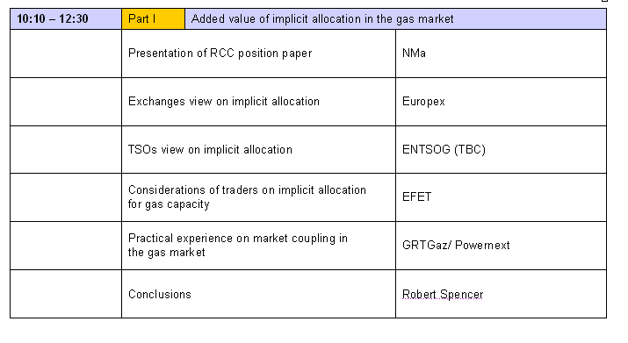
The morning session of the workshop is meant to explore the added value of implicit allocation in the gas market

Slide 4
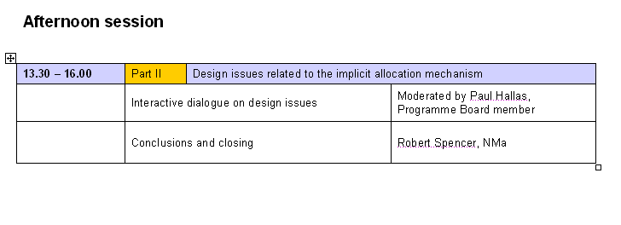
In the afternoon session the design issues related to the implicit allocation mechanism will be discussed in an open dialogue

Slide 5
The RCC will present several statements on the design issues and envisions to discuss these in a “lower house debate” style
Statements are only meant for discussion (and do not reflect RCC opinion)
Chatman house rules apply
The RCC will present a statement and provide
The RCC will present a statement and provide brief introduction
Participants who like to respond to a statement walk to a microphone
Participants who like to respond to a statement walk to a microphone
Participants should not get into an argument who is `wrong or right`
Participants should not get into an argument who is `wrong or right`

Slide 6
Each statement is introduced via an elevator pitch and participants can – once a statement has been discussed – anonymously vote
- The implicit allocation mechanism should not include a reserve price
- The implicit allocation mechanism should only make use of bids and offers made on the exchange instead of the OTC

Slide 7
The RCC will draft an evaluation of comments and based upon input received revise – if applicable – the position paper
“workshop minutes”
NMa will draft internal minutes of the GRI NW workshop on implicit allocation
Evaluation of comments
The RCC will draft an EoC that explains to what extent – and how – stakeholders input has been taken into account
Final position paper
Based upon the EoC the position paper will be revised – where applicable – and finalized

Slide 8
The aim is to present the final RCC position paper during the Stakeholder Group meeting on 23 November in Copenhagen
19 Oct
5 Nov
8 Nov
15 Nov
19 Nov
22 Nov
2013
EoC and revised position paper
Final position paper to SG
Workshop
Presentation Madrid Forum
Revised position paper for approval
End of consultation
Presentation SG meeting

