Slide 1

24th IG Meeting
South Gas Regional Initiative
23rd September 2013

Slide 2
24th IG meeting SGRI- Agenda

Slide 3
Capacity information requested
Agreement on capacity split for the different products?
  PT-SP:X% of the technical /available capacity to be offered in March for next year
    Remaining /Y% to be offered in June
  SP-FR: X% of the technical /available capacity to be offered in March for next 15 years
    Remaining /Y% to be offered in June

Slide 4
II. Capacity allocation mechanisms
  II.1. IT implementation plan for CAM application in 2014. Progress expected
  II.2. Further harmonisation needed: gas day, nominations...
  II.3. Allocation of capacity in Portugal under the new regulation
Area of work | Responsible | Starting | Deadline
OSP France-Spain: annual allocation of ST capacities | TSOs | Nov. (yearly) | Dec. (yearly)
CAM harmonisation proposal PT-SP | NRAs-TSOs | Jan. 2011 | Jun. 2012 (COMPLETED)
CAM harmonisation proposal in the whole region | NRAs-TSOs | Jan. 2012 | Dec. 2013
Set up a common TSO Allocation Platform: Roadmap and Implementation | TSOs | Jul. 2012 | Dec. 2014

Slide 5
III. Congestion Management Procedures
Progress expected in auctions implementation
Capacity to be allocated at the borders via auctions
  (for information by TSOs)

Slide 6
II. Capacity allocation mechanisms
II.1. IT implementation plan for CAM application in 2014. Progress expected
  (for information by TSOs)

Slide 7
II. Capacity allocation mechanisms
  II.2. Further harmonisation needed: gas day, nominations...
  (for information by Enagas)

Slide 8
II. Capacity allocation mechanisms
  II.3. Allocation of capacity in Portugal under the new regulation
  (for information by REN)

Slide 9
III. Congestion Management Procedures
  III.1. CMP implementation: existing and expected regulation in each country, application, convergence of the different mechanisms
Area of work | Responsible | Starting | Deadline
CMP harmonization in the whole region | NRAs-TSOs | Oct. 2012 | Oct. 2013
CMP harmonization in the whole region (including UIOLI firm ST) | NRAs-TSOs | Oct. 2012 | Jul. 2016

Slide 10
III. Congestion Management Procedures
III.1. CMP implementation: existing and expected regulation in each country, application, convergence of the different mechanisms
(for information by Regulators)

Slide 11
III. Congestion Management Procedures
Status of the regulations in each country
FRANCE
CRE’s Deliberation was published end of June.
CNE has already revised their regulatory proposal after the public consultation and it has been sent to their Board for approval.
Approval and publication are expected by the new NRA, CNMC.
ERSE, in cooperation with TSOs and stakeholders, will start working on the implementation of a capacity surrender mechanism.
Since there’s no long term allocations, Portugal considers that they have no need for LT UIOLI.
The need for OSBB mechanism is also questionable, since there is available capacity to be booked at borders.
In any case, CMP will be compatible with their new CAM and coordinated with Spanish mechanism.
SPAIN
PORTUGAL

Slide 12
III. Congestion Management Procedures
CMP implementation in France
Process for implementation on 1st October 2013
Public consultation from 4 to 23 April on the TSOs proposal of implementation discussed within the South GRI.
  19 responses received: 10 network users, 3 national associations, 3 TSOs, 2 infrastructure operators, 1 confidential.
  Contributions received from CNE, BNetzA and CREG.
CRE’s deliberation published on 27th June, 2013
  Publication of the risk analysis for the OS/BB scheme
  Publication of non-confidential responses to the public consultation.

Slide 13
III. Congestion Management Procedures
CMP implementation in Spain
Process for implementation on 1st October 2013
First draft approved by CNE on 11 July
  Detailed mechanisms defined: capacity surrender, LT UIOLI and OSBB.
Public consultation from 15 July to 7 August on the CNE proposal of implementation discussed within the South GRI.
  8 responses received: 1 network users association, 3 public entities, 1 TSO, 1 DSO association, 1 business group and the Technical System Manager.
A new version produced in early September and sent to the Board
  This version includes comments from public consultation and alignment with the already implemented mechanisms in France.
  Board approval expected before by the CNMC

Slide 14
III. Congestion Management Procedures
CMP implementation
Capacity surrender mechanism
SIMILAR MECHANISMS ON BOTH SIDES OF THE FRENCH-SPANISH BORDERS
  Possibility to surrender in full or in part the initial capacity without any limitation in volume and duration.
  Surrendered products to be allocated under the form of quarterly products (until 4 consecutive products) and monthly products during the regular allocation process on each point.
  The surrendered capacity can not be proposed by the initial holder on the secondary market before the end of the commercialisation window by the TSO.
  Time stamp rule for the reallocation of surrendered products.

Slide 15
III. Congestion Management Procedures
CMP implementation
Capacity surrender mechanism
  If the surrendered capacity is not reallocated, capacity is given back to the user after the auction.
  The user does not have the possibility to unbundle a bundled product.
  The TSO shall commercialize the surrendered bundled product in a bundled form.
Financial obligations of the initial holder of the capacity
  No systematic fees will be applied on the surrender mechanism.
  If the initial price (P1) is lower than the price when reallocated the capacity (P2): the shipper is relieved from any payment obligation
  If the initial price (P1) is higher than the price of the reallocated capacity (P2): price invoiced to the shipper is equal to the difference between P1 and P2.

Slide 16
III. Congestion Management Procedures
CMP implementation
Overselling and buy-back mechanism
  SIMILAR MECHANISMS ON BOTH SIDES OF THE FRENCH-SPANISH BORDERS
  The implementation of the overselling and buy-back mechanism is based on a risk analysis for each IP to be updated regularly.
  CRE asked TIGF to cooperate with Enagas with the view to offering, as soon as possible, the additional capacity at Larrau in the direction of Spain to France in a coordinated manner.
  CNE proposal requires the Technical System Manager and TSOs to coordinate with adjacent TSOs when defining the methodology to determine the additional capacity and the buy back mechanism.
The oversubscribed capacity is offered in addition to the technical capacity through the regular allocation process.
  TSOs will be able to offer additional capacity in form of several products

Slide 17
III. Congestion Management Procedures
CMP implementation
Overselling and buy-back mechanism
  Buy back procedure:
    TSOs make their best efforts to bundle the additional capacity with the additional capacities offered by the adjacent TSOs and to coordinate for the buy-back procedure.
    When the buy-back procedure is launched, the users do not have the right anymore to revise upwards their renominations on the concerned point until the end of the gas day.
    Cap on the buy-back price
    In France: average of the clearing prices of the quarterly, monthly and day-ahead auctions weighted by the booked quantities during these auctions, plus 25%.
    In Spain: The price won’t be higher than 25% of a reference price, which will be jointly defined with adjacent TSOs and according to market price.

Slide 18
III. Congestion Management Procedures
CMP implementation
Overselling and buy-back mechanism
  Buy back procedure:
    First phase : auction based on a voluntary participation of the users to the buy-back with a price cap (125% of the TPA tariff or the clearing price) Manual procedure by the TSO on 1st October until the implementation of an electronic European platform.
    Second phase: if this voluntary phase is not sufficient to solve the physical problem ➔ default rule: buy-back based on the prorata
    prorata of the firm booked capacities at the IP at the above price, without an increase of 25% (The buy back price will be the TPA tariff or the clearing price of the auction).

Slide 19
III. Congestion Management Procedures
CMP implementation
Overselling and buy-back mechanism
In France: The revenues linked to additional capacity and the potential costs generated by the buy-back are covered at 50% in the CRCP.
In Spain: 90% of the revenues/cost will be assigned to the gas system, the rest to TSOs.
  Implementation in France on GRTgaz network:
  On the IPs of Taisnières H (FR – BE) and Obergailbach (FR – DE): Additional capacity (5% of technical capacity) will be offered on quarterly, monthly and day-ahead products.

Slide 20
III. Congestion Management Procedures
CMP implementation
UIOLI long term
Already implemented in France since 2007 and in Spain since 2002 at all IPs including third countries IPs
DIFFERENCES BETWEEN THE FRENCH AND SPANISH MECHANISMS
CNE proposal is more detailed and specific in aspects related to how calculate underutilized capacity and how to allocate it than CRE’s deliberation, although, in principle, this would not necessarily mean a non-homogeneous application.
In France, there is an important involvement of NRA in the final withdrawal decision, while CNE proposes an automatic process performed by TSOs where NRA involvement is only necessary in case of conflict and for monitoring purposes. In any case, this aspect wouldn’t also affect the results of the mechanism application.
In any case, it will be necessary to monitor the impact of the application of this mechanisms, in order to improve coordination.

Slide 21
III. Congestion Management Procedures
CMP implementation
UIOLI long term in France
Implementation of LT UIOLI has involve minor adjustments included in CRE Deliberation
  The TSOs informs CRE in case of systematic underutilization, and if capacity has not been offered in the secondary market under reasonable conditions, and if no proper justification is provided by the network users.
  In case other users request firm capacity on the entry-exit point, the TSO analyses the congestion situation of the entry-exit point.
  The withdrawal is proposed by the TSO to CRE.
  The final decision is taken by CRE, after consultation/coordination of this withdrawal in case of bundled products with adjacent NRAs.
TSOs regularly provide to CRE data on individual subscriptions and flows.

Slide 22
III. Congestion Management Procedures
CMP implementation
UIOLI long term in Spain
Every April, TSOs will review the capacity utilization of those users with annual and quarterly products when their contracted capacity lasts more than one year
TSOs will review the utilization level in two periods: from 1 April to 30 September in the previous year and from 1 October in the previous year to 30 March in the current year.
The utilization level, in percentage, will be calculated as following:
average of daily capacity use
average of daily contracted capacity
There will be systematic underutilization of the contracted capacity if one of the following happens:
In the both periods the utilization level is under 80%
In both periods there are, at least, 60 days when the user firstly nominates above 80% of the contracted capacity, and later renominates half or less than it initial nomination
X 100

Slide 23
III. Congestion Management Procedures
CMP implementation
UIOLI long term in Spain
TSOs will check if unused capacity has been offered in the secondary market under reasonable conditions- the user has offered the capacity at a price equal to or lower than the maximum between: price paid by the user and the reserve price at the moment the user offered the capacity in the secondary market
If there is capacity underutilization and capacity has not been offered in the secondary market under reasonable conditions, the TSO will withdraw user’s capacity. Underutilization will be only justified (and capacity won’t be withdrawn) when technical failure occurs in the infrastructure.
Capacity will be withdrawn during the following gas year and offered firstly in the quarterly auction and afterwards in the monthly auctions. The capacity to be withdrawn will be calculated as a percentage of the already contracted capacity in the following gas year.

Slide 24
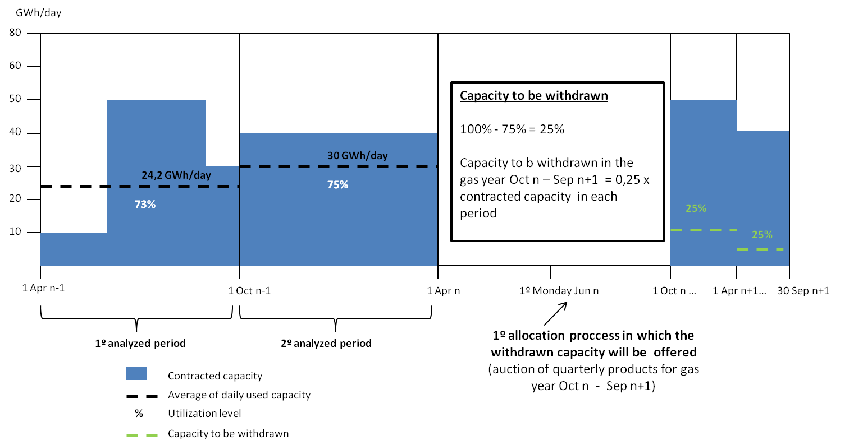
III. Congestion Management Procedures
CMP implementation
UIOLI long term in Spain

Slide 25
III. Congestion Management Procedures
CMP implementation
UIOLI long term in Spain
Withdrawn capacity will be reallocated in the allocation process after all the available technical capacity and the surrendered capacity have been allocated.
When in the allocation process demanded capacity is lower than withdrawn capacity, a pro-rata mechanism will be applied.
When the capacity reallocation involves a price lower than the original, the primary capacity holder will cover the difference.
Primary holders retain rights and obligations till the withdrawn capacity is allocated
In order for TSOs to offer withdrawn capacity in the ordinary allocation processes, withdrawn capacity won’t be offered in the secondary market in the periods: 15 days before the auction for quarterly products and 0 days before the monthly products auction

Slide 26
IV. Infrastructures
IV.1. 2013 South Gas Regional Investment Plan (GRIP)
Area of work | Responsible | Starting | Deadline
Regular update and publication in CEER website of project status of OS 2013 and 2015 | TSOs-NRAs | Dec. (yearly) | Jun. (yearly)
Drafting of the South Regional Investment Plan 2012 | TSOs | Jul. 2011 | Jan. 2012 (COMPLETED)
Feedback to ENTSO-G on contents and methodology of the regional investment plan | NRAs | Jan. 2012 | Jul. 2012 (COMPLETED)
Input to ENTSO-G for the Community-wide TYNDP 2013 | TSOs | Jan. 2012 | Apr. 2013
Creation of a working group in the region in order to test the process of PCI identification | NRAs -TSOs | Mar. 2012 | March 2013
Drafting of the South Regional Investment Plan 2014 | TSOs | Jan. 2013 | Apr. 2014

Slide 27
IV. Infrastructures
IV.1. 2013 South Gas Regional Investment Plan (GRIP)
(for information by TSOs)

Slide 28
V. Markets
V.1. LNG and cross-border flows in the South Region
(for information by Regulators)

Slide 29
V. AOB and next meetings

Slide 30
V. CALENDAR 2013
Next meetings:
Next IG meeting: Mid October (to be defined)
Next SG meeting: 15 November

