Slide 1


24rd SG Meeting
South Gas Retional Initiative
Madrid, 21st March 2019

Slide 2
I. Agenda

Slide 3
II. Accomplishment of the Work Plan 2017 - 2018
Work Plan 2017-2018
    Target 1. Use of interconnections in the Region
    Target 2. Gas balancing regime in the Region
    Target 3. Improvements on market integration
    Target 4. Follow up of infrastructures developments
    Target 5. Implementation of OSBB

Slide 4
II. Accomplishment of the Work Plan 2017 - 2018
  Target 1. Use of interconnections in the Region
Assessment of the use of interconnections in the Region from the implementation of the CAM Network Code -1st Oct 2014 to 30th Sept 2016- (capacity offered, use of infrastructures, capacity allocation, flows, congestion status).
Conclusions:
Prevailing flow direction in the Region: North to South
  VIP Pirineos: FR-ES
  VIP Iberico: ES-PT
Booked capacity in prevailing direction:
  VIP Pirineos: mainly booked through LT contracts (unbundled) remaining capacity to be auctioned in PRiSMA (bundled) is scarce.
  VIP Iberico: LT contracts (unbundled) bookings (around 65% of capacity)

Slide 5
II. Accomplishment of the Work Plan 2017 - 2018
  Target 1. Use of interconnections in the Region
Use of capacity:
  Seasonal use in both VIPs
  Use of booked capacity:
    Bundled (booked through auctions: Y, Q, M, D and WD): >90%
    Unbundled (booked through LT contracts): average use 80%-90% (seasonal use)
    Unused contracted capacity is not offered in secondary markets.
  Congestion
    VIP Pirineos:
      Winter 2014-2015: contractual congestion
      Some days in Nov/Dec 2014: physical congestion
    CMP mechanisms in place: surrender (both VIPs) and UIOLI LT (ViP Pirineos).
  Recommendations:
    Optimization of CMP application
    Keep on monitoring the market appetite for incremental capacity
  Publication on ACER website: October 2017

Slide 6
II. Accomplishment of the Work Plan 2017 - 2018
  Target 2. Gas balancing regime in the Region.
  Comparative analysis carried out in the three countries since the entry into force of the BAL NC to September 2017
  Conclusions:
There are five balancing areas in the Region (after the merger of market areas in France in Nov 2018 there will be three).
There are three market places in the SGRI: PEG Nord, TRS and MIBGAS (after the merger two: TRF (PEG Nord+TRS) and MIBGAS).
Inclusion of Portugal side in MIBGAS is in progress.
Each country has defined different operating bands to trigger balancing actions. France has the smallest tolerated variability.
With regard to the rules and timelines on nomination and re-nomination procedures, the three countries of the region follow the same pattern
Information provision models: France and Spain (“base case” model) and Portugal (“variant 2”).
  Imbalances charges (FR, SP and PT): weighted average gas price of their respective markets ± small adjustment (2,5%).
  Balancing actions:
    trading platform FR and SP
    auctions (PT). PT will join MIBGAS soon.

Slide 7
II. Accomplishment of the Work Plan 2017 - 2018
  Target 2. Gas balancing regime in the Region.
  Recommendations:
  keep on working in monitoring and gathering data to gain knowledge from practical experience, in order to identify those areas where there is room for improvement.
  Potential for application of cross-border balancing
  Studying potential regulatory improvements
                Publication on ACER website: October 2018

Slide 8
II. Accomplishment of the Work Plan 2017 - 2018
  Target 3. Improvements on market integration
VIP Iberico. Follow-up of the inclusion of Portuguese side in MIBGAS with regard to the accommodation of MIBGAS rules, implementation of implicit allocation mechanism, communication procedures and the implementation of the market model. NRAs´contribution has been completed and they will keep on supporting the process when requested.
VIP Pirineos. Follow-up of the spreads of prices among different EU marketplaces, in particular, the spreads MIBGAS-TRF and the potential impact of the market areas merger in France on VIP Pirineos.

Slide 9
II. Accomplishment of the Work Plan 2017 - 2018
  Target 4. Follow-up of infrastructure developments in the Region (TYNDP, GRIPs….)
  Target 5. Implementation of OSBB
The OSBB mechanism was approved in April 2016. The Initiative has followed up the progress on the implementation of the mechanism that was successfully completed on the 1st April 2018.
Since then, OSBB mechanism has been offered on a daily basis, provided the conditions to be offered have been met at both sides of the IPs.

Slide 10
III. SGRI Work Plan 2019-2020
Target 1. Infrastructures
Follow-up work
Follow-up of infrastructure development (PCIs, TYNDP, GRIP…)
Calculation of capacity at VIPs
Secondary market and transfer of use
Deliverable
Update on the report on use of VIP infrastructures.

Slide 11
III. SGRI Work Plan 2019-2020
Target 2. Market integration in the Region
Follow-up work
Follow-up of market integration in the Region: flows, spreads and regulated prices.
Keep on supporting the inclusion of Portuguese side in MIBGAS (following the arising needs)
Once Portuguese side has joint MIBGAS, monitoring the well-functioning of the market, in particular, with regard to the interactions between explicit and implicit allocation
Follow-up of merger of market areas in France and potential impact on VIP Pirineos.
NRAs recommendations and conclusions
Deliverable
Implementation of UIOLI LT mechanism at VIP Iberico

Slide 12
III. SGRI Work Plan 2019-2020
Target 3. Contribution of gases to decarbonisation
Follow-up work
Sharing good practices/pilot projects (hydrogen for mobility, certificates of origin, impact of renewable gases on gas quality…)
Follow-up on discussions on renewable gases implementation
The role of gases, in particular for mobility.
Target 4. Any other issue for discussion
"Abolition of summer time changes" as per new EU Directive proposal - analysis of impacts and implementation
(proposal to take on board depending on the approval of European regulation)

Slide 13
IV. VIPs: USE OF CAPACITY
  For information by TSOs

Slide 14
V. INFRASTRUCTURES IN THE REGION
  V.1.Workshop on GRIPs
  For information by NRAs

Slide 15
V. INFRASTRUCTURES IN THE REGION
  V.2. TYNDP 2018
  For information by TSOs

Slide 16
VI. PCI LIST
  VI.1. 2019 list: projet candidates of PCIs in the Region
  For information by TSOs

Slide 17
VI. PCI LIST
  VI.2.STEP Project
After CBA (Cost Benefit Analysis), TSOs sent the investment request for Cross Border Cost Allocation (CBCA) to NRAs (CNMC, CRE and ERSE) on 23th July 2018 (date from which time starts running) .
Deadline for NRAs to make a decision: 23th January 2019 (6 months).
Common decision adopted by CNMC and CRE on 22th January 2019. The parties considered the project not mature enough (only interruptible capacity was provided) and recommend the TSOs to perform further evaluations on this PCI in order to assess whether the project would provide a clear and positive cost-benefit outcome in the future.
On the other hand, ERSE stayed the need to develop the project and submitted to ACER a supporting analysis
ACER to decide if there is basis for their intervention

Slide 18
VII. MARKET INTEGRATION
  VII.1. Application of market-based instruments to ensure firmness of capacities in the Trading Region in France.
  For information by TSOs

Slide 19
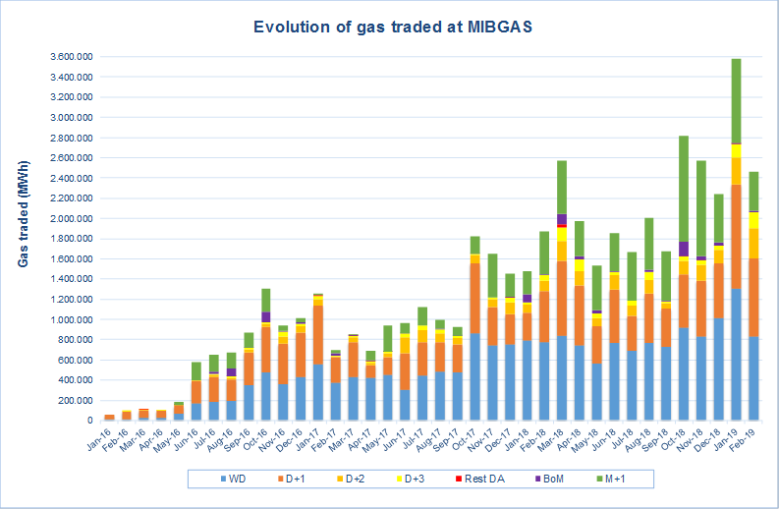
VII. MARKET INTEGRATION
  VII.2. MIBGAS - Spot market
Traded volume grew 81% in 2018 (24.261 GWh)
VII. MARKET INTEGRATION
Number of registered traders reached 81 (+16 new members)

Slide 20
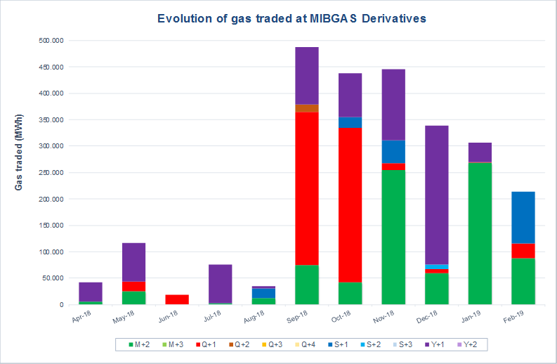
VII. MARKET INTEGRATION
  VII.2. MIBGAS Derivatives - Future market
Futures marked started in April 2018
With voluntary market markers to promote liquidity
Traded volume was 1998 GWh in 2018

Slide 21
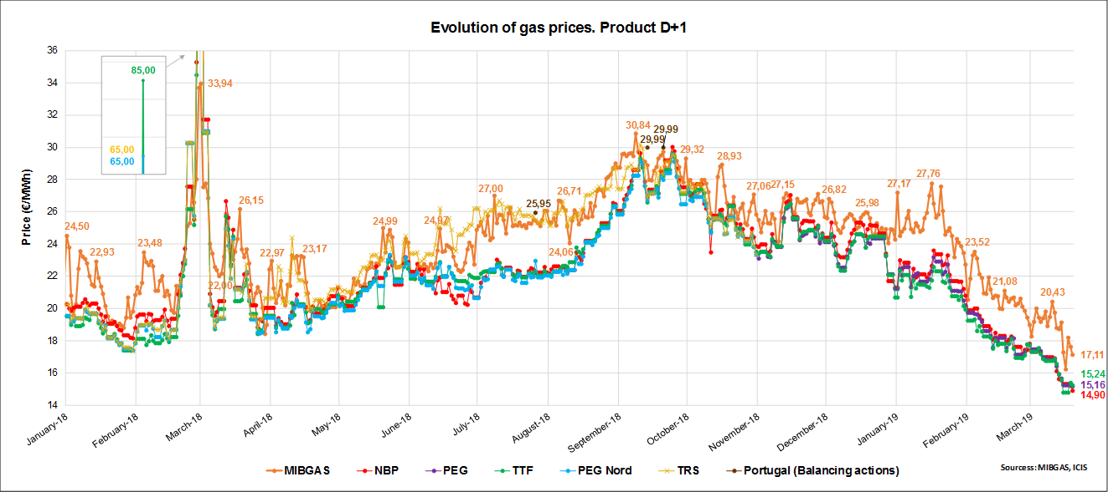
VII. MARKET INTEGRATION
  VII.2. MIBGAS
  Evolution of gas prices

Slide 22
VII. MARKET INTEGRATION
  VII.2.MIBGAS.
  Potential developments for the inclusion of Portuguese side in MIBGAS
Development and implementation of Market Rules
Memorandum of understanding for regulatory supervision
Information exchange protocol MIBGAS-REN
Information exchange protocol related to the implicit capacity allocation of VIP Ibérico
Approval of Portuguese cost recognition for MIBGAS

Slide 23
VIII. AOB

Slide 24

Thank you for your attention!
www.acer.europa.eu
TAR TF Telco
Ljubljana, 14 June2017

