Slide 1


37th IG Meeting
South Gas Regional Initiative
31st May 2016
CNMC premises

Slide 2
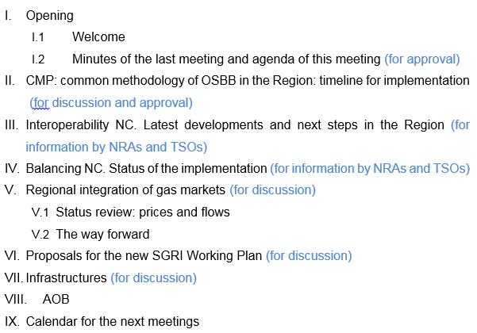
Agenda

Slide 3
II. CMP: Common methodology of OSBB for the Region. Timeline for implementation
Final Approval OSBB scheme: 36th IG meeting (20th April 2016)
NEXT STEPS
  Web publication: ACER, ERSE, CRE, CNMC
  https://www.cnmc.es/es-es/energ%C3%ADa/circularesenerg%C3%ADa.aspx?udt_2808_param_detail=1890
Timeline for implementation
  Deadline for OSBB to be implemented: April 2017
  TSOs proposal for implementation:
    Implementation of reverse auctions
    Adaptation of IT systems

Slide 4
III. Interoperability NC. Latest developments and next steps in the Region
Interconnection Agreement:
  Interconnection Agreement Template : published on 11st April 2016
  Detailed explanation of ongoing work on interconnection agreements (TSO)
Other adaptations to the IO NC (TSO)

Slide 5
III. Interoperability NC. Latest developments and next steps in the Region
Regulators will monitor the implementation of the code as from 1st May 2016
    Exchange information between NRAs and TSOs from the bilateral discussions to analyse the compliance of the current Interconnection Agreements with the content of NC
    Follow up of the harmonisation about short term monitoring on gas quality: TSOs data publication

Slide 6
III. Interoperability NC. Latest developments and next steps in the Region
Regulators are waiting for the TSO’s information about Interconnection Agreements:
Interconnection Agreement: Each IP TSOs must ensure:
    Rules for flow control.
    Measurement principles for gas & quality
    Rules for the matching process
    Rules for allocation of gas quantities
    Communication procedures in exceptional events
    Settlement of disputes
    Amendment process of Interconnection Agreement
Common data exchange solutions

Slide 7
III. Interoperability NC. Latest developments and next steps in the Region
Regulators are waiting for the TSO’s information about Interconnection Agreements (Cont.):
Interconnection Agreement: Each IP TSOs must ensure:
    Rules for flow control.
      Designate the TSO who is responsible for steering the gas flow across IP.
      Matching process.
      OBA correction
      Flow control arrangements.
      Quantity of gas.
    Measurement principles for gas & quality
      Description of the metering station
      Gas quality parameters and ranges.
      Data validation.
      Data frequency and content
      Signals and alarms
      Access to measurement facility, verification, modification, calibration, etc.
      Etc.

Slide 8
III. Interoperability NC. Latest developments and next steps in the Region
Regulators are waiting for the TSO’s information about Interconnection Agreements (Cont.):
Interconnection Agreement: Each IP TSOs must ensure:
    Rules for the matching process:
      Rules of the communication and processing
      Matching rule for nominations and renominations
      Provision of data exchange for the matching process
    Rules for allocation of gas quantities
      Operational Balancing Account: as close to zero as possible.
      OBA takes into account characteristics of IP, linepack, capacities, gas flow dynamics.
      If other rule different to OBA is followed this rule must be published and network users are invited to comment.

Slide 9
III. Interoperability NC. Latest developments and next steps in the Region
Regulators are waiting for the TSO’s information about Interconnection Agreements (Cont.):
Interconnection Agreement: Each IP TSOs must ensure:
    Communication procedures in exceptional events
    Possible impact on quantities and quality
    Possible impact on confirmed quantities
    Expected and actual end of the exceptional event
  Settlement of disputes.
  Amendment process
Gas quality Data Publication. (Art. 16)
  Once per hour during the gas day (Wobbe index and GCV) every IP.
  Data availability, for so long?
Information provision on short term gas quality variation. (Art. 17)
  List of parties to receive gas quality information.
Common data exchange solutions (Art. 20 to 24)
  Document based data exchange
  Integrated data exchange
  Interactive data exchange

Slide 10
III. Interoperability NC. Latest developments and next steps in the Region
  (for information by NRAs and TSOs)

Slide 11
III. Interoperability NC. Latest developments and next steps in the Region
Actions:
Deadline to receive the formal communication of compliance of TSOs: 30 June 2016
NRAs expect to receive detailed information about Interconnection Agreements compliance.
NRAs assessment of the information received.
Following positive evaluation: publication on the TSO’s web site.

Slide 12
IV. Balancing NC. Status of the implementation
(for information by NRAs and TSOs)
CNMC’s Circular 2/2015 establishing the balancing rules in the transmission network system – Jul. 2015 (Oct. 2016)
Issues already developed:
  1st Nov 2015:
    Information provision by users
    Rules for nomination/renominations
  16th December 2015:
    Come into operation the trading platform: MIBGAS
  1st March 2016:
    Procedure for accreditation of users
  12nd May 2016:
    Methodology of imbalance prices, neutrality charges and invoicing procedure - CNMC Resolution
  https://www.cnmc.es/es-es/energ%C3%ADa/circularesenerg%C3%ADa.aspx?udt_2808_param_detail=48404

Slide 13
IV. Balancing NC. Status of the implementation
(for information by NRAs and TSOs)
Issues to be developed:
Guarantees to cover possible imbalances - to be approved by the Industry Ministry (by the end of June 2016).
Incentives for TSO to use balancing actions efficiently - to be approved by CNMC (by the end of 2016).
Parameters to define when a TSO balancing action is required – to be approved by the Ministry of Industry. A draft has been produced by the TSO (by 1st October 2016).

Slide 14
IV. Balancing NC. Status of the implementation
(for information by NRAs and TSOs)
  (for information TSOs)

Slide 15
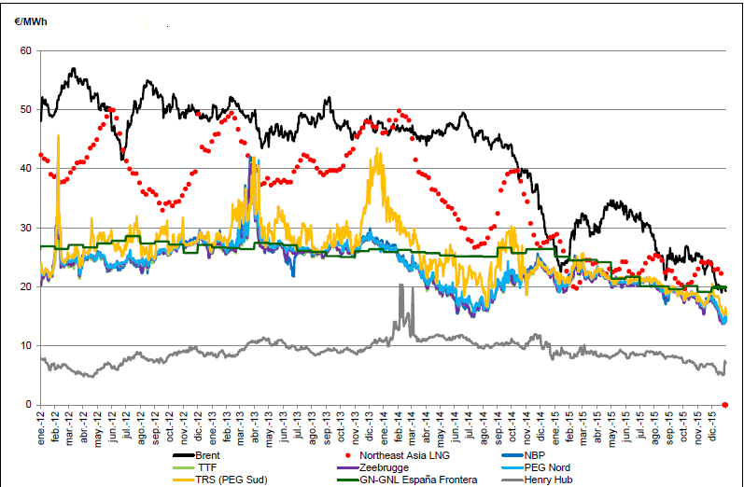
V. Regional integration of gas markets
V.1 Status review: prices and flows
(for discussion)
Spot prices

Slide 16
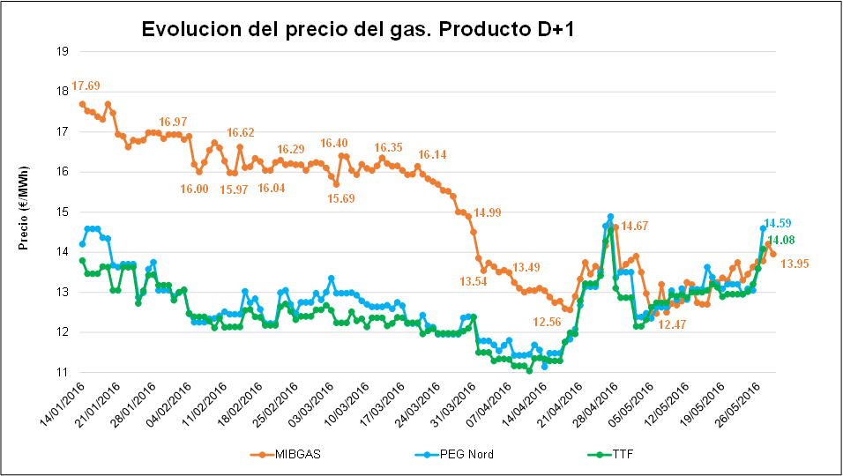
V. Regional integration of gas markets
V.1 Status review: prices and flows
(for discussion)
Spot prices: MIBGAS, PEG Nord & TTF

Slide 17
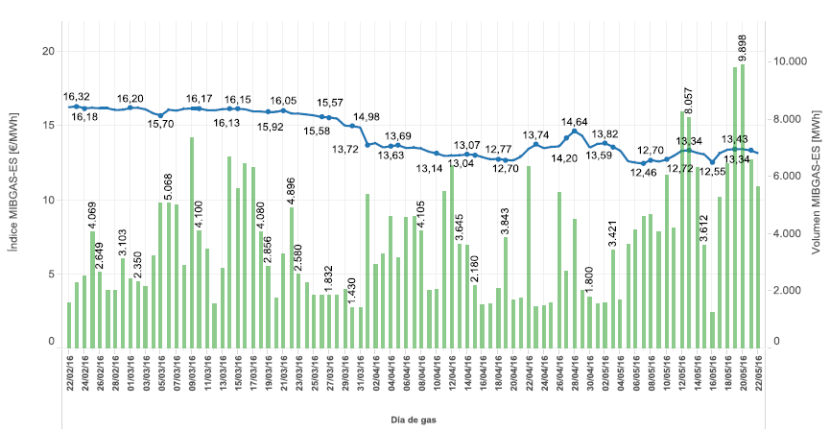
V. Regional integration of gas markets
V.1 Status review: prices and flows
(for discussion)
MIBGAS: Price and volume (feb16-may16)

Slide 18
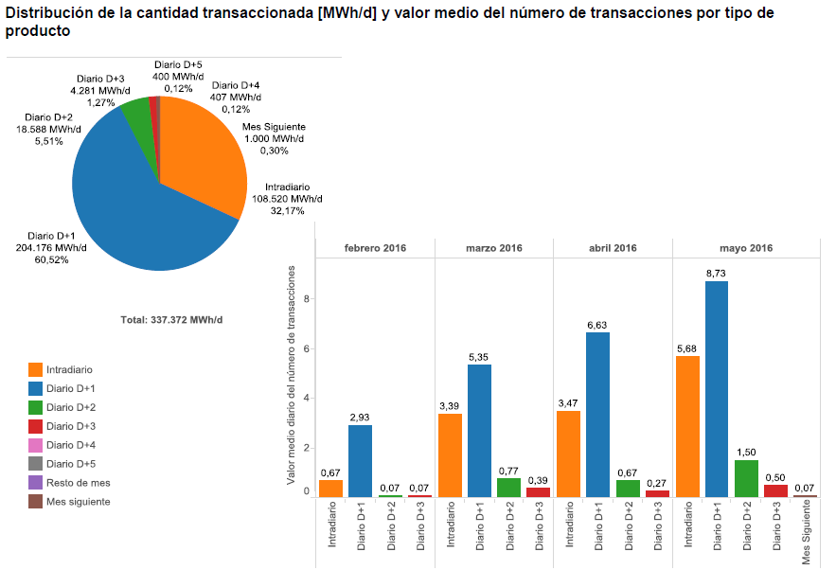
V. Regional integration of gas markets
V.1 Status review: prices and flows
(for discussion)
MIBGAS: Volumen by kind of product (feb16-may16)

Slide 19
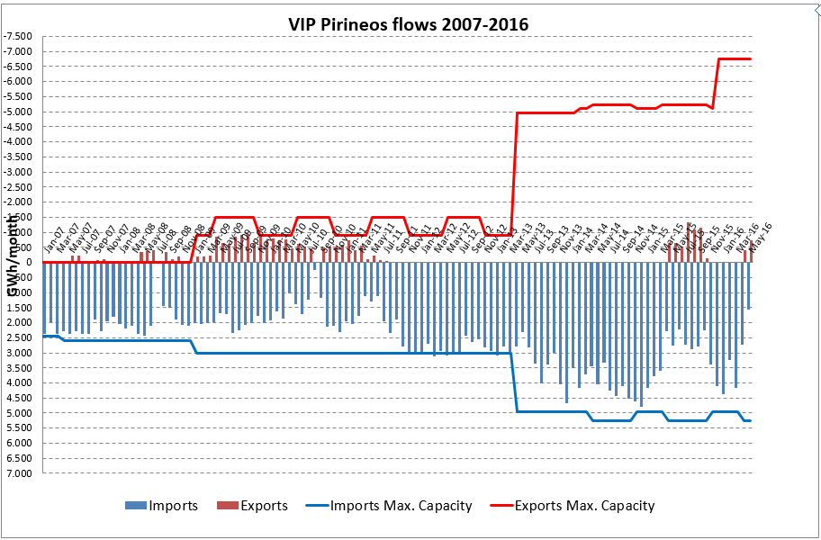
V. Regional integration of gas markets
V.1 Status review: prices and flows
(for discussion)
VIP Pirineos: border flows 2007-2016

Slide 20
V. Regional integration of gas markets
V.1 Status review: prices and flows
(for discussion)
VIP Ibérico. Border flows 2010-2016

Slide 21
V. Regional integration of gas markets
V.2 The way forward
(for discussion)
Spot prices
MARKET INTEGRATION MODELS
Market area model
Trading region model
Wholesale market with implicit allocation
One single market área
Single wholesale market with a single virtual point
Single balancing system
One single market área
Single wholesale market with a single virtual point
Two balancing zones
Implicit allocation (gas and capacity are assigned simultanously): two market areas
Single wholesale market with a single virtual point
Two balancing zones
Less interconnection capacity/ less regulatory harmonization needs

Slide 22
V. Regional integration of gas markets
V.2 The way forward
(for discussion)
Two approaches in the Region:
  France & Spain: continue with the harmonisation process of network codes, supervision, etc.
  Portugal & Spain: further integration. Wholesale gas market with implicit allocation.
    Next steps

Slide 23
VI. Proposals for the new SGRI Working Plan
(for discussion)
Work Plan:
CMP: Implementation and follow-up of the CMP procedures.
  TSO’s assessment of the gas flows in the VIP.
  Assessment of the VIP’s congestion status.
  Use of anti-hoarding mechanisms in the region and NRAs assessment of the CMP implementation
  Regulation improvements.

Slide 24
VI. Proposals for the new SGRI Working Plan
(for discussion)
Work Plan:
2. Balancing: Implementation and follow-up of the Balancing regimes at national levels.
  TSO’s assessment about unbalancing volumes, costs, number of TSO balancing actions, etc.
  Sharing information in the region.

Slide 25
VI. Proposals for the new SGRI Working Plan
(for discussion)
Work Plan:
3. Market integration.
  Next steps to further market integration:
    Iberia.
    Iberia with France

Slide 26
VI. Proposals for the new SGRI Working Plan
(for discussion)
Work Plan:
4. Infrastructures.
  TSO’s TYNDP.
  NRA’s assessment.
  New PCI list.
Interoperability.
  Implementation and follow up

Slide 27
VII. Infrastructures
(for discussion)

Slide 28
VIII. AOB

Slide 29
VI. Calendar for the next meetings
20
31
Next meetings:

