Slide 1


39th IG Meeting
South Gas Regional Initiative
4th October 2016
Teleconference

Slide 2
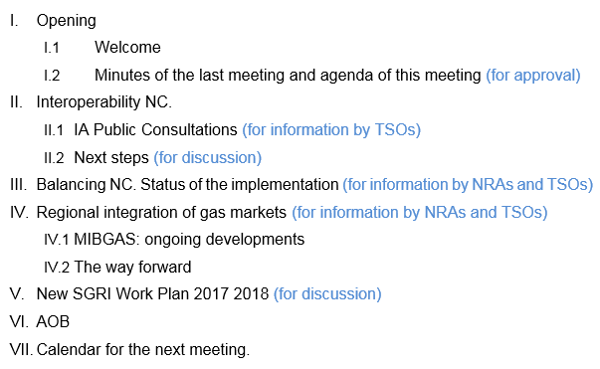
Agenda

Slide 3
II. Interoperability NC. Implementation
Implementation
Interconnection Agreement (TSO):
  Interconnection Agreement Template: published on 11th April 2016
  Interconnection agreements:
    France-Spain. Full text sent to regulators on 15th July.
    Portugal-Spain. Full text sent to regulators on 2nd August.
  Interconnection agreements (Public Consultation):
    Non-confidential version with the following sections:
      Rules for the matching process
      Rules for the allocation of gas quantities
      Communication procedures in case of exceptional situation

Slide 4
II. Interoperability NC. Implementation
Implementation
Interconnection Agreement (TSO):
  Interconnection agreements (Public Consultation):
    Non-confidential version on public consultation:
      France-Spain. from 15th Sept to 15th Nov
      Portugal-Spain. from 26th Sept to 26th Nov
TSOs assessment of the PC results. IA updated by the end of November.
Following positive NRAs evaluation: publication on the TSO’s web site by the end 2016
Other adaptations to the IO NC (TSO)

Slide 5
III. Interoperability NC. Latest developments and next steps in the Region
  (for information by TSOs)

Slide 6
III. Balancing NC. Status of the implementation
(for information by NRAs and TSOs)
Spain
CNMC’s Circular 2/2015 establishing the balancing rules in the transmission network system – Jul. 2015
Entry into force: 1st October 2016
Issues recently developed :
  Adaptation of market rules:
    Ministry´s Resolution approving rules management of guarantees of the gas system (2 august 2016): protocols of communication with TSOs, management of breaches, amount and validity of guarantees for imbalance and capacity booking…
    Ministry´s Resolution Organised Market (6 June 2016) approving the model agreement for the creation of a market maker and purchasing procedure of cushion gas.

Slide 7
III. Balancing NC. Status of the implementation
(for information by NRAs and TSOs)
Spain
Issues recently developed: (cont)
  NGTS06 “Matching” and NGTS07 “Balancing” (23 September 2016) Define matching and balancing rules.
  NGTS03 “Programming”, NGTS04 “Nominations” and detailed protocols PD07 and PD13 (28 September 2016). Define the calendar for nominations and renominations.
  PD 18 “Technical Parameters for normal operation and balancing actions” (30 September 2016). Define parameters establishing normal operation of the grid and when TSO must buy title products in the VTP.

Slide 8
III. Balancing NC. Status of the implementation
(for information by NRAs and TSOs)
  (for information TSOs: first overview)

Slide 9
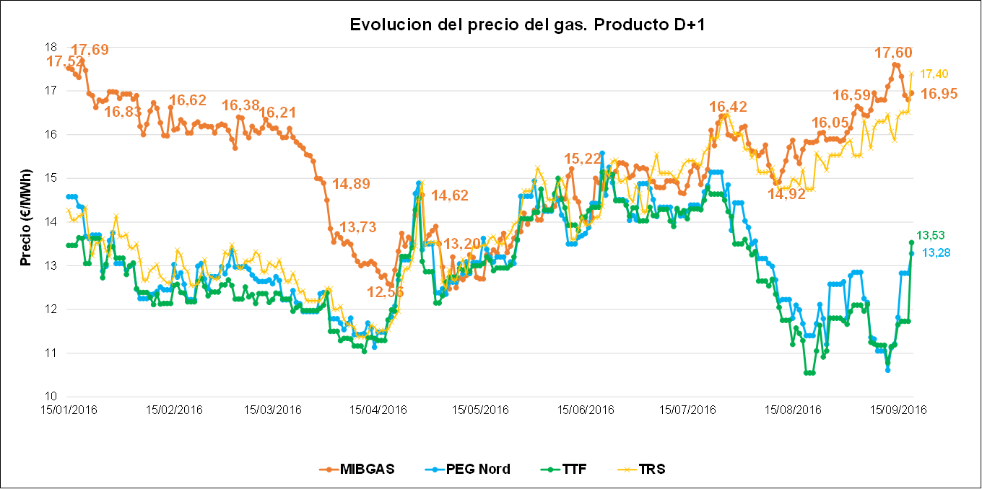
IV. Regional integration of gas markets
IV.1 MIBGAS: ongoing developments
(for discussion)
MIBGAS has been operating since the end of 2015 in Spain

Slide 10
IV. Regional integration of gas markets
IV.1 MIBGAS: ongoing developments
(for discussion)
Gas interconnection capacity

Slide 11
IV. Regional integration of gas markets
IV.1 MIBGAS: ongoing developments
(for discussion)
Current situation:
  VIP Ibérico capacities offered and allocated accordingly to CAM NC
  Explicit allocation of capacity: yearly, quarterly, monthly, daily and intraday products; using PRISMA.
  Physical gas flows only from Spain to Portugal direction
  % capacity allocated through auctions by product (on average):
    Yearly: around 50% of marketed capacity
    Quarterly: around 4%
    Monthly: around 16% (one day reached 37%)
    Daily: around 30% (one day reached 93%)
    Intraday: from 0% to 27%
  No congestion (physical or contractual)
  No price premium in PRISMA auctions

Slide 12
IV. Regional integration of gas markets
IV.1 MIBGAS: ongoing developments
(for discussion)
Iberian market integration:
    Iberian market integration in two steps:
  Short term target: implementation of implicit allocation mechanism with cross border tariffs
  Long term target: implementation of a trading region model
  Issues to be tackled:
  How much capacity put aside for implicit allocation
  Which kind of products? Daily/intraday/monthly?
  Coordination of explicit/implicit allocation mechanisms and interaction of implicit allocation with regulation in place (CAM, CMP, balancing and nominations/renominations)
  Prevent distortions among capacity users
  Several bilateral meetings between Spain and Portugal have been already held in June, July and September.

Slide 13

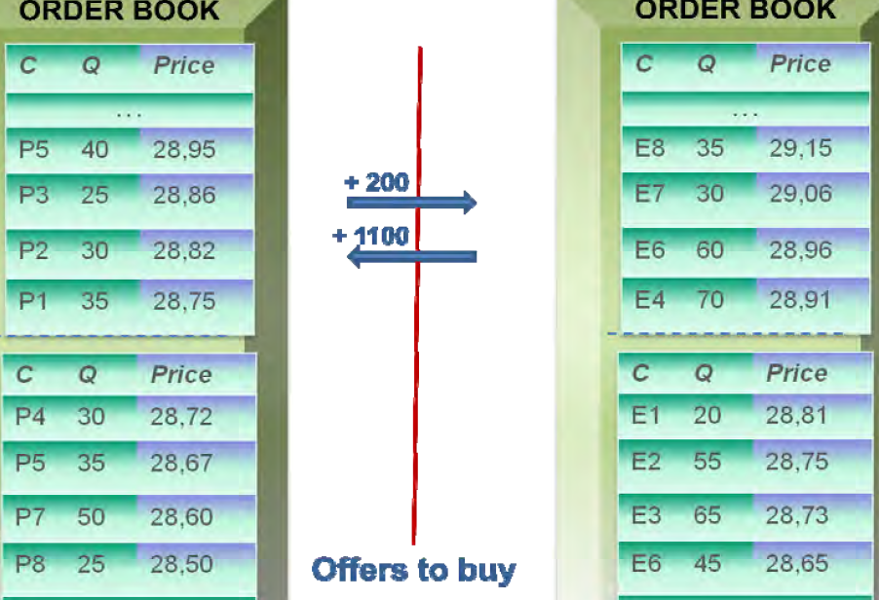
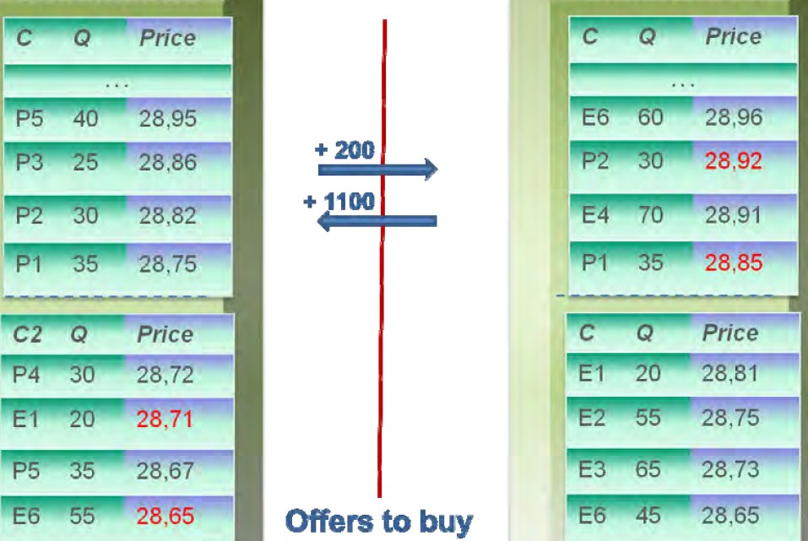
Iberian market integration
Market coupling with implicit allocation
Implicit allocation involves capacity + commodity (gas) trading in single product (in MIBGAS)
One single market, two balancing areas (Spain and Portugal)
Capacity in the interconnection is set aside for implicit allocation
Market Participants make their buy and sell offers in the Portuguese and Spanish node: two separated order books
MIBGAS includes all offers in both books by adding/deducting the cross border tariff in place, and reorder all offers in both order books.
Cross border tariff ES +PT
Starting point
(each order book list offers to sell and to buy in the two countries)
Final situation
Reorder offers in both books
Portugal
Order book
MIBGAS
Buy
Sell
P1
P2
P3
P4
Gas Portugal

Slide 14
IV. Regional integration of gas markets
IV.1 MIBGAS: ongoing developments
(for discussion)
Iberian market integration
Roadmap:
  Revision of Market Rules, so MIBGAS would be the Exchange in both countries
  MIBGAS and both TSOs able to exchange the information needed (IT)
  Launch of the Virtual Trading Point in Portugal
  Revision of capacity allocation regulation in both countries to make room for the implicit capacity allocation.
  Introduction of the Implicit Allocation in MIBGAS trading system (IT)
  Launching the implicit allocation mechanism in MIBGAS

Slide 15
IV. Regional integration of gas markets
IV.2 The way forward
(for discussion)
Market integration
Two approaches in the Region:
  France & Spain: continue with the harmonisation process of network codes, supervision, etc.
  Portugal & Spain: further integration. Wholesale gas market with implicit allocation.

Slide 16
V. Proposals for the SGRI new Work Plan
Work Plan 2017-2018
I. First target: about the use of infrastructures in the Region:
Assessment of the use of interconnections in the Region from the implementation of the Network Codes: from 1st October 2014 to 30th September 2016.
  The current situation of gas interconnections in the Region.
    Capacities
    Flows
  The use of the gas interconnections.
    Booked capacities.
    Capacity used.
    Available capacities.
  Assessment of the capacity allocated since the implementation of the CAM network code.

Slide 17
V. Proposals for the SGRI new Work Plan
I. First target: about the use of infrastructures in the Region (Cont.):
  Assessment of the gas flows and the congestion status.
    Analysis of the VIP’s congestion status.
    Use of anti-hoarding mechanisms in the region.
    Assessment of the CMP implementation.
  Recommendations
    For the allocation of capacity.
    For the congestion management.
  Conclusions.
  Deliverable Deadline: March June 2017

Slide 18
V. Proposals for the SGRI new Work Plan
I. First target: about the use of infrastructures in the Region (Cont.):
  Comments:
    CRE. Moving the deadline to June 2017
    ENAGAS. Using indicators proposed by CEPA consulting in line with ACER and ENTSOG
    ACER:
      The deliverable includes elements from both MMR and CAM/CMP implementation monitoring report but from a regional perspective. It will be interesting to see recommendations.
      Moving the deadline to June 2017.

Slide 19
V. Proposals for the SGRI new Work Plan
II. Second target: about gas Balancing regimes in the region:
Follow-up of the Balancing regimes at national levels and in the interconnections. Assessment about unbalancing volumes, costs, number of TSO balancing actions, etc. (from 1st October 2016 to 30th September 2017):
  Sharing information in the region:
    NRAs will do the index and contents of the “template” report.
    Every TSO will complete the report about their own balancing zone.
  NRAs and TSOs will do a synthesis how the different balancing regimes are working the SGRI.
    Deliverable Deadline: December 2017

Slide 20
V. Proposals for the SGRI new Work Plan
II. Second target: about gas Balancing regimes in the region:
  Comments:
    ACER:
      It would interesting to see the evolution of the BAL regimes/markets (if repeated in 2018)

Slide 21
V. Proposals for the SGRI new Work Plan
III Third target: Market integration
  Next steps to further market integration:
    Iberia.
      To accommodate MIBGAS market rules.
      To revise CAM rules at the Iberian VIP to accommodate implicit allocation mechanism.
      To elaborate a proposal of communication procedures among MIBGAS and TSOs.
      To implement the model.
          Deadline: According to Iberian gas deadlines.

Slide 22
V. Proposals for the SGRI new Work Plan
III Third target: Market integration
  Next steps to further market integration:
    Iberia with France
      NRAs will analyse market rules (exchange) of every market.
      NRAs will assess market prices behavior.
      NRAs will make some recommendations and conclusions.
      Deliverable Deadlines: a) March 2017
      b) October 2017
      c) December 2017

Slide 23
V. Proposals for the SGRI new Work Plan
III Third target: Market integration
  Comments:
    CRE. Further discussion on the content and approach of the report
    ACER. If integration between Iberia and France is subject to progress of Iberian market, coordination of the deliverables timelines is needed.

Slide 24
V. Proposals for the SGRI new Work Plan
IV. Fourth target: Tariffs
  TSO’s assessment of the current cross border transmission tariffs.
  NRAs analysis and conclusions.
      Deliverable Deadlines: 1) December 2017
      2) June 2018

Slide 25
V. Proposals for the SGRI new Work Plan
IV. Fourth target: Tariffs
  Comments:
    CRE. NRA´s assessment instead of TSO´s
    ACER. Are LNG tariffs also covered?

Slide 26
V. Proposals for the SGRI new Work Plan
V. Fifth target: Infrastructures.
  TSO’s TYNDP proposal.
  NRA’s assessment.
      Deliverable Deadlines: according to the PCI process

Slide 27
V. Proposals for the SGRI new Work Plan
V. Fifth target: Infrastructures.
  Comments:
    CRE. Assessment of PCI instead of TYNDP.
    ACER. Is it linked with the GRIP?

Slide 28
V. Proposals for the SGRI new Work Plan
VI. Sixth target: Other possible pending issues:
  Interoperability.
    Follow up of the implementation of the job done in 2016.
  OSBB
    Follow up of the implementation of the job done in 2016.

Slide 29
V. Proposals for the SGRI new Work Plan
VI. Sixth target: Other possible pending issues:
  Comments:
    ACER. Will OSBB follow up from target 1 depending on the findings?

Slide 30
VI. AOB

Slide 31
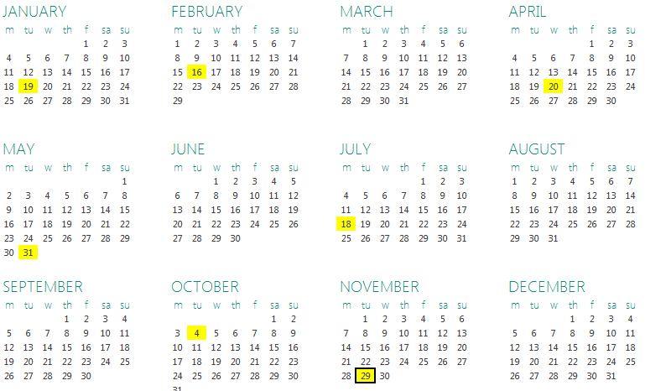
VII. Calendar for the next meetings
Next meetings: 29th November 2016

