Slide 1


41th IG Meeting
South Gas Regional Initiative
24th January 2017
Teleconference

Slide 2
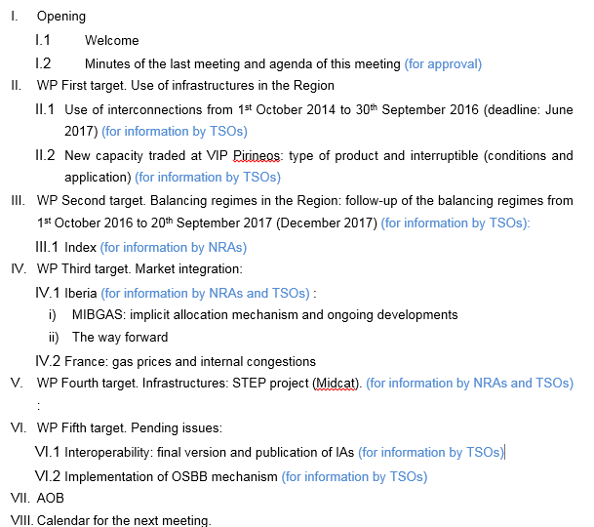
Agenda

Slide 3
II. WP First target: use of infrastructures
  II.1. Use of interconnections from 1st October 2014 to 30th September 2016 (deadline: June 2017)
  WP timeline (for information by TSOs)

Slide 4
II. WP First target: use of infrastructures
  II.2. New capacity traded at VIP Pirineos: current status (for information by TSOs)
  New capacity offered (TIGF offered new interruptible capacity from France to Spain: 60 GWh/day. No limitation of the Spanish side)
  New available capacity from FR to ES in both sides.
  Currently offered as unbundled capacity.
  Which are the interruptible conditions and how have been applied?
  Product time horizon (day/intraday, monthly…..)
  Proposal
  Possibility of offering this capacity as bundled/interruptible in both sides.

Slide 5
III. WP Second target: balancing
III.1 “Gas balancing regimes in SGRI”: draft index (for information by NRAs)
  1. Subject matter. Brief description of the objective and scope of the study. (drafter: NRAs)
  2. Description of the balancing regimes in place (France, Spain and Portugal). (drafter: NRAs)
  The document will detail at least main characteristics with regard to the notifications, operational balancing, nominations, information provision, daily imbalance methodology, TSOs neutrality arrangements and linepack flexibility.

Slide 6
III. WP Second target: balancing
III.1 “Gas balancing regimes in SGRI”: draft index (cont.)
  3. Follow-up of the functioning of the balancing schemes since its application (1st October 2015 in France and 1st October 2016 in Portugal and Spain) to 30th September 2017. (drafter: TSOs)
    3.1. Trade notifications (number of notifications, incidents, application of the TSO´s rule for notification quantities discrepancies, etc.)
    3.2. Operational balancing (unbalancing volumes, costs, number of TSO balancing actions, short term product acquired, use of balancing services, TSOs incentives, information provided by TSOs, etc.
    3.3. Nominations (information provided at interconnections points, incidents with regard to nominations, harmonization needs regarding nominations at IPs, etc.).
    3.4. Imbalances charges (imbalanced quantities, maximum price, minimum price, effectiveness of the price small adjustment)
    3.5. Application of neutrality methodology (neutrality charges, application of incentives…)
    3.6. Information provision (incidents, cooperation between TSOs and forecasting parties, preliminary CBA….)
    3.7. Application of linepack flexibility (conditions, number of users interested, cost, nomination requirements….).
  4. Conclusions and recommendations. (drafter: TSOs, NRAs)
      Comments (draft index) until 15 February

Slide 7
IV. WP Third target: Market integration
  IV.1. Iberia (for information by NRAs)
  MIBGAS: implicit allocation mechanism.
    Current Status:
      Proposal submitted and discussed in previous meetings.
      Summary of the proposal:

Slide 8
IV. WP Third target: Market integration

Slide 9
IV. WP Third target: Market integration

Slide 10
IV. WP Third target: Market integration
  IV.1. Iberia (for information by NRAs)
  MIBGAS: implicit allocation mechanism. Next Step of the Procedure proposed:
      Write it in a more open basis:
        No fixed reserved amount of capacity. (Initially can be the figures agreed)
        More flexibility of sharing capacity after monthly capacity allocation. (Initially the factor can be 100%)

Slide 11
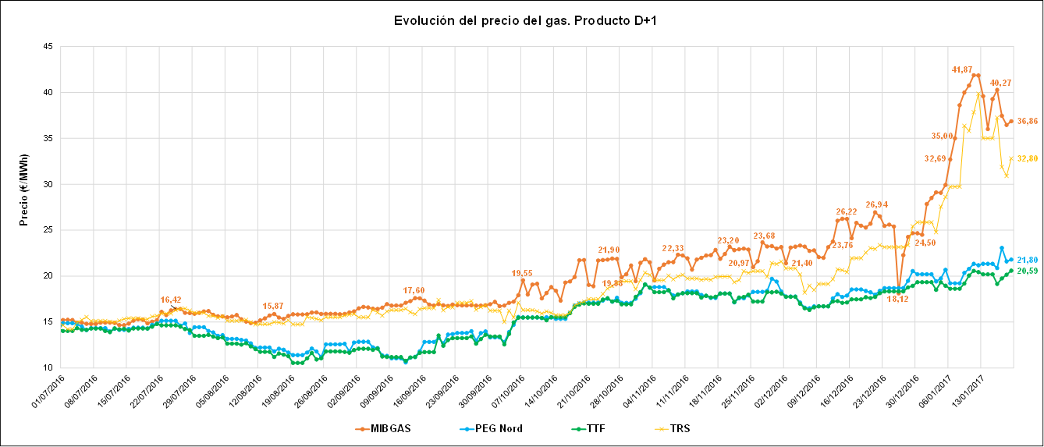
IV. WP Third target: Market integration
  IV.2. France: gas prices and internal congestions (for information by NRAs and TSOs)

Slide 12
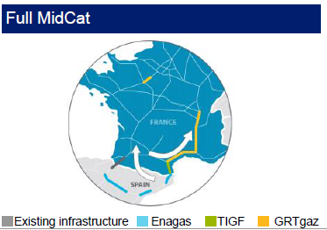
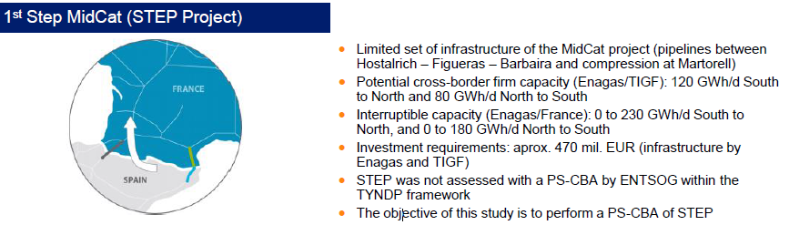
  IV.1. VIP Pirineos: STEP project
  (for information by NRAs and TSOs)
The project STEP CBA promoted by the EC and developed by Pöyry consultancy started in December 2, 2016. The draft interim report will be delivered after 2 months and the draft final report after 5 months since project start date.
High level meeting held on 15th December was presented the inception report
V. WP Fourth target: Infrastructures

Slide 13
VI. WP Fifth target: Pending issues
  VI.1. Interoperability. NC implementation:
  (for information by TSOs)
    Interconnection Agreement:
    Final version of IAs:
      VIP Pirineos. NRAs have been submitted (18th January):
        Final version of the IA received (most of the comments received in the public consultation have been taken on board).
        Reasoned document with comments received in the public consultation
      IA VIP Iberico. Final version and reasoned document not received yet. When?
    Publication on TSOs websites of IAs and reasoned document. When?
    Other adaptations to the IO NC (TSO, ACER)

Slide 14
VI. WP Fifth target: Pending issues
  VI.1. Implementation of OSBB mechanism (for information by TSOs)
  OSBB scheme approved on April 2016.
  Current status:
    Implementation agreed by 1st April 2017
          Current status?

Slide 15
VII. AOB

Slide 16


VIII. Calendar of the next meeting
Next meeting: March 2017 (date tbd)

