Slide 1


45th IG Meeting
South Gas Regional Initiative
8th February 2018
Teleconference

Slide 2
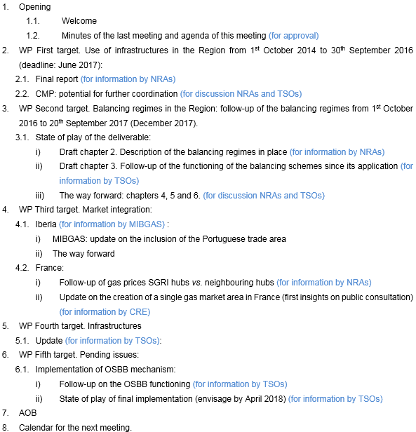
Agenda

Slide 3
2. WP First target: use of infrastructures
2.1. Final report (for information by NRAs)
Assessment of the use of interconnections in the Region from the implementation of the Network Codes: from 1st October 2014 to 30th September 2016.
  Published on ACER website: November 2017
TARGET 1 WP 2017-2018
ACHIEVED!

Slide 4
2. CMP: common methodology in the Region
2.2. CMP: potential for further coordination
Background (44th IG): brainstorming on the development of coordinated mechanisms
Following the recommendations of the WP target 1 “Use of infrastructures in the Region”:
Guidelines of CMP:
UIOLI ST
Surrender capacity
UIOLI LT. In place
OSBB: In place
Elements for consideration:
  All mechanisms implemented except UIOLI ST.
  CMP key role in the use optimization of the existing infrastructures
  Coordination should lead eventually to have the same rules at both sides

Slide 5
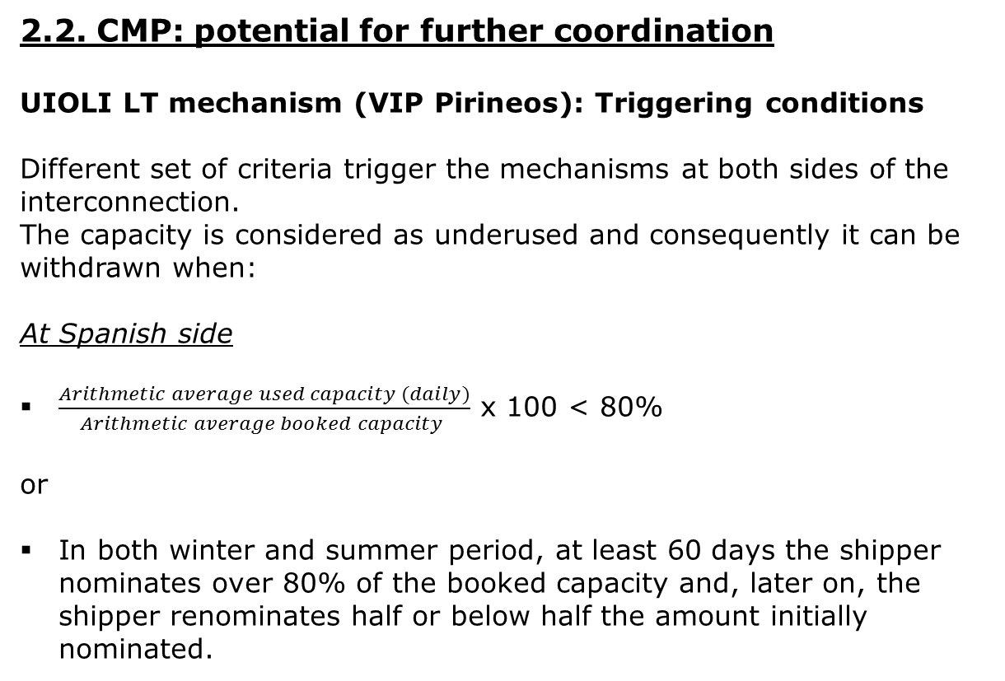
2. WP First target: use of infrastructures
2.2. CMP: potential for further coordination
UIOLI LT mechanism (VIP Pirineos): Triggering conditions
Different set of criteria trigger the mechanisms at both sides of the interconnection.
The capacity is considered as underused and consequently it can be withdrawn when:
At Spanish side
$\frac{Arithmetic average used capacity (daily)}{Arithmetic average booked capacity }$ x 100 < 80%
or
In both winter and summer period, at least 60 days the shipper nominates over 80% of the booked capacity and, later on, the shipper renominates half or below half the amount initially nominated.

Slide 6
2. WP First target: use of infrastructures
2.2. CMP: potential for further coordination
UIOLI LT mechanism (VIP Pirineos): Triggering conditions (cont.)
At French side
If, for two successive periods of 6 consecutive Months, starting on the 1st October or the 1st April, the Daily Scheduled Quantities of withdrawal or delivery for the Shipper at a Network Interconnection Point are, on average, less than 80% of the Daily Entry or Exit Capacity subscribed by the Shipper at the aforementioned Network Interconnection Point for a period greater than or equal to one year, which has not been sold to another shipper under the Contract or has been returned
And;
If, TIGF has not been able to fulfil at least one duly justified request from another shipper for an annual subscription for a Daily Entry or Exit Capacity at the aforementioned Network Interconnection Point.

Slide 7
2. WP First target: use of infrastructures
2.2. CMP: potential for further coordination
UIOLI LT mechanism (VIP Pirineos): Application
As a result of the existing different criteria, it can happen that criteria for triggering the mechanism are met at one side of the IP but not in the other. The unilateral application of UIOLI LT (only at one side):
If applied to unbundled products or to what TSOs call “false unbundled” (two unbundled product but same shipper holding the capacity at both sides) the effectiveness of the application could be limited or even useless since capacity for matching at the other side would be still booked.
If applied to bundled products:
  it would convert bundled capacity into unbundled. Is acceptable under EU regulation to “debundle” capacity?.
  It could be contrary to the EU regulation (CAM rules) which advocates for maximising the offer of bundled capacity.
In conclusion, the mechanism as it is currently set out is in practice unapplicable A common set of criteria are needed.

Slide 8
22. WP First target: use of infrastructures
2.1. Potential for full alignment of criteria UIOLI LT
UIOLI LT mechanism: Principles to be followed
Principles stemming from ACER´s opinion on the application of the surrender mechanism:
Background: CMP are applied in the most effective way at all Ips, “with a view to maximizing available capacities in all adjacent entry-exit systems”.
Literal interpretation: CMP is not only exclusively applicable “in the event of” contractual congestion, CMP also aim at the early management of future congestion events. “In the event of” is synonym for“if something should happen”).
Teolological interpretation….”Regulation 715/2009 intends to tackle contractual congestion by establishing principles of congestion management, ensuring the freeing-up of unused capacity in the gas networks with the direct effect of guaranteeing a level playing field between users of new and existing capacity. This objective contributes to the achievement of efficiency gains, competitive prices, higher standards of service, SoS and sustainability”.

Slide 9
2. WP First target: use of infrastructures
2.1. Potential for full alignment of criteria UIOLI LT
UIOLI LT mechanism: Principles to be followed
“Looking at market dynamics, contractual congestion is hardly predictable and is detectable on the basis of an expost assessment only”.
“In such case, it is already too late to try to resolve the particular congestion”.
….”shippers could end up paying more than what they would have paid (auctions with Premium) if TSO had been able to offer and allocated unused capacity prior to the ocurrence of contractual congestion.
“CMP is to avoid, to the extent posible, the occurrence of contractual congestion. In particular, their application has a fundamentally preventive function, notably the prevention of capacity hoarding, especially in the view of the difficulty in predicting congestion before occurence”.
“The same consideration applies to LT UIOLI mechanism in so far as such measures are directed to reduce the level of stable underutilised contracted capacity by a network user, so as to exclude, from the outset, the possibility for contractual congestion to ocurr on a regular basis”.

Slide 10
2. WP First target: use of infrastructures
2.1. Potential for full alignment of criteria UIOLI LT
The way forward RCC agreed on asking TSOs: VIP Pirineos: analyzing (backtesting) what had happened in the auctions if it had been offered capacity released due to the application of the LT UIOLI mechanism to capacity systematically underused (less than 80%), especially in the case of auctions with premium. Three simulations: first, following French rules in both sides; second, following Spanish rules in both sides; and third, with any possible improvement TSO can suggest. VIP Iberico: Since LT UIOLI mechanism must be developed in Portugal, analyzing historical flows and LT bookings at both sides in order to decide how to proceed. ACER is invited to give their criteria on how it must be applied the LT UIOLI mechanism across Europe. Deadline: 13th April

Slide 11
3. WP Second target: balancing
3.1 Index and first draft (for information by NRAs)
  Subject matter. Brief description of the objective and scope of the study. (drafter: NRAs)
  i) Draft chapter 2.
  Description of the balancing regimes in place (France, Spain and Portugal). (drafter: NRAs)
    General principles
    Virtual trading point
    Trading platform
    Notifications
    Balancing actions and system flexibility
    Nominations and renominations
    Information provision
    Imbalances charges
    Financial neutrality of the TSM: allocation of balancing actions costs
Done. Sent for comments
Done
1st draft including the regimes of the three countries (for comments).

Slide 12
3. WP Second target: balancing
3.1 Index and first draft (for information by NRAs)
ii) Draft chapter 3.
  3. Follow-up of the functioning of the balancing schemes since its application (1st October 2015 in France and 1st October 2016 in Portugal and Spain) to 30th September 2017. (drafter: TSOs)
  iii) The way forward
  4. Findings and relation with market functioning (drafter: TSOs, NRAs)
  5. Potential for application of cross-border balancing (drafter: TSOs, NRAs)
  6. Conclusions and recommendations. (drafter: TSOs, NRAs)
  Deadline: February 2018
1st draft to be presented by the TSOs (for comments).
The way forward
Drafting of chapters 4, 5 and 6 (for discussion).

Slide 13
4. WP Third target: Market integration
  4.1. Iberia (for information by MIBGAS)
i) Update on the inclusion of the Portuguese trade area in MIBGAS.
State of play and way forward

Slide 14
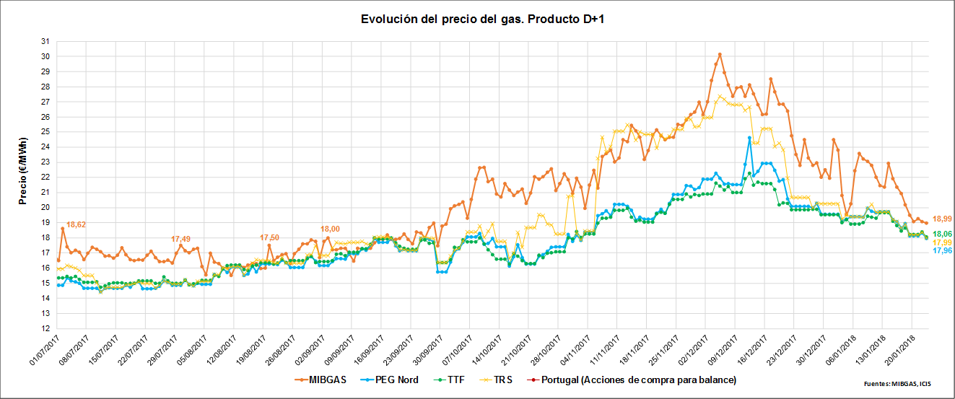
4. WP Third target: Market integration
  4.2. France: gas prices and internal congestions (for information by NRAs and TSOs)
  i) Follow-up of gas prices SGRI hubs vs. neighbouring hubs
  Evolution of prices D+1 (1st July 2017- 20th February 2018)

Slide 15
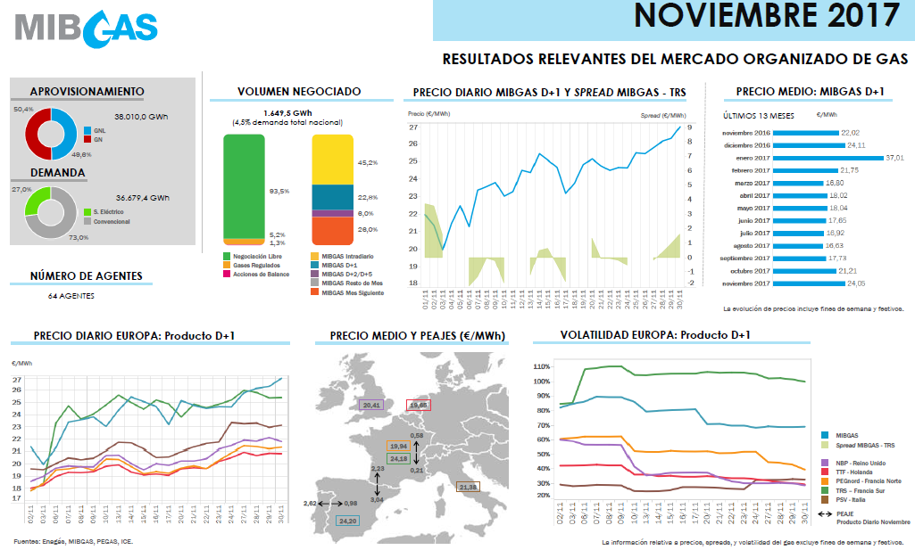
4. WP Third target: Market integration
  i) Follow-up of gas prices SGRI hubs vs. neighbouring hubs (cont.)

Slide 16
4. WP Third target: Market integration
  4.2. France: gas prices and internal congestions (for information by CRE and TSOs)
  ii) Update on the creation of a single gas market area in France
  Results of the public consultation and update on the status of the creation a single gas market area in France

Slide 17
5. WP Fourth target: Infrastructures
  5.1. Update on infrastructures development (for information by TSOs)
  STEP: current status:
    CBA Studies.
    High Level Group meeting on 27 of January.
    The way forward.

Slide 18
6. WP Fifth target: Pending issues
6.1. Implementation of OSBB mechanism: current application and ongoing developments (for information by TSOs)
OSBB scheme was approved on April 2016.
  Implementation of OSBB mechanism:
    Manual mode: 1st April 2017 (VIP Ibérico)/ 6th November 2017 (VIP Pirineos)
    Fully automatic mode scheduled by 1st April 2018
  Both VIPs:
    Results of the application of the mechanism until now
    Status of ongoing developments to application fully automatic mode

Slide 19
7. AOB

Slide 20

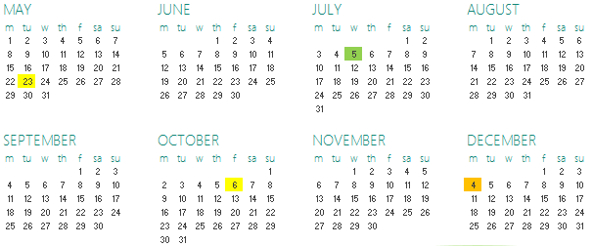

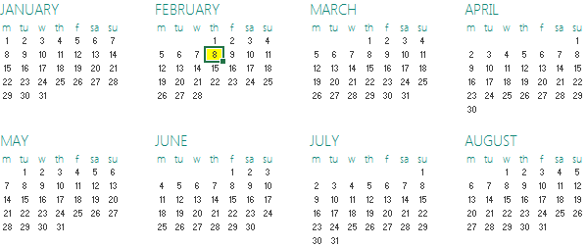
8. Calendar of the next meeting
SG
IG
RCC
Next IG meeting: tbd (tentative dates: 9th-10th April)

Slide 21
Thank you for your participation

