Slide 1


47th IG Meeting
South Gas Regional Initiative
28th June 2018
Teleconference

Slide 2
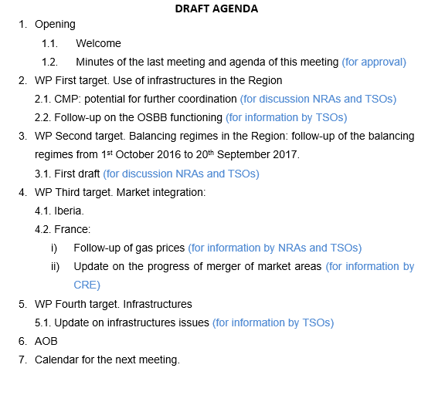

Slide 3
2. WP First target: use of infrastructures
2.1. CMP potential for further coordination: the way forward
Ongoing analysis: VIP Pirineos. Backtesting: what had happened in the auctions already held if the underused capacity had been removed from capacity holders. Three simulations: first, following French rules in both sides; second, following Spanish rules in both sides; and third, with any possible improvement TSOs can suggest. VIP Iberico: Since LT UIOLI mechanism must be developed in Portugal, analyzing historical flows and LT bookings at both sides in order to decide how to define rules for LT UIOLI implementation.
For information by TSOs

Slide 4
2. WP First target: use of infrastructures
2.2. Follow-up of the OSBB functioning
For information by TSOs

Slide 5
3. WP Second target: balancing
  A first draft of the report is presented for discussion. The aim of the report is assessing and drawing learnings from the implementation of the balancing NC in the three countries of the Region
  Deadline for comments: 10th of July
  Deadline to approve the document: 7th September

Slide 6
3. WP Second target: balancing
  Conclusions and recommendations
  There are five balancing areas in the Region (after the merger of market areas in France in Nov 2018 there will be three).
  There are three market places in the SGRI: PEG Nord, TRS and MIBGAS (after the merger two: TRF (PEG Nord+TRS) and MIBGAS).
  Inclusion of Portugal side in MIBGAS is in progress.
  Each country has defined different operating bands to trigger balancing actions. France has the smallest tolerated variability.
  With regard to the rules and timelines on nomination and re-nomination procedures, the three countries of the region follow the same pattern
  Information provision models: France and Spain (“base case” model) and Portugal (“variant 2”).

Slide 7
3. WP Second target: balancing
  Conclusions and recommendations (cont.)
  Imbalances charges (FR, SP and PT): weighted average gas price of their respective markets ± small adjustment (2,5%).
  Balancing actions:
    trading platform FR (automatized by computer algorithm) and SP (manual)
    auctions (PT). PT will join MIBGAS soon.
  Recommendations:
    keep on working in monitoring and gathering data to gain knowledge from practical experience in order to identify those areas where there is room for improvement.

Slide 8
3. WP Second target: balancing
  Recommendations (cont.)
    Potential for application of cross-border balancing
      It can contribute to:
        More efficient and cost-effective operation of the network
        Foster competition between EU gas markets
      Studying potential required regulatory developments:
        Registration of TSOs as market agents in neighboring countries
        Conditions to use available cross-border capacity after allocation to market participants for free or nearly free
        Any other?
For discussion by NRAs and TSOs

Slide 9
4. WP Third target: Market integration
  4.1. Iberia (for information by NRAs)
State of play and way forward

Slide 10
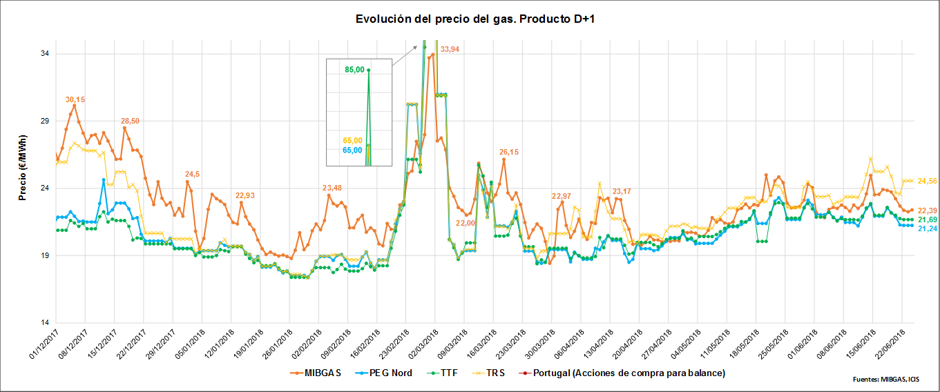
4. WP Third target: Market integration
  4.2. France: gas prices and internal congestions (for information by NRAs and TSOs)
  i) Follow-up of gas prices SGRI hubs vs. neighbouring hubs
  Evolution of prices D+1 (1st December 2017- 22nd June 2018)

Slide 11
4. WP Third target: Market integration
  4.2. France: gas prices and internal congestions (for information by CRE and TSOs)
  ii) Update on the creation of a single gas market area in France
  For information by CRE

Slide 12
  5.1. Update on infrastructures development
5. WP Fourth target: Infrastructures
  For information by TSOs

Slide 13
7. AOB

Slide 14

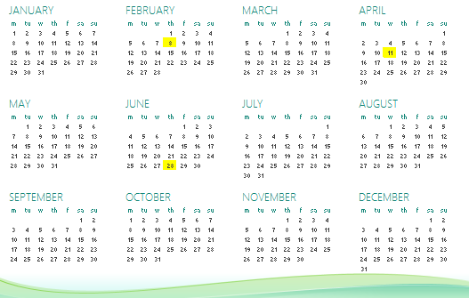
8. Calendar of the next meeting
IG
Next IG meeting: tbd (tentative date: XX September)

Slide 15
Thank you for your participation

