Slide 1


50th IG Meeting
South Gas Regional Initiative
17th June 2019
Telco

Slide 2
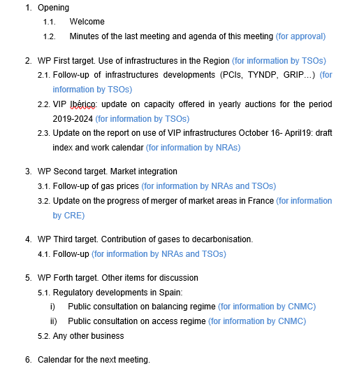
AGENDA

Slide 3
2. WP First target: use of infrastructures in the Region
2.1. Follow-up of infrastructure development (PCIs, TYNDP, GRIP…)
  For information by TSOs

Slide 4
2. WP First target: use of infrastructures in the Region
2.2. VIP Ibérico: update on capacity offered in yearly auctions (2019-2024)
  For information by ENAGAS/REN

Slide 5
2. WP First target: use of infrastructures in the Region
  2.3. Report on use of infrastructures (Oct16-Apr19): draft index and timeline (for information by NRAs)
  Assessment of the use of interconnections in the Region in the period 1st October 2016 to 30th April 2019.
  Draft index
  The current situation of gas interconnections in the Region (capacities, capacity calculation methodology).
  Capacity bookings.
  Use of interconnections (relationship among technical capacity, capacity bookings, use of contracts and flows).
  Assessment of the gas flows and the congestion status.
    Analysis of the VIP’s congestion status.
    Use of anti-hoarding mechanisms in the region.
    Assessment of the CMP implementation.
  Conclusions and recommendations.

Slide 6
2. WP First target: use of infrastructures in the Region
  2.3. Report on use of infrastructures (Oct16-April19): draft index (cont.)
  The current situation of gas interconnections capacity in the Region.
    Technical capacities (bundled/unbundled, firm/interruptible)
    Capacity calculation methodology
    Capacity set aside for the next 15 years (art. 8 CAM)
    LT contracts
    Available capacity to be auctioned in PRISMA
Description of technical capacities (bundled/unbundled, firm/interruptible), capacity calculation methodology, bundled/unbundled/interruptible products offered at both sides of the IPs, capacity set aside for the next years (article 8), LT contracts in place –OS- (booked capacity, expiration dates, bundling arrangements (art 20)…), capacity set aside for future auctions (art.8 CAM) and available capacity for PRISMA auctions. Analysis and recommendations.

Slide 7
2. WP First target: use of infrastructures in the Region
  2.3. Report on use of infrastructures (Oct16-April19): draft index (cont.)
2. Assessment of capacity bookings
  Capacity bookings in PRISMA by product and time horizon (bundled/unbundled/interruptible….yearly, quarterly…) and LT contracts (OS).
  Secondary market capacity trade (reselling capacity or rights of nomination methodology at each sides of the VIPs)
  Nomination/renominations procedures
Capacity bookings by contract (bundled/unbundled/interruptible/LT contracts), secondary markets (description of reselling capacity/rights of nominations mechanisms (and time horizons in which is allowed) in place at both sides of the VIPs, secondary market trade figures, nomination/renomination procedures, available capacities after total bookings (total bookings: LT contracts and PRISMA). Analysis and recommendations (assessment of issues, such as preferences of the users with regard to contracting capacity in different time horizons, coordination between TSOs….).

Slide 8
  2.3. Report on use of infrastructures (Oct16-April19): draft index (cont.)
  3. Assessment of the use of the interconnections Oct 16- Sept 19.
TSO are invited to assess this relationship, in particular:
  Relation among technical capacity, capacity bookings, use of capacity contracts and flows.
  Relation between used capacity and time horizon: how the capacity contracted is effectively used by contract (% contracted/used capacity in yearly, quarterly, monthly, daily and intraday and LT contracts….bundled/unbundled).
  Differences in use/interest in contracting capacity between winter/summer by products (seasonal use) and any other issue affecting the interest for contracting capacity (US injection periods, spreads of prices/demand increases/any other issue observed triggering capacity bookings…) .
  Interaction between allocation of capacity at VIPs (VIP Pirineos and VIP Ibérico) and networks operated by other TSOs (Reganosa and GRTgaz).
  Areas where further coordination/cooperation between TSOs may be needed (users’ claims management…).
  Performance analysis and recommendations.
2. WP First target: use of infrastructures in the Region

Slide 9
2. WP First target: use of infrastructures in the Region
  2.3. Report on use of infrastructures (Oct16-April19): draft index (cont.)
Assessment of the gas flows and the congestion status.
  Analysis of the VIP’s congestion status.
  Use of anti-hoarding mechanisms in the region.
  Assessment of the CMP implementation.
Every TSO is asked to assess:
Description of CMP in place in the VIPs (detailed rules at each side of the IPs).
Evaluation of the application of CMP mechanisms (assessment of use of contracts and potential for CMP application , CMP application data in the period….).
Potential improvements/clarification of CMP rules…..
- Areas where further coordination/cooperation between TSOs.
- Analysis and recommendations.

Slide 10
2. WP First target: use of infrastructures in the Region
  2.3. Report on use of infrastructures (Oct16-April19): draft index (cont.)
  5. Conclusions and recommendations
  Main conclusions of the assessment with regard to capacity allocation, use of capacity, flows and CMP and recommendations.

Slide 11
2. WP First target: use of infrastructures in the Region
  2.3. Report on use of infrastructures (Oct16-April19): next steps and timeline
  Detailed index will be sent for comments and online approval (by 24th June).
  Next IG meeting TSO will present a first draft of the report.
TSOs will periodically inform about the development of the report on the use of the interconnections in the period 1st October 2016 to 30th April 2019
Deadline: December 2019

Slide 12
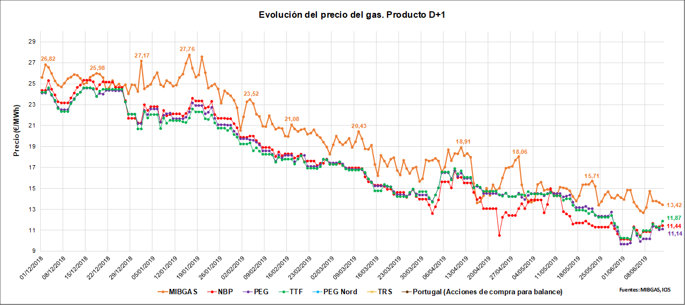
3. WP Second target: market integration
3.1. Follow-up of gas prices SGRI hubs vs. neighbouring hubs
(for information by NRAs and TSOs)
Evolution of prices D+1 (1st December 2018- 13th June 2019)

Slide 13
3. WP Second target: market integration
  3.2. Update on the progress of merger of market areas in France
  For information by CRE

Slide 14
3. WP Second target: market integration
  3.3. Implementation of UIOLI LT mechanism at VIP Iberico
  For information by REN

Slide 15
4. WP Third target: contribution of gases to decarbonisation
  4.2. Follow-up
  For information by TSOs and NRAs

Slide 16
5. WP Forth target: other items for discussion
  5.1. Regulatory developments in Spain
    Public consultation on balancing regime (for information by CNMC).
    Public consultation on access regime (for information by CNMC).
    Deadline for comments: 5th July 2019
    Documents available in Spanish at:
    https://www.cnmc.es/ambitos-de-actuacion/energia/consultas-publicas

Slide 17
5. WP Forth target: other items for discussion
  5.1. Regulatory developments in Spain: New access regime
  New LNG model, similar to the applied in the US: A virtual LNG plant for regasification and LNG storage.
  Standard capacity products allocated through market-based procedures (currently FCFS).
  Time horizons products aligned with CAM.
  New services offered (both individual and aggregated services)
  CMP application.
  Guarantees (same model).

Slide 18
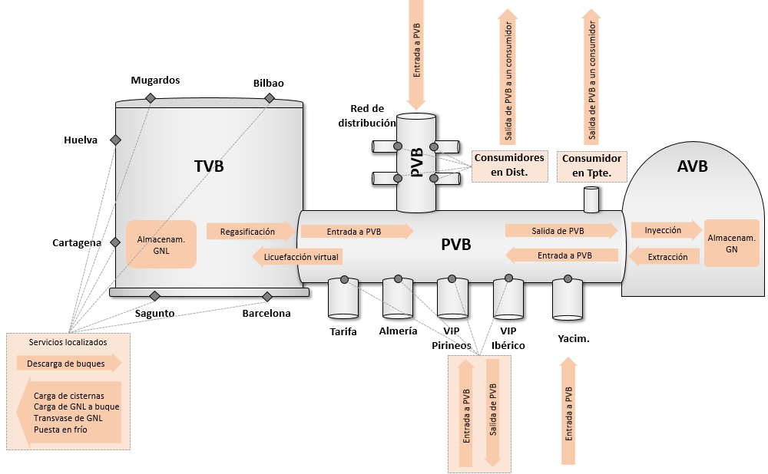
  5.1. Regulatory developments in Spain: new access regime
Virtual LNG terminal
Virtual UGSS
Gas Balacing Point

Slide 19

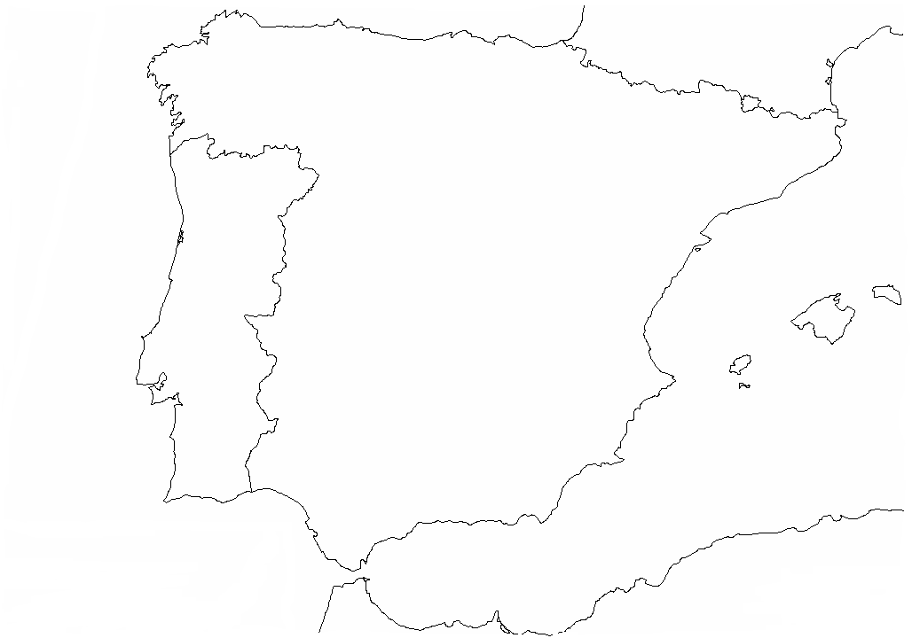
  5. WP Forth target: other items for discussion
  5.1. Regulatory developments in Spain: Access regime
A (New model)
Virtual LNG plant for regasification and LNG storage
:
DE (Current situation):
Mugardos
Bilbao
Mugardos
Bilbao
Almacenam. y regasif. VIRTUAL
PVB
Sistema de tpte.– dist.
Barcelona
Barcelona
Sagunto
Sagunto
PVB
Sistema de tpte.– dist.
Cartagena
Cartagena
Huelva
Huelva
6 LNG plants for loads and reloads (user chooses LNG plant)
6 LNG balancing zones (one for each plant)
6 LNG markets (one for each plant)
Regasification contract for each LNG plants
Nomination for each LNG plant
6 LNG plants for loading and reloading (user chooses LNG plant)
1 single balancing zone for LNG plants as a whole
1 single market for LNG plants as a whole
1 single regasification contract for LNG plants as a whole
1 single LNG storage contract for LNG plants as a whole
1 single regas nomination for all LNG plants

Slide 20
5. WP Forth target: other items for discussion
  5.1. Regulatory developments in Spain: new balancing regime
  Transport network: same balancing model, according to NC. Minor adjustment for imbalances charges increases from 2,5% to 5% over the market price.
  Main regulatory changes:Similar balancing regime for virtual LNG plant and virtual US (with the same minor adjustment).
  Other changes:
  financial guarantees calculation by user is calculated more frequently (from every 15 days to daily calculation), taking into account more recent data of imbalances of the user (currently guarantees are calculated over previous year data (quarter of maximum imbalance) and now daily calculation takes daily data.
  Operational limitations for users with big negative imbalances.

Slide 21
5. WP Forth target: other items for discussion
5.2. AOB

Slide 22
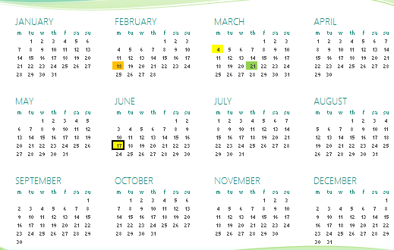
5. Calendar of the next meeting
RCC
IG
SG
Next IG meeting: 10th September (tentative date, tbd)

Slide 23
Thank you for attending

