Slide 1
C O U P L E D
ENTSO-E Regional Group Northwest Europe
NWE TSO Day Ahead Project
NRA – TSO – PX meeting, 15 June 2011

Slide 2
NWE Day Ahead project
Main decisions from TSOs
Status of discussions with Power Exchanges
Organisation – project structure
Next steps – main issues and questions
Timeline
Among TSOs
With Power Exchanges
With Regulators

Slide 3
Target NWE TSOs DA solution – Key functional blocks
*) from presentation at Florence Forum in December 2010

Slide 4
Main decisions from TSOs
Objective of the NWE Day Ahead Project:
Implement a single price coupling for the following countries : Belgium, Denmark, Finland, France, Germany, Luxembourg, Norway, Sweden, the Netherlands, Great Britain
Design of NWE Day Ahead Project as Blueprint for the European Solution, adjacent regions free to join when ready
Pragmatic approach chosen:
Preserve as much as possible the existing systems used for current market coupling (pre and post coupling)
Preserve as much as possible the current agreements between Power Exchanges and TSOs in NWE region
New processes and agreements are needed for coupling GB to CWE and adapted between Nordic and CWE

Slide 5
CWE
NWE situation end of 2012
CWE
Amprion
5
ELIA
1
Shipping agent
EnBW
Coordinated
capacity
calculation
6
RTE
2
4
Bilateral Exchanges
Calculation and / or
Validation
Share of
congestion
revenue
Tennet BV
Platform to harmonise
the IT format
Tennet GmbH
Nordic Countries
3
Nordic Countries
Svenska Kräftnät
Market Coupling
Algorithm
Coordinated
capacity
calculation
5 and 6
Stattnett
Shipping agent & Share of congestion revenue
Internalised in NordPool
Fingrid
1
Energinet
RTE
NG
NG
Tennet BV
Internal
organisation
of PXs
Shipping agent
5
Energinet
50Hz
Tennet BV
Stattnett
Share of
congestion
revenue
Energinet
Tennet GmbH
6
Pre-Coupling
Coupling
Post-Coupling
1
5
6
No change at all to current processes
2
Possible change/creation of a platform for harmonisation
3
Necessary adaptation of the MC algorithm
4
Possible changes for harmonisation
Existing flows
Flows to be created or updated

Slide 6
Main decisions from TSOs
PCR acceptable as the starting point for the coupling solution
TSOs need comfort that their requirements are met; TSOs have to set minimum requirements to comply with third package obligations (see next steps)
Governance aims to fulfil the following objectives:
Make the extensions to other TSOs as easy as possible / as standard as possible on equal terms
Avoid multiple bilateral discussions / solutions on common issues: study of the possible use of a central contracting entity
Main principles agreed in one common NWE DA project

Slide 7
NWE Day Ahead project
Main decisions from TSOs
Status of discussions with Power Exchanges
Organisation – project structure
Next steps – main issues and questions
Timeline
Among TSOs
With Power Exchanges
With Regulators

Slide 8
Status of discussions with NWE PXs
Discussions launched in March 2011 on the basis of use of PCR
Intensive discussions launched under a cooperative mode in order to speed up the process
Progress has been made on drafting of 2 documents for the launch of the NWE project
All Party Cooperation Agreement (APCA) – for the Design
Programme Initiation Terms (PIT) – covering the high level principles of all phases

Slide 9
APCA Design
Contract in order to cover the rights, actions and obligations of all parties under the design phase
Main principles:
Cooperation during Design Phase
Regulation on project organisation
Regulation on cost sharing and cost recovery for the design phase
Regulations on task description during the design phase
Principles of facilitation of the implementation phase (to ease the progress on APCA implementation)

Slide 10
Programme Initiation Terms (PIT)
Describe the overall objective of NWE Market Coupling
Describe the main steps leading to an operational market coupling: design phase and implementation phase with indication of time frames
Describe the main principles of all phases (design, implementation and operation) of the NWE Day Ahead Project
Define general governance principles
Define general project structure – organisation PXs and TSOs
Define general principles on cost recovery / funding / transparency

Slide 11
NWE Day Ahead project
Main decisions from TSOs
Status of discussions with Power Exchanges
Organisation – project structure
Next steps – main issues and questions
Among TSOs
With Power Exchanges
With Regulators

Slide 12
Organisation – project structure
Due to preserving as much as possible of the existing systems, an approach through several levels is foreseen:
Regional level:
Define and agree the design of the Solution, Algorithm development (common position from all parties), Governance for operation
Define and agree the general principles for post coupling
Define and agree central cost recovery / funding
Balance between payments for solution and ownership of solution
Local level: On the basis of the common positions from the design phase, some local actions will take place on:
Implementation of post coupling
Cost recovery /funding agreement for post coupling

Slide 13
NWE Day Ahead project
Main decisions from TSOs
Status of discussions with Power Exchanges
Organisation – project structure
Next steps – main issues and questions
Timeline
Among TSOs
With Power Exchanges
With Regulators

Slide 14
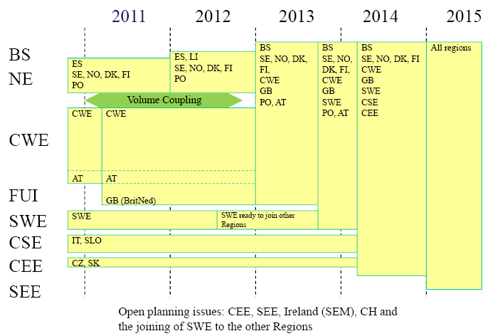
Timeline for NWE DA project
Target launch date is end 2012
Date will be announced once design phase has been completed

Slide 15
TSOs positions to be clarified
Some of the major questions that TSOs need to clarify during the design phase:
Pre coupling:
Creation of a common capacity platform to centralise all information to be sent to Power Exchanges for Coupling?
Coupling:
What are requirements (new/amended/existing) that need to be included on the Market Coupling Algorithm regarding TSOs issues ?
For example: ramping constraints, losses, dynamic bidding areas?
Post Coupling:
What is the solution to be implemented on countries where no market coupling is in place, or where current EMCC-arrangements meet new circumstances?
Do we define a possible standard solution for the extensions?
Common TSO governance being finalised

Slide 16
Requests made to Power Exchanges
TSOs require some more comforts, i.e. need to ensure that the following points are fulfilled/delivered by Power Exchanges before launching the project:
Compliance of the PCR with the European competition legislation
Information on the algorithm (COSMOS) and its selection process to share a common knowledge among all NWE Parties
PXs view on the principles of cost recovery / funding for all phases in PIT
Technical feasibility of PCR solution
Non Disclosure Agreement to start algorithm validation work
Alignment of PCR with the general governance principles required by the TSOs
After these steps: Common PXs-TSOs Working Group has to be launched in order to make some progress on the algorithm development and validation.

Slide 17
Requests to National Regulators
In order to launch the NWE Day Ahead Market Coupling Project, TSOs request the NRAs to agree on cost recovery / funding principles of the project, TSOs offer to provide input
how to share total costs among the parties?
how the parties recover the costs?
both total and stranded costs have to be addressed?
Based on principles from NRAs and input from Power Exchanges, TSOs will formulate cost recovery / funding proposal to NRAs to be approved by NRAs

Slide 18
Thank you for your attention

