Slide 1






NWE/PCR Update
AESAG Meeting
1 February 2012

Slide 2
PCR PXs - common solution proposal
The objective is twofold:
  To deliver NWE for the end of 2012 (target date);
  To secure the 2014 roadmap.
The PCR PXs have agreed on the following solution:
  Joint development of PMB (PCR Matcher/Broker) for the launch of NWE target 2012;
  Parallel development of PCS (current version of PCS upgraded with Nordic requirements) as possible solution for the launch of NWE target 2012 until sufficiently clear whether needed or not.
No later than May, it will be decided which system will be used for the NWE launch.
In case PCS is used at the start of NWE, a second step will be needed to replace PCS by the PMB.

Slide 3
Development activities
Two blocks of development activities are needed to follow the parallel development.
  Upgrade of PCS:
    PCS remains centralised;
    NWE requirements are supported;
  Implementation of PMB :
    Decentralised PCR solution;
    NWE /PCR requirements are supported;
    Joint design/analysis phase involving all PXs during February

Slide 4
PX Technical Planning
Go live system selection
Feb 2012 | Mar 2012 | Apr 2012 | May 2012 | Jun 2012 | Jul 2012 | Aug 2012 | Sep 2012 | Oct 2012 | Nov 2012 | Dec 2012 | Q1 2013 | Q2 2013
Design phase
Algo interface frozen
Algo fully industrialised
Development PMB // PCS
Finalise Development PMB⁺
Algo requirements & specs frozen
Algorithm industrialisation
PX local systems adaptations *
Test preparation
PMB // PCS System Tests
Algo Sys. test
PX local systems
system Tests
PXs integr. tests
Integration & Procedural Tests **
Tests PMB+
Market Validation
PXs
readiness
Dec 2012
PXs
Readiness
Jun 2013
Procedures **
Contingency
* Pending planning validation of PX local system provider
** Requires coordination with TSOs planning
+ In case the Implementation of PCS in NWE is decided due to delays in PMB development

Slide 5
NWE PX Budget

Slide 6
PCR System Choice Update
At November AESAG, PXs described a parallel approach being taken to procure the PCR matcher/broker (PMB) system
  OMIE/GME/APX-ENDEX/Belpex to undertake a tender process with 5 preselected suppliers
  EPEX/NPS to request quote for modification of existing system used in CWE
Tender process completed on time: 3 high quality proposals received (9 Jan), one recommended (24 Jan)
PXs informed NWE TSOs that they would prefer to select a single PMB system provider
Exchange of EPEX/NPS proposal and the 3 shortlisted proposals from the tendering process; recommendation by APX/BPX/OMIE/GME
In order not to delay the NWE implementation by end of 2012
  APX-ENDEX/Belpex, OMIE and GME will proceed with selected service provider to start the analysis phase (which we need anyway, no obligation for development yet) starting immediately. EPEX/NPS will participate in analysis phase
  EPEX/NPS will proceed with parallel analysis phase for a solution based on the existing system used in CWE with minimal changes to be triggered in May if needed. APX-ENDEX/Belpex will participate too

Slide 7
Next steps
To start the NWE project in a proper way and to comply with the planning presented, the following steps (including some PCR steps) have to be tackled:
Design of pre-coupling (ATC handling) and post-coupling (Shipping agent mechanism) → NWE TSOs;
Clarification of the specification on Nordic flows calculation (for the algorithm) by end of January and Nordic functionalities for PMB//PCS during February → PXs;
Clarification and agreement on fallback procedures → Joint;
Finalise PMB provider selection → PXs;
Finalisation of the PCR agreements (including governance and other terms) → PXs;
Interim agreement if needed (including governance and other terms for use the system in the interim) → PXs;
Finalisation of the NWE APCA and the cost recovery mechanism → Joint NWE;
Start the NWE project organisation (i.e. appoint joint PMO) → Joint NWE.
→ Heavy workload...

Slide 8
Back-up slides

Slide 9
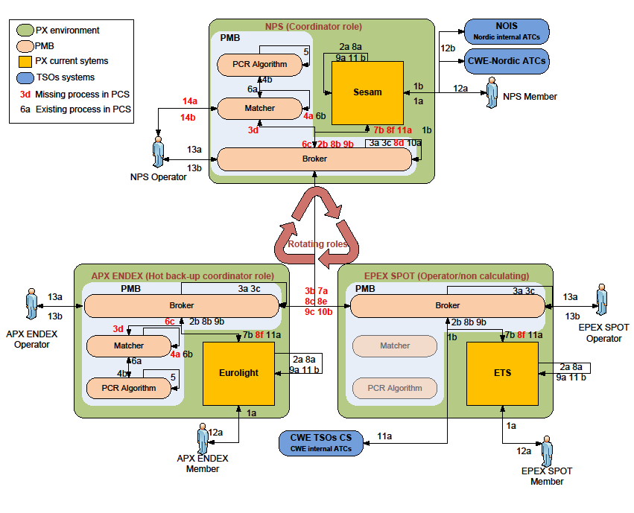
HLFA – PMB (only NWE PXs shown for simplicity)

Slide 10
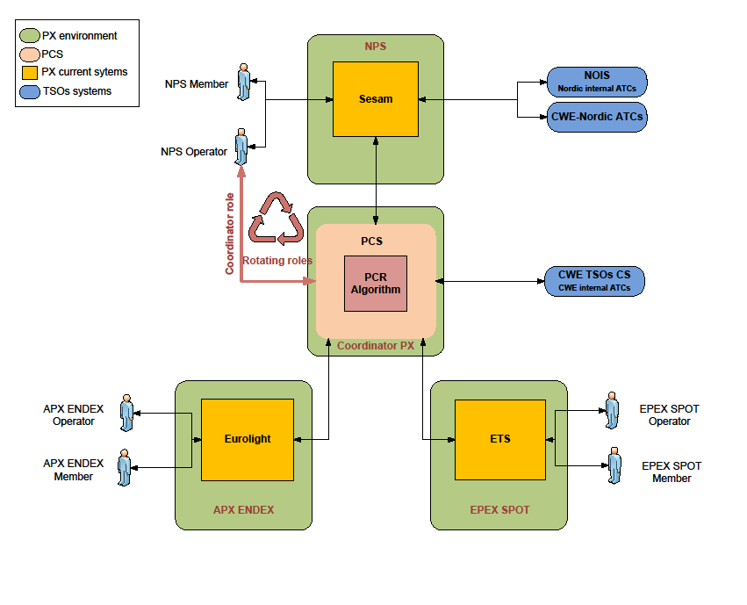
HLFA - PCS

