Slide 1
Public Consultation : main conclusions (1/2)
Forward Risk-Hedging Products and
Harmonisation of Long-Term Capacity Allocation Rules
Planning for allocation rules and the auction platform
NRAs propose to follow a two-steps approach:
2013:
Based on the wish-list and within the scope of existing auction rules, TSOs elaborate LT auction rules for the LT auctions 2014;
Process and planning to be discussed with ENTSO-E/TSOs in March
TSOs define criteria to establish the single auction platform.
2014:
Based on the wish list TSOs elaborate a European common set of LT auction rules. This set of rules should apply to all LT auctions for 2015 onwards;
TSOs establish the single auction platform.

Slide 2
Public Consultation : main conclusions (2/2)
Forward Risk-Hedging Products and
Harmonisation of Long-Term Capacity Allocation Rules
Complementary studies
The contributions raised the importance of assessing TRs impact on the liquidity of both forward and day ahead markets and benefits with FTRs compared to PTRs.
The Agency will investigate further the potential barriers to the Internal Electricity Market of having different mechanisms for the longer timeframe.
In addition, it is mentioned both in the conclusions and the wish-list that, by the end of 2013, TSOs/ENTSO-E should provide a feedback and costs / benefits analysis on:
The impact of introducing longer-term products,
The introduction of buyback possibilities.

Slide 4
Main issues in the draft FCA NC as of 17 Jan 2013
Forward Capacity Allocation Network Code
Main issues
(Art 40) Clarification on the process to determine whether TR should be allocated
Where TRs are already allocated, no need to decide on whether appropriate cross-zonal financial hedging is offered
Where NRAs consider that appropriate hedging tools are offered, no need to decide not to allocate TR / they may decide the TSOs not to allocate TRs (check legal robustness), and then other articles do not apply
Review of this decision only at the initiative of NRAs or upon request of SOs
(Art 2 & 46) Revenue Adequacy principle
Concept not foreseen in the FG
Implication for UIOSI ?
(Art 67-70) Firmness
Use of LT Firmness Deadline ?
Compensation principles not in line with the FG
« Reimbursement of Initial Price Paid » : only in case of force majeure in the FG
« Capped Market Spread-Based Compensation » : only before nomination (or LF Firmness deadline)
(Art 44 & 45) Process and deadlines for platform(s): 3 years ½ ?
Definition for the common set or requirements (6 months) + NRAs approval (6 m) + Decision (12 m) + NRAs approval (6 m) + Establishment (12 m)

Slide 5
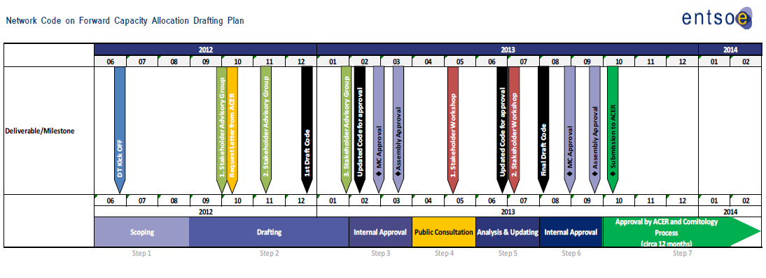
Planning
Forward Capacity Allocation Network Code

Slide 7
Public Consultation: main conclusions (1/2)
Forward Risk-Hedging Products and
Harmonisation of Long-Term Capacity Allocation Rules
On the types of products, the replies to the public consultation reflect the differences between:
The Nordic electricity market model
Price hedge (through CfDs)
No PTR / Physical delivery through the Day ahead market
The continental models
Allocation of TRs by TSOs
No clear-cut outcome
TRs desired (except in the Nordic region)
Preference for PTR
Issues regarding FTR
Main conclusions: would be worth studying the impacts on liquidity of the day-ahead and forward markets

Slide 8
Public Consultation: main conclusions (2/2)
Forward Risk-Hedging Products and
Harmonisation of Long-Term Capacity Allocation Rules
Wish list
General support of the wish-list
A few points to be clarified
Issues to be adressed in the NC, e.g. :
firmness
approval and amendments procedures
application of UIOSI or pay-out of capacity products
definition of force majeure
Harmonisation of LT capacity allocation rules
Products: longer term requested
Secondary market: buy-back possibilities for TSO
Auction platform: volontary process with deadline and one single auction platform
Main conclusions: requesting TSOs to study longer-term products + buyback (with “caps”)

Slide 10
Other issues in the draft FCA NC as of 17 Jan 2013
Forward Capacity Allocation Network Code
Other issues
Clarification of the objectives of the code (used as a criteria for some requirements)
Process to elaborate and approve rules (separate requirements, rules, firmness…) : complicated
Best / reasonable endeavours to be removed (as recommended in CACM NC)
(Art 7 et seq.) NRAs approval : all/each? – considering also consequences of article 40
(Art 29, 34 & 35) Clarification on the methodologies for capacity calculation and LT volume determination, including specifications on the splitting rules across timeframes and volumes allocated in yearly auction, and on validation process
Capacity calculation : adaptations may be necessary to be in line with ACER’s requests on CACM
(Art 80 et 81) Transitory measures: only for Platforms in the FG (not for HAR and firmness)

Slide 11
Revenue Adequacy in the draft FCA NC as of 17 Jan 2013
Forward Capacity Allocation NetworkCode
Revenue Adequacy
(Art 2) “Revenue Adequacy means the condition that links the LTR payouts to the collected Day Ahead congestion income in order to mitigate the risk to System Operators of adverse financial deficits due to specific design aspects of Day Ahead Capacity Allocation such as, but not limited to, adverse flows, losses;”
Concept not foreseen in the FG
Only link the LTR payout and the collected Day Ahead congestion income; not applicable to firmness? (+ the Long Term auction revenue?)
Implication for UIOSI ?
It is not clear that firmness will be guaranteed for the capacity as stated in the Framework Guideline.
To what extent Revenue Adequacy is different from cost recovery?
Framework Guidelines (Art 4.2) claim that :
The FCA Network Code(s) shall require that PTR are subject to the UIOSI requirement at the time of nomination (or equivalent market allocation process), which means, as a default, the resale of non-nominated capacity rights. TSOs shall give the total financial resale value of capacity (in the case of an explicit auction this is equal to the clearing price of the auction in which the capacity is resold; in the case of an implicit auction this is equal to the day-ahead price differential between the two zones) back to the market participants who owned the PTR.

Slide 12
Firmness in the draft FCA NC as of 17 Jan 2013
Forward Capacity Allocation Network Code
Firmness
Issues to be discussed in the FCA :
What is the LT Firmness Deadline for ?
As compensation principles are defined for the period before the DA Firmness Deadline in the FCA NC ?
Firmness as of FCA NC and FG
Long Term Firmness Deadline
Day Ahead Firmness Deadline
FCA NC
(Art 56) Compensation principles:
Reimbursement of Initial Price Paid
Capped Market Spread-Based Compensation
See CACM NC
Nomination Deadline
Financial firmness
Caps on the compensation may be introduced in the case of curtailment announced before the nomination deadline
Physical firmness is the preferred approach
Financial firmness may be accepted in case of explicit auctions
Physical firmness (or equivalent)
FG (6.4)
Compensation shall generally be equal to the price difference between the concerned zones in the relevant time frame.

Slide 13
Process to establish the platform(s) in the draft FCA NC as of 17 Jan 2013
Forward Capacity Allocation Network Code
Platforms
Issues to be discussed in the FCA :
Process to establish the platform = 3 years ½? Better to have an operational PF within 6 months after the entry into force of the NC
Transitory measures: two more years ? (Art. 79.4)?
Deadlines for the PF as of FCA NC
FCA NC
Art 44
Art 45.1
Art 45.3
Art 65
Entry into force of the NC
6 months to define the common set of requirements
24 months
transitory measures
6 months
NRAs’ approval
12 months to decide on the establishment of the PF
6 months
NRAs’ approval
12 months for the PF to be operational
2014
(at the earliest)
3 years 1/2
2020 ?
2018 ?

