Slide 1
Projects on Transfer of LT Auctions and Market Coupling
3rd December 2013

Slide 2
Transfer of LT Auctions and SWE Market Coupling
Two decoupled projects
Full-Market Coupling requires the withdrawal of IFE Daily Explicit Auctions
Transfer of LT Auctions affects the IFE Yearly and Monthly Explicit Auctions
RTE and REE had planned to implement the transfer of LT Auctions in November 2013 and the SWE Market Coupling in March 2014
Delay in the implementation of the transfer of IFE LT Auctions due to the change by CASC of the agreed terms & conditions for which RTE and REE had the regulatory comfort from the respective NRAs.
REE has also been affected by the new terms & conditions diverging from the ones agreed
REE offers all its help and collaboration to solve IT problems identified on RTE’s side

Slide 3
Identified solutions
REE offers all its collaboration both to RTE and NRAs to ensure that the full coupling is not affected by the IT issues identified by RTE
REE and RTE have worked in close cooperation analysing different options to do so. In this context, REE would be in favour of any of the following solutions:
Maintain current task sharing (REE yearly and intraday auctions and RTE monthly and daily auctions) acting CASC as a service provider to RTE for the monthly auctions
Quick Win solution: this solution does not require high level regulatory changes but a deeper legal and fiscal analysis is needed to asses the implications of CASC acting in its own name on behalf of RTE. These detailed analysis may need an additional time.
REE delegates in another company (RTE, REN, OMIE) its activities related to long-term capacity management. This third entity would then delegate the execution of long-term explicit auctions to CASC
This solution would require updates of High Level Spanish Regulation
CASC acts as service provider for both RTE and REE for the execution of all long-term explicit auctions
This solution could require updates of High Level Spanish Regulation
REE would in be position to implement Options 1, 2 and 3 in case its NRAs require to do so

Slide 4
Possible roadmap
16th December 2013 → RTE-REE Agreement on adaptation of FR-ES allocation rules
20th December 2013 - 15th January 2014 → Period of public consultation on FR-ES allocation rules
End January 2014 → Submission of approval package to NRAs
End March 2014 → Approval and application of new regulatory framework
5th April 2014 (to be confirmed by NWE) → SWE Full-Coupling

Slide 5
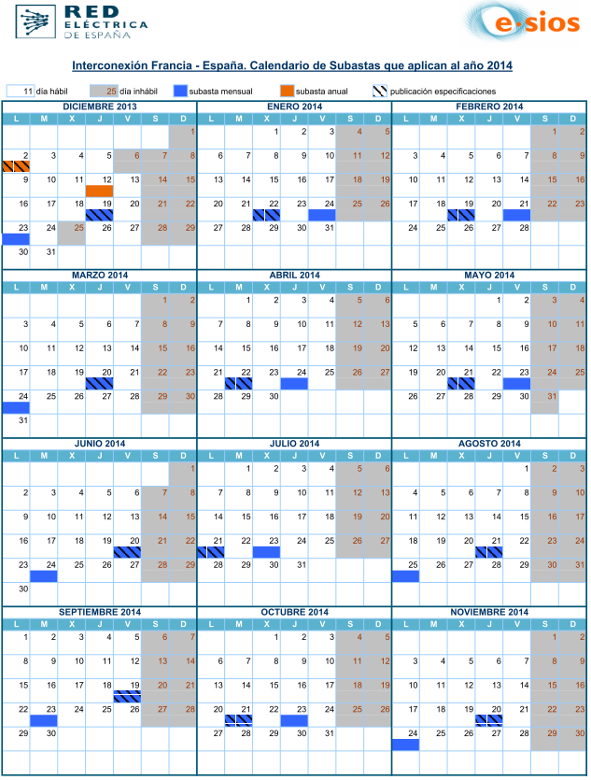
2014 Auctions calendar

Slide 6
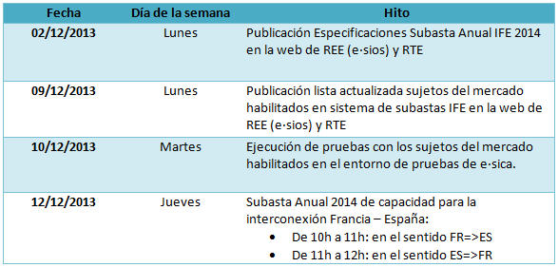
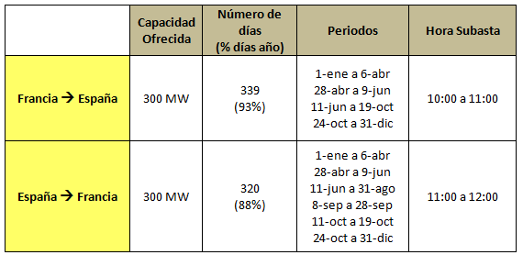
2014 Yearly auction

