Slide 1
Enagás, GRTgaz, REN and TIGF
29th IG meeting
12th December 2014

Slide 2
III.1 Monthly auctions: results

Slide 3
1. Summary for the rolling monthly auctions
Regarding NC CAM and the ENTSOG calendar since last September, Enagas, REN and TIGF are holding on rolling monthly capacity auctions.
All the auctions have been carried out with no incidents. Prisma platform has run correctly.
There wasn’t enough demand in order to increase the price of the auctions. So every auctions closed at starting prices.
The flow from Spain to Portugal and France to Spain have seen some interest meaning there have been a few bids.
The flow from Spain to France and Portugal to Spain have seen no interest.

Slide 4
1. October capacity auction results – VIP PIRINEOS
Flow Spain-France
Bundled Capacities
Unbundled Capacities
Firm monthly Bundled capacity auction-VIP-ES-FR
kWh/h | Oct. 2014
Capacity offered | 1.745.502
Capacity Allocated | -
Firm monthly Unbundled capacity auctions-VIP-ES-FR
kWh/h | Oct. 2014
Capacity offered | 2.093.350
Capacity Allocated | -
Flow France-Spain
Allocation per Shipper
Bundled Capacities
Firm monthly Bundled capacity Flow France-Spain
kWh/h | Oct. 2014
Capacity offered | 655.515
Shipper 1 | 41.667
Shipper 2 | 180.000
Firm monthly Bundled capacity auction-VIP-FR-ES
kWh/h | Oct. 2014
Capacity offered | 655.515
Capacity Allocated | 221.667
34%
Capacities at 25º C

Slide 5

1. October capacity auction Results – VIP IBERICO
Allocation per Shipper
Firm monthly Bundled capacity Flow Spain-Portugal
kWh/h | Oct. 2014
Capacity offered | 1.565.340
Shipper 4 | 64.010
Shipper 5 | 41.667
Firm monthly Bundled capacity auction-VIP-ES-PT
kWh/h | Oct. 2014
Capacity offered | 1.565.340
Capacity Allocated | 105.677
7%
Flow Portugal-Spain
Flow Spain-Portugal
Firm monthly Bundled capacity auction-VIP-PT-ES
kWh/h | Oct. 2014
Capacity offered | 3.333.333
Capacity Allocated | -
Firm monthly Unbundled capacity auctions-VIP-ES-PT
kWh/h | Oct. 2014
Capacity offered | 232.727
Capacity Allocated | -
94% of the offered capacity was allocated in the annual yearly auction
Capacities at 25º C

Slide 6
2. November 2014 capacity auction results – VIP. PIRINEOS
Flow Spain-France
Bundled Capacities
Unbundled Capacities
Firm monthly Bundled capacity auction-VIP-ES-FR
kWh/h | Nov. 2014
Capacity offered | 1.579.268
Capacity Allocated | -
Firm monthly Unbundled capacity auctions-VIP-ES-FR
kWh/h | Nov. 2014
Capacity offered | 2.093.349
Capacity Allocated | -
Flow France-Spain
Bundled Capacities
Allocation per Shipper
Firm monthly Bundled capacity auction-VIP-FR-ES
kWh/h | Nov. 2014
Capacity offered | 239.929
Capacity Allocated | 166.667
Firm monthly Bundled capacity Flow France-Spain
kWh/h | Nov. 2014
Capacity offered | 239.929
Shipper 1 | 83.333
Shipper 2 | 83.334
69%
Capacities at 25º C

Slide 7
2. November 2014 capacity auction results – VIP.IBERICO
Flow Spain-Portugal
Allocation per Shipper
Firm monthly Bundled capacity Flow Spain-Portugal
kWh/h | Nov. 2014
Capacity offered | 1.565.340
Shipper 3 | 64.010
Shipper 4 | 41.667
Shipper 5 | 83.333
Firm monthly Bundled capacity auction-VIP-ES-PT
kWh/h | Nov. 2014
Capacity offered | 1.565.340
Capacity Allocated | 189.010
12%
Flow Portugal-Spain
Flow Spain-Portugal
Firm monthly Bundled capacity auction-VIP-PT-ES
kWh/h | Nov. 2014
Capacity offered | 3.333.333
Capacity Allocated | -
Firm monthly Unbundled capacity auctions-VIP-ES-PT
kWh/h | Nov. 2014
Capacity offered | 232.727
Capacity Allocated | -
94% of the offered capacity was allocated in the annual yearly auction
Capacities at 25º C

Slide 8
3. December 2014 capacity auction results – VIP. PIRINEOS
Flow Spain-France
Bundled Capacities
Unbundled Capacities
Firm monthly Bundled capacity auction-VIP-ES-FR
kWh/h | Dec. 2014
Capacity offered | 1.579.268
Capacity Allocated | -
Firm monthly Unbundled capacity auctions-VIP-ES-FR
kWh/h | Dec. 2014
Capacity offered | 2.093.349
Capacity Allocated | -
Flow France-Spain
Allocation per Shipper
Bundled Capacities
Firm monthly Bundled capacity Flow France-Spain
kWh/h | Nov. 2014
Capacity offered | 239.929
Shipper 1 | 41.667
Shipper 2 | 83.333
Shipper 3 | 84.000
Firm monthly Bundled capacity auction-VIP-FR-ES
kWh/h | Dec. 2014
Capacity offered | 239.929
Capacity Allocated | 209.000
87%
Capacities at 25º C

Slide 9
3. December 2014 capacity auction results – VIP. IBERICO
Flow Spain-Portugal
Allocation per Shipper
Firm monthly Bundled capacity Flow Spain-Portugal
kWh/h | Dec. 2014
Capacity offered | 1.565.340
Shipper 4 | 83.333
Shipper 5 | 64.010
Shipper 6 | 6.917
Firm monthly Bundled capacity auction-VIP-ES-PT
kWh/h | Dec. 2014
Capacity offered | 1.565.340
Capacity Allocated | 154.260
10%
Flow Portugal-Spain
Flow Spain-Portugal
Firm monthly Bundled capacity auction-VIP-PT-ES
kWh/h | Dec. 2014
Capacity offered | 3.333.333
Capacity Allocated | -
Firm monthly Unbundled capacity auctions-VIP-ES-PT
kWh/h | Dec. 2014
Capacity offered | 232.727
Capacity Allocated | -
94% of the offered capacity was allocated in the annual yearly auction
Capacities at 25º C

Slide 10
IV. CMP: last developments of OSBB proposal
Additional Capacity to be offered Methodology

Slide 11
1. Main aspects
Enagás and TIGF common proposal of additional capacity to be offered in response to the decisions adopted in the 14th RCC meeting that took place on the 5th of June 2014
Enagas and TIGF have already agreed the following principles:
Oversubscription to be offered in daily basis
Common methodology for both directions of the Interconnections
Oversubscribed capacity should be bundled
Historical data to be used for the calculation of the additional capacity from April 2013 in advance → small statistical sample that requires conservative parameters to minimize risky situations.
Estimated implementation date: April 2016 (daily additional capacity will be offered through daily firm bundled products)

Slide 12
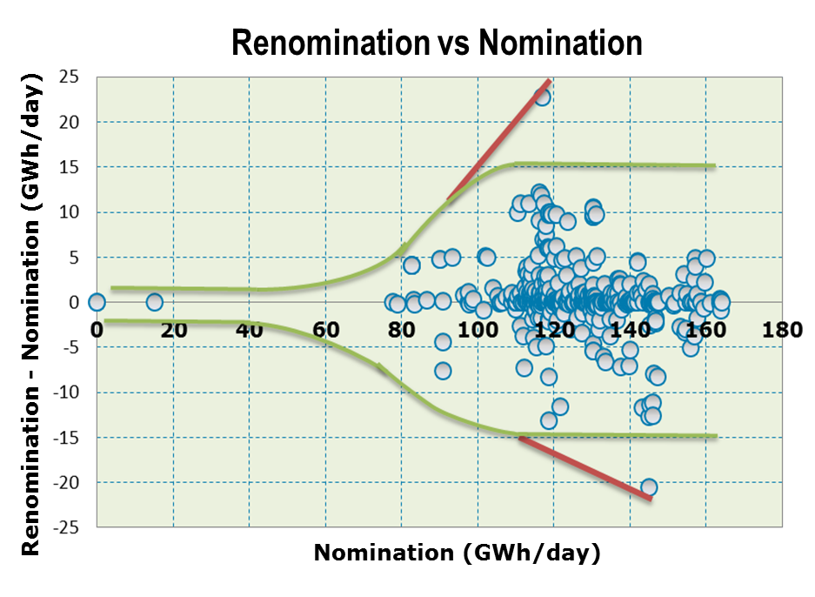
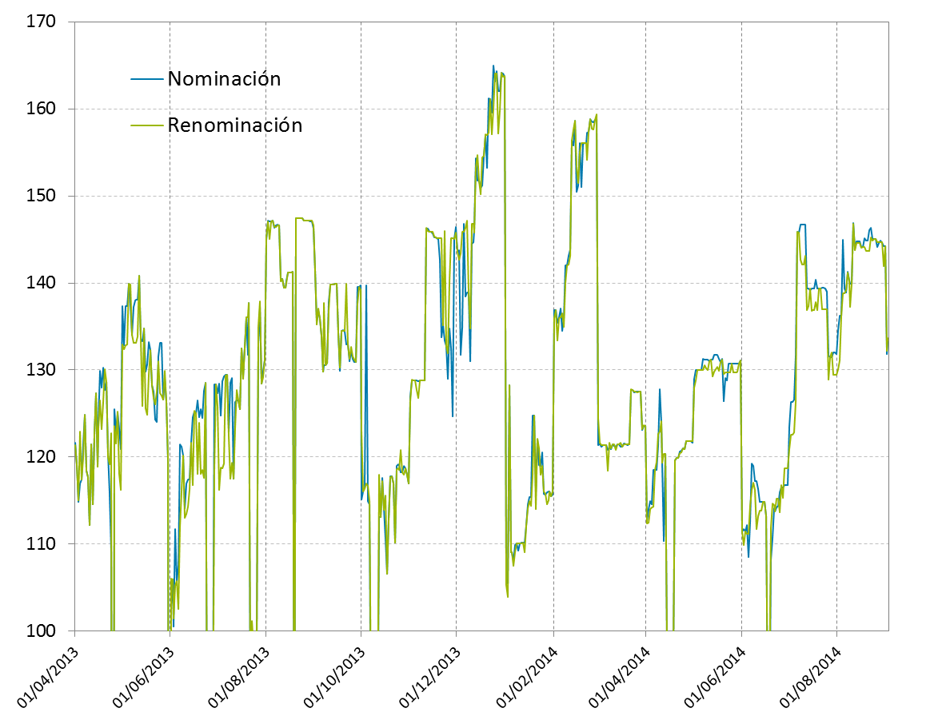
2. Methodology
Historical data. Renomination vs Nomination
In order to forecast the most accurate value of the Renomination, its relation with the variable Nomination is analyzed.
99% of the days, the deviation between the last nomination and its renomination is below
15 GWh/d
The maximum deviation between the last nomination and its renomination has been
M_{D} = 25 GWh/d

Slide 13
2. Methodology
Risk Identification
When offering oversubscription, a risk index should be defined in order to identify the risk level that the TSO is assuming. This risk level should be based on the maximum historical deviation between the last nomination and its renomination.
Therefore, the proposal for Risk Index IR is the following:
  ,where:
  M_{D} → maximum deviation between the last nomination and its renomination of the period of study that composes the historical sample:
,where:
      N_{i} →last nomination of each day i
      R_{i} → renomination of each day i
      i ranges between 1st-April-2013 and the last day of the sample
  f → safety factor, proposed as 10% → f = 1,1

Slide 14
2. Methodology
Trigger value
Taking into account the Risk Index IR previously defined, there is a nomination value above which the oversubscription carries a high risk.
This value is called Trigger Value T_{V} , which is defined as:
,where:
  Cn → Nominal Capacity
  IR → Risk Index
  MO → Operational Margin, set as 25% OBA →
OBA is currently set in Larrau in 40 GWh/d
When the nomination is higher than T_{V}, oversubscription will be 0.

Slide 15

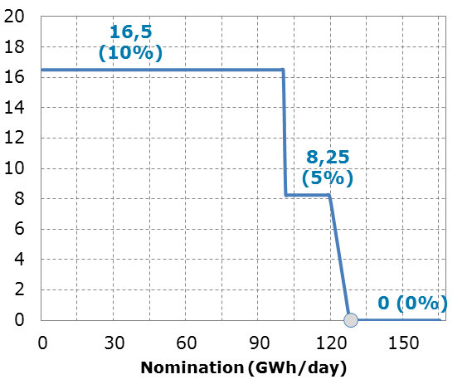

2. Methodology
Additional capacity to be offered function
f(x) → Additional capacity
Additional capacity (GWh/day)
where:
  Cn → nominal capacity
  Tv → Trigger value
  IR → Risk Index
  MO → Operational margin
  X → nomination
  A → Cap 1 over Cn
  B → Cap 2 over Cn

Slide 16
3. Contrasting example
Contrasting example Larrau
  Cn → 165
  % OBA = 25%
  F = 10%
  A = 10%
  B = 5%

Slide 17

4. Methodology implementation
NO Additional capacity will be offered for the day D in case of:
  Special programmed operations between both TSOs.
  Emergency situations that might activate other processes or agreements
  Shippers or TSOs IT System failures
  TOSs justified intervention
ANNUAL REPORT.
METHODOLOGY UPDATE
Variables (M_{D}, IR, T_{V} y f(x)) → daily calculation with the
  latest information of nominations and renominations.
Fixed paramteters (% OBA, historical sample to be used, security factor f y cap over nominal capacity) → Possible annual update if necessary

Slide 18
VIII.2 Candidate projects of common interests in the Region

Slide 19
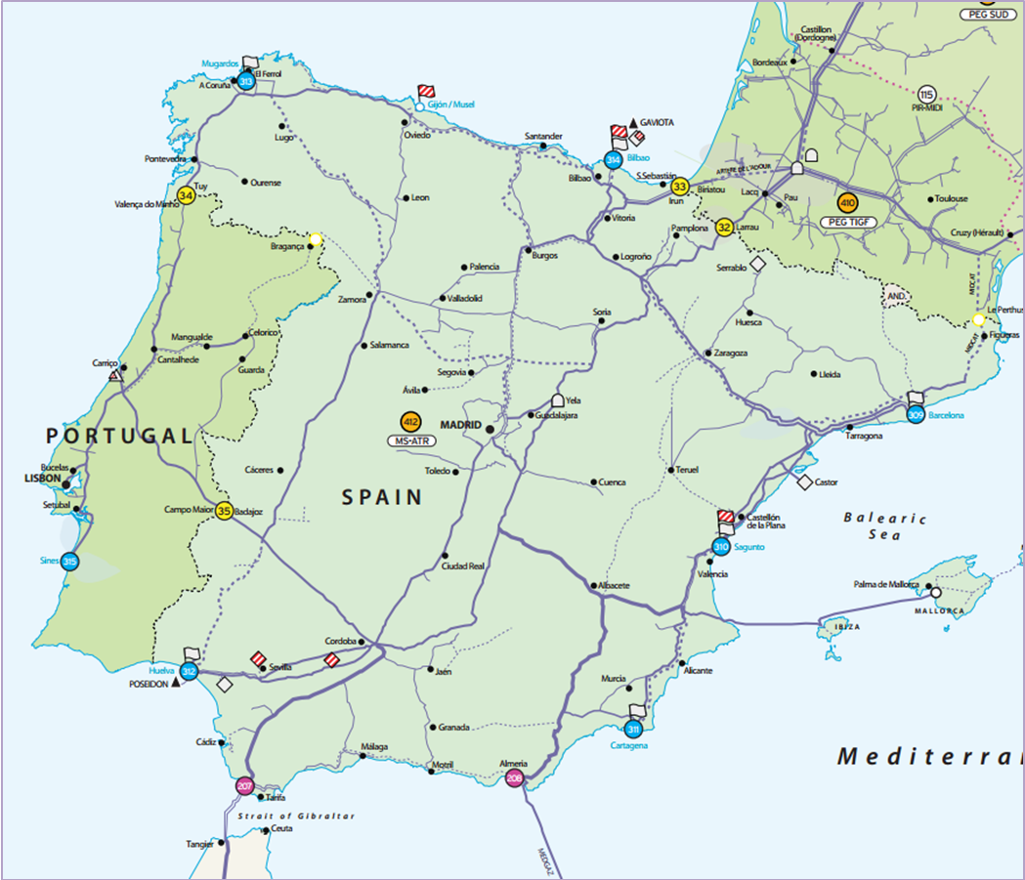
1. Enagás candidate projects for PCIs
INFRASTRUCTURE PROJECTS ASSOCIATED TO MIDCAT (Spain)
5
3
2
4
1

Slide 20
1. Enagás candidate projects for PCIs
INFRASTRUCTURE PROJECTS ASSOCIATED TO THE
3RD INTERCONNECTION SPAIN-PORTUGAL (Spain)
2
1

Slide 21
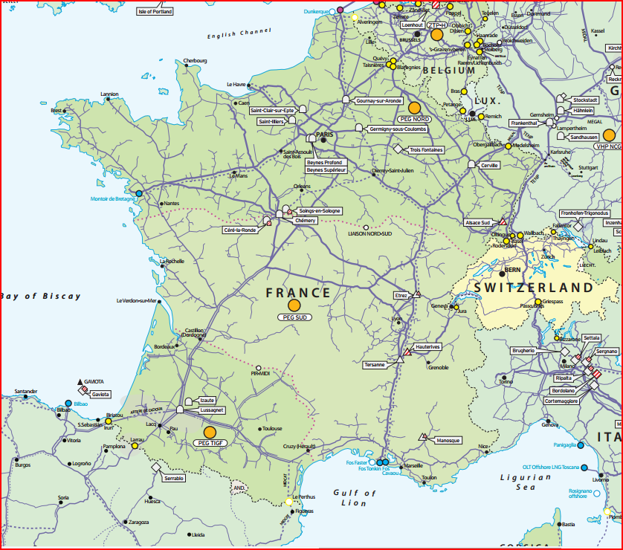
2. GRTgaz candidate projects for PCIs
Adaptation L gas H gas
Luxembourg
Reverse flow FR → GE
Val de Saône
Reverse flow CH → FR
Arc Lyonnais
Gascogne Midi
Eridan
Midcat
Fosmax
(Elengy)
Cyrénée

Slide 22
2. GRTgaz candidate projects for PCIs
  GRTgaz will apply for the PCI status for the following projects :
  Cluster 65
    Fosmax expansion (GRTgaz) : Project is not candidate but is necessary for the project of Elengy and therefore to this cluster
    Eridan : pipeline 220 km, adaptation interconnections St Martin and St Avit, enables flows from South to North
    Arc Lyonnais: pipeline 150 km, enables flows from South to North
  Cluster 64
    MIDCAT : compression in St Martin and Montpellier
    Eridan
    Arc Lyonnais
      Proposition under discussion to add Arc Lyonnais to this cluster, as it enables both flows from Fos and Spain

Slide 23
2. GRTgaz candidate projects for PCIs
  Creation of a single market place :
    Val de Saône : pipeline 200 km, 3 interconnections, 1 compression station
    Gascogne Midi : 2 interconnections
  Reverse capacity from CH to FR at Oltingue : with Fluxswiss and Snam
    Potential cluster with the German part (reverse flow on TENP)
  Adaptation L-gas to H-gas :
    with Storengy, GrRD and Fluxys
    Not modeled
  Interconnection between France and Luxembourg : with CREOS
  New interconnection IT-FR to connect Corsica (Cyrénée)
  Reverse capacity from France to Germany at Obergailbach
    Modeling issue to be solved (mirror project missing)

Slide 24
3. REN candidate projects for PCIs
INFRASTRUCTURE PROJECTS ASSOCIATED TO THE
3RD INTERCONNECTION SPAIN-PORTUGAL (Portugal)
1
2
3
Pipeline Celorico – Spanish border
162
28
Cantanhede Compressor Station
12
3
Pipeline Cantanhede – Mangualde
67
28

Slide 25
3. REN candidate projects for PCIs
REN will apply for the 2nd list of PCI with the project 3rd Interconnection between Portugal and Spain, that will be included in the next TYNDP.
On a first stage (1st phase), the project increases the security of supply in the Portuguese gas system and facilitates the integration of the Portuguese market at Iberian and European level, improving competition and providing shippers with access to alternative balancing gas
The increase of capacity associated to the next stages of the project (2nd and 3rd phases), linked and supplemented with the development of Midcat and with the projects merging GRTgaz North and South zones, will contribute to the strategic concept of the North-South Corridor in Western Europe and it opens possibilities of arbitrage between the different European gas sources.

Slide 26
4. TIGF candidate projects for PCIs
TIGF will apply for the PCI status for the two following projects :
  MIDCAT : third interconnection point between Spain and France
  Gascogne-Midi : first step to allow the creation of a single market place in France
The aim of these two projects is to contribute to the creation of the North – South corridor in western Europe and to bring fluidity to the market, as foreseen in the regulation 347/2013.
These two projects will be included in the next TYNDP

Slide 27
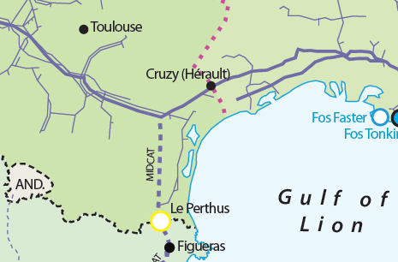
4. TIGF candidate projects for PCIs
MIDCAT, on TIGF’s side, is composed of
  Pipeline between Spanish border and compression station of Barbaira (120kms)
  Reinforcement of compression station at Barbaira (10MW)
  Pipeline between Lupiac and Barran (28kms)
  Midcat project also implies GRTgaz in France and Enagas in Spain

Slide 28
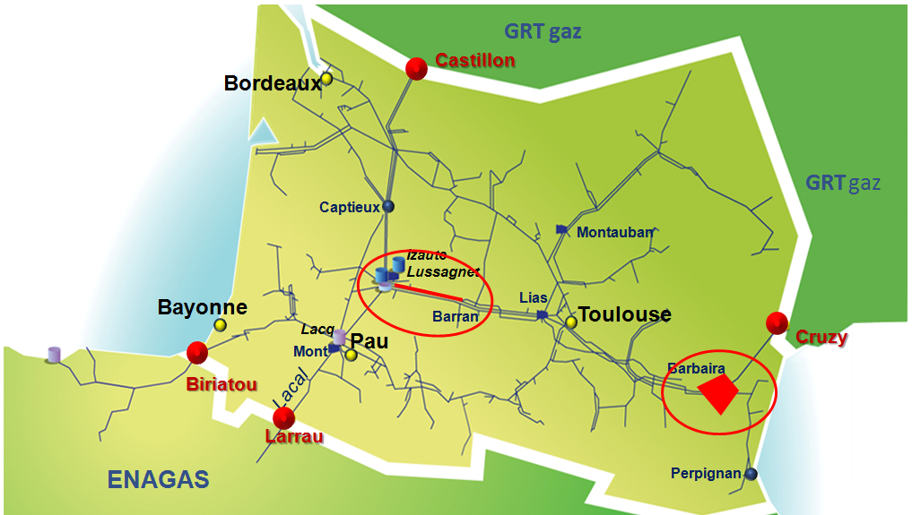
4. TIGF candidate projects for PCIs
Gascogne-Midi is composed of
  Pipeline between Lussagnet and Barran (60kms)
  Reinforcement of compression station at Barbaira (5-7MW)
  A public consultation has been organized followed by a deliberation from the CRE (7 May 2014)

Slide 29
VIII.3 ENTSOG CBA methodology

Slide 30
1. CBA methodology
TIGF, Enagás, GRTgaz and REN participate actively in the CBA process of ENTSOG:
  ESW-CBA for the next TYNDP: participation to the NeMo KG
  PS-CBA for the evaluation of projects: participation during the session forecasted in January and February in Brussels

Slide 31
2. ENTSOG CBA
Energy System Wide Cost-Benefit Analysis Methodology (ESW CBA)
ENTSOG has developed the methodology under Regulation 347/2013.
The ESW CBA is structured in 2 steps:
  TYNDP-step: to be applied by ENTSOG
  PS-step: to be applied by project promoters to individual projects (due to the time constrain, it will be ENTSOG who it is going to leader this step)

Slide 32
3. ESW-CBA
Lead by Entsog

Slide 33
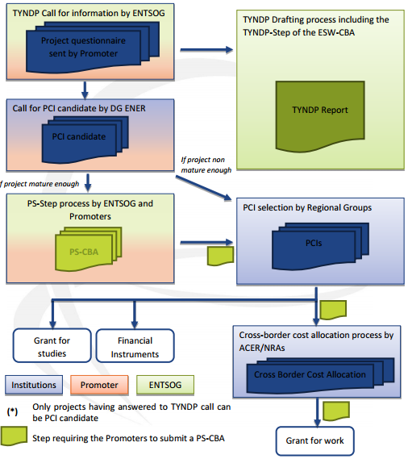
3. CBA role under PCI process

Slide 34
4. Common input data (TYNDP-step & PS-step)
Time horizon: 21-year
List of input data
System-wide data: related to existing infrastructures, gas demand and supply, power generation and coal.
Project-specific data: related to each project as provided by its promoter and including:
  General and technical data: as part of the call for infrastructure projects launched by ENTSOG ahead of each TYNDP report
  Financial data: used by the promoter in the last stage of the PS-Step (including CAPEX, OPEX, Financial Discount Rate and Amortization period)

Slide 35
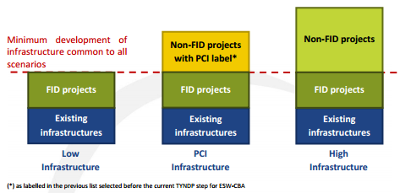
4. Common input data: scenarios
Global context:
  Green: “Gone green” projection in the UK Future Energy Scenarios (high prices of CO2 emissions and reduction of oil-price linkage)
  Grey: Current Policies Scenario from EIA WEO 2013 (low prices of CO2 and high energy prices)
Demand scenarios:
  Scenario A: favourable economic and financial conditions
  Scenario B: non-favourable economic and financial conditions
Supply scenarios: for each supply source 3 scenarios: Minimum, Intermediate and Maximum
Climatic cases:
  Average summer day
  Average winter day
  14-day Uniform risk
  1-day design case
Infrastructure scenarios:

Slide 36
5. Network modelling for TYNDP-step & PS-step
ENTSOG model applies the methodology to
  The capacity figures obtained by TSOs through hydraulic simulations
  The power-generation capacity figures derived from ENTSOE visions
  The demand and supply approach defined in the input data
It is considered the seasonal aspect in the yearly modelling, considering simultaneously the summer, the winter and the peaks.
The basic block of the topology is the balancing zone (or zone) → they are connected through arcs representing the sum of the capacities of all interconnection points between the zones (after the application of the lesser rule).
At each zone the demand and supply should be balanced. The demand of each zone is split between conventional demand (domestic, commercial industrial) and the gas demand for power generation.
The objective of the modeling is to minimize the gas, coal, CO₂ bills of Europe.
The constrain of the modeling is to define a flow pattern balancing each node supply and demand using the capacities defined in the arcs and the gas/coal/CO₂ prices.
In the ESW-CBA the social welfare of a project is estimated. The social welfare is calculated at European and at Member State level.
The disruption cases are mainly the same ones which were included in the previous TYNDP

Slide 37
6. Indicators
A set of indicators has been defined in order to cover all specific criteria of Regulation.
According to the way they are calculated 2 types can be distinguished:
  Capacity-based indicators which reflect the direct impact of infrastructures on a given country as their formulas are limited to capacity and demand of a country
    Import Route Diversification
    N-1 for ESW-CBA
    Bi-Directional Project
  Modelling-based indicators which reflect in addition the indirect cross-border impact of infrastructure as their formulas also consider the availability and nature of flows resulting from the modelling of the European gas system.
    Remaining flexibility
    Disrupted Demand
    Uncooperative Supply Source Dependence
    Cooperative Supply Source Dependence
    Supply Source Diversification
    Supply Source Price Dependence
    Price convergence

Slide 38
7. TYNDP step
This step builds a bridge between the previous selection of PCIs and the upcoming one.
It is carried out by ENTSOG as part of its Union-Wide.
It sets the framework for the selection of PCIs through:
    the collection of infrastructure projects
    the definition of all data
    the assessment of the cumulative impact of PCI Infrastructure Scenario
    the assessment of gas infrastructure
The assessment of the European gas system carried out on the years n, n+5, n+10, n+15 and n+20 (where n is the year of analysis) is composed of:
    the modelling of the European gas system under all cases necessary to support the quantitative and monetary analyses
    a quantitative analysis based on the calculation of the set of indicators
    a monetary analysis based on the calculation of the cost of gas supply, coal consumption and CO2 emissions related to power generation

Slide 39
8. PS step (I)
Stage 1: Description of the project
Stage 2: Financial analysis
  Financial Net Present Value
  Financial Internal Rate of Return
  Financial Benefit/Cost ratio
Stage 3: PS-step modelling
  The same cases as in the TYNDP-Step shall be modelled on the years n, n+5, n+10, n+15 and n+20 (n being the year of analysis) for the Low and High Infrastructure Scenarios. The only difference will be the addition or the subtraction of the project based on the incremental approach.
Stage 4: Quantitative analysis
Economic analysis

Slide 40
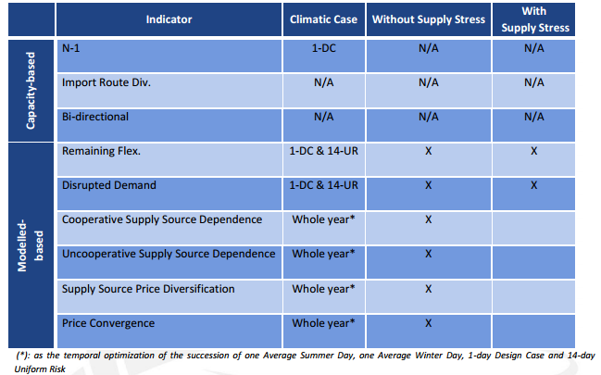
8. PS step (II)
Stage 4: Quantitative analysis (cont.)
  List of indicators to be calculated for each Global context and Gas demand scenario
  The numerical value of each indicator and the incremental value as the difference between the values with and without the project shall be reported

Slide 41
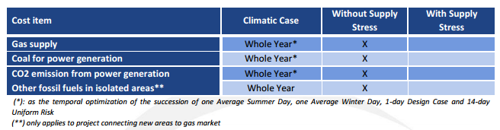
8. PS step (III)
Stage 5: Calculation of saved-costs
Stage 6: Net social welfare per country
  Social welfare induced by the project in the country
  CAPEX and OPEX of the project spent in the country
Stage 7: Economic performance indicators
  Economic net present value
  Economic internal rate of return
  Economic Benefit/Cost ratio
Monetary analysis

Slide 42
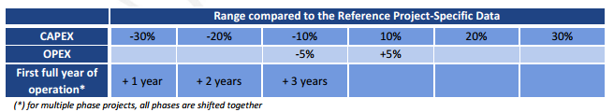
8. PS step (IV)
Stage 8: Sensitivity analysis
Stage 9: Qualitative analysis
  The qualitative analysis is the last part of the combined approach. The Promoter shall:
    Comment the results of the Quantitative and Monetary Analyses
    Monetization of demand disruption
    Describe additional benefits that would not have been sufficiently captured
    Identify the significantly impacted country as part of the Area of Analysis
    Identify the environmental impact of the project and associated mitigation measures
    Describe the complementarity of his Project with other projects

Slide 43
Thank you for your attention!

