Slide 1


Slide 2
Self-evaluation template for GTM
Alessandro Ischia, E-Control

Slide 3
Process of implementing the GTM
Self-evaluation by NRAs
  A technical assessment - to be performed in each Member State - of the market situation based on the indicative criteria (metrics)
  GTM invites regulators to perform such analysis on a regular basis – at least once every 3 years – with the involvement of relevant national authorities and stakeholders
  Key question to be answered: Can it be expected that the natural evolution of the market will lead to meeting the criteria by 2017?
GTM metrics: Informing the ‘Evaluation’
Market Participant Needs
Order book volume
Bid offer spread
Order book price sensitivity
Number of trades
Market Health – Competition, Security of Supply
Herfindahl-Hirshmann Index
Different supply sources
Residual Supply Index
Market concentration for bid and offer activities
Market concentration for trading activities

Slide 4
Self-evaluation process
Analysis
Periodic analyses by National Regulatory Authorities (NRAs) of market development
Assess-ment
Criteria not met: NRAs assess whether natural evolution is sufficient to meet criteria within 3-year period or more active intervention is required (incl. Network Code implementation)
Plan
Where more active intervention required: NRAs propose – based on assessment – a plan to achieve target criteria (with Member States and stakeholder involvement, consultation, Cost Benefit Analysis-CBA )
Market integration tools
Where market integration is considered the preferred option: GTM market integration tools (detailed CBA)
Surrogate measures
Where none of these market integration options deliver a positive CBA: NRAs to propose equivalent surrogate measures
Periodic analysis also to review achievements against commitments and proposals

Slide 5

GTM implementation – MMR
ACER will include the metric calculation results (biannually) for each market in the Market Monitoring Report (MMR) as soon as (REMIT) data is available
  October 2015: market places data
  April 2016: OTC data
  Probably first covered in MMR 2016
  (published 2017)
NRAs to carry out self-evaluation on the basis
of the MMR
ACER to summarize and evaluate the results
of the self-evaluation and the proposed measures

Slide 6
GTM implementation – template
ACER supports the GTM implementation and has developed a template to facilitate NRAs’ self-evaluation work
Self-evaluation in two phases
  Phase 1:
    Assessment of the current state of wholesale market functioning based on GTM metrics
    Identification and description of the key drivers towards improved wholesale market functioning
    Expected state of wholesale market functioning in 2017
    Consultation
  Phase 2:
    Identification and description of potential structural market reforms
    Consultation
Key success factors
  NRAs’ commitment to carry out the self evaluation
  NRAs’ commitment to pursue measures to improve wholesale market functioning based on GTM metrics (MMR will show NRA’s performance over time)

Slide 7
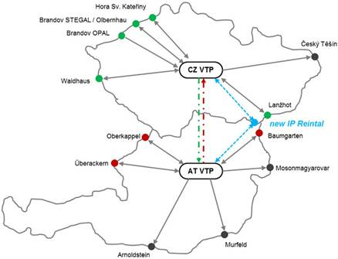
Czech-Austrian market integration
Objective: close integration of Czech and Austrian gas markets
  Market survey
  in Q2 2015
  indicated
  preference for
  market integration
  as compared to a
  classical market
  connection (i.e. new IP)
7

Slide 8
Czech-Austrian market integration
Joint working group between the involved NRAs (ERÚ and E-Control) and the TSOs (Net4Gas, GCA and TAG)
  Various market integration models have been developed and analysed
    Market connection via new IP Reintal
    Trading Zone with separate VTPs
    Trading Zone with common VTP
    Trading Region
  Model selection is ongoing
  Model implementation will include a consultation and feedback from market participants will be crucial
8

Slide 9
Contact
Alessandro Ischia
 + 43 1 24 7 24 810
 alessandro.ischia@e-control.at
☒ www.e-control.at

