Slide 1
Enagás, GRTgaz, Reganosa, REN and TIGF
37th IG meeting
31st May 2016

Slide 2
Interoperability NC.
Latest developments and next steps in the Region

Slide 3
Status of the implementation
Latest developments (i)
The Interoperability Network Code came into force on 1 May 2016
Article 13 and Article 14. Harmonization of reference conditions.
  Enagás has submitted to CNMC the analysis of the implementation of this point by 24/04/2016.
Article 16. Short term monitoring on gas quality
  ENAGAS: http://www.enagas.es/enagas/es/Transporte_de_gas/Medicion_y_calidad_de_gas/Publicacion_de_Calidad_de_Gas_Horaria
  GRTgaz: http://www.smart.grtgaz.com/en/flux_physiques_horaires/PIR?startDate=2016-05-24&endDate=2016-05-25&range=daily
  REN: https://www.ign.ren.pt/monitorizacao-horaria-qualidade
  TIGF:https://tetra.tigf.fr/SBT/public/QualiteGazFiltree.do

Slide 4
Status of the implementation
Latest developments (ii)
Article 17. Information provision on short-term gas quality variation
  Enagás submitted to CNMC the selection of the parties that receive information on gas quality variation by 25/04/2016.
  GRTgaz proposes a service called QUALiPgaz http://www.grtgaz.com/fileadmin/clients/consommateur/documents/fr/QUALiPgaz_05122012.pdf
  REN is evaluating the list of target parties and the corresponding level of IT developments needed to comply with this provision.
  TIGF is just finalizing the list of clients and adjacent operators to be informed.
Chapter V: Data exchange
  The current data exchange between TSOs and between TSOs and Network users is compliant with what is established in Article 21: “Common data exchange solutions”

Slide 5
Status of the implementation
Interconnection agreements. Status minimum mandatory content
At this moment, Enagás & REN and Enagás & TIGF are working on two new documents for the Interconnection Agreements, which are subject to the provisions of EU Regulation 2015/703.
Despite this, the minimum levels set in Interoperability, mostly, are being met in practice at the interconnection points between France & Spain and Spain & Portugal:
  Article 3 of the Regulation EU 2015/703 (NC INT):
  “Adjacent transmission system operators shall ensure that at least the following terms and conditions (…) are covered by an interconnection agreement in respect of each interconnection point:
  rules for flow control;
  measurement principles for gas quantities and quality;
  rules for the matching process;
  rules for the allocation of gas quantities;
  communication procedures in case of exceptional events;
  settlement of disputes arising from interconnection agreements;
  amendment process for the interconnection agreement.”

Slide 6

Status of the implementation
Interconnection agreements. Status minimum mandatory content
Interconnection Agreements for IPs between Francia and Spain
Currently Agreements:
    OPERATING MANUAL: INTERCONNECTION POINTS BETWEEN TIGF NETWORK AND SPANISH GAS SYSTEM. Final Version: 30/10/2010. Includes several Exhibits:
          Exhibit A: Electronic mail (e-mail) addresses and telephones numbers
          Exhibit B: Technical Assistance Joint Agreement in case of exceptional operating situations
          Exhibit C: Specifications of gas quality fixed by Spanish regulations
          Exhibit D: Specifications of gas quality fixed by TIGF
    OPERATING ADDENDUM 1. Final Version: 02/06/2014. Where there was introduced de VIP PIRINEOS interconnection point.
    MEASUREMENT PROTOCOL INTERCONNECTION POINT: I.P. FRANCE G02. Final Versión : 17/07/2015
These documents include the scopes in Article 3 of the EU Regulation 703/2015

Slide 7

Status of the implementation
Interconnection agreements. Status minimum mandatory content
Interconnection Agreements for IPs between Portugal and Spain
Currently Agreements:
    OPERATING MANUAL: “GESTIÓN TÉCNICA CONJUNTA DE LAS CONEXIONES INTERNACIONALES IP 39 e IP 40” Final Version: 17/06/2009.
    OPERATING FIRST ADMENDMENT TO THE “GESTIÓN TÉCNICA CONJUNTA DE LAS CONEXIONES INTERNACIONALES IP 39 e IP 40” Final Version: 01/09/2011. Where there was introduced the VIP IBERICO interconnection point.
    TECHNICAL ASSISTANT AGREEMENT between REN and ENAGÁS in case of exceptional operating situations. Final Version: 30/06/2011.
These documents include the scopes in Article 3 of the EU Regulation 703/2015

Slide 8
Balancing NC.
Status of the implementation

Slide 9
Status of the implementation
Latest developments
The edited version of ENTSOG Monitoring Report on Implementation of BAL NC has been sent to General Assembly for approval and publication.
This is the first monitoring report after the entrance into force of the BAL NC on 1 October 2015.
At national level,
  On the Spanish side, implementation is still on going.
    It will be implemented by 1 October 2016
    Currently, there are some documents under consultation: guarantees and the standard contract
  On the Portuguese side:
    REN is working on the development of the necessary rules and procedures to appear in the accompanying regulatory documents before 1 October 2016

Slide 10
VI. Proposals for the new SGRI Working Plan

Slide 11
SGRI Work Plan
To be added
Infrastructures:
  Follow up of South GRIP

Slide 12
VII. Infrastructures

Slide 13
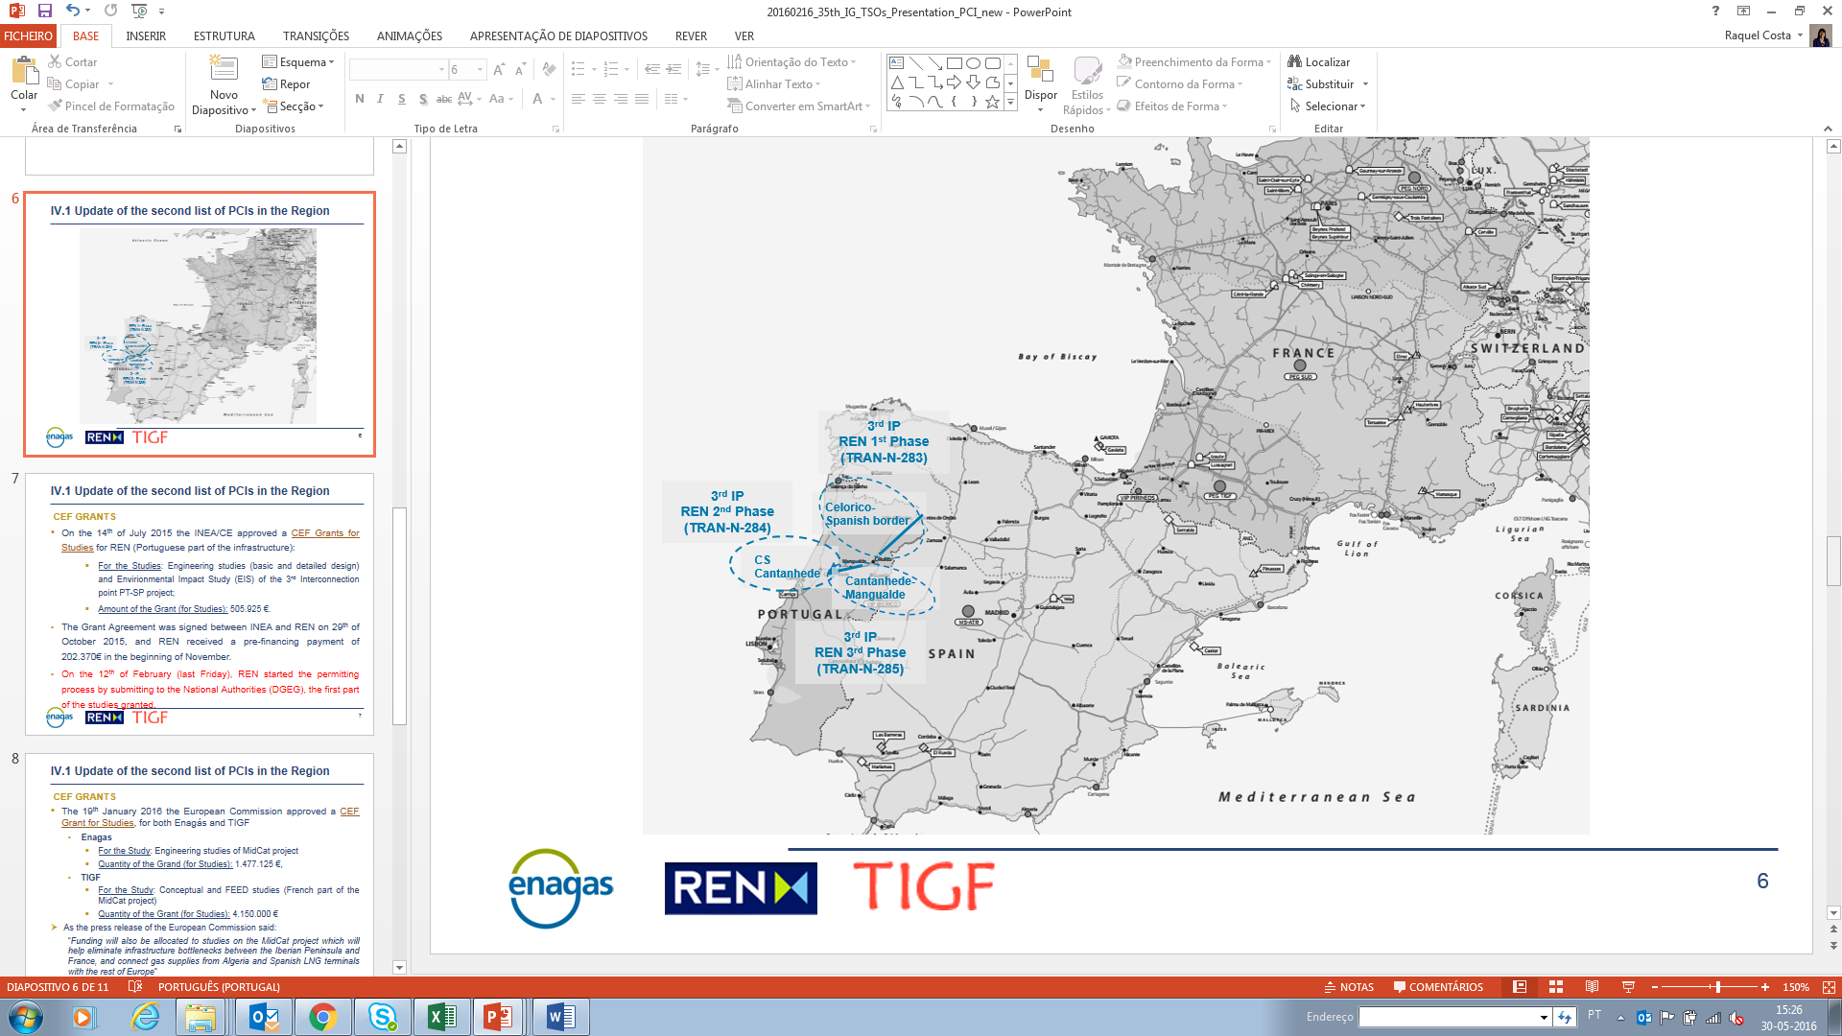
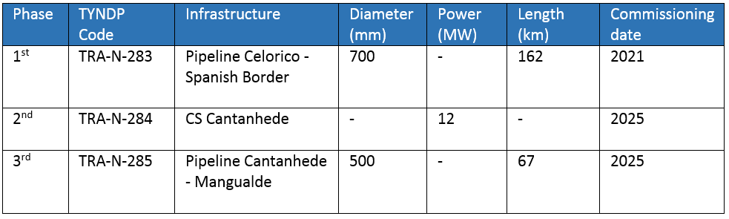
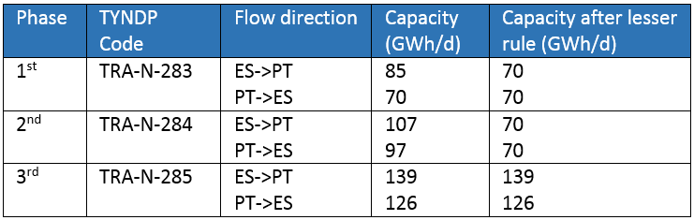
TYNDP 2017: REN, 3rd IP PT-ES

Slide 14
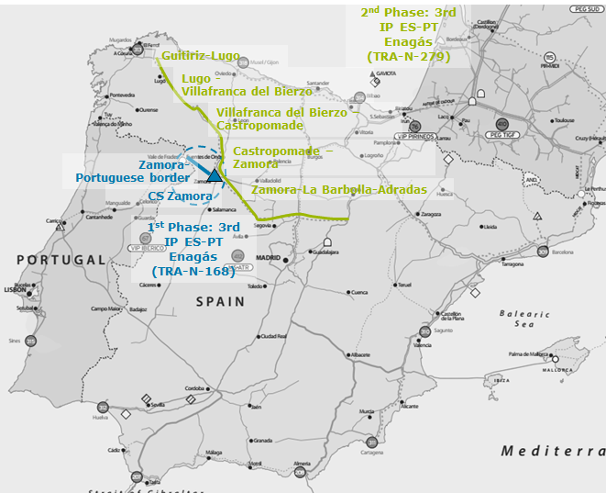
TYNDP 2017: Enagas, 3rd IP

Slide 15
TYNDP 2017: Enagas, MidCat

Slide 16
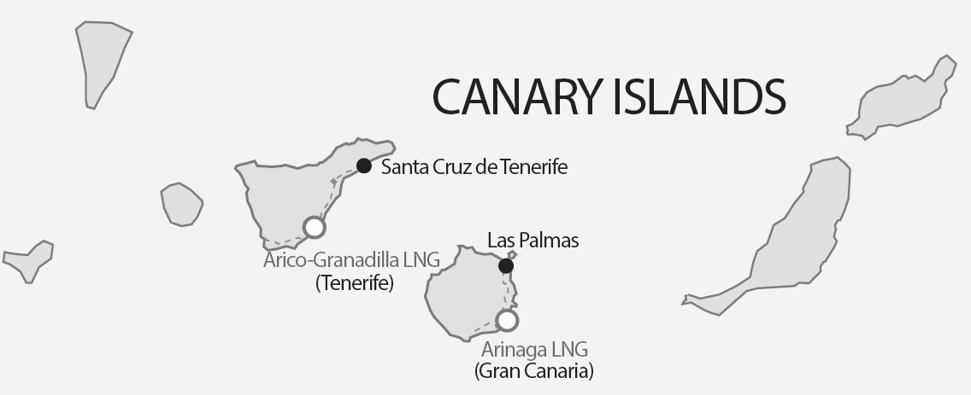
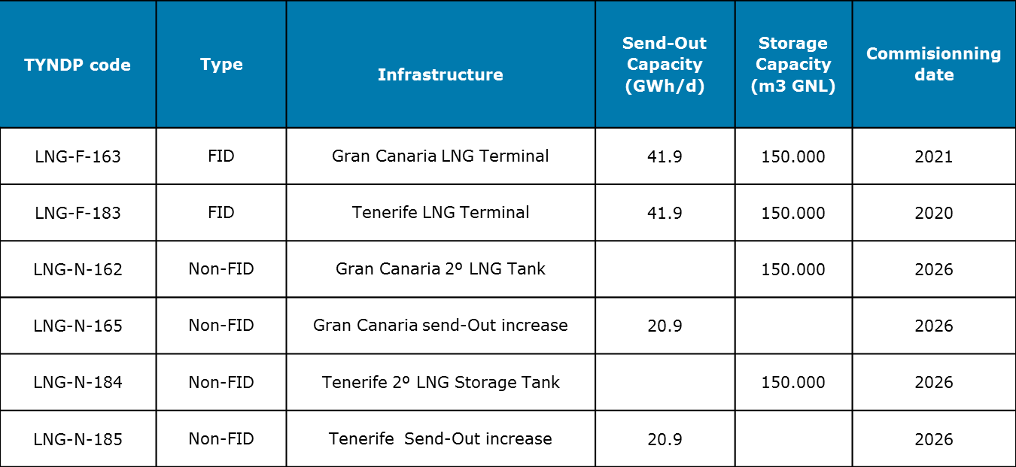
TYNDP 2017: Enagas, Canary Islands – LNG Terminals

Slide 17
TYNDP 2017: GRTgaz
TYNDP code | Status | Project | Commissioning
TRA-F-391 | FID | Gascogne-Midi : adaptation of stations in Cruzy and St Martin | 2018
TRA-F-43 | FID | Val de Saône project | 2018
TRA-F-45 | FID | Reverse capacity from CH to FR at Oltingue | 2018
TRA-N-047 | Non-FID | Reverse capacity from France to Germany at Obergailbach | 2022
TRA-N-256 | Non-FID | Iberian-French corridor: Eastern Axis-Midcat Project* | 2024
TRA-N-258 | Non-FID | Developments for Montoir LNG terminal 2.5 bcm expansion | 2022
TRA-N-269 | Non-FID | Developments for Fosmax (Cavaou) LNG 8.25 bcm expansion | 2022
TRA-N-429 | Non-FID | Adaptation L- gas - H-gas
(*): 230 GWh/d from Spain to France and 160 GWh/d from France to Spain (joint TIGF & GRTgaz project)

Slide 18
TYNDP 2017: TIGF
TYNDP code | Status | Project | Commissioning
TRA-F-331 | FID | Gascogne Midi | 2018
TRA-F-251 | FID | Artère de l’Adour | 2015
TRA-N-252 | Non-FID | New interconnection between France and Spain (First Step Midcat) | 2022

Slide 19


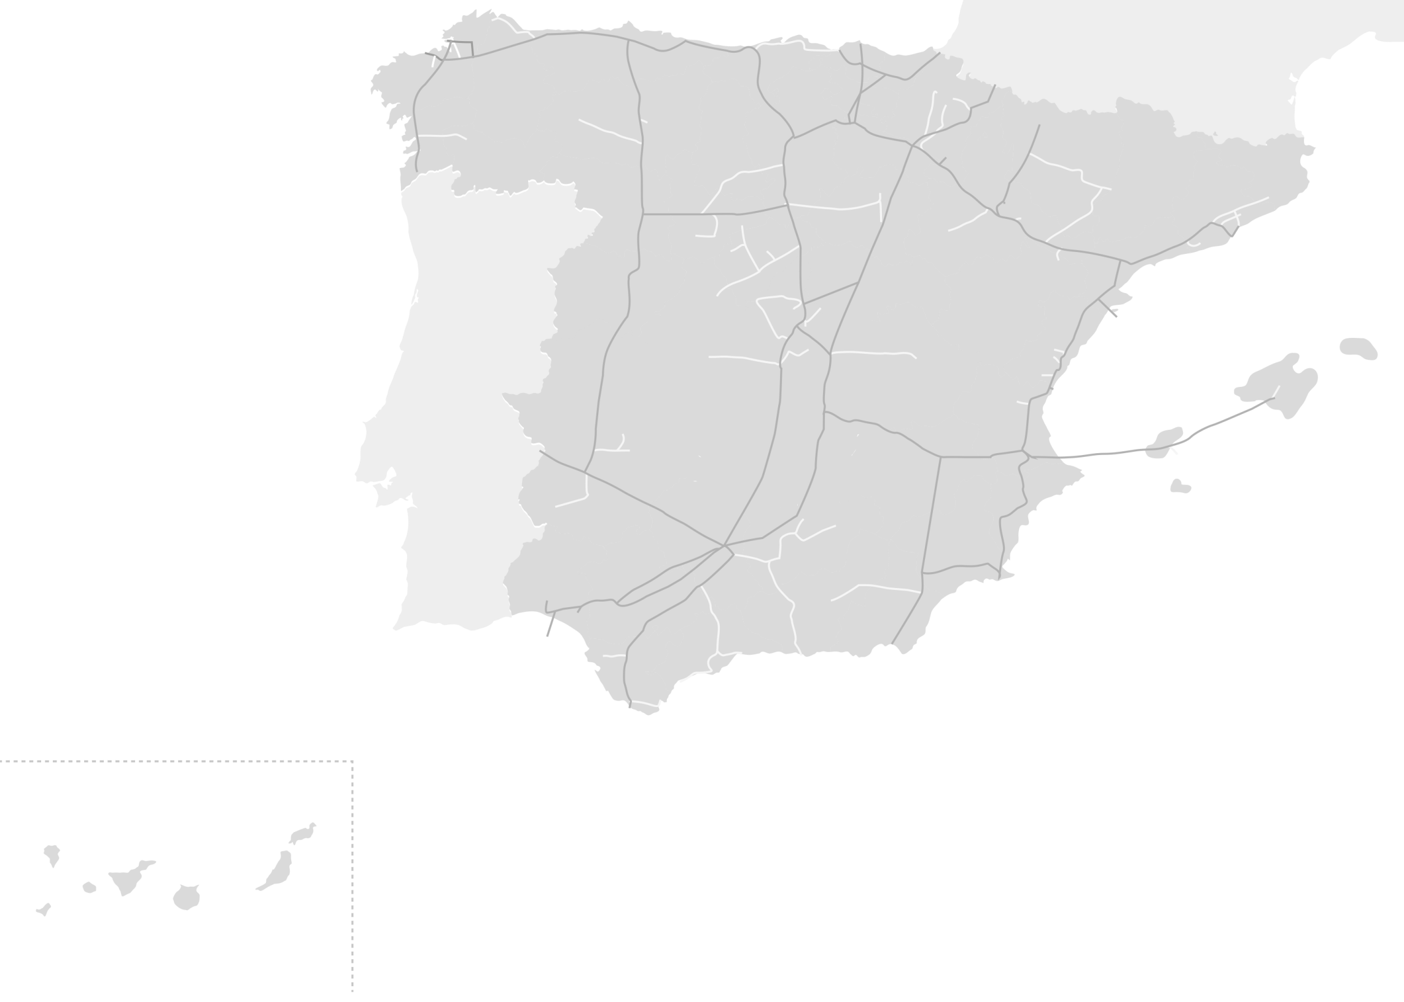









TYNDP 2017: Reganosa
Mugardos
Bilbao
Irún
Third Tank (2023)
Second Jetty (2021)
Gas Pipeline Guitiriz-Zamora (2020)
Additional Vaporizer (2024)
Guitiriz-Zamora
Gaviota
Larrau
Serralbo
Tui
Yela
Barcelona
Badajoz
Sagunto
Marismas
Cartagena
Almería
Huelva
Tarifa
Poseidón

Slide 20
South GRIP
Latest Developments
Chapters of the South GRIP
  Introduction
  General Context
  Supply
  Infrastructure projects
  Assessment of the gas system
  Projects answering needs in the South Region
  Conclusion
  Legal Disclaimer
  Glossary
Each TSO has taken the responsibility of the development of at least one chapter.
Periodical TELCOs have been arranged every 2 weeks.
Publication is expected by the end of 2016.

Slide 21
Thank you for your attention!

