Slide 1
Enagás, GRTgaz, Reganosa, REN and TIGF
40th IG meeting
29th November 2016

Slide 2
Interoperability NC.

Slide 3
IAs Public Consultations results
VIP PIRINEOS
Public consultation jointly launched by TIGF and Enagás
Launched on 15th September 2016
Deadline: 15th November 2016
Comments received from 3 companies.
Clarification and inclusion of terms in the glossary – following the “Guide for Interconnection Agreements” from ENTSOG
Times to be defined as am/pm for the sake of accuracy
Inclusion of Local Products for balancing services in the IPs
Exceptional event situation: Inclusion of gas excess and gas shortage as exceptional events.
Exceptional event situation: Inclusion of back-up procedures in case of failure of IT systems.
Exceptional event situation: Inclusion of the impact on their Imbalance penalties
Publication of the whole Interconnection Agreement
The flow control (Split) is subject to public consultation,
The OBA limits associated with regasification plants are higher than those associated with Interconnections by pipeline

Slide 4
IAs Public Consultations results
VIP IBERICO
Public consultation jointly launched by REN and Enagás
Launched on 26th September 2016
Deadline: 26th November
Comments received from 1 company.
Clarification and inclusion of terms in the glossary – following the “Guide for Interconnection Agreements” from ENTSOG
Inclusion of Local Products for balancing services in the IPs
Exceptional event situation: Inclusion of gas excess and gas shortage as exceptional events.

Slide 5
III. Balancing NC
First insight of the BAL NC implementation

Slide 6
First insight of the BAL NC implementation
Implemented by 1st October 2016
Enagás GTS takes the necessary balancing actions to maintain the transmission network within its operational limits
All relevant information is published:
The Network Imbalance Index (IDQ), hourly updated
Network’s Estimated Aggregated Imbalance (DQA)
Daily Projected Closing Imbalance (DBP)
Information about the Technical Manager of the Gas System balancing actions
Announcements of the needs to make PVB market offers in the organized market
Information obligations (daily and intraday demand forecast of natural gas in the transmission network for “d” and “d+1”, …)
Reference Price for Imbalances
MIBGAS published on 26 Oct 2016 an announcement for the selection process of Market Makers for MIBGAS for the first semester of 2017, for Spot products (Within-day and Day Ahead) and Prompt (Balance of Month and Month Ahead)

Slide 7
First insight of the BAL NC implementation
PORTUGAL
Implemented by 1st October 2016
REN maintains the transmission network within operational limits by use of Operational Gas
All relevant information for Network Users is made available on-line:
Demand information
Non-Daily Metered Forecast data
Intraday Metered data actualization updated 3 times
Initial Daily Imbalance and Reference Prices every D+1
Final Daily Imbalance at the end of the month
Key findings from October prove:
quick behavior adaptation by all stakeholders
acceptable usage of Operational Gas: 15,3 GWh accumulated by the end of month (21,3 máx on 20/Oct)

Slide 8
Infrastructures:
new GRIP, TYNDP and PCIs

Slide 9
Infrastructures: new GRIP, TYNDP and PCIs
New South GRIP
TSOs are working in all the chapters of the South GRIP
Regular conference calls have taken place and also a physical meeting on 27 September 2016, in Madrid.
Another physical meeting is scheduled on 14 December 2016, in Brussels, just after the meetings of the Regional Group (12 December) and of ENTSOG Investment Working Group (13 December).

Slide 10
Infrastructures: new GRIP, TYNDP and PCIs
TYNDP 2017
Publication is expected by the end of 2016
The public consultation is scheduled for the 1st quarter 2017
For the first time, ENTSOG has published a map with all the infrastructures included in TYNDP 2017.
ENTSOG has already published some sections of TYNDP 2007:
Demand
Scenarios
Production and Supply Potentials
Power generation assumptions
Capacities
Infrastructure projects
Project details
Country Specifics
Gas Quality Reference Values

Slide 11
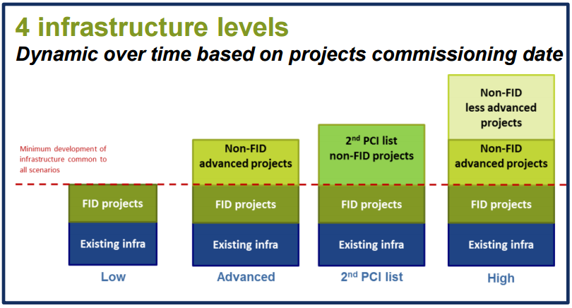
Infrastructures: new GRIP, TYNDP and PCIs
TYNDP 2017
ENTSOG has presented the preliminary results of TYNDP 2017 in a open webinar on 18 October 2016
Only the results of the low Infrastructure (FID projects) level were presented
ENTSOG will run the simulations for the PS-CBA in the 1st quarter 2017. The project promoters are now working in the grouping of the projects for these simulations.

Slide 12
Infrastructures: new GRIP, TYNDP and PCIs
PCI 2017
The preliminary TYNDP 2017 results (low infrastructure level) were presented in the meetings of the NSI West Gas (7 November 2016), as part of 3rd PCI selection process. Next meeting of the Gas Cross Regional Groups will take place on 12 December 2016.
The TYNDP 2017 preliminary results are being used for the identification of problems and needs of each of the Corridors. The needs and the problems of the “NSI West Gas Corridor ” are still under discussion

Slide 13
Thank you for your attention!

