Slide 2
Market integration in the CEE countries
Czech – Austrian trading region
GRI SEE
08 July 2016, Budapest
Notes:
RO-HU-AT - a pilot project for incremental capacity
How to develop functioning markets?
Infrastructure needs and initiatives for Europe
RO-HU-AT - a key project for Central and South-East Europe

Slide 3
Market integration
First integration idea in the
CEE countries in 2011-
CEETR Project
CZ - AT market integration

Slide 4
Czech-Austrian market integration
Joint working group between the involved NRAs (ERÚ and E-Control) and the TSOs (Net4Gas, GCA and TAG) established in 2014
Various market integration models have been analyzed
Market connection via new IP Reintal
Trading Zone with separate VTPs
Trading Zone with common VTP
Trading Region
4

Slide 5
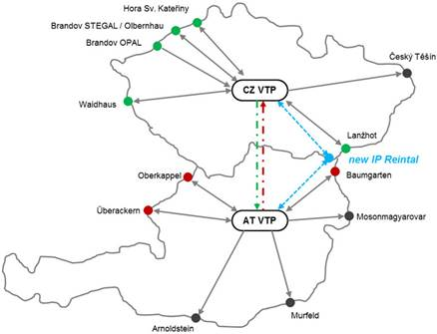
Czech-Austrian market integration
Objective: close integration of Czech and Austrian gas markets
Market survey in Q2 2015 indicated preference for market integration as compared to a classical market connection (i.e. new IP)
5

Slide 6
Envisaged model
Source: N4G
Lanžhot
Český Těšín
Baumgarten
Mosonmagyarovar
Hať IP (STORK II)
Czech Republic
Republic of Austria
South Stream IP
Ind. Production
Ind. Production
Brandov (STEGAL)
Murfeld
Olbernhau/HSK
Common VTP
Brandov (OPAL)
Arnoldstein
Balancing
N4G
GCA
Gas Exchange
PXE (futures) / OTE (SPOT)
CEGH (both)
Überackern
Waidhaus
AT-CZ Trading Region
Oberkappel
TSOs level
DSOs level
VBP_{CZ}
VBP_{AT}
Balancing
OTE
Balancing
AGCS
End-user Zone CZ
End-user Zone AT

Slide 7
What to do?
TRU
Insufficient interconnection capacity does not allow for a market integration ?

Slide 8
What to do?
Trading region upgrade (TRU)
solution to better connect CZ and AT markets
TRU

Slide 9
Trading Region Upgrade (TRU)

Slide 10
Trading region upgrade
VTP CZ
VTP AT

Slide 11
Trading region upgrade
VTP CZ
VTP AT

Slide 12
Trading region upgrade
VTP CZ
VTP AT

Slide 13
Spread AT-CZ and capacity costs on yearly basis
Transportation costs
Transportation costs
Source: Wagner Elbling & Comp.

Slide 14
Spread AT-CZ and capacity costs on day-ahead basis
Transportation costs
Transportation costs
Source: Wagner Elbling & Comp.

Slide 15
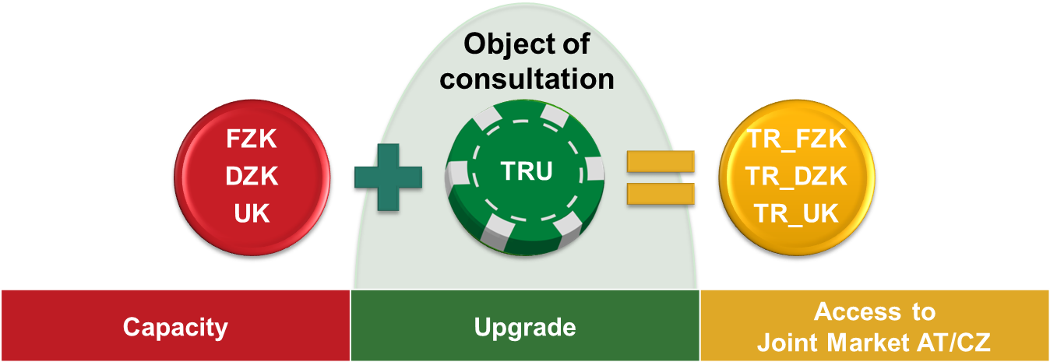
Consultation revealed interest
Consultation on TRU took place in April 2016
The survey showed general support but triggered several questions
Next steps
Answering questions raised (July 2016) - FAQ
Stakeholder event after the summer

Slide 16
Sample of answers to questions
Does TRU fall under the regulations defined in the “CMP Annex”?
(can it be surrendered, will mechanisms such as DA UIOLI, LT UIOLI etc. apply?)
NO, the current design of TRU Option does not foresee the application of CMP Measures.

Slide 17
Sample of answers to questions
What will be the contract duration (daily,..) of TRU at the SCPs? Product runtimes of TRU are missing.
It is planned to start the selling of TRU Option with a contractual validity of up to one year (pilot phase). Depending on the market demand shorter durations (e.g. quarters, months and days) are imaginable.
Regardless of the validity duration, TRU Option can be attached to daily, monthly, quarterly and yearly Entry capacity rights.

Slide 18
Sample of answers to questions
It is unclear who exactly will offer TRU?
GCA and N4G will offer TRU Option to be attached to capacity at the Entry Points of each market area.

Slide 19
Sample of answers to questions
Can TRU also be used in combination with TAG capacity (since TAG is not mentioned in the document)?
For the time being TAG GmbH does not plan to offer the TRU Option. However, the TRU Option can also be used in connection with TAG GmbH Entry Capacities.

Slide 20
Sample of answers to questions
The document lacks a clarification as to which capacity rights enable to purchase and use TRU.
Is a primary transportation contract needed, or is it sufficient to have capacity allocated at an entry point? (for instance usage rights purchased on the secondary market)
For the right to book TRU Option no capacity rights are necessary.
For the usage of TRU Option it is sufficient that entry capacity rights are allocated to a balance group no matter if capacity has been booked on primary or secondary markets.

Slide 21
Sample of answers to questions
The document does not at all specify whether TRU is a bi-directional (AT<->CZ) option, or whether two uni-directional options (AT->CZ + CZ->AT) can be purchased.
In other words: Is it intended to sell two products, one to access the Austrian VTP via Czech Republic (“TRU AT”) and one to access the Czech VTP (“TRU CZ”) via Austria (consequently two TRU coins are offered), or is it intended to sell only one TRU coin to access the respective other country?
It is planned to offer TRU Option for unidirectional use, in Austria by GCA for the use together with Austrian entry capacities and in the Czech Republic by N4G for Czech entry capacities.

Slide 22
Sample of answers to questions
How much capacity will be offered as TRU? What will be the price of TRU (for each direction)?
TSOs are just discussing about the possible capacity offer, so we cannot give an answer to this question at this point in time. As for any other auction on PRISMA, the amount on offer as well as the applicable reserve price will be published well ahead of the auction, in line with current publication lead times.
E-Control is not able to give a binding information for the tariff that is applicable in Austria as from 1 October 2017 (expected start of TRU). On 1 January 2017 a new regulatory period will start in Austria and tariffs for that period will be published in Q4 2016.

Slide 23
Conclusion
TRU consultation revealed interest
2016 Q3 aswers to FAQ
2016 Q4 stakeholders event
2017 TRU will be offered (?)
Implementation steps to follow

Slide 24
Contact
Alessandro Ischia
 + 43 1 24 7 24 810
 alessandro.ischia@e-control.at
☒ www.e-control.at

