Slide 1
Enagás, GRTgaz, Reganosa, REN and TIGF
24rd SG meeting
8th february 2018

Slide 2
3.1 ii) Draft chapter 3 : Follow-up of the functioning of the balancing schemes since its application

Slide 3
III. FRANCE | TIGF data
    TIGF has set up a balancing statement, recording what it spends and earns under aforementioned transactions and the balancing rules of the transmission contract.
    Since the 1st of october 2015, the balance is allocated to Shippers as a proportion of the quantities delivered, according to the Deliberation of the French Energy Regulatory Commission of 15 January 2015 approving the balancing rules.

Slide 4
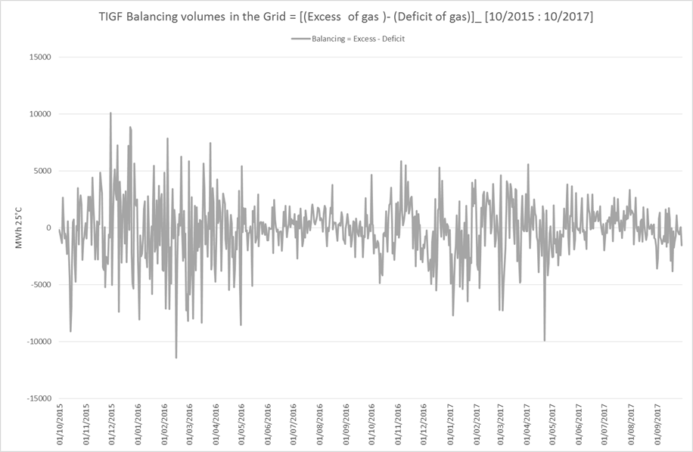
III. FRANCE | TIGF balancing volumes
A positive position on the graph indicates that shippers are long
a negative position indicates that shippers are short

Slide 5
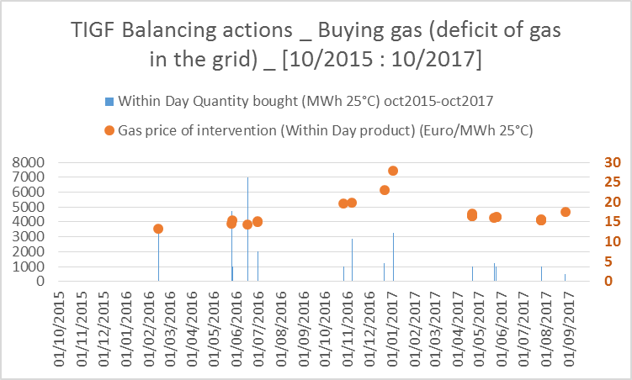
III. FRANCE | TIGF interventions against gas deficit
    Sum up of the 23 buying interventions on PEGAS platform

Slide 6
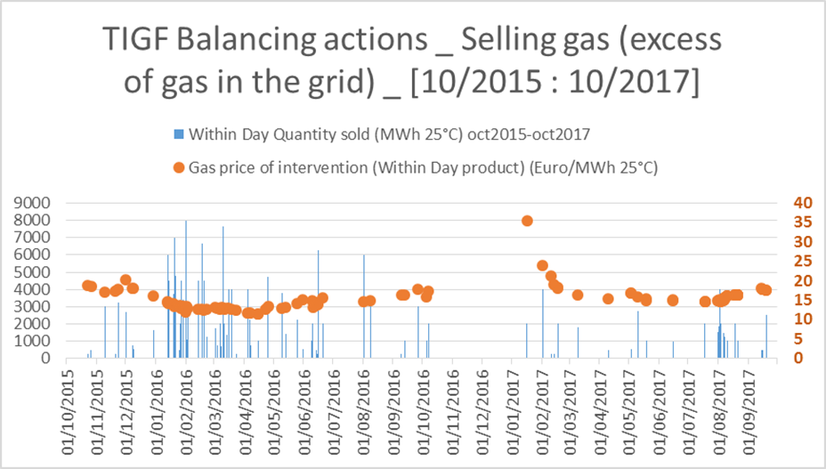
III. FRANCE | TIGF interventions against gas excess
    Sum up of the 116 selling interventions on PEGAS platform

Slide 7
III. FRANCE | GRTgaz

Slide 8
III. SPAIN | ENAGÁS data
    The data collection is almost done and the Spanish Section of the document is currently being completed.

Slide 9
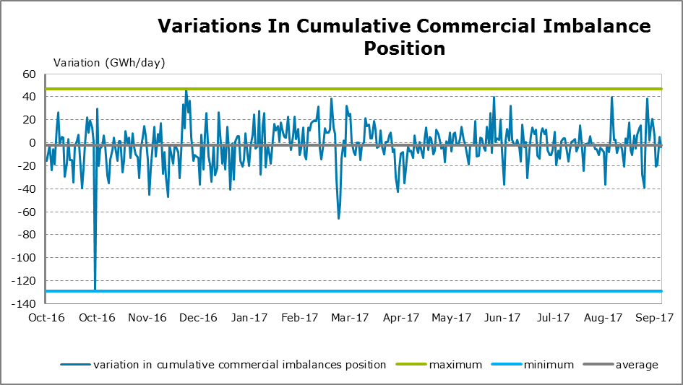
III. SPAIN | ENAGÁS Commercial Imbalance

Slide 10
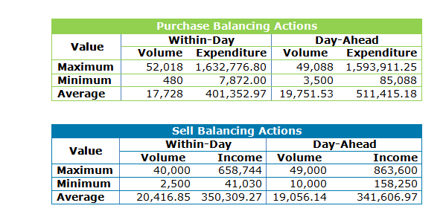
III. SPAIN | ENAGÁS Balancing Actions
    Number of days balancing actions are taken: 80
      Sell balancing actions: 17
      Buy balancing actions: 63

Slide 11
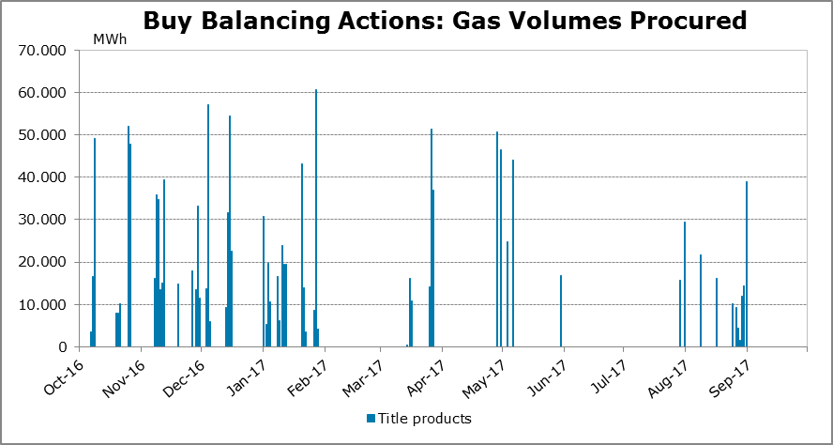
III. SPAIN | ENAGÁS Buy Balancing Actions

Slide 12
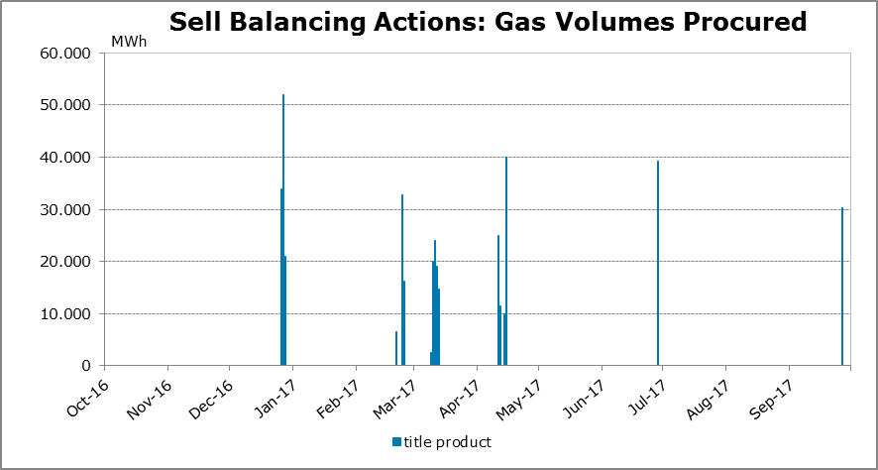
III. SPAIN | ENAGÁS Sell Balancing Actions

Slide 13
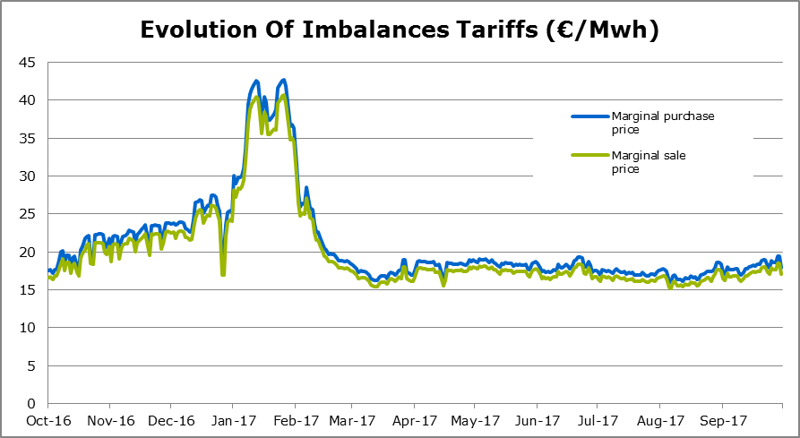
III. SPAIN | ENAGÁS Imbalances Tariffs

Slide 14
III. PORTUGAL | REN data
    NC BAL implementation on 1st October 2016
    All balancing provisions are implemented and processes are being improved
    Balancing actions were taken through balancing services since no trading platform was available for the Portuguese balancing zone.
    The data collection for the draft chapter 3 is almost complete. The Portuguese Section of the document is currently under development.

Slide 15
III. PORTUGAL | REN Commercial Imbalance
Daily maximum Users Long: 05.Aug
+ 4 843 MWh
Daily minimum Users Short: 07.Oct
-12 048 MWh
    System behavior has been improved after initial adaptation.

Slide 16
III. PORTUGAL | REN Balancing System
Total Balancing Actions: buy of 42 000 MWh
31/Oct
20/Apr
08/Jun
28/Apr
23/Jun
05/May
30/Jun
12/May
    A total of 7 balancing actions were taken in order to restore the operational gas.

Slide 17
III. PORTUGAL | REN Balancing Actions
    Number of balancing actions: 7
      Purchase balancing actions: 7
      Sell balancing actions: 0
 | Quantity [MWh] | Auction Price [€] | Expenditure [k€]
20/04 | 6 000 | 19,00 € | 114,00 k€
28/04 | 6 000 | 19,55 € | 117,30 k€
05/05 | 6 000 | 19,57 € | 117,42 k€
12/05 | 6 000 | 19,15 € | 114,90 k€
08/06 | 6 000 | 18,51 € | 111,06 k€
23/06 | 6 000 | 19,15 € | 114,90 k€
30/06 | 6 000 | 18,99 € | 113,94 k€
TOTAL | 42 000 |  | 803,52 k€
    All Balancing Actions trigged were successful.

Slide 18
III. PORTUGAL | REN Imbalance Price
[€/MWh]
min | max
17,99 | 45,67
14,07 | 39,60
    Daily Imbalance Charges were applied considering proxy PMP_{Mibgás} + cross-border tariffs + small adjustment.

Slide 19
III. PORTUGAL | REN VTP Bilateral Trading
Daily average:
13 transactions
Daily average:
7 transactions
    The need to balance NUs portfolios led to an increase of the bilateral transactions.

Slide 20
5. Infrastructures

Slide 21
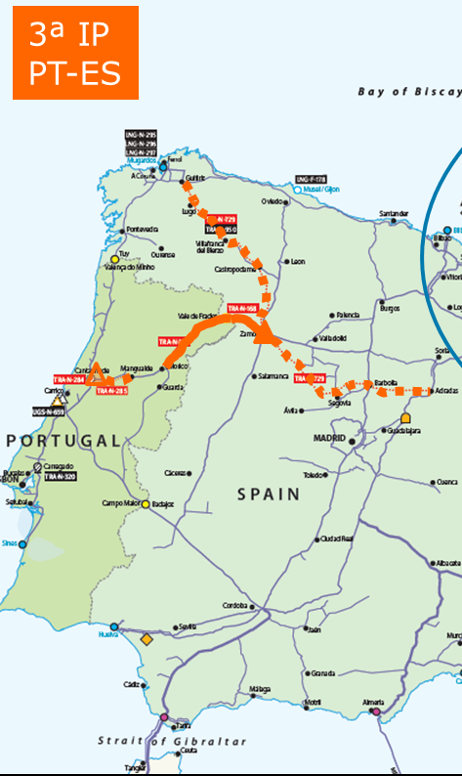
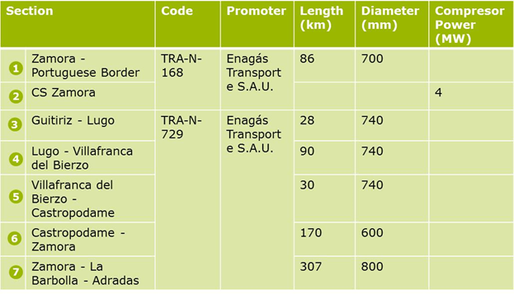
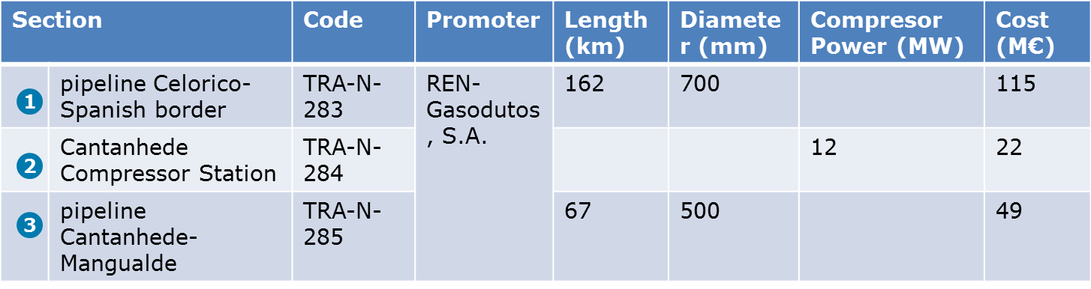
PCIs in the Region
3
4
5
1
6
1
2
2
7
3
The project was included in the 3rd list of PCI from EC (November 2017)¹
1 According with the Delegated Regulation amending Regulation on guidelines for trans-European energy infrastructure (EU) No 347/2013
(November 2017).

Slide 22
PCIs in the Region
3rd Interconnection Point PT-ES
From Portugal Side:
REN received CEF grants, in 2015, to do the studies (basic and detailed) for this project;
Basic studies (cartography and engineering) were done in 2016;
The project is in stand-by because is dependent on the implementation of the STEP project;
The Environmental Impact Study was done and submitted to the National Energy Authority, on February 2016;
REN received by the Competent Environmental Authority, last Tuesday, the Environmental Impact Declaration (EID) with decision unfavorable.

Slide 23
6.1 follow-up on the OSBB functioning

Slide 24
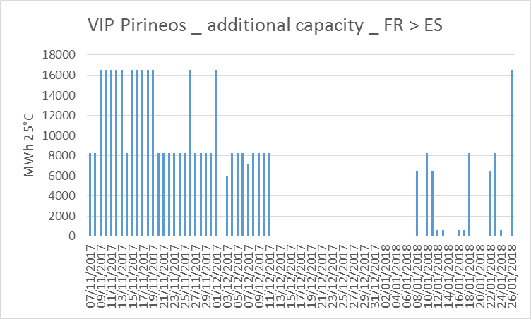
6.1 Additional Capacity proposed at VIP Pirineos
Date of implementation: 6th November 2017.
Days of OS offer: 100
Allocation of OS capacity: No.
IT issue linked to PRISMA upgrade
    Additional capacity proposed on PRISMA but not subscribed

Slide 25
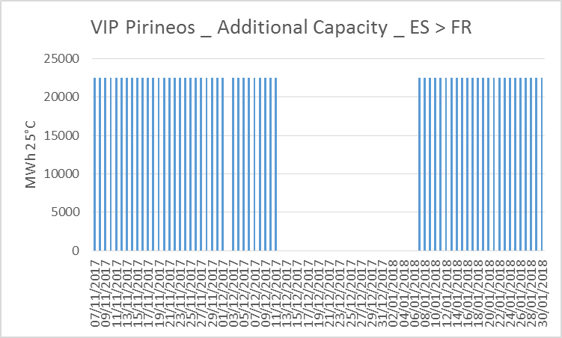
6.1 Additional Capacity proposed at VIP Pirineos
Date of implementation: 6th November 2017.
Days of OS offer: 103
Allocation of OS capacity: No.
IT issue linked to PRISMA upgrade
    Additional capacity proposed on PRISMA but not subscribed

Slide 26
6.1) Additional Capacity proposed at VIP Iberico
VIP IBERICO. Spain to Portugal
Date of implementation: 4th July 2017.
Days of OS offer: 21.
Allocation of OS capacity: No.

Slide 27
6.1) Additional Capacity proposed at VIP Iberico
VIP IBERICO. Portugal to Spain
Date of implementation: 4th July 2017.
Days of OS offer: 104.
Allocation of OS capacity: No.
18th October 2017
No offer of OS
Technical problems

Slide 28






6.2 OSBB at VIPs
Already Implemented since 4th July 2017
Daily calculation OS capacity to offer by each TSO.
Daily matching OS capacity of offer
Daily offer OS capacity at PRISMA Platform
OSBB at
VIP Iberico
Already Implemented since 7th November 2017
Daily calculation OS capacity to offer by each TSO.
Daily matching OS capacity of offer
Daily offer OS capacity at PRISMA Platform
OSBB at
VIP Pirineos
Working on IT Process improvements

Slide 29
Thank you for your attention!

