Slide 1
Enagás, GRTgaz, Reganosa, REN and Teréga
47th IG meeting
28th June 2018

Slide 2
2. WP First target. Use of infrastructures in the Region

Slide 3
2.1. CMP: potential for further coordination

Slide 4
2.1 CMP: Potential for further coordination
NRAs request
VIP PIRINEOS
VIP IBERICO
What would had happened if capacity withdrawn from LT UIOLI would had been offered in the auctions (focus on the auctions that cleared with a premium).
LT UIOLI is not developed in Portugal → analyze historical flows as well as LT bookings.
Point 8 of Spanish regulation (Circular 1/2013):
“TSOs will offer the capacity to be withdrawn in the allocation processes of the next gas year, for the first time in the quarterly products, and then in the monthly products”
LT capacity comes from 3 contracts:
Units: kWh/d 0 ºC
Spain to Portugal direction
Shipper | Starting date | Termination date | Booked capacity
Shipper A | 01/01/15 | 31/12/20 | 89.000.000
Shipper B | 01/10/14 | 31/08/21 | 2.000.000
Shipper B | 01/10/14 | 28/02/22 | 2.000.000
Auctions that cleared with premium since the application of CMP:
Units: kWh/d 0 ºC
France to Spain direction
Product | Time from | Offered | Requested | Allocated
Monthly | 01/01/17 | 19.985.070 | 38.029.347 | 16.089.732
LT capacity is booked through unbundled auctions.
LT bookings and use
LT UIOLI analysis carried out in April 2016:
22 GWh/d underused in April 2015 – March 2016.
If the 22 GWh/d detected as underused would had been offered in the Monthly auction for January 2017, the capacity requested in the first bidding round would had been booked.
Booked VS Technical
2014 | 2015 | 2016 | Oct. 17 - Jun. 18
81% | 85% | 84% | 77%
79% | 79% | 72% | 64%
64% | 68% | 62% | 50%
Used VS Booked
Used VS Technical

Slide 5
2.1 CMP: Potential for further coordination
2018 LT UIOLI analysis
Period of analysis March 2017 – April 2018
VIP PIRINEOS
VIP IBERICO
France to Spain direction:
Capacity underused by 2 network users.
9 GWh/d underused.
Spain to France direction:
Capacity underused by 6 network users.
111,7 GWh/d underused.
Spain to Portugal direction:
LT contracts capacity at Spanish side underused by 1 network user.
Currently not applicable at Portuguese side due to non-existence of Long Term contracts (over one year).
Analysis sent to CNMC

Slide 6
2.1 CMP: Potential for further coordination
2018 LT UIOLI analysis
Period of analysis March 2017 – April 2018
VIP PIRINEOS
Period 1 : 04/2017 to 09/2017 – 6 months
STATUS : congested based on Premium on product [10/2016-09/2017]
1 Expeditor under uses his capacity =< 80%
Period 2 : 10/2017 to 03/2018 – 6 months
STATUS : non congested based on product [10/2017-09/2018]
1 Expeditor under uses his capacity =< 80%
CONCLUSION = conditions not met for triggering of UIOLI LT.
Analysis sent to the CRE

Slide 7
6. WP Fifth target. Pending issues

Slide 8
6.1 Follow-up on the OSBB functioning

Slide 9
6.1 Follow-up on the OSBB functioning: statistics
VIP PIRINEOS: [07/11/2017 to 26/06/2018]
Days since implementation = 231
 | France to Spain |  | Spain to France
 | (days) | % | (days) | %
OS offered | 68 | 29% | 132 | 57%
not offered : IT issue (Teréga) | 27 | 12% | 27 | 12%
not offered : [Nomination] above trigger value | 72 | 31% | 8 | 3%
not offered : Planned reduction | 64 | 28% | 64 | 28%
Maintenance period :
09/04/2018 -> 18/05/2018 + 28/05 to 22/06/2018
for FR > ESP direction : No OS sold
For ESP > FR direction : On day 02/03/2018, all OS sold = 22,5 GWh
Additional capacity proposed on PRISMA but not subscribed

Slide 10
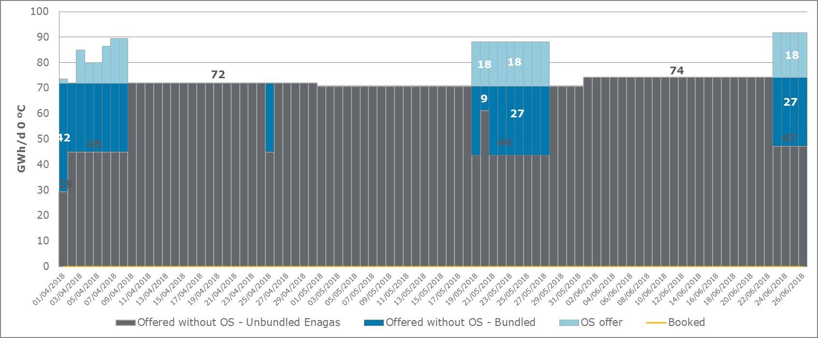
6.1 Follow-up on the OSBB functioning
VIP PIRINEOS: FR - ES
Bundled offer – without OS
Unbundled offer – Enagas
Daily auctions
OS offer
No allocation of capacity
Allocation of OS capacity: No.
Additional capacity proposed on PRISMA but not subscribed

Slide 11
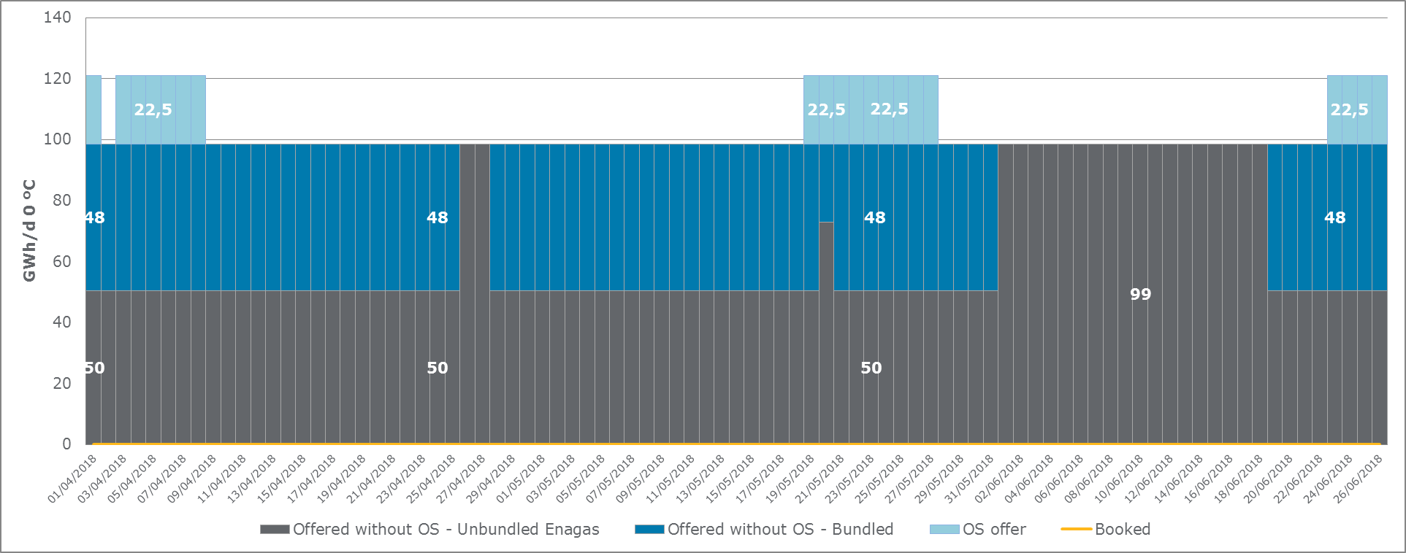
6.1 Follow-up on the OSBB functioning
VIP PIRINEOS: ES - FR
Bundled offer – without OS
Unbundled offer – Enagas
Daily auctions
OS offer
No allocation of capacity
No Allocation of OS capacity

Slide 12
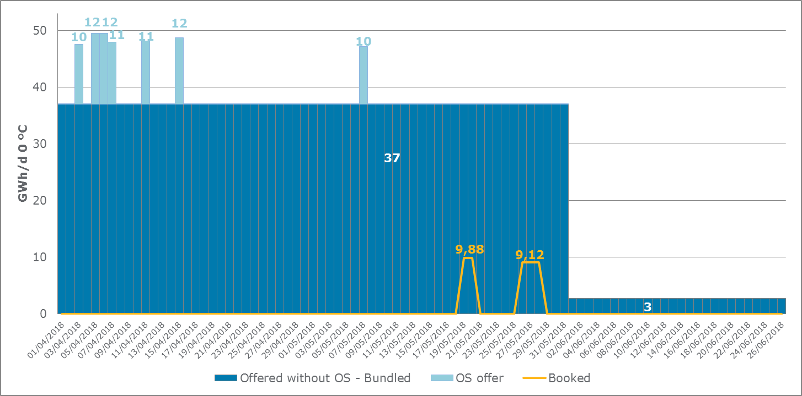
6.1 Follow-up on the OSBB functioning
VIP IBERICO. Spain to Portugal
37 GWh/d
Bundled offer – without OS
Daily auctions in April and May 2018
3 GWh/d
Bundled offer – without OS
Daily auctions in June 2018
OS offer
≈ 9,8 GWh/d booked in 5 auctions.
No allocation of OS capacity.

Slide 13
Thank you for your attention!

