Slide 1
Enagás, REN and Teréga
49th IG meeting
4th February 2019

Slide 2
2.1. Proposals on secondary market

Slide 3
2.1 Proposals on secondary market
Current Situation
Enagas developed in 2015 the secondary market for transferring capacity in PRISMA platform for yearly, quarterly and monthly product.
 | Product | Original Contract | New product resulting from the transaction
Transfer of Capacity | Yearly |  | Y, Q, M, D
 | Quarterly |  | Q, M, D
 | Monthly |  | M, D
 | Daily |  | D
 | Within day |  | -
Transfer of Use | Yearly |  | Y, Q, M, D
 | Quarterly |  | Q, M, D
 | Monthly |  | M, D
 | Daily |  | D
 | Within day |  | -
Next steps
Enagas is currently developing the daily product for the transfer of capacity and the transfer of use for yearly, quarterly, monthly and daily product.
Question: Should we develop a joint method to offer bundled transfer of use?

Slide 4
3.2. Capacity auctions at VIPs: calculation of capacity to be offered for the next gas years

Slide 5
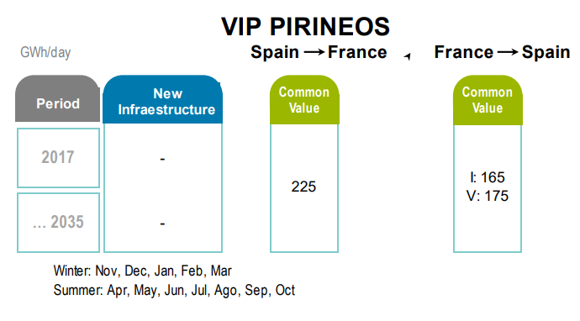
3.2 Capacity auctions at VIPs Calculation of capacity to be offered for the next gas years
VIP PIRINEOS
VIP IBERICO
No changes to current long-term capacities at VIP PIRINEOS.
In response to the Iberian NRAs request, TSOs are working on the technical analysis of the capacity to be offered in the coming years at VIP IBERICO.
The document analyzes the past behavior of the VIP, flows configurations at both physical points, as well as different tools and mechanisms to maximize capacity.
The foreseeable implementation of a new model of access to the regasification plants in Spain has been considered.
The document will be sent to NRAs at the end of March.

Slide 6
3.4. Capacity offered at VIP Pirineos

Slide 7
3.4 Capacity offered at VIP Pirineos
Current Situation

Slide 8
3.4 Capacity offered at VIP Pirineos
Current Situation

Slide 9
Thank you for your attention!

