Slide 1
52st IG meeting
22th November 2019

Slide 2
2.1. Follow-up of infrastructures developments

Slide 3
2.1 TYNDP 2020 & 4th PCI list 2019
Public consultation
High Level Decision making body
*
Regional needs identification
Methodology drafting and publication
Technical Decision making body
Draft final 4th PCI list
Nov 18 - Mar 19
Feb - May 19
Mar - Jun 19
5th Jul 19
Mid-Oct 19
Oct 19
Final 4th PCI list
Public consul.
Project submission
NRAs consultation
ACER opinion
Jan / Feb 20
Jun – Jul 20
Nov - Dec 18
Mar- Apr 19
Jul – Sept 19
Spring 18 - Nov 19
May 19
May - Aug 19
Oct/Nov 19 – Mar 20
ENTSOs joint scenario development
& Scenario report
Practical Implementation Document (PID)
Project collection
System needs assessment
Apr 20
Q2/Q3 20
PS-CBA Fiches
Draft TYNDP report
Final TYNDP report
4th PCI list
TYNDP 2020
ENTOSG & EC´s milestones
Enagas´ milestones
Final report/list
Jan 20– March 20
Infrastructure Report & Maps
System Assessment Report
Gas Quality Outlook
Annexes
Project assessment CBA

Slide 4
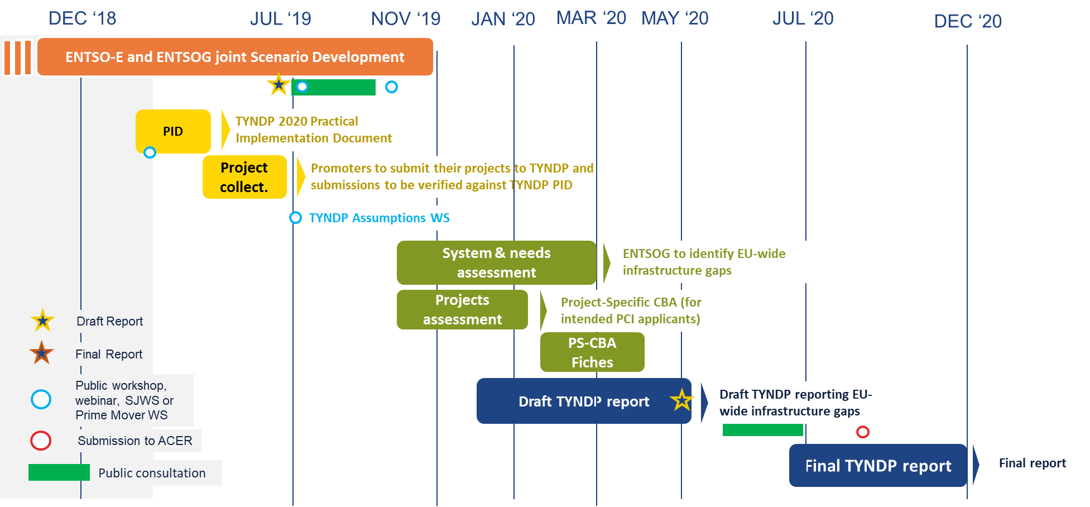
2.1 Focus on TYNDP 2020

Slide 5
2.1 PCI selection process
Common Decision of CRE and CNMC concerning the STEP
STEP
Investment Request – ACER conclusion
Technical Decision making body
Draft PCI list
HLG
22nd Jan 19
22nd Jun 19
5th Jul 19
31st Oct 19
Tbc
27th Jun 19
30th Sept 19
Jan/Feb 20
The final PCI assessment methodology was published by the EC
ACER Opinion on the draft PCI list
Final PCI list publication (OJEU)

Slide 6
2.2. Report on the use of VIP infrastructures October 16- Sept19: progress and work calendar

Slide 7
2.2. Report on the use of VIP infrastructures October 16- Sept19: progress and work calendar
SEPT 19
OCT 19
NOV 19
DEC 19
JAN 20
FEB 20
MAR 20
1st draft of the report
Completing and checking the 1st draft
Curent status:
Working on the first draft
2nd draft of the report (with Jun19 -Sept19 data)
Intermediate Report (report with Oct16-Jun19 data)
Final Report (report with Oct16-Sept19 data)

Slide 8
3.2 Follow-up gas prices

Slide 9
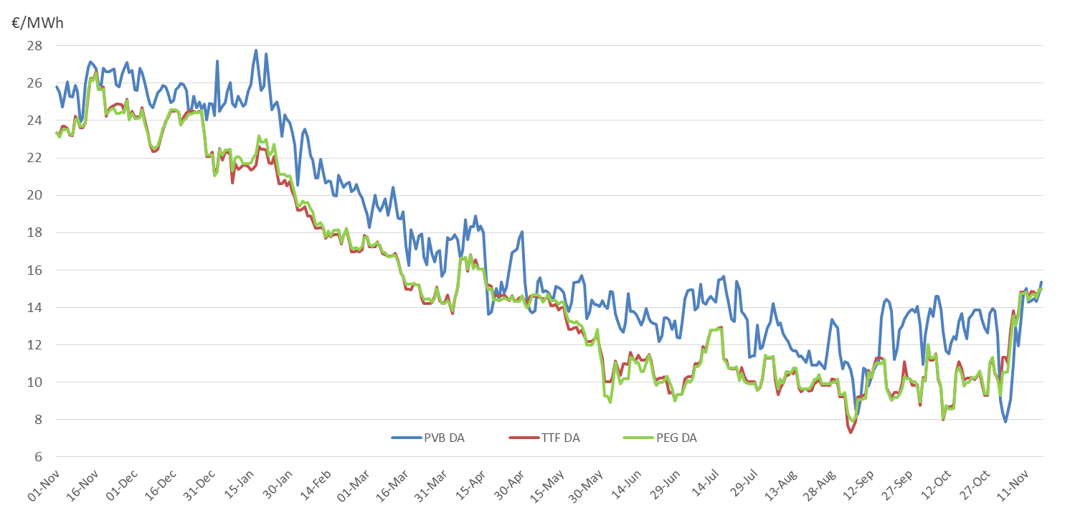
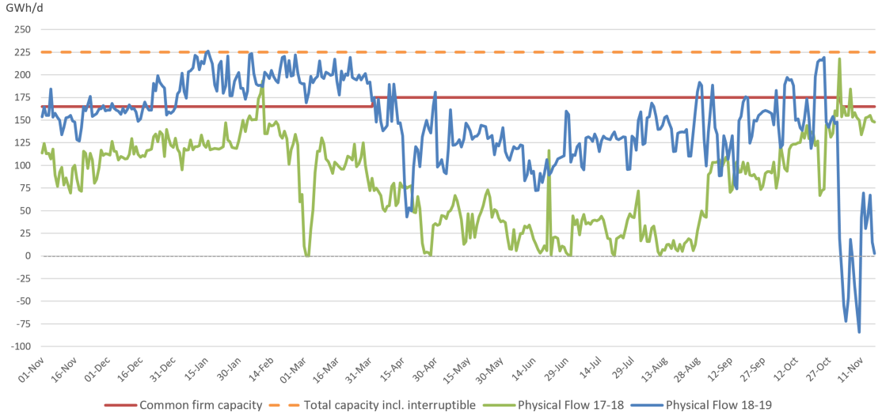
3.2 Follow-up gas prices
Day-ahead prices France, Spain and The Netherlands
Capacity utilization VIP Pirineos 1st Nov – 11th Nov 17-18 vs 18-19

Slide 10
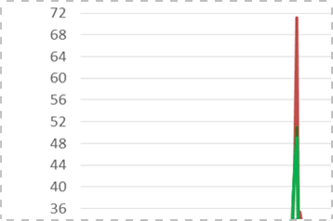
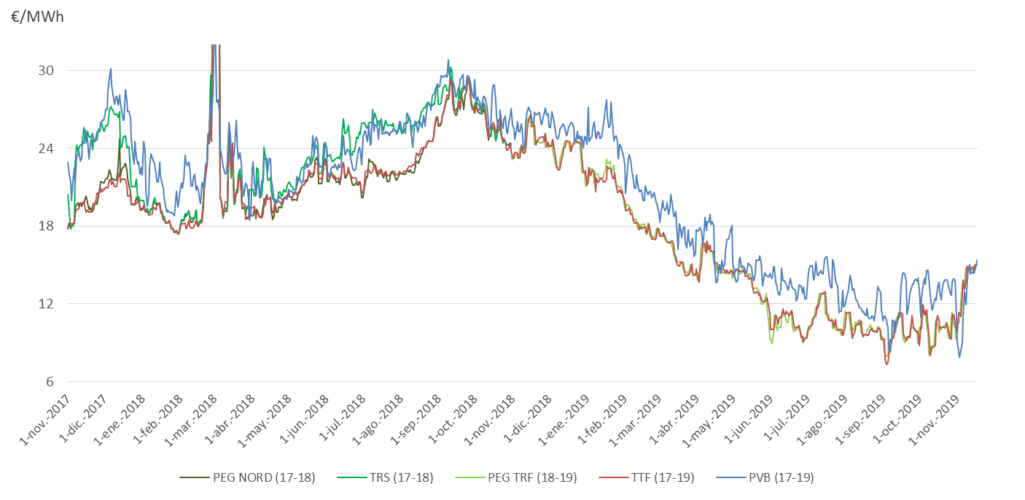
3.2 Follow-up gas prices
Day-ahead prices France, Spain and The Netherlands

Slide 11
Thank you for your attention!

