Slide 1

GRI SSE
Working plan 2019 - 2020
EU Network Code implementation on IPs between EU and EnC TSOs
Aleksandar Popadić
Energy Agency of the Republic of Serbia
27th Stakeholders meeting
GAS REGIONAL INITIATIVE – SOUTH SOUTH –EAST
Virtual meeting, October 30, 2020

Slide 2
Reasons and tasks
  Reasons for analysing IPs between EU and EnC TSOs
  Legal gap for NC implementation on these IPs
  Significant flow on IPs between Ukraine and EU TSOs
  Possibilities for EU traders to use UGS in Ukraine
  Compare old way and NC CAM capacity allocation practice
  Check rules on new IPs between EU and EnC TSOs – new pipelines
  Tasks of the project
  Basic layer of monitoring of EU NC implementation
  Ddetermination of actual practise on IPs between EU and EnC TSOs
  Make recommendations for full NC implementation on IPs between EU and EnC TSOs

Slide 3
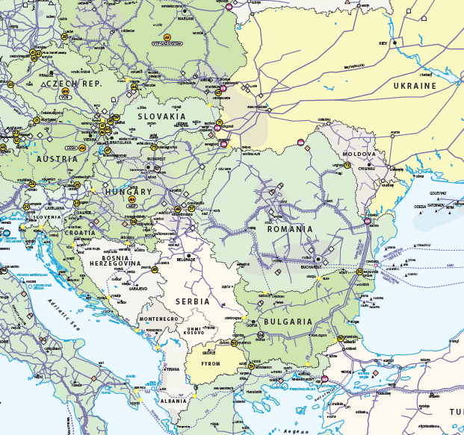

IPs between EU and EnC TSOs
Direction | IP Name
UA - PL | Drozdovichi - Drozdowicze
PL - UA | Hermanowice
SK - UA | Budinice
UA - SK | Budinice
UA - SK | Uzhgorod - Velke Kapušany
UA - HU | Beregovo - Beregdaroc 1400
HU - UA | Beregdaroc 800 - Beregovo
UA - RO | Orlovka - Isaccea
UA - RO | Tekovo - Mediesu Aurit
BG - NM | Kyustendil - Zidilovo
HU - RS | Kiskundorozsma - Horgoš
RO - MD | Ungheni

Slide 4
Data collection
  Questionnaire with questions from
    NC INT, Transparency, CMP, NC CAM, NC BAL, NC TAR
  Primary source of information
    Questionnaire sent to NRA from:
  EU - Poland, Slovakia, Hungary, Romania, Bulgaria, Greece, Italy
  EnC – Ukraine, Moldova, Serbia, North Macedonia, Albania
    Submitted fulfilled questionnaires from:
  EU - Poland, Hungary and Bulgaria
  EnC – Ukraine, Moldova, Serbia and North Macedonia
  Other sources of information
  EnC reports about implementation of EU NC in EnC members
  TSOs web page

Slide 5
Data analysis
  Data assessment for EU TSOs
    EU TSOs implement almost all EU NC on IPs with EnC TSOs
    Detail analysis is not necessary, few information in conclusions
  Data about pipelines in construction
  TAP pipeline: IPs GR - AL and AL- IT
  Gastrans pipeline: IPs BG - RS and RS - HU
  NRA did not sent data for pipelines in construction
  Responisible NRAs approved TAP and Gastrans Network Codes
  Data from EnC TSOs
  There are 23 groups of questions
  Answers are divaded in 3 groups: Y or N or Y/N
  Y/N when all answers in the group are not the same (all Y or all N)
  Final assesesment do not include results for NC TAR

Slide 6
Compliance with NC INT
  UA TSO – TSO does not not publish WI and GCV on web site. Some problems exists with difference in gas quality and difference in odourisation practices
  MD TSO – TSOs communication is not in English, TSO does not publish WI and GCV on web site, other types of data exchange
  SR TSO – TSO does not publish WI and GCV on web site, other types of data exchange and system security is not implemented
  NM TSO – IA is not signed, different set of units, TSO does not publish WI and GCV on web site, other types of data exchange and system security is not implemented
IPs | UA-PL | UA-SK | UA-HU | UA-RO | RO-MD | HU-SR | BG-NM
IA | Y | Y | Y | Y / NO | Y / NO | Y | NO
Set of units | Y | Y | Y | Y | Y | Y | Y / NO
Gas quality | Y / NO | Y / NO | Y / NO | Y / NO | Y/ NO | Y / NO | Y / NO
Data exchange and system security | Y | Y | Y | Y | Y / NO | NO | NO

Slide 7
Transparency compliance
  UA TSO – There is no information about capacity allocation, congestion mamagment, planned and actual interruption of capacity and about secondary capacity in English. Time horizon, frequency of information and units of data is not adequate
  MD TSO – only NC, capacity allocation and capacity trade in Romanian can be found on TSO web page
  SR TSO –no information about capacity in English. There is not any information about secondary market. Units and format of data is not adequate
  NM TSO – only NC in English can be found on TSO web page
IPs | UA-PL | UA-SK | UA-HU | UA-RO | RO-MD | HU-SR | BG-NM
Content of publications | Y / NO | Y / NO | Y / NO | Y / NO | NO | Y | Y / NO
Information about capacity on IPs | Y / NO | Y / NO | Y / NO | Y / NO | NO | Y / NO | NO
The time horizon and the frequency | NO | NO | NO | NO | NO | NO | NO
Capacity on secondary market | NO | NO | NO | NO | NO | NO | NO
Way of providing information | Y / NO | Y / NO | Y / NO | Y / NO | NO | Y / NO | NO

Slide 8
CMP compliance
  UA TSO – CMP is not implemented. Only NRA can require from TSO to withdraw underutilized contracting capacity
  MD TSO – CMP is not implemented
  SR TSO – CMP is not implemented
  NM TSO – CMP is not implemented
IPs | UA-PL | UA-SK | UA-HU | UA-RO | RO-MD | HU-SR | BG-NM
Oversubscription and buy back | NO | NO | NO | NO | NO | NO | NO
Firm DA use it or lose it | NO | NO | NO | NO | NO | NO | NO
Surrender of contracting capacity | NO | NO | NO | NO | NO | NO | NO
Long term use it or lose it | Y / NO | Y / NO | Y / NO | Y / NO | Y / NO | NO | NO

Slide 9
NC BAL - nomination & re-nomination
  UA TSO – Unit in nomination is not in kWh
  MD TSO – NC BAL is not transposed
  SR TSO – Deadlines for nomination an re-nomination is not in line with NC BAL
  NM TSO – Unit in nomination is not in kWh, start time for renomination differ from NC BAL. All reasons for nomination rejectiones are not implemented
IPs | UA-PL | UA-SK | UA-HU | UA-RO | RO-MD | HU-SR | BG-NM
Nomination and re-nomination | Y / NO | Y / NO | Y / NO | Y / NO | NO | Y / NO | Y / NO
Reasons for nomination rejection | Y | Y | Y | Y | NO | Y | Y / NO

Slide 10
NC CAM compliance
  UA TSO – does not analyse technical capacity on IP jointly with adjacent TSO. Capacity is not in kWh/(day/h) and not offered for the next 15 y. Incremental capacity procedure is not implemented. Interruptible capacity is not offered as a within-day product
  MD TSO – NC CAM is not implemented. TSO offers capacity in kWh/(day/h) and cooperates with adj. TSO for maintenance plans
  SR TSO – Not analyse technical capacity on IP jointly with adjacent TSO. Capacity is not allocated on auction, TSO offers only yearly and monthly capacity. Incremental capacity procedure is not implemented. Interruptible capacity is not offered on auction and not offered as a within-day product
  NM TSO – CAM is not implemented
IPs | UA-PL | UA-SK | UA-HU | UA-RO | RO-MD | HU-SR | BG-NM
Adjacent TSOs cooperation | Y / NO | Y / NO | Y / NO | Y / NO | Y / NO | Y / NO | NO
Allocation of firm capacity on IP | Y / NO | Y / NO | Y / NO | Y / NO | Y / NO | Y / NO | NO
Incremental capacity | NO | NO | NO | NO | NO | NO | NO
Interruptible capacity | Y / NO | Y / NO | Y / NO | Y / NO | NO | Y / NO | NO

Slide 11
NC TAR compliance
  Deadline for NC TAR implementation is 31 May 2021.
  UA TSO – NC TAR is not implemented. Multipliers and seasonal factor exist, but they are not calculated in line with NC TAR
  MD TSO – NC TAR is not implemented
  SR TSO – NC TAR is not implemented. Multipliers and seasonal factor exist, but they are not calculated in line with NC TAR
  NM TSO – NC TAR is not implemented
IPs | UA-PL | UA-SK | UA-HU | UA-RO | RO-MD | HU-SR | BG-NM
Cost allocation assesment | NO | NO | NO | NO | NO | NO | NO
Level of multipliers ans seasonal factors | Y / NO | Y / NO | Y / NO | Y / NO | NO | Y / NO | NO
Price of bundled capacity and VIP | NO | NO | NO | NO | NO | NO | NO
Clearing price and payable price | Y / NO | Y / NO | Y / NO | Y / NO | NO | NO | NO

Slide 12
Results in NC implementation
  EU TSOs implementation on IPs with Enc TSOs
  PL and HU TSOs – implements all, except bundled capacity and procedure for incremental capacity
  BG TSO - the most of provisions are not implemented
  Missing of legal obligation and EnC TSOs unpreparedness are the main reasons for non implementation of EU TSO
  EnC TSOs implementation on IPs with EU TSOs
  Ukraine 4 – Y, 9 – Y/N and 6 N
  Serbia 4 – Y, 7 – Y/N and 8 N
  Moldova 1 – Y, 6 – Y/N and 12 N
  N Macedonia 0 – Y, 5 – Y/N and 14 N
  Pipelines in construction with IPs between EU and EnC
    Will implement all EU NCs based on TAP and Gastrans NC

Slide 13
Recommendations
  EnCs contracting parties
  Gov. / NRAs and TSOs to decide about EU NCs transposition / implementation: only on IPs or on all entry/exit points
  Gov. or NRAs to transpose all EU NCs in national legal framework
  TSOs to implement all provision of EU NCs
  EnC Secretariat
  Remind EnC Gov. and NRAs about EU NCs obligation
  Continue to offer help in transposition and implementation
  To use quantitative approach when assessing NCs implementation
  EU TSOs and NRAs
  NRAs – to support NC implementation on IPs with EnCs
  TSOs to implement all EU NCs from their side of IP
  TSOs to offer help including capacity platform for bundled capacity

Slide 14
Thank you!
Contact:
Aleksandar Popadić
Energy Agency of the Republic of Serbia
Terazije 5 / V, 11000 Belgrade
e-mail: aleksandar.popadic@aers.rs
URL: www.aers.rs

