Slide 1
55th IG meeting
15th September 2020

Slide 2
2.1 Follow-up of infrastructures developments

Slide 3
Planning TYNDP 2020
The Scenarios TYNDP 2020 report was published in June
Special call for ETRs (new projects or update information) in June
Infrastructure and Assessment chapters were discussed and approved by the INV WG (internally) in July
Project Assessment
Public consultation
System Assessment
ACER´s opinion
2020
2021
Jan
Feb
Mar
Apr
May
Jun
Jul
Aug
Sep
Oct
Nov
Dec
Jan
Feb
Publication: PS-CBA Groups
Submission & update of ETRs
TYNDP Chapters: Approval of the Assessment and Infrastructure Reports
Approval of Draft TYNDP by INV WG
Approval of Draft TYNDP by the Board
Approval of Final TYNDP by the GA
Publication:
Final TYNDP
Publication: Scenarios
TYNDP Report
Infrastructure & Assessment Reports; Maps; Gas Quality Outlook; Annexes
Publication: Draft TYNDP report & Project Fiches
Internal milestones
Publications

Slide 4
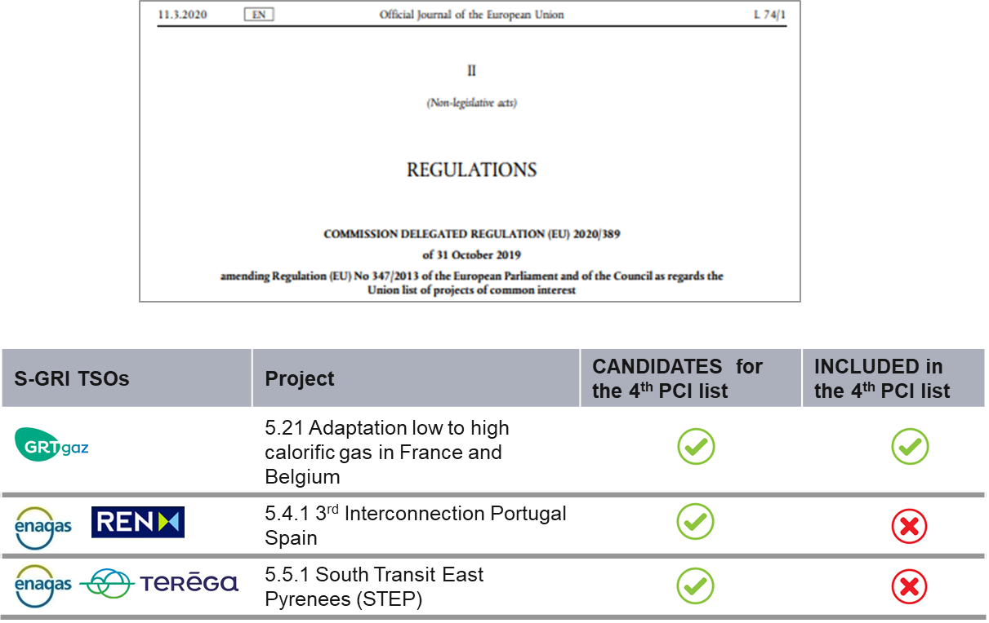
PCI List
The 4th PCI List was adopted on October 2018 and published in OJEU on March 2019. The detail of the candidates and PCI projects included in the List was already presented in previous IG meetings:
The 5th PCI List process will start when the Project Specific CBAs (Project Fiches) are sent to the EC.

Slide 6
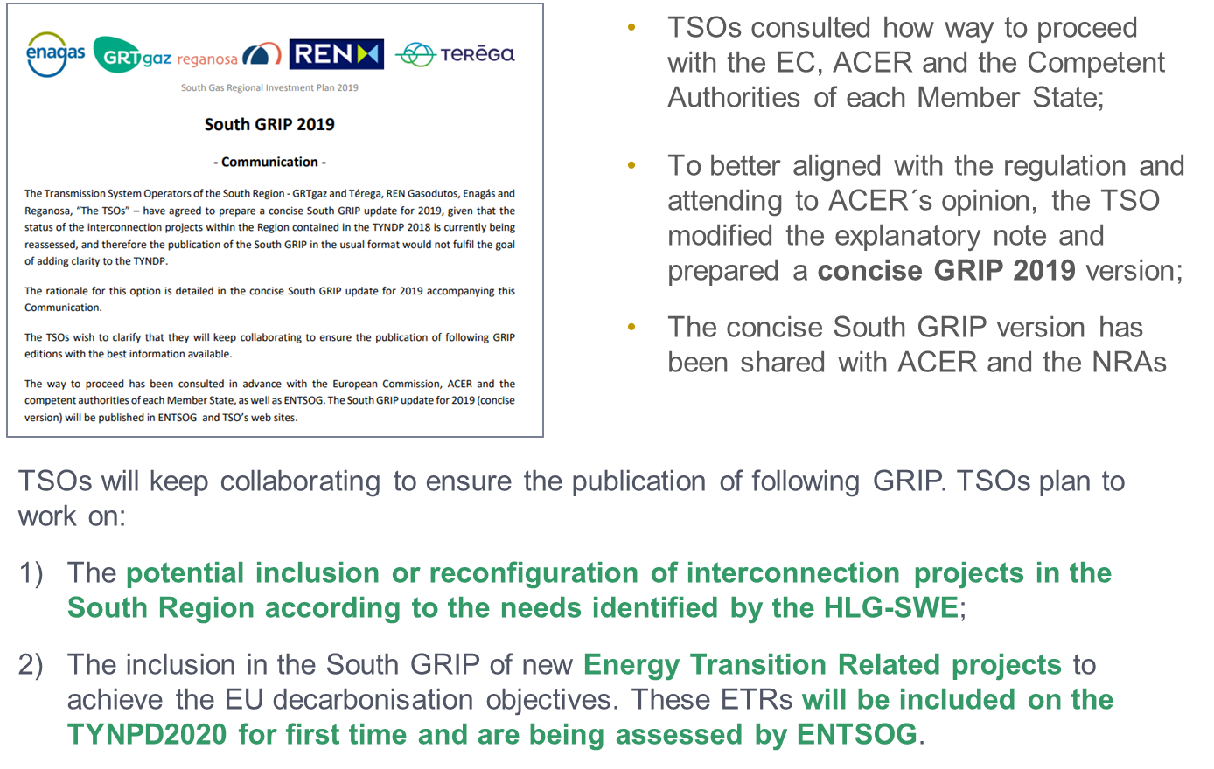
South GRIP
The Concise South GRIP was shared with the EC, ACER and the Competent Authorities and published in the TSOs websites: Enagás, GRTgaz, Teréga, Reganosa and REN
The process was already presented in the previous IG meeting
TSOs will keep collaborating to ensure the publication of following GRIP

Slide 7
2.2. Report on the use of VIP infrastructures October 16- Sept19: state of art

Slide 8
Conclusions
The gas flow direction from North to South prevails over the South North direction in terms of net physical flow, as well as the direction from Spain to Portugal.
The capacity offered to the market is calculated by adjacent TSOs with a common methodology based on CAM NC.
At VIP Pirineos and VIP Ibérico, the unbundled capacity booked with LT contracts, subscribed before the implementation of the CAM NC, represents the largest part of the booked capacity at each point and direction, except for the Portugal to Spain flow direction at VIP Ibérico.
Capacity offered and booked in a bundled way on PRISMA is minor. This state of fact will continue till 2023 for VIP Pirineos and until end of 2020 at VIP Ibérico, where the first LT contracts will end.

Slide 9
North-South link
The North-South link was physically congested. Merger of zones as from 1st November 2018 has solved the physical congestion issue, thus allowing the removal of the North-South link. Market coupling offer was increased on a daily basis according to available daily capacities in order to anticipate the removal of this link.
Since the North-South link does not exist anymore, no further observations need to be made.

Slide 10
VIP Pirineos
New market conditions changed the booking and usage behavior
  The creation of the Trading Region France induced, since 01/11/2018, a single gas price in France. The price spread takes now place at the VIP Pirineos instead of occurring at the north south link which disappeared
  The PEG price decreased below 8 €/MWh because of:
    Mainly : the abundance of LNG delivered to the European markets at low price;
    Partly : the French storage regulation increased the number of market players on the PEG which helped in increasing the HUB liquidity;
Such price signals have influence on gas routes as shown in this report.
Transit quantities can be boosted or reversed, punctually or over long period.
After two years of congested IP despite very marginal allocation at yearly auctions, Teréga propose to apply a coefficient of congestion on tariffs only when 98% of the marketable capacity is marketed at yearly auctions

Slide 11
VIP Ibérico
The direction Spain to Portugal prevails over Portugal to Spain direction.
A seasonal booking and use during the summer months in the Spain to Portugal direction is observed that is less evident during the studied period in respect to the previous exercises. In this direction, booked capacity is practically fully used, and every type of product is utilized, except for the period January to June 2019, when the flow reverted due to the price advantages of accessing the Spanish gas market from the Portuguese LNG plant instead of the Spanish LNG plants.
In the direction Portugal to Spain, we can observe a change in shipper’s behaviour during 2019, as explained here above, where the bookings reached levels close to the 63% of the technical capacity.

Slide 12
3.1 Follow-up gas prices

Slide 13
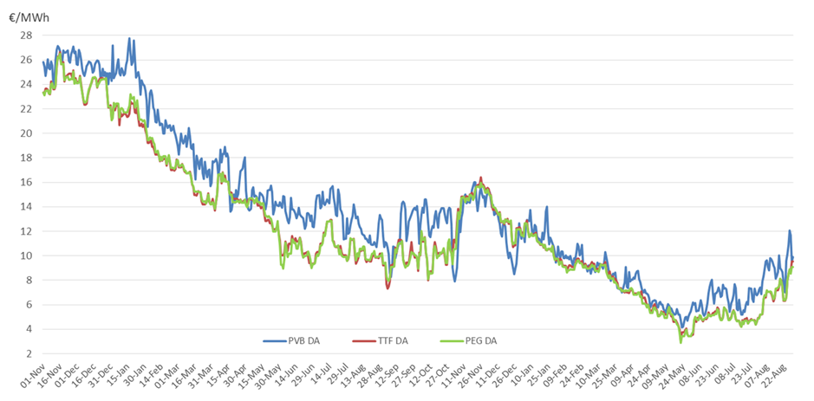
Day-ahead prices France, Spain and The Netherlands

Slide 14
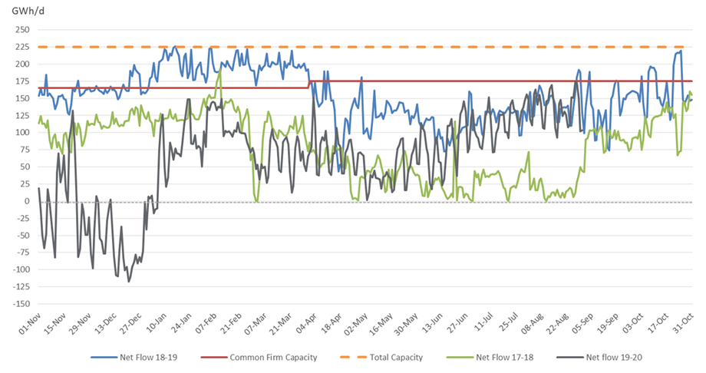
Capacity utilization VIP Pirineos 1st Nov – 11th Nov 17-18 vs 18-19 vs 19-20

Slide 15
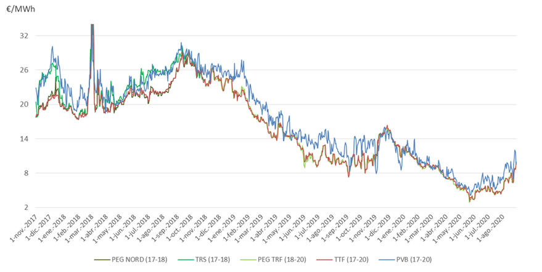
Day-ahead prices France, Spain and The Netherlands

Slide 16
4.1. Contribution of gases to decarbonisation

Slide 17
TYNDP2020: Energy Transition Projects - Enagás
H₂ production
Green Crane – it is a joint initiative by Enagás and SNAM to deploy renewable hydrogen value chains at scale. It aims to develop local hydrogen demand as well as cross-border routes to NW and Central Europe and to analyse potential links to the South of France. In Spain, it comprises the regional hubs of Baleares, Aragon, Asturias, Castilla y León and Pais Vasco.
Other Energy Transition projects
Sun2Hy – R+D+i project to research Photoelectrochemical hydrogen production and hydrogen injection into the gas grid.
CORE LNGas Hive and LNGHIVE2 – Development of the logistics chain integrated, safe and efficient for the supply of liquefied natural gas, LNG (small scale and bunkering) as fuel in the transport sector, especially maritime, in the Iberian Peninsula.
Railway project roadmap – Transformation of railway transport to LNG

Slide 18
Thank you for your attention!

