Slide 1
25th SG meeting
26th January 2021

Slide 2
2.2 Update of infrastructures developments

Slide 3
Planning TYNDP 2020
The draft TYNDP 2020 was published on 25 November
A public consultation is underway (deadline: 15January)
After receiving ACER opinion, final TYNP 2020 will be published in March 2021
Project Assessment
Public consultation
System Assessment
ACER opinion
2020
2021
Feb
Mar
Apr
May
Jun
Jul
Aug
Sep
Oct
Nov
Dec
Jan
Feb
Mar
Publication: PS-CBA Groups
Submission & update of ETRs
TYNDP Chapters: Approval of the Assessment and Infrastructure Reports
Approval of Draft TYNDP by INV WG
Approval of Draft TYNDP by the Board
ENTSOG TYNDP webinar
Approval of Final TYNDP by Board and GA
Publication: Scenarios
TYNDP Report
Infrastructure & Assessment Reports; Maps; Gas Quality Outlook; Annexes
Publication: Draft TYNDP report & Project Fiches
Publication:
Final TYNDP
Internal milestones
Publications

Slide 4
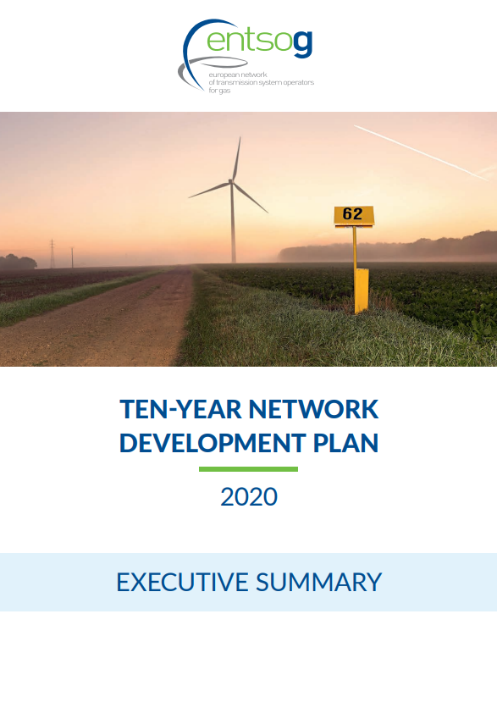
Content
TYNDP 2020 scenario report
Executive Summary (and Synopsis)
Assessment Report
Infrastructure Report
Gas Quality Outlook
Annexes
  A. Infrastructure projects list
  B. TYNDP Maps
  C. Capacities
  D. Methodology report
  E. Modelling results
  PS-CBA package

Slide 5
TYNDP 2020 Scenario Report (source: TYNDP 2020 Executive Summary and Scenario Report)
ENTSOG and ENTSO-E cooperated in the development of three different scenarios
National Trends
Central policy, bottom-up, scenario, designed to reflect the most recent EU member state National Energy and Climate Plans (NECP), submitted to the EC in line with the requirement to meet current European 2030 energy strategy targets. 2040 time horizon.
Distributed Energy
Decentralized approach to the energy transition
In line with the COP 21 targets with the objective to understand the impact on infrastructure needs against different pathways reducing EU-28 emissions to net-zero by 2050.
COP21 scenarios have a 2050 time horizon.
Global Ambition
Development in a centralized way

Slide 6
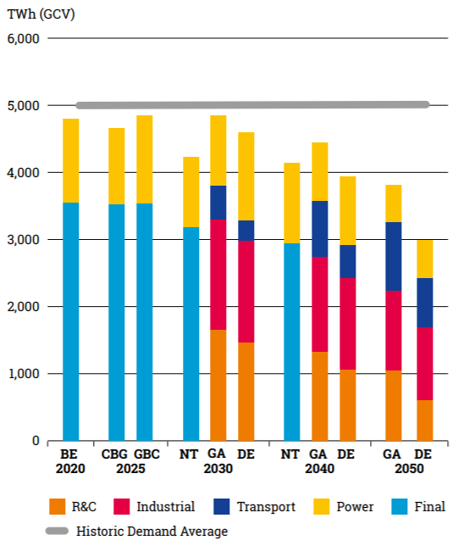
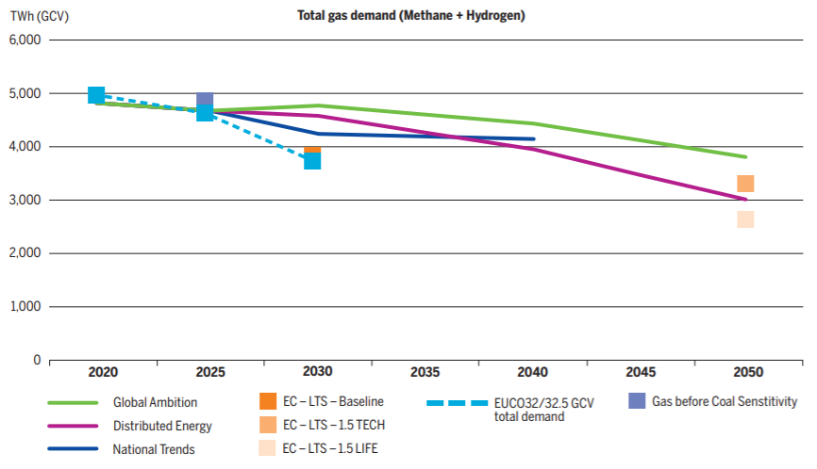
TYNDP 2020 Scenario Report – Demand
By 2030, National Trends has the lowest gas demand. Global Ambition and Distributed Energy reach higher decarbonization levels of the energy system with higher quantities of gas due to three main reasons:
Faster switch from carbon-intensive fuels, such as coal and oil to gas;
Higher shares of renewable and decarbonized gases in the gas mix; and
Higher power generation due to higher electricity demand.
A switch from carbon-intensive coal to natural gas with lower carbon intensity by 2025, results in 186TWh additional gas demand. However, this would lead to emissions reduction in the electricity generation of a minimum of 85 MtCO2. At least until 2030 gas demand for power generation is increasing with the level of decarbonization and electricity demand.
The picture changes for 2040, where also National Trends has accomplished the coal phase-out but shows lower renewable power generation. As a result, National Trends has the highest gas demand for power by 2040.

Slide 7
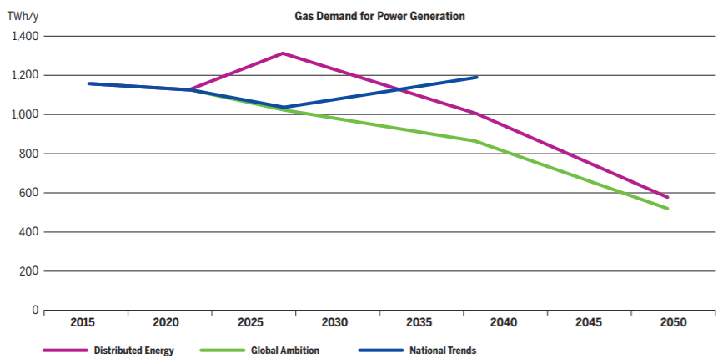
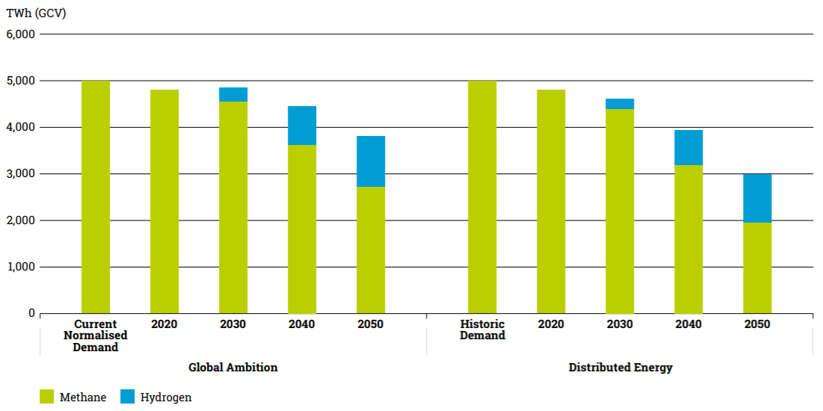
TYNDP 2020 Scenario Report – Demand
Distributed Energy considers a higher penetration of P2G technologies with significant volumes produced more locally and thus a similar development of the hydrogen demand.
Global Ambition considers a more centralized decarbonization where the increasing demand is mainly supplied by pre-combustive hydrogen production.
Higher electrification means higher gas demand for power generation, at least until renewables get to the needed penetration levels

Slide 8
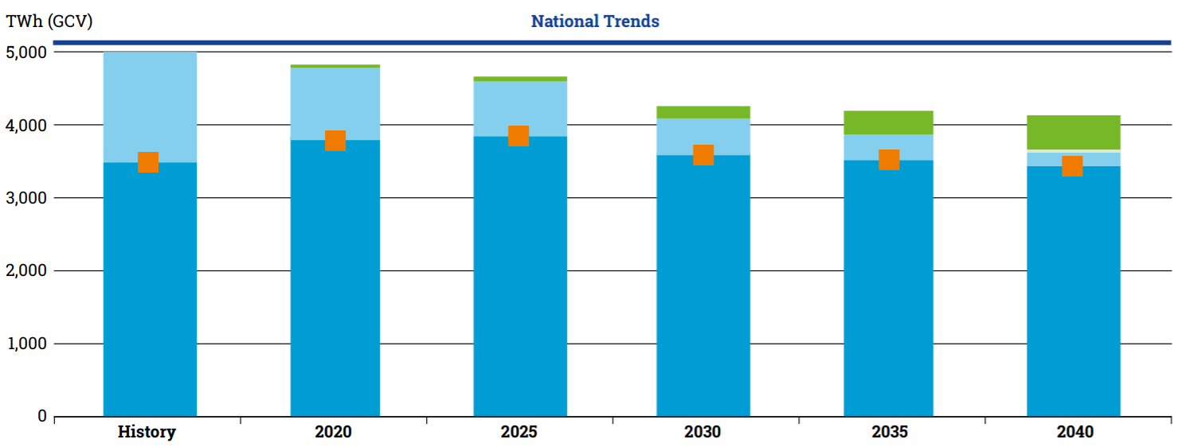
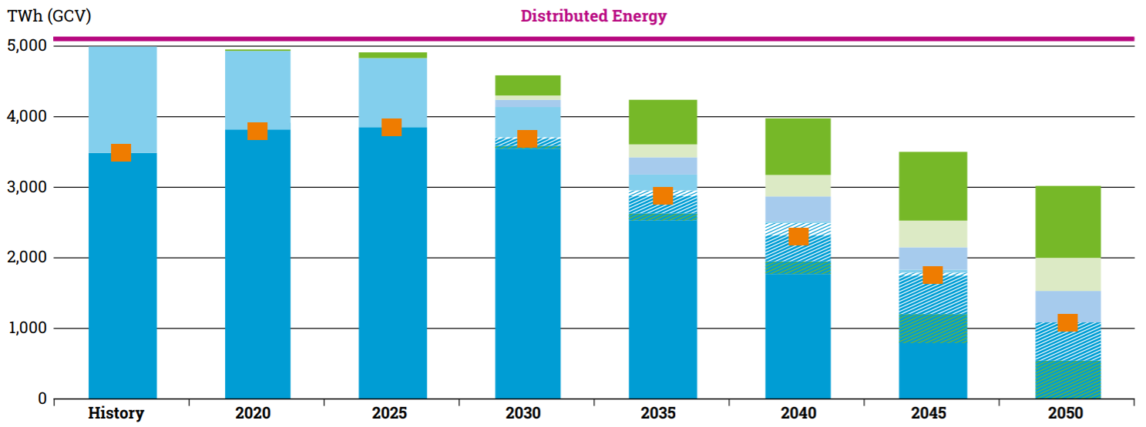
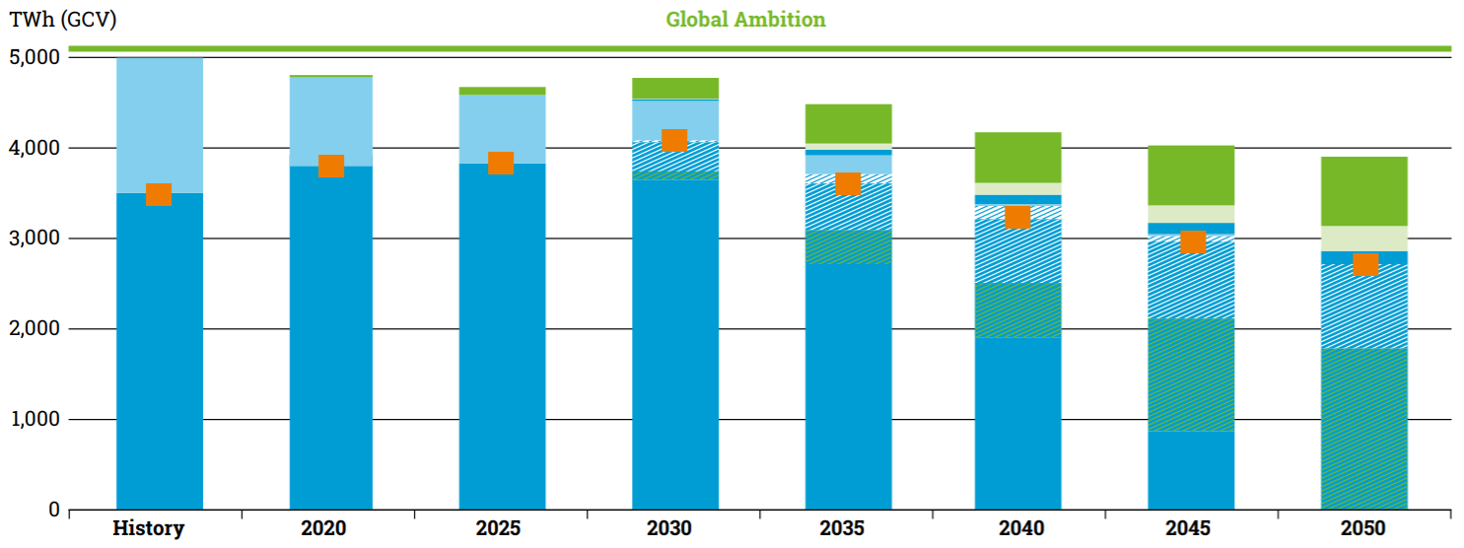
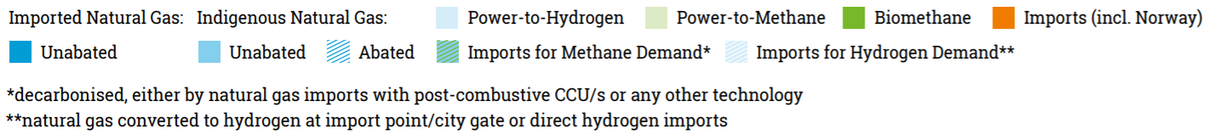
TYNDP 2020 Scenario Report – Supply
Due to lack of consistency between the individual NECP’s, the supply mix for National Trends is not split into different gas qualities
As a decentralized scenario, Distributed Energy considers a high level of indigenous production of renewable gas. As so, it requires a significant increase in renewable electricity generation to meet the P2G demand.
As a centralized scenario, Global Ambition combines both high decarbonization levels with a global gas supply and access to a variety of sources. However, thanks to general demand decrease also imports decrease by 25% by 2050 compared to current levels.

Slide 9
TYNDP 2020 Assessment Report
In this report, ENTSOG assesses the resilience of the European gas system attending to security of supply, competition and market integration criteria, under all the scenarios. This assessment is also performed for all infrastructure levels.
For the sustainability criteria, ENTSOG designed the scenarios in line with COP 21 targets and for the first time, include Energy Transition Projects.
Due to the inclusion of hydrogen demand (as national production and imports) for the first time, and the decrease on natural gas demand from 2030, some Peninsula indicators change in 2030 and 2040 without new infrastructure.

Slide 10
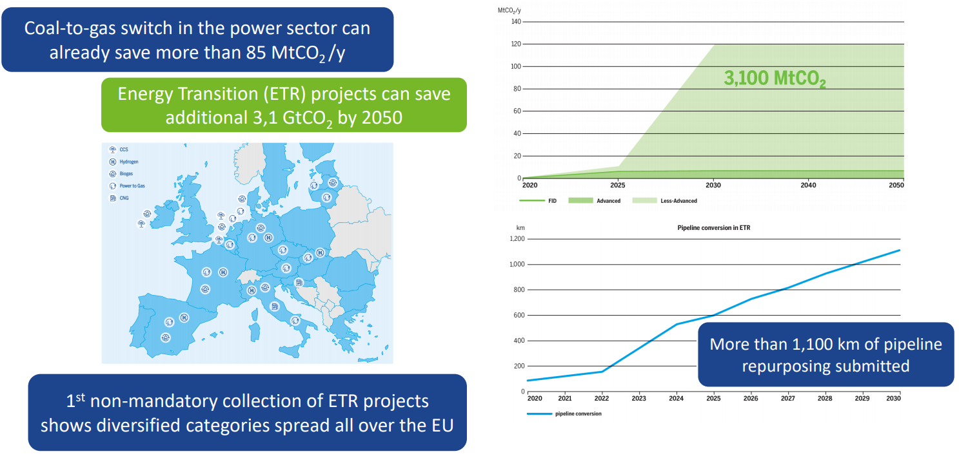
Sustainability
ENTSOG has preliminary assessed the contribution of all ETR projects to reducing the CO₂ emissions of the energy system.

Slide 11
Security of supply
Assesses the resilience of the European gas system to cope with various stressful events (climatic stress, supply route disruptions and infrastructure disruptions). The indicators analysed are the following:
Climatic Stress. Climatic stress conditions result in high gas ­demand situations and are therefore challenging for the gas system. The ability of the system may be ­challenged to cope with: a peak day demand, a 2-week cold spell demand and a 2-week Dunkelflaute (possible impact of a long period with minimum amount of wind and solar energy)
Supply Routes Disruptions. Portugal and Spain are affected by Algerian pipeline import route disruption under some scenarios and some infrastructure level, but always with a Remaining Flexibility (RF) > 0.
Single Largest Infrastructure Disruption (SLID).
For all the climatic stress situations, the existing gas infrastructure in the region is resilient

Slide 12
Competition and market integration
Minimun Annual Supply Dependence. Minimum share of a given source in the supply mix, being the source share which cannot be substituted by the other supply sources. Only under Global Ambition scenario some limitations remain between the Iberian Peninsula and the rest of Europe
LNG and Interconnection Capacity Diversification (LICD). It only considers LNG terminals capacities and the interconnections capacities between European Countries. It also depends on the number of commercial frontiers (no imports). Neither of the Iberian Peninsula countries improve the situation because no interconnection infrastructures’ were added to the simulations
Commercial Supply Access and Supply Source Diversification. It measures the number of supply sources (including national production as a source) an area can ­commercially access. The Iberian Peninsula has access to 2 supply sources in most of the scenarios and France from 3. The situation improves in 2040, due to the increase on H2 national production and the decrease on natural gas demand
Marginal Price. It assesses how Marginal Prices of ­European countries are sensitive to contrasted ­supply price configurations and their ability to ­converge. The SGRI region is mostly affected by the maximization/minimization of LNG and South gas (Algerian) prices.

Slide 13
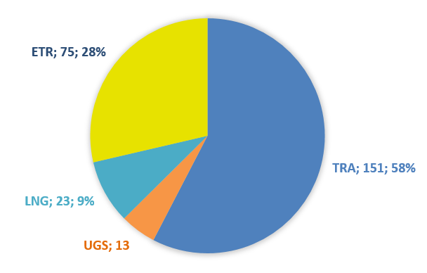
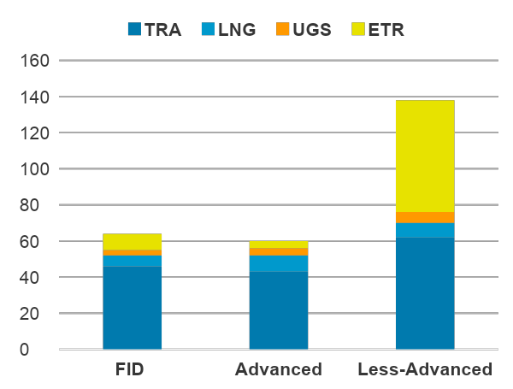
TYNDP 2020 Infrastructure Report
187 submissions of TRA, UGS & LNG projects (207 in TYNDP 2018)
New in TYNDP 2020 => Collection of Energy Transition Related projects (ETR)
+75 submissions
PORTUGAL
2 projects
2 TRA
SPAIN
14 projects
1 TRA
6 LNG
7 ETR
FRANCE
14 projects
3 TRA
2 LNG
9 ETR
Investments by Infrastructure Type
Investments by Status

Slide 14
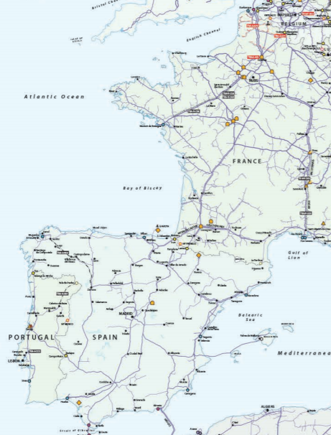
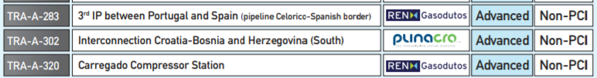
South TRA Projects

Slide 15
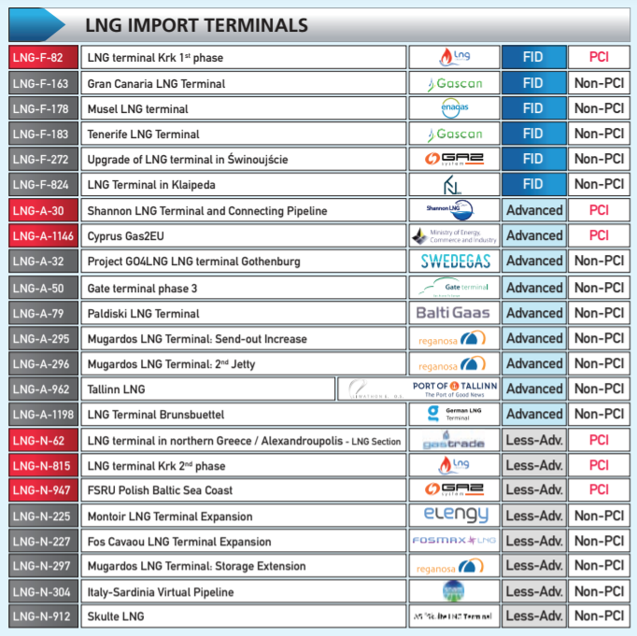
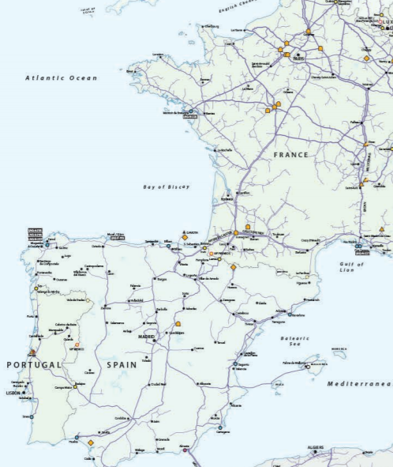
South LNG Projects

Slide 16
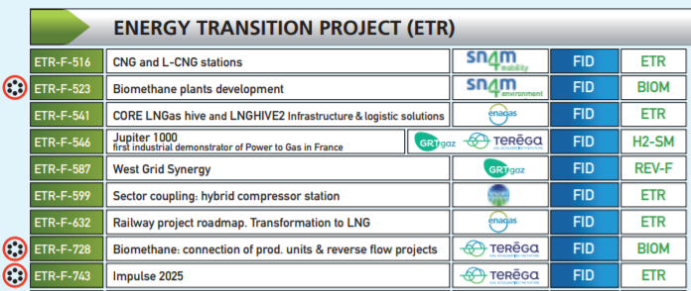
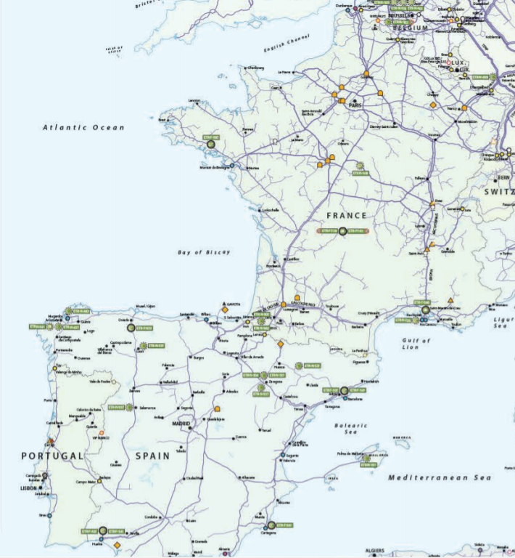
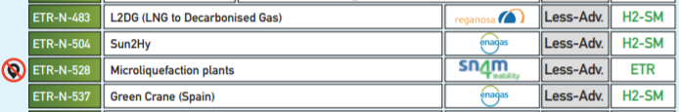
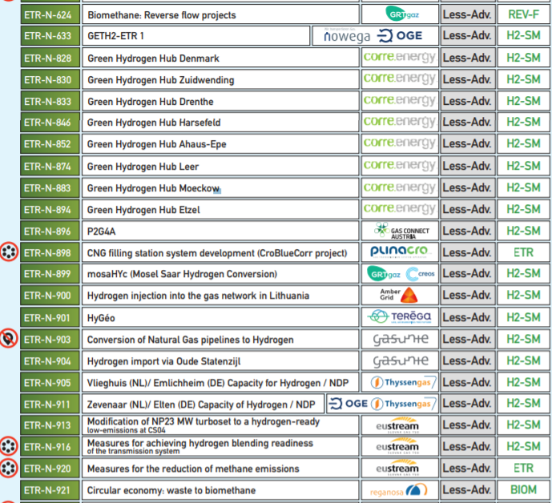
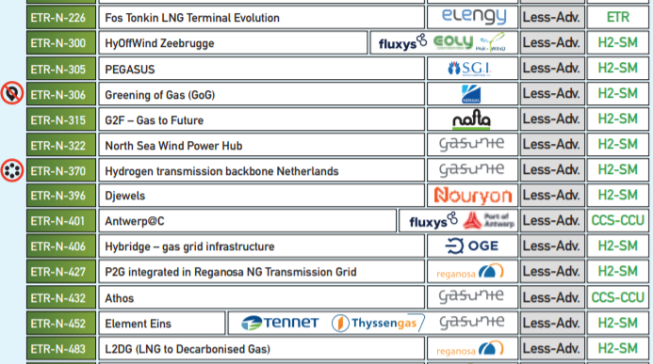
South ETR Projects
16 Projects
8 Hydrogen Projects
4 Biomethane/ Reverse- flow
4 Other types

Slide 17
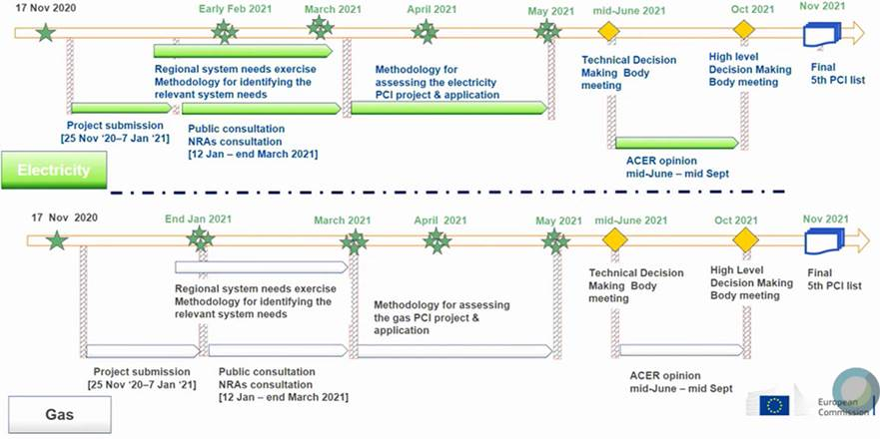
5th PCI list
The 5th PCI list will be prepared in line with current TEN-E Regulation and not with future one. H2 is not in the scope of current regulation.

Slide 18
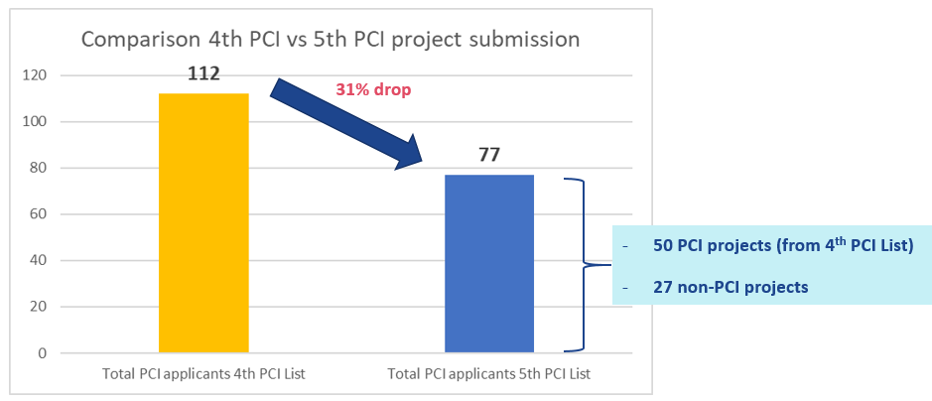
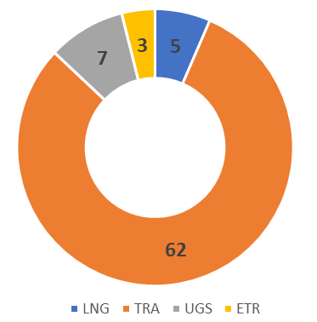
5th PCI List
EC Public consultation on project candidates open between 14 Jan to 8 April

Slide 19
South GRIP
Reganosa will be the coordinator of 2021 edition
Planning agreed in ENTSOG
From 24/11/2020 to 29/01/2021: submission of updated information.
  TSOs contact for GRIPs
  Draft list of simulation requests, including:
    Number of simulations
    Outputs (Curtailment rate, demand curtailment, RF,MP…)
    Scenarios
    Supply mix configuration, year, period, infrastructure & disruption.
  Additional information (if needed)
February 2021: preparation of simulations timeline (exchanges between TSOs-ENTSOG).
March 2021: ENTSOG starts the modelling and support to TSOs.
September 2021: end of ENTSOG support to TSOs.
TSOs Actions
15 of February: Kick-off meeting (online)
Strategy and content 2021 edition proposal: Focus on ETR projects and decarbonization priorities in line with European Green Deal.

Slide 20
2.2 Report on the use of infrastructure Oct16-Sep19

Slide 21
Conclusions
The gas flow direction from North to South prevails over the South to North direction in terms of net physical flow, as well as the direction from Spain to Portugal.
The capacity offered to the market is calculated by adjacent TSOs with a common methodology based on CAM NC.
At VIP Pirineos and VIP Ibérico, the unbundled capacity booked with LT contracts, subscribed before the implementation of the CAM NC, represents the largest part of the booked capacity at each point and direction, except for the Portugal to Spain flow direction at VIP Ibérico.
Capacity offered and booked in a bundled way on PRISMA is minor. This state of fact will continue till 2023 for VIP Pirineos (at VIP Ibérico, the first LT contracts ended in late 2020)

Slide 22
North-South link
The North-South link was physically congested. Merger of zones as from 1st November 2018 has solved the physical congestion issue, thus allowing the removal of the North-South link. Market coupling offer was increased on a daily basis according to available daily capacities in order to anticipate the removal of this link.
Since the North-South link does not exist anymore, no further observations need to be made.

Slide 23
VIP Pirineos (1/3)
New market conditions changed the booking and usage behavior
  The creation of the Trading Region France induced, since 01/11/2018, a single gas price in France. The price spread takes now place at the VIP Pirineos instead of occurring at the north south link which disappeared
  The PEG price decreased below 8 €/MWh because of:
    Mainly : the abundance of LNG delivered to the European markets at low price;
    Partly : the French storage regulation increased the number of market players on the PEG which helped in increasing the HUB liquidity;
Such price signals have influence on gas routes as shown in this report.
Transit quantities can be boosted or reversed, punctually or over long period.

Slide 24
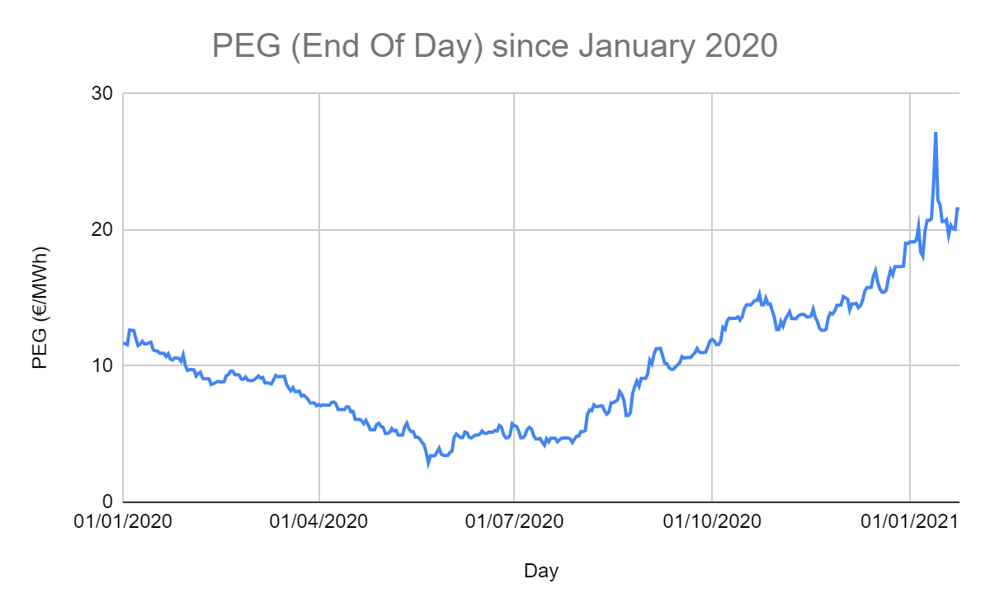
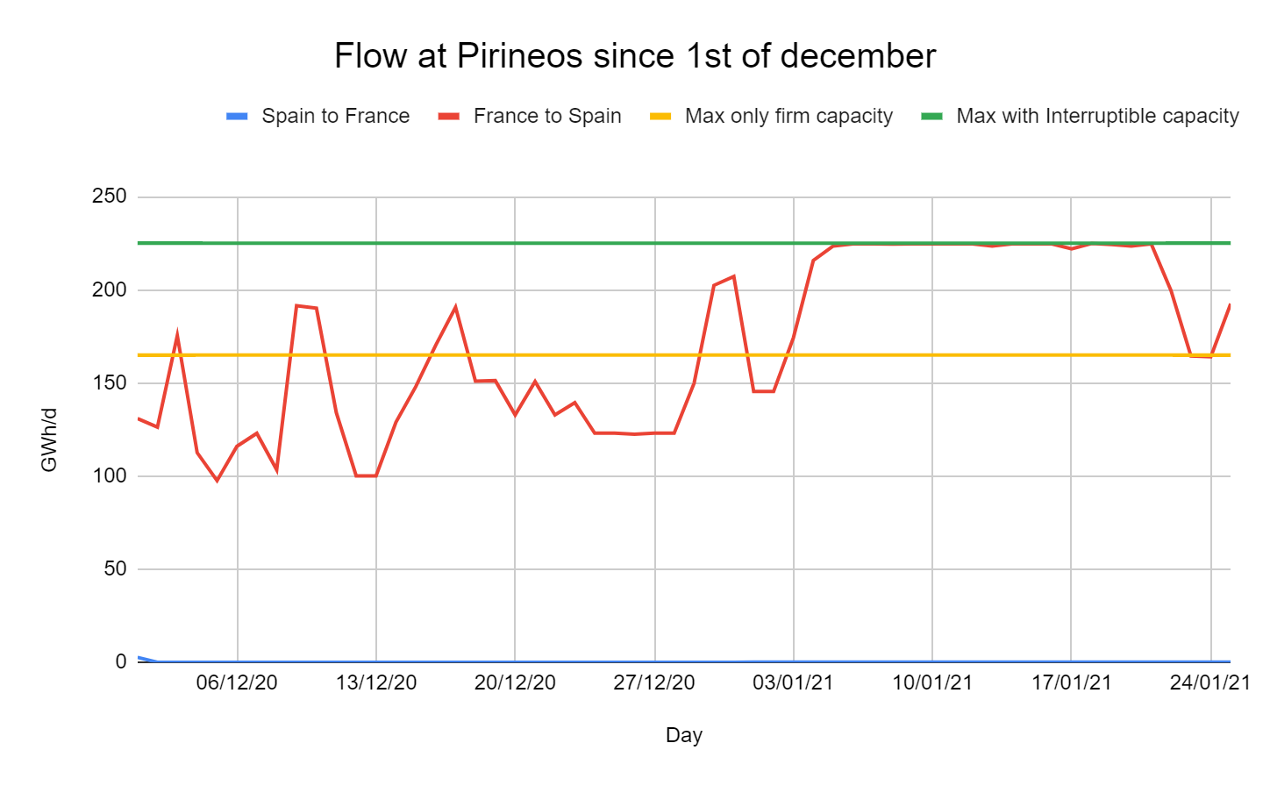
VIP Pirineos (2/3)
Some news since 2019 :
    After some periods of Spain to France flow at Pirineos (November) , the flow is now from France to Spain :
    From January 2020 until May 2020, continues bearish trend → PEG Price decreased under 3 €/MWh in May 2020
    Bounce back from June 2020, and is now around 21,5 €/MWh
    The Spread PEG/PVB was very interesting mainly because of :
    LNG was going to Asia instead of Europe
    Cold temperatures in Spain
    High CCGT runs

Slide 25
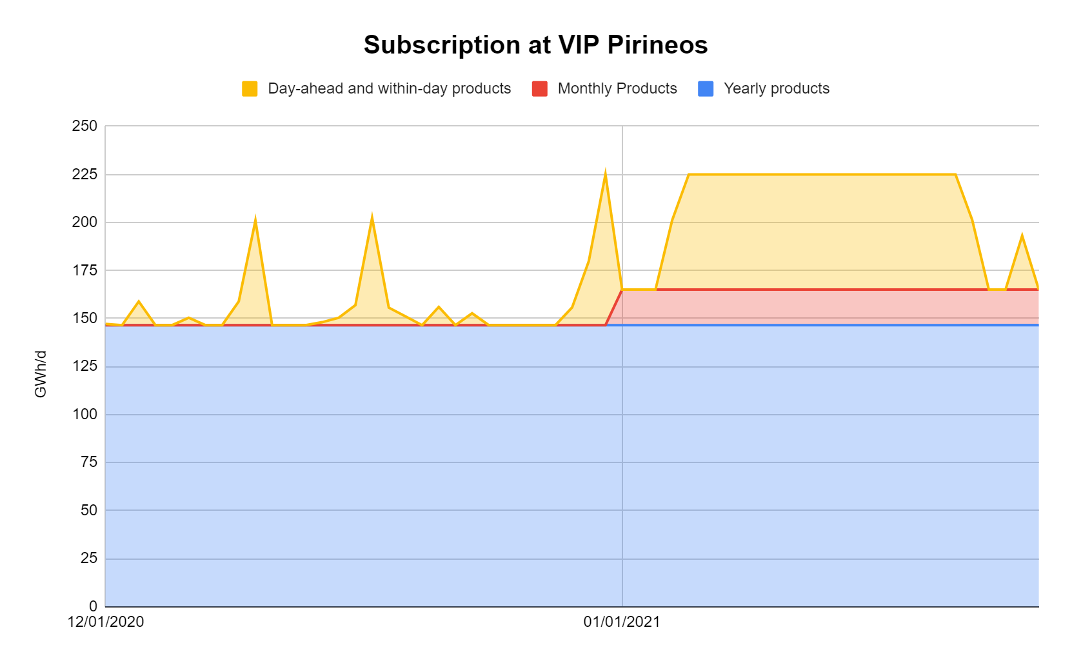
VIP Pirineos (3/3)
Capacity subscribed on PRISMA since december 1st :
Additional information : ACER-ENTSOG Public Consultation following EFET reported FUNC Issue until 19/02/21 – “Greater flexibility to book firm capacity at IPs”
    In January 2021, all the firm capacity (165 GWh/d) and almost all the interruptible capacity (60 GWh/d) are subscribed every day
    For February 2021, there is already 156 of 165 GWh/d subscribed

Slide 26
VIP Ibérico
The direction Spain to Portugal prevails over Portugal to Spain direction.
A seasonal booking and use during the summer months in the Spain to Portugal direction is observed, although less evident during the studied period in respect to the previous exercises. In this direction, every type of product is utilized, although capacity utilization rate decreased, reaching an average rate below 30% in gas year 2018-2019
In the direction Portugal to Spain, we can observe a change in shipper’s behavior during 2019, resulting in a flow reversal from January to June, where the daily bookings reached levels close to 63% of the technical capacity
This happened because during gas year 2018-2019 shippers in the Iberian market have prioritized LNG over Algerian Gas, taking advantage of cheaper LNG prices. Moreover, a reduction in regasification and transmission tariffs set in July 2018 in Portugal also induced some flows from Portugal to Spain, though in annual terms there is a net flow from Spain to Portugal

Slide 27
2.3 Implementation of the UIOLI LT mechanism at VIP Ibérico

Slide 28

2.3 Coordinated application procedure
LT UIOLI
  Annex I to Regulation (EC) No 715/2009 foresees the application of Congestion Management Procedures (CMP) in the event of contractual congestion, including the Long-Term Use-It-Or-Lose-It (UIOLI-LT) mechanism
  The Regulation (EU) 2017/459 (new NC CAM) introduced the obligation to offer LT capacities at interconnection points. The offer of LT capacity at VIP Ibérico started with the 2018/2019 annual yearly capacity auction at 2 July 2018 (for 5 years) introducing the conditions for the application of this mechanism at this interconnection point
  The SGRI WP 2019-2020 foresees the implementation of a UIOLI LT mechanism at VIP Iberico as a deliverable regarding Target 2 - “Market Integration In The Region”
  At the 50th IG Meeting, on 17 June 2019, TSOs committed to the task of implementing the mechanism at VIP Ibérico in a coordinated way, contributing as such to a harmonized UIOLI LT mechanism in the SGRI area
  REN and Enagás presented a draft proposal of the coordinated mechanism to the NRAs which promoted a public consultation on the mechanism in February 2020
  The harmonized UIOLI LT mechanism was first applied at VIP Ibérico in May 2020

Slide 29
2.3 ii) Experience on the creation of a single market area in France (TRF)

Slide 30
Agenda
Reminder of the context of the merger
How to design such a project
  Customer listening process
  Mecanisms chosen to manage the limits
    Zoom on Locational Spread
Feedback on the first 2 years

Slide 31

Trading Region France

Slide 32
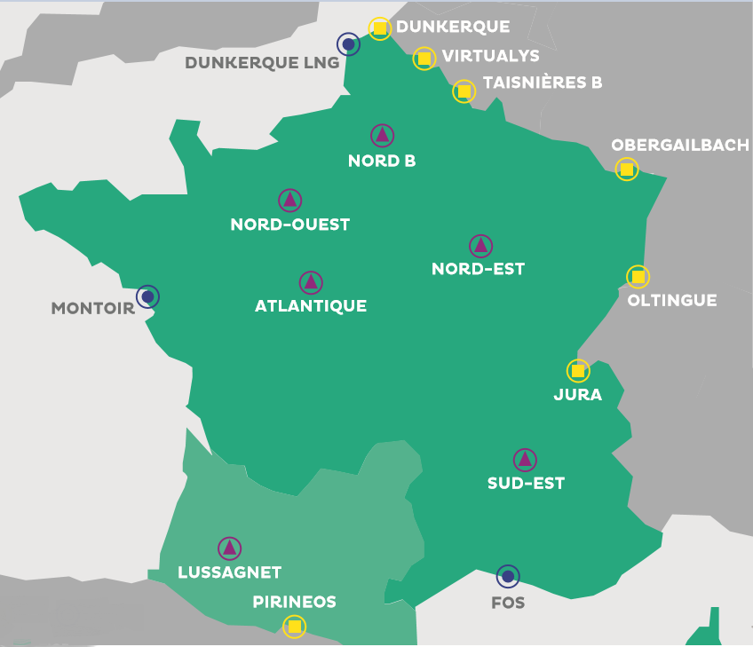
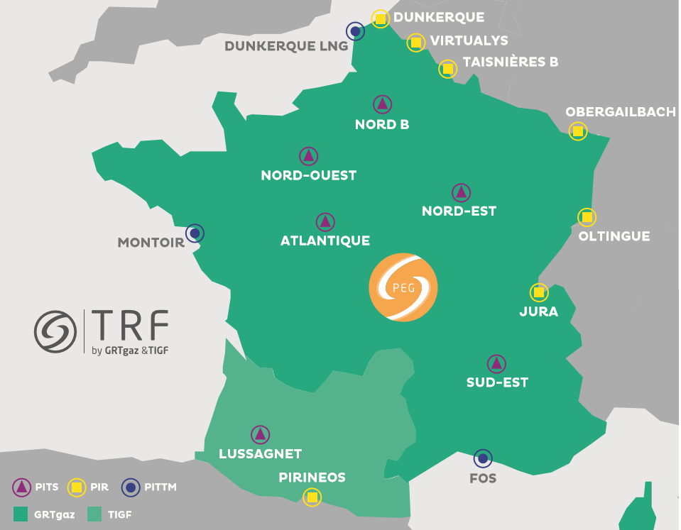
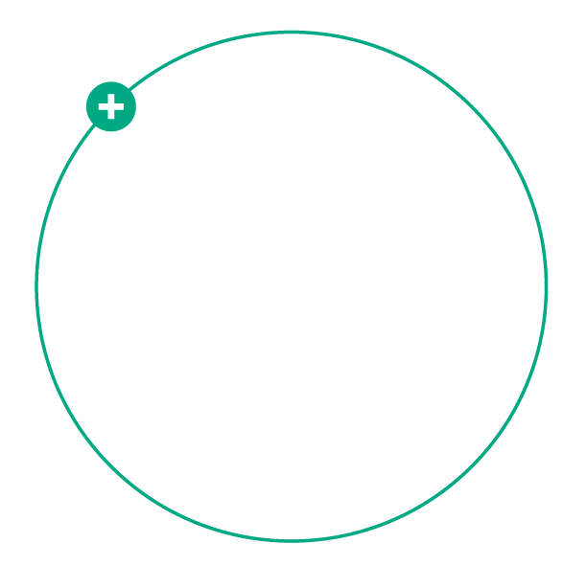
Creation of the TRF and the PEG
Before november 1st, 2018:
Since November 1st, 2018 :
PEG NORD
TRS
1 Entry/Exit zone: TRF
1 VTP: PEG
2 VTPs:
(PEG Nord and TRS)
Teréga and GRTgaz have decided to call the single trading area the TRF, an acronym standing for Trading Region France.
The TRF include a virtual gas exchange point, the PEG

Slide 33
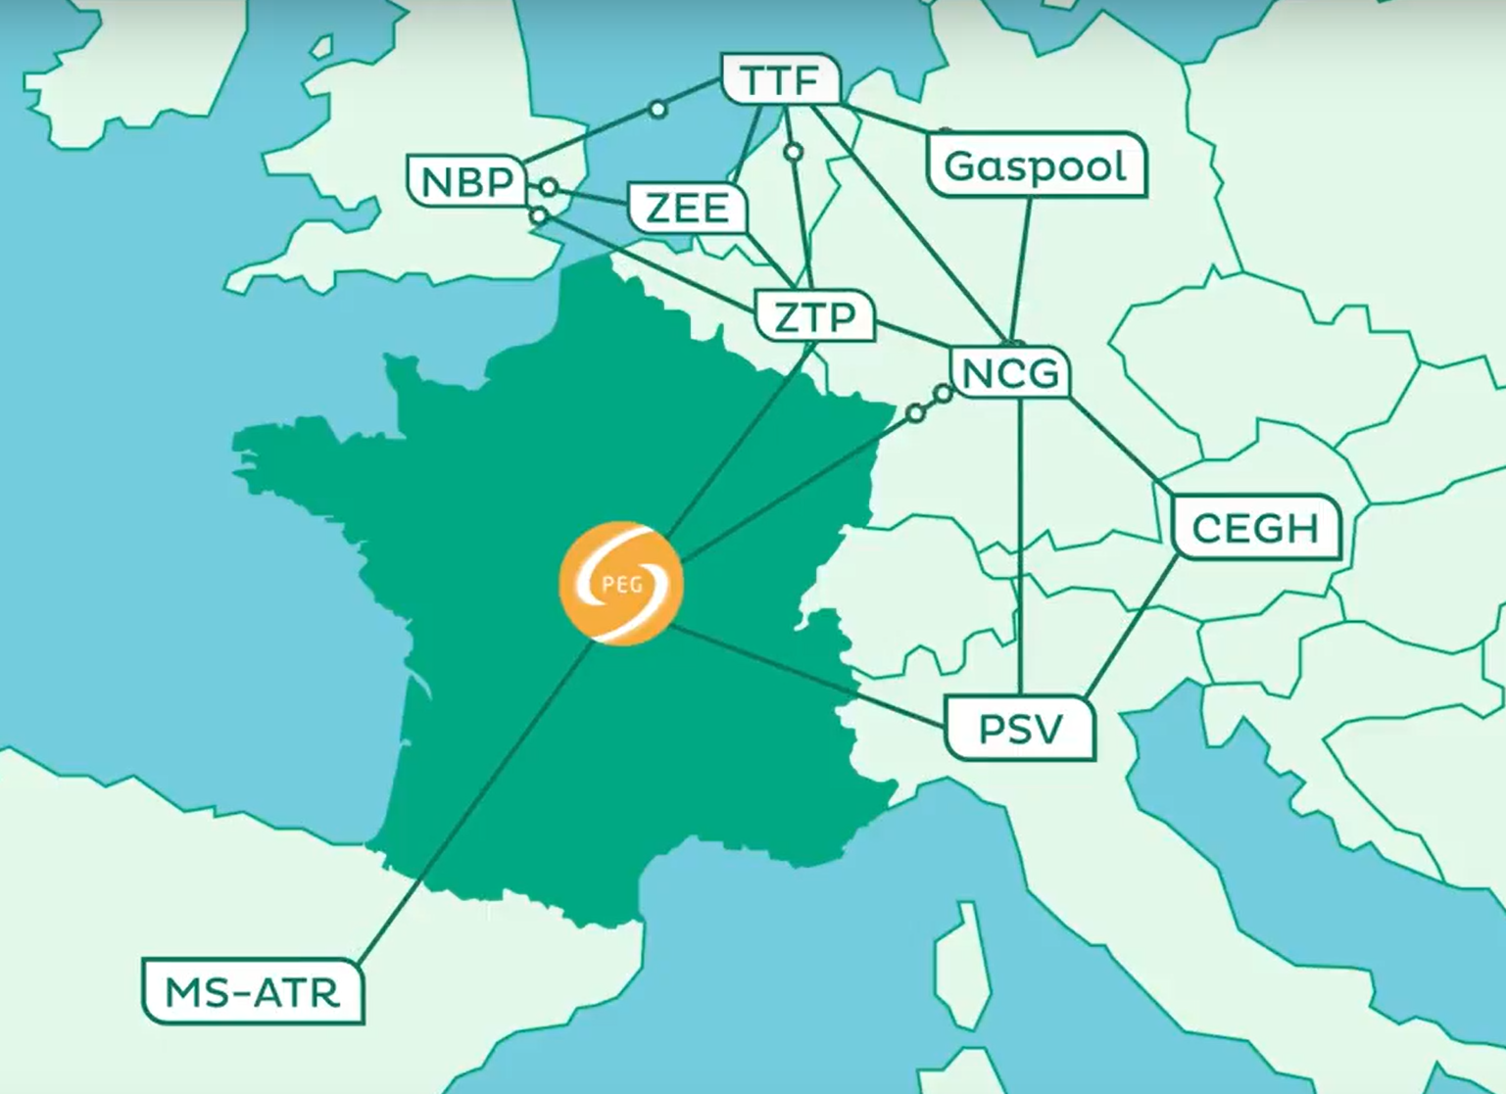
The expected benefits: a more attractive gas market
A single gas price in France (disappearance of “North-South spreads”), for the benefit of all consumers
  A French market more fluid, less volatile, more competitive that is better integrated into the European market
  A security of supply of France strengthened by improving access to different gas sources and allowing a wider choice of sourcing patterns
For the benefit of a competitive market over the long term

Slide 34
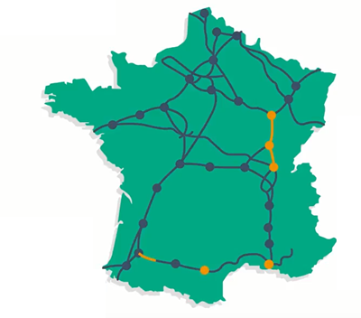
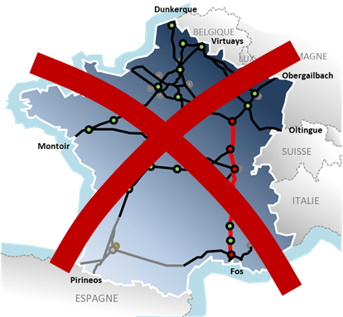
A “mixed” solution agreed with the market
Well thought out investments in infrastructures
Complementary mechanisms co-built with the market
The new structures cover a wide range of flow patterns but do not guarantee all situations. Some residual limits of the network are remaining
Merger 100% supported by infrastructure
The new structures increase the availability of the capacities and therefore allow more flows to transit from the North to the South
Val de Saône: €671m in total
Gascogne/Midi: €152m in total
Val de Saône
Gascogne-Midi
~2 Mds €

Slide 35
How to design such a project

Slide 36



A challenge solved thanks to a complete and innovative customer listening process
  A new co-construction system with the market
  Co-construct a new Offer with the market, our key partners and other infrastructure operators, then cooperate it
15 WG since 2015
Online survey
Serious Game « Game of Flows »
What benefits were sought in a co-construction with the market?
Remind the market of the history of the TRF to make them accept the rules of the game: A merger with rational investments that requires contractual mechanisms.
To allow them to test our ideas, to create new ones and thus to make them co-responsible in the choices while accustoming them to new ones.

Slide 37
Mechanisms selected for management of residual limits & merit order
The selected mechanisms are activated on a short-term basis, only if the limit is imminent, following this merit order:
1. Agreements with adjacent operators (D-1 and D)
Existing applicable solutions
2. Interruption of interruptible capacities and UIOLI on D-1 and D
3. Non-trading of unsubscribed capacities on D-1 and D
Mechanisms created
4. Locational spread: call to the market (D)
5. Mutualised restriction of nominations: last resort (D)

Slide 38
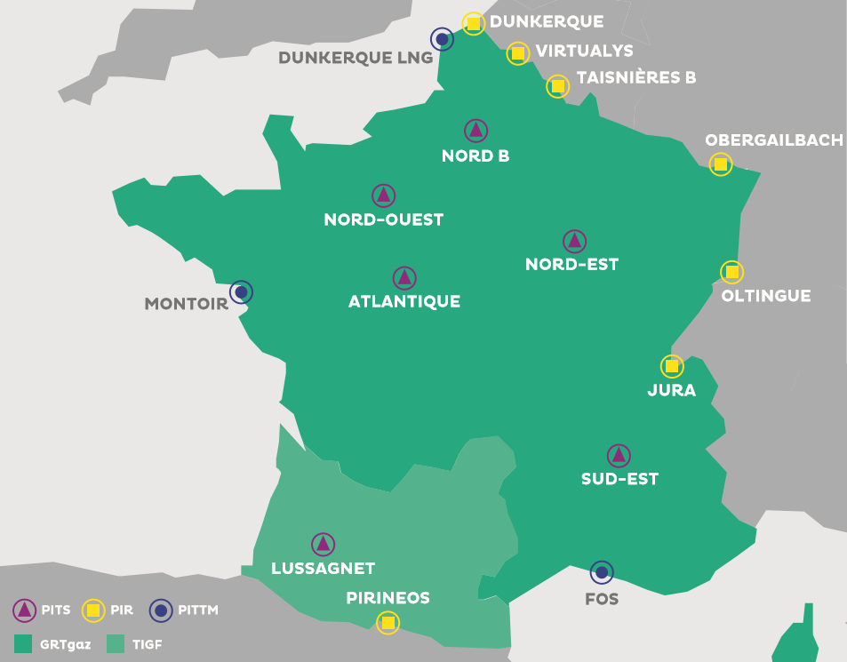
Locational spread main principles
Market product, relying on the gas stock exchange, on a reference platform for customers (PEGAS), with a twofold within-day locational product:
      → Purchase by TSOs downstream of the limit
      → And simultaneous sale of the same quantity by the TSOs upstream of the limit
      > This amounts for the TSOs to buying a “spread”
Neutral impact of the locational spread on the balancing of the selected shipper (the PEG nomination balances the physical nomination)
      A flexible mechanism : via a call for tenders for voluntary shippers, for the purchase, sale, or both, for the quantities that they choose
Optimised cost : activated within-day only when a proven limit is reached and only for the quantity necessary to resolve the limit

Slide 39
Lookback at TRF: 2018-2020

Slide 40
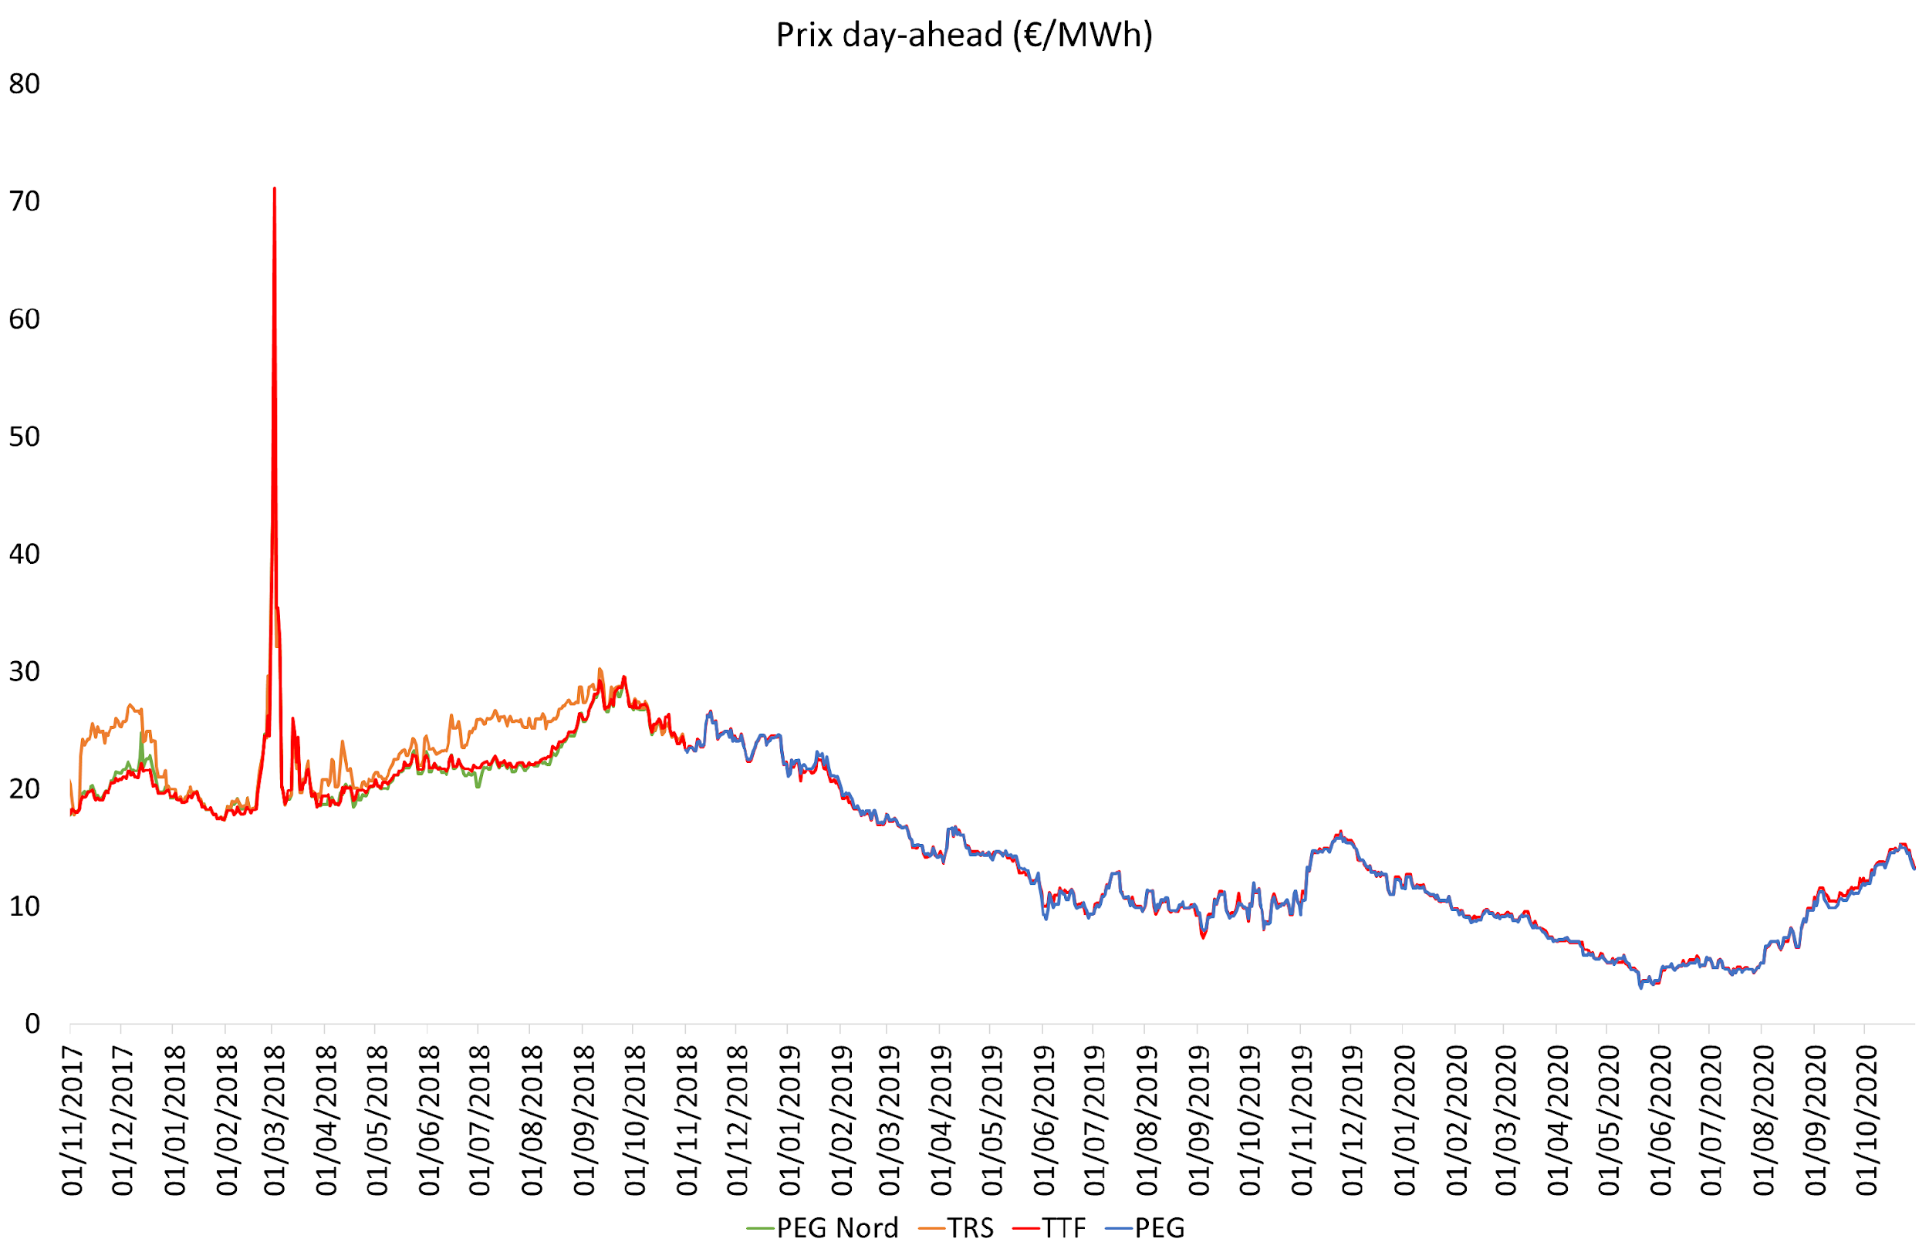

PEG very correlated to TTF
Since the beginning of the TRF: absolute spread between PEG et TTF < 0,3 €/MWh 84% of time
Average Spread: -0,04 €/MWh
Benefit for the french market as a whole
TRF
7,6 €/MWh
Average PEG price summer 2020
11,3 €/MWh
Summer 2019

Slide 41
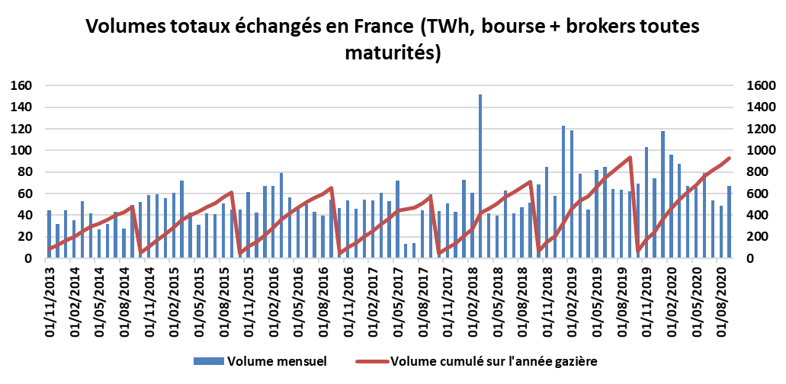

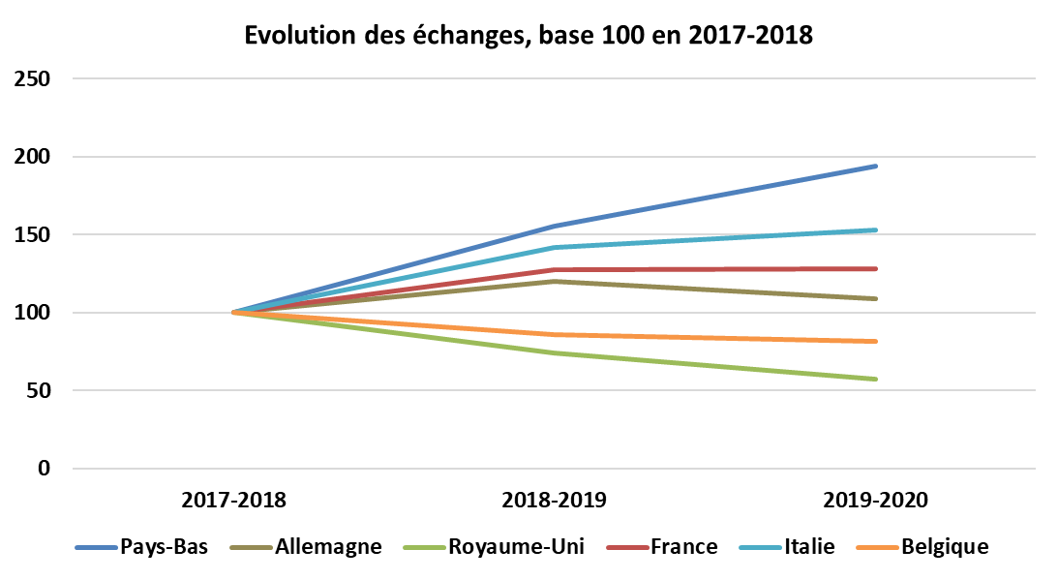

More and more liquidity
Increasing traded volumes ( Spot and Futures)
Total traded volumes in France (TWh, gas exchange + brokers all maturities)
2 397 GWh
Daily average PEG exchanges Summer 2020
2 428 GWh
Summer 2019
Source: Argus
Increasing number of PEG market players
Evolution of number of exchanges, base 100 in 2017-2018
128
105
Octobre 2020
Average 2017-2018 before TRF

Slide 42
2019 ➔ 2020: better indicators of congestion
(2019)
2020
TRF’s reference scenario 2017 (M€)
Days in RED ALERT
Summer 2020 [April - October]
Occurrence since 1st November 18 : 8%
Occurrence summer 2020 : 10%
58
18
1
10
LOCATIONAL SPREADS
0,85
(2020)
7,2
(2019)
2019 | 2020
42 calls : 95% Efficiency Occurrence Nov.18/Oct.19 : 11% Occurrence summer 2019 : 18% 2019 : 1808 GWh @3,99€/MWh | 15 calls : 100% Efficiency Occurrence Nov.19/Oct.20 : 3% Occurrence summer 2020 : 5% 2020 : 660 GWh @1,29€/MWh
44
15
Days of congestion
0
38
15
(2020)
36
(2019)
2
0
MUTUALIZED RESTRICTION
Decrease of congestions and associated costs

Slide 43
Conclusion
The French merger is a full success
The solution was design by all market participants (TSOs, Shippers, CRE, Exchange,…)
Works and IT modification were on time for November 1st
Figures show an increase of liquidity and of number of participants on the PEG
The congestion management mechanisms are very effective to solve residual congestion on the network and are the best cost-benefit balance for shippers

Slide 44
Back-up slides

Slide 45
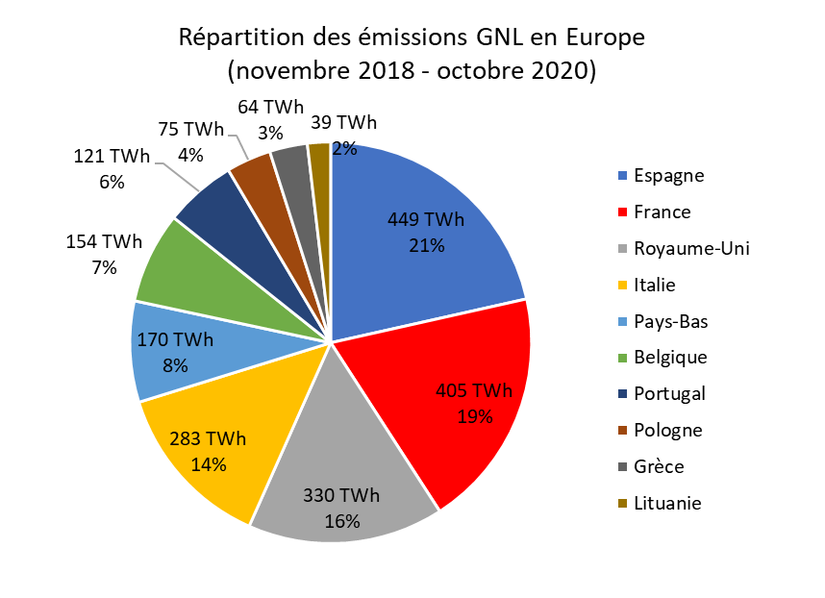
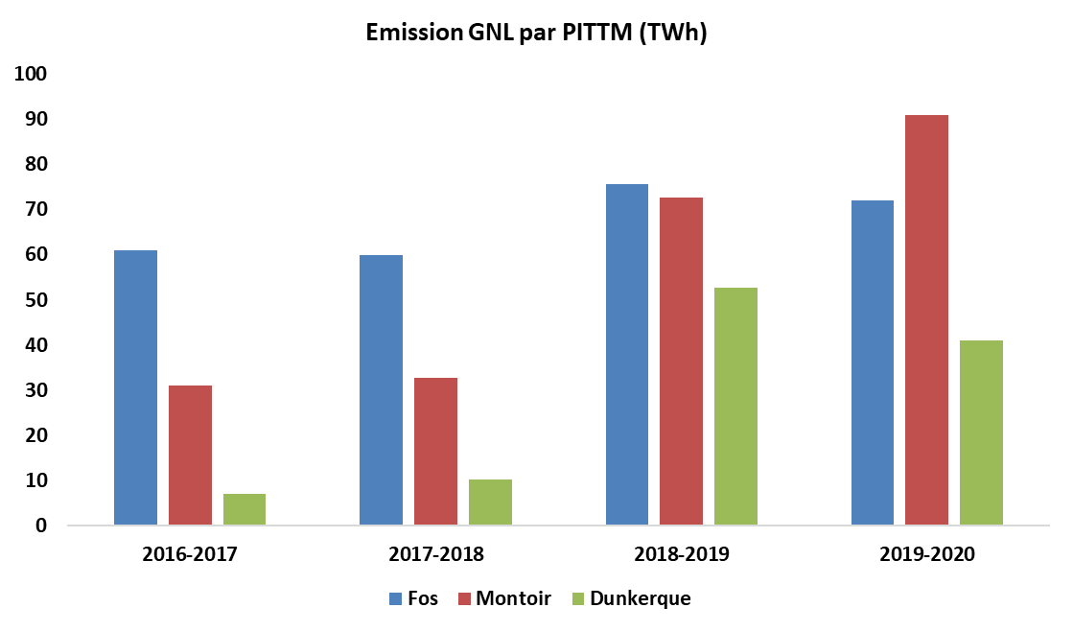
Agile TRF, strong place for LNG
TRF has benefited from world excedent of LNG - its LNG market share close to the Spanish one
Liquidity and depth of PEG have absorbed quantities of LNG, thanks to storages and IPs
Fos has taken advantage of this depth
  +22% emissions compared to 2017/2018 before TRF
  TRS only would not have allowed this increase
Terminals new balanced competitivity
  +157% emissions in Montoir
  +443% in Dunkerque
LNG’s emissions breakdown in Europe (Nov.18/Oct.20)

Slide 46
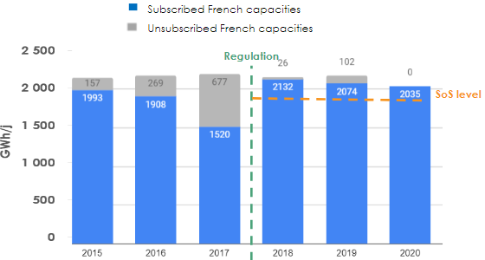
Benefits of storage reform
➔ Thanks to storage regulation on 1st January 2018:
Marketing rules* have allowed full bookings of marketable volumes by Storengy and Teréga
➔ Thanks to the access of a liquid TRF
Auctions participation very important (Demand > between ~8 et 12 times Offer)
Numerous new market players
Auctions clearing prices that reflect market values
=
Creation of TRF and storage regulation in 2018 have jointly allowed the reinforcment of french gas system
and security of supply
* Marketing rules:
A few simple standard products
Reserve prices @ €0/MWh for most of N+1 capacities
Fixing auctions (1 round) with pay-as-clear
Standardized marketing calendar

Slide 47
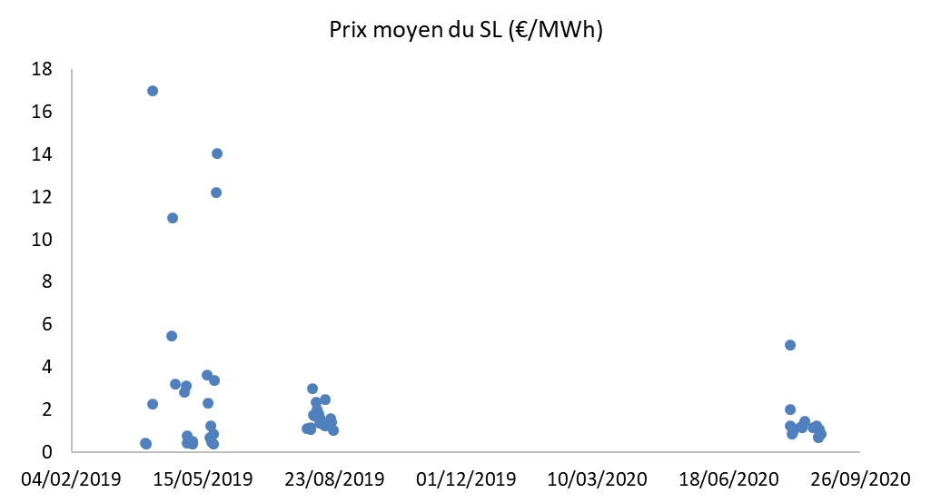
Decrease of cost of locational spread
Reduction of occurrences in 2020
  Optimized operational management following Rex 1st year
  Interruptible capacities at PITS (interface points Storage – Grid) introduced by the CRE
Reduction of average price
  Calls’ methods (range)
  Selection method
  Better competitio n
Average price LS (€/MWh)
4,0
€/MWh
1,3
€/MWh

Slide 48
Thank you for your attention!

