Slide 1
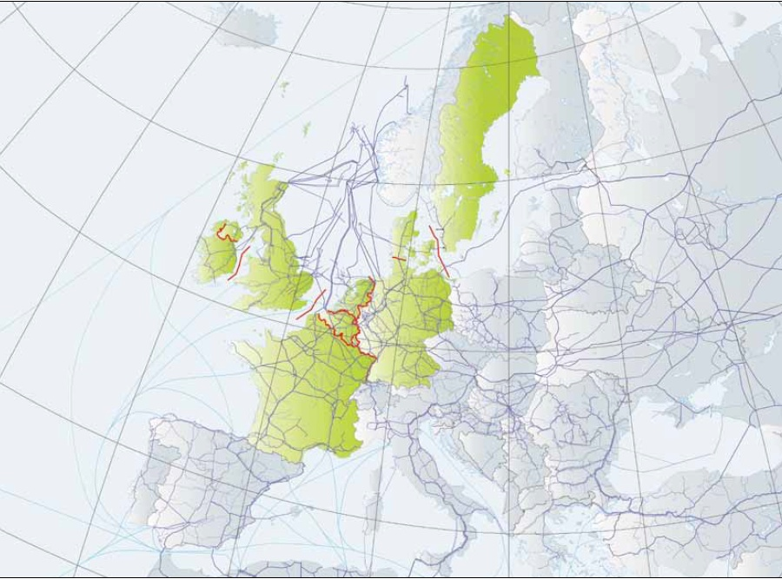
Gas Regional Investment Plan
North West 2013-2022
Stakeholder Consultation Presentation
4th April 2013

Slide 2
Consultation Details
This presentation informs stakeholders about the content of the North West Gas Regional Investment Plan 2013-2022 (NW GRIP)
Presentation at the GRI NW meeting in the Hague on 4th April 2013
This presentation will be accompanied by a consultation questionnaire
Published on the regional TSOs’, ENTSOG and GRI websites and shall be regarded as the input for the stakeholder consultation
Stakeholder Consultation start date 4th April 2013
Stakeholder Consultation end date 3rd May 2013
Responses to be submitted to NW GRIP coordinator GTS (see last slide with contact details)

Slide 3
NW GRIP 2013: Timeline
23 Nov 12
Early 13
4th April
3rd May
1st July
1st Sep
1st Oct
Late 2013
GRI NW consultation on concept
Start drafting the document
Stakeholder Consultation start date
Stakeholder Consultation end date
Share draft version with GRI NW
Deadline for GRI NW response
Final publication
Post GRIP publication consultation

Slide 4
Introduction
Why a GRIP?
Third Energy Package legal obligation
Regulation Art. 12(1) 715/2009/EC
Obligation for TSOs to publish a regional investment plan every two years
1st NW GRIP published in November 2011
First ever GRIP published from any region
Show how infrastructure projects influences cross-border points in the Northwest region
Highlighted strong collaboration between regional TSOs
Response to GRIP 2011 consultation round
No direct response to the questionnaire provided
EFET response
RCC response
Additional value GRIP 2013 compared to TYNDP 2013-2022
Additional element of regional cooperation
Update of project data and 2012 data
More detailed information about TYNDP identified cross-border issues

Slide 5
Structure NW GRIP 2013
High level principles
Complement ENTSOG TYNDP and ensure consistency with National Plans
Build on the inaugural NW GRIP and improve it
Improve stakeholder communication/consultation
Describe/explain the Region‘s assets & needs
Explain why investments in gas transmission projects are required in the Region
Describe projects
Agreement reached during the Nov. 2012 Copenhagen GRI NW GRIP consultation next NW GRIP to include:
Improvements based on feedback received, including RCC recommendations
Enhanced regional supply and demand analysis
Showing the Impact of projects on cross border points
Show procedure and results of regional cross border open seasons / auctions
‘Deep Dive’ into regional congested points as highlighted by TYNDP 2013-2022

Slide 6
Chapters NW GRIP 2013
Executive Summary
Introduction
North West Specifics
Supply and Demand
In Depth Review of TYNDP Identified NW Issues
Projects
Conclusions
Annex
  Project description: more detailed description/visualisation compared to TYNDP

Slide 7
Chapter North West Specifics I
The capacity developed by gas infrastructure projects directly improves the development of the European internal energy market by enhancing all three aspects of European Energy Pillars.
Pillar I Competition
Decades of collaboration and front runners in promoting competition
Resulted in the most liquid hubs in the EU
Previous and current Auctions and Open Seasons listed in the GRIP
All relevant projects included and elaborated in the GRIP
Pillar II Security of Supply
Long history of security of supply, cold spell 2012 cooperation illustrative for the region
Decrease in indigenous production, increase need for imports
L-gas issues up to 2022 only applicable to German situation, covered in German Netzentwicklungsplan and Pentalateral Forum, information to be included
Pillar III Sustainability
Gas as the cleanest fossil fuel plays a role in the future energy supply.
Gas infrastructure allows for a strong growth in the use of renewable sources (wind/sun), as it can affordably provide the required network flexibility and it can serve for example as a means to store energy.

Slide 8
Chapter North West Specifics II
This chapter will also outline the various reasons for the need for investment in gas infrastructure in the NW region
Sufficient capacity to promote competition
Sufficient capacity to guarantee security of supply
Substitute decreasing regional production
Supply diversification
Maintenance projects related to the ageing infrastructure
Sufficient network flexibility
But also barriers to investment exist, what is needed
A favourable regulatory framework (in the project’s definition, execution and operation phase).
A stable investment climate, ensuring that system owners are incentivised to invest in infrastructure projects and that investors can trust that they have a sufficient return on their investments
A clear political vision, not only on an annual volume base, but also on a daily/hourly capacity base

Slide 9
Chapter Supply & Demand
The NW GRIP will cover the following Demand based topics
Annual Demand for the north west region compared to total EU demand
Annual Demand development by country
Breakdown of Annual Demand into Gas Fired Power Generation and other
High Daily Demand scenarios
An example of the Impact of Renewables on Gas Fired Power Generation
The Supply aspect of the chapter will look into
The North West region’s growing import dependency
How regional Supply Source diversification will evolve
Infrastructure development of LNG in the region
The chapter will provide a wide ranging Supply and Demand outlook for North West Europe
*All 2012 figures shown the next charts are based on 2013 forecast data, by the time of publication 2012 data will be available.
9

Slide 10
Chapter S&D: Annual Demand

Slide 11
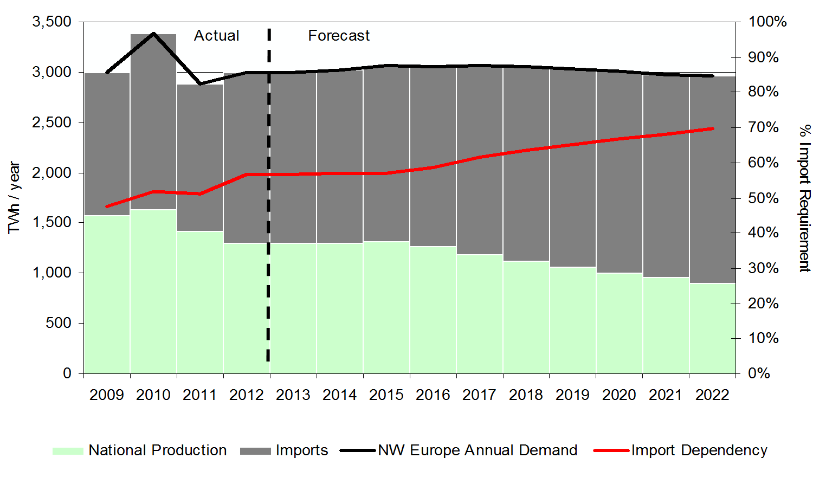
Chapter S&D: Annual Balance

Slide 12
Chapter S&D: High Daily Demand
The Design-Case scenario is favoured by the TSOs of the NW region, as it is considered the most robust. 2011 data has been used for 2012 in this example, actual data will be available for final publication.

Slide 13
Chapter ‘In Depth Review of TYNDP Identified NW Issues’
TYNDP covers four types of analyses:
Resilience assessment (potential investment gaps)
Findings for: Denmark, Sweden and Luxemburg
Supply dependency assessment (the dependence of some Zones on a single supply source)
Findings for Germany (GASPOOL market area), Denmark, TIGF France and South France
Network adaptability assessment (the ability of the system to adapt to various supply patterns)
No findings in NW region
Supply source diversification assessment (the capability of the system to enable its Zones to access different supply sources)
Overview included in NW GRIP S&D chapter

Slide 14

Chapter ‘In Depth Review of TYNDP Identified NW Issues’: Example
Resilience Assessment
Potential investment gaps
Germany, Denmark (and Sweden)
TYNDP Project Ellund
Capacity extension from Germany to Denmark would solve this issue
Projects were identified through an Open Season in 2009
FID-project Step 1 increase capacity from Oct. 2014 at a level of 310,000 m³/h
Non-FID project Step 2 increase capacity in 2016 at a level of 500,000 m³/h
Update GRIP 2013
Step 2 is now also FID
No investment gap

Slide 15
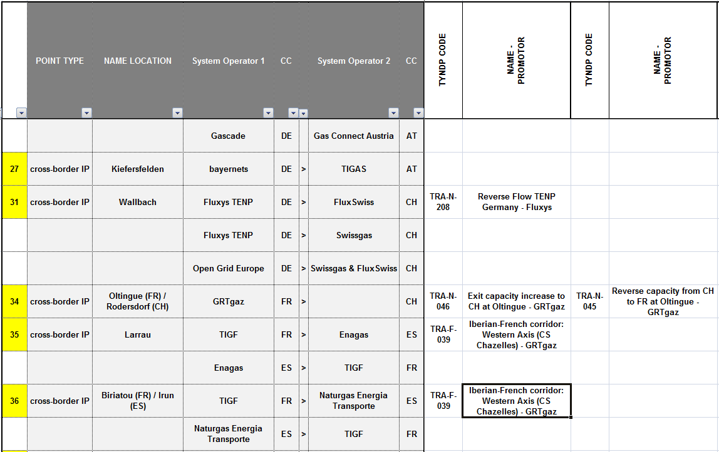
Chapter Projects: Matrix
The matrix improves regional transparency by showing how infrastructure projects impact border points and vice versa.

Slide 16
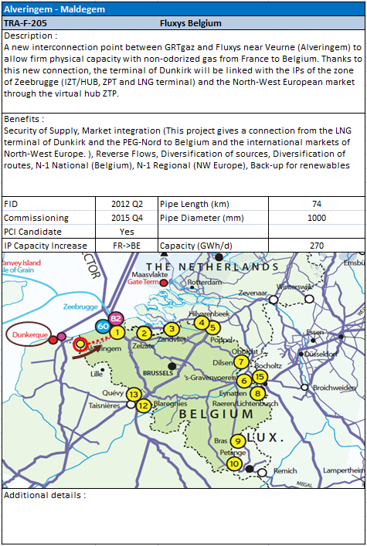
Annex: Project Details
Based on the project
information in the TYNDP
Plus new info if applicable
Plus more graphical
information

Slide 17
Consultation Questionnaire – Sample
What additional information/analysis would you like to see included in the North West Specifics and/or Supply & Demand chapter?
Do you think that the NW GRIP enhances transparency on projects? If not, please provide your reasoning.
Which chapter, do you think, will be of most interest to you and why?

Slide 18
Questions
18

Slide 19
Point of Contact / Response to be sent to
Mr. Piet Nienhuis, Gasunie Transport Services
P.Nienhuis@gastransportservices.nl
+31 (0) 50 521 2854

