Slide 1

South Region
Gas Regional Investment Plans
SGRI – 30th April 2013

Slide 2
GRIP South
Index
  Perimeter / methodology / objectives
  Content
  ACER opinion on GRIPS (25th March 2013)
  Planning
2

Slide 3
GRIP South : Perimeter /methodology / Objectives
  3 Countries : Portugal – Spain – France
  4 TSOs with rotating principle for coordination :
    ENAGAS → GRTgaz → REN or TIGF
  Methodology :
    In line with the ENTSOG TYNDP : complements, explanations, analyses at regional level
    Assistance from ENTSOG : Modelling, editing...
    Stakeholders : communication via ENTSOG meetings and GRI South

Slide 4

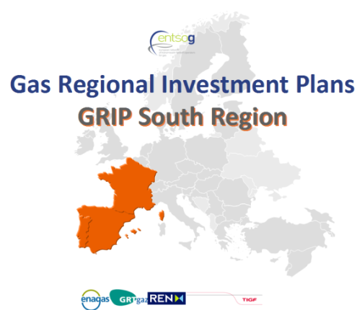
GRIP South Region: Content
Main drivers/objectives :
Complementing EU-TYNDP and consistent with National Plans
Taking into account comments received on the previous GRIP
Build on the current South GRIP, improving it
Improve communication / consultation
Describe/explain the Region assets & needs
Explain why investments in gas transmission projects are required in the Region
Describe the projects, their links, their added value... with focus on :
“The strategic concept of the North-South Corridor in Western Europe, that is to better interconnect the Mediterranean area and thus supplies from Africa and the Northern supply Corridor with supplies from Norway and Russia.” (EC, EIP for 2020)

Slide 5
ACER Opinion on GRIPs (25th March 2013)
TSOs of the South Region are pleased with the general positive opinion of ACER on GRIP South 2011-2020.
  “The South GRIP is more than merely a zoom of the TYNDP 2011-2020 to the South region, and it contains some added value with regard to it.
  In the GRIP TSOs provide their estimation of supply and demand data (especially their characterization, with a focus on the significance of LNG for supply and consumption in gas-fired electricity generation in the region for demand).
  The GRIP includes assessments of the qualitative potential benefits of new investments and of their contribution to security of supply (network resilience under risk scenarios), with a focus on the France-Spain Eastern Axis (MidCat) and the third IP between Spain and Portugal. These analyses aim at justifying the need to undertake such investments.”
5

Slide 6
ACER Opinion on GRIPs (25th March 2013)
  ACER recommendations already ongoing or planned (1/2) :
    More detailed and focused approach towards regional network development in comparison to the TYNDP
    Better justify the needs and remedies to resolve bottlenecks or congestions
    Further analyses regarding changes affecting the LNG market and their consequences for flow patterns
    More justification for new investments: in particular data on utilization rates of cross-border interconnection capacities over the last years
    Take into account the outcome of Open Season procedures concerning proposed IP developments
6

Slide 7
ACER Opinion on GRIPs (25th March 2013)
  ACER recommendations already ongoing or planned (2/2) :
    Projects’ integration in the national network and other infrastructure developments connecting the region with neighboring regions should also be considered
    To link the SoS benefits attributed to the MidCat project and the 3rd IP Spain-Portugal with the flexibility tools in the Region, in particular storage
    Greater involvement of stakeholders; open dialogue using GRI structures
7

Slide 8
ACER Opinion on GRIPs (25th March 2013)
  Other ACER recommendations to address :
    Role to play in the PCI selection process involves a more consistent sets of data, project evaluation methodologies and definitions; project assessment / justification based on TEN-E methodology for CBA; analysis of possible alternative projects would be helpful
    →Role to clarify; ENTSOG CBA methodology under development - not available yet
    Coordination with Electricity RIP to improve coherence of data and results
    More ENTSOG guidance for more harmonization (coordination and homogeneity) of the GRIPs
    Update of supply and demand scenarios; demand forecasts should be revised in the next GRIP in order to better reflect the effects of the economic crisis
8

Slide 9
ACER Opinion on GRIPs (25th March 2013)
  Conclusion :
  GRIP South 2013 will take into account most of the recommendations;
  If not possible for this edition, some recommendations will be addressed the 3rd edition
9

Slide 10
Planning
  TSOs meetings : from October 2012 ...
  ENTSOG TYNDP publication : 21st February 2013
  Writing of the new GRIP : from February 2013 ...
  Stakeholders communication / consultation:
    GRI South meeting(s) : IG meetings, SG meetings
    ENTSOG meeting(s) : Workshop(s)
    Consultation phase on TSOs and ENTSOG websites (to confirm)
  Publication : Q4 2013
10

Slide 11
Thank you for your attention

