Slide 1
SWE Day-ahead market coupling
(Pre- and Post-Coupling project)
Paris, 1st March 2013
11th IG meeting - SWE ERI

Slide 2
Agenda
1
Project overview
2
High Level Functional Architecture
3
Legal framework and regulatory evolutions
4
Project planning

Slide 3




Reminder: background of SWE market coupling
  Project objective: Day Ahead market coupling of the SWE region to the NWE region, based on PCR solution
  XXI Florence Forum: European single internal market by 2014
  10th IG meeting of the SWE ERI (14/05/2012 in Paris): mandate to enter in a project phase through the signature of a Cooperation Agreement between the parties to specify Pre- and Post-Coupling (PPC) arrangements, analyze impacts and changes to be made and prepared for implementation
  6th SG meeting of the SWE ERI
  (25/10/2012 in Madrid): first report

Slide 4
Reminder: the SWE project organization
  The SWE Organization comprises:
    The Steering Committee (“SC”) which contains representatives from all project parties and is the unique body entitled to make decisions
    The General Working Group (“GWG”) is in charge of the day-to-day management of the project
    The Legal Working Group (“LWG”) is in charge of preparing the necessary agreements between the SWE parties to operate the Market Coupling and identifying the required regulatory changes
    The Procedure and Testing Working Group (“PTWG”) is in charge of producing the procedures and of organizing and carrying out the SWE test activities
  Implementation of PCR solution in the region (algorithm, associated IT systems) is being developed by PXs
SWE High Level Meeting (HLM)
PMO
GENERAL WORK GROUP
(OMIE)
SWE PPC PROCESSES STEERING COMMITTEE (SC)
(REE)
LEGAL WORKING GROUP (LWG)
(EPEXSpot)
PROCEDURES AND TESTING WORKING GROUP (PTWG)
(EPEX Spot/OMIE)

Slide 5
The SWE-PPC project status
A Cooperation Agreement has been signed for the design phase and an amendment for the implementation phase is to be finalized soon for its signature
The design phase for Pre-Coupling, Post-Coupling and Exceptional Situations is almost finalized
The design of Fallback solutions (the exceptional situation when there is a decoupling) is currently being analyzed. Two options are under evaluation: daily shadow (explicit) auctions aligned with CWE/NWE and deemed flow zero (allocation in ID timeframe)
A first set of regulatory changes which are needed in Spain and Portugal has been provided to the relevant National Regulatory Authorities and is waiting for publication. These changes include the modification of Gate Closure Time of the DA Iberian market (MIBEL) to 12:00 (CET)
Preparation of the other regulatory changes (e.g. PCR algorithm and adaptation of Spanish Operation Procedures to PPC process) is in process

Slide 6
Agenda
1
Project overview
2
High Level Functional Architecture
3
Legal framework and regulatory evolutions
4
Project planning

Slide 7
High Level Functional Architecture
Pre-coupling and post-coupling
    Pre-coupling describes the process of sending and validating the ATC/NTC needed for the Coupling.
    Post-coupling describes the process of checking market results and communicating the scheduled cross border exchanges between the different bidding zones and the settlement and billing and payment of the congestion rent
  Exceptional situations and Fallback
    Exceptional situations procedures explain how to manage:
    Absence of transfer capacity information for a border in the last permitted moment
    Non-coherent transfer capacity information for a border in the last permitted moment
    Fallback is the process initiated in case of:
    Impossibility of solving the European Coupled market. Need of a Fallback procedure for the Spain – France border in decoupled situation
    For Portugal and Spain, no fallback will be investigated as OMIE will ensure delivery of schedules on the border

Slide 8
High Level Functional Architecture
Pre-coupling
Parallel sending of ATC values

Slide 9
High Level Functional Architecture
Post-coupling, validation of results
Parallel validation of results
Validation

Slide 10
High Level Functional Architecture
Post-coupling, congestion rent
50% share of day-ahead rent, involvement of CASC for RTE
Explicit nomination for the French side only
CRDS: Congestion Rent Distribution System

Slide 11
High Level Functional Architecture
Exceptional situations
The following cases are being investigated by the GWG
Situation description
Case 1 : No ATC received No ATC value from REE and RTE No ATC value from REE and REN
Case 2 : One ATC value missing ATC from REN and no ATC from REE ATC from RTE and no ATC from REE ATC from REE and no ATC from REN ATC from REE and no ATC from RTE
Case 3 : Mis-matches ATC values Different ATC values from REE and REN Different ATC values from REE and RTE
The following fallback solutions are discussed:
    Shadow auctions
    Deemed flow zero - Intraday allocation

Slide 12
High Level Functional Architecture
Fallback solutions for coupling – Option 1: Shadow auctions
Explicit shadow auctions are carried out for allocating physical capacities for the following day
Taking into account the results of this explicit allocation of capacities, Market Parties have to modify their bids in the day-ahead market or make bilateral contracts. PXs should reopen their orders books once the explicit auctions have been carried out
This mechanism is similar to the daily explicit auction currently in place on the France-Spain border
This mechanism is currently in place as the standard fallback solution in CWE coupling
PROS | CONS
Market based mechanisms Financial risk is not carried by TSOs nor PXs Market Parties can decide the use of capacity (direction, volume and price), depending on their needs Solution known by market parties (similar to current mechanisms and already in place on other borders) | Time necessary for carrying out Shadow auctions may not be sufficient: need for a more detailed analysis of timings Need of proper reaction by MPs (risk of unacceptable peak prices if some bids are not duly updated in DA market - past experience not always positive) Need to take into account the delays and implications on the following markets in Spain (implicit nomination, generation scheduling ...)

Slide 13
High Level Functional Architecture
Fallback solutions for coupling – Option 2: Deemed flow zero - Intraday allocations
A volume of zero is given as capacity to be allocated in the matching process between FR and ES for the resolution of the pricing algorithms in the decoupled markets (long term capacities are taken into account in any case)
The capacity that is not given in the DA market is offered later on in the intraday timeframe, whatever the allocation method is in place.
MPs may need to update their bids in the DA market once the information about the initiation of fallback is given. In this case PXs would then reopen their order books
PROS | CONS
Timing: the pricing algorithm can be easily run with a zero capacity between bidding areas. Robustness: this solution seems easier to implement and has less operative impact on MPs, compared to shadow auctions Avoidance of some financial risk to TSOs and PXs as the D-1 congestion rent is zero (cannot be negative) Can be a last resort solution if shadow auctions fail | Risk of price spread spikes in the day-ahead markets when no capacity is allocated in DA No congestion rent in DA Non market-based solution

Slide 14
Agenda
1
Project overview
2
High Level Functional Architecture
3
Legal framework and regulatory evolutions
4
Project planning

Slide 15
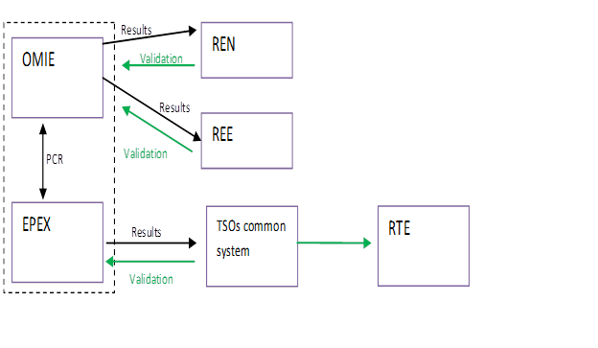
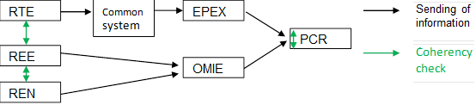
Legal structure for the operational phase
An analysis of the necessary contractual and regulatory developments to start the SWE coupling is required:
Pre-coupling
Post-coupling
The common aim of all parties is to stick as much as possible to the existing contractual, statutory and regulatory arrangements
However in any case, some points do require contractual provisions
The proposed legal framework is based on a light framework agreement and bilateral contracts

Slide 16
High Level legal framework
1
: Light framework agreement for all parties
2
3
4
: Bilateral contracts
1
3
Statutory and regulatory provisions
4
PCR agreements
Contractual relationship
2
No contractual nor regulatory provisions implemented

Slide 17
Option 2: detailed presentation
All parties light framework agreement
1
    High level description of procedures
    Congestion rent waiver (only for market results and decoupling to be evaluated in a further stage – to be discussed at further stage)
    Governance
    Change control procedure
    Communication
    Non-disclosure obligations
    Intellectual Property Rights (IPRs)
    Light liability provisions (exclusion of indirect damages, specific provisions but no single liability cap).
OMIE – EPEX : PCR
RTE – EPEX
OMIE – REE / REN
4
2
3
PCR agreements provide interregional procedures for the coupling ➔ to be added : pre-post coupling regional procedures.
Daily operation procedures
  matching of the ATC
  decoupling
  fall-back
Obligation to ensure consistency on operational side of all bilateral arrangements among themselves and with PCR + liability provisions of PCR
Operations
    Daily operation procedures
      Pre- and post-coupling
      fall-back
      exceptional situations
    Firmness of the ATC
PCR agreements
Regulatory framework

Slide 18
Status of operational and regulatory changes
  Change of Gate Closure Time of the Iberian market to 12:00 (CET)
  A set of regulatory changes needed in Spain can be identified
    High level regulation (Ministerial Order 4112/2005)
    MIBEL Markets Rules and Operational Procedures in Spain (e.g. tick size…)
    FR-ES Interconnection rules (IFE Rules)
    Cooperation Agreement RTE-REE for the management of the interconnection
  A set of regulatory changes needed in Portugal can be identified
    Manual de Procedimento da Gestão Global do Sistema and corresponding Avisos;
    Agreement between REN and OMIE.
  Implementation of these changes before November 2013 is on the critical path for market coupling go live
  The signature of all needed agreements between parties is a critical condition for program progress

Slide 19
Agenda
1
Project overview
2
High Level Functional Architecture
3
Legal framework and regulatory evolutions
4
Project planning

Slide 20
The SWE-PPC project planning
  Preliminary SWE Project planning:
    The remaining design activities are mainly the finalization of the design, the extension of the project to implementation, the proposal of the regulatory changes and contractual developments needed to implement PPC processes. It is foreseen to finish the design phase in March 2013 and to start the implementation phase of the project with IT developments and testing
    It is the objective of all SWE parties to participate in the NWE integration tests in June 2013, provided that all local SWE tests are completed successfully at that date. As PCR members EPEX and OMIE already participate in the PCR testing
    The Florence Forum conclusions of the 20th and 21st November 2012 meeting have confirmed that the European community supports “all parties to proceed speedily, including the SWE region as soon as possible”
    The SWE project go-live date will be defined in a reasonable manner once the process is evaluated in detail together with NWE
  SWE parties have assessed two options for the planning (cf. next slides). These planning options take into account coordination with NWE and include the assessment of temporary solutions for some specific processes

Slide 21
Proposal of the high level planning
Startup solution
2013
2014
 |  | Feb | March | April | May | June | July | Aug | Sept | Oct | Nov | Dec | Jan | Feb
Operational activities
IT developments
Testing activities
Regulatory evolutions
Design finalization
Implementation preparation
Reception of comfort letters (RTE)
NWE Go live window
Operators training
MPs training
Main characteristic of this startup solution:
Sending of ATCs on FR/ES only by REE
Aspects to be taken into account:
Reduced time for industrialized post coupling testing (including nominations)
No room for contingency
Regulatory modalities for this specific interim solution to be defined
Design approval
Project implementation plan
Signature of amendment to Cooperation Agreement for implementation
Design approval
Comfort letters
Project implementation plan
Procedures refinement
Contractual framework drafting
Contracts drafting
IT Specs
IT developments
PX’s IT Specs..Post C.
PX’s Post Coupling IT developments
TSO’s IT Specs..Post Coupling
TSO’s Post Coupling IT developments
Master test plan definition
Local testing
Connectivity testing
Master test plan
Sanity, integration testing
Procedural and acceptance testing
Coordination with NWE testing activities
Participating in PCR/NWE testing
Local regulation evolutions/changes
Public consultation(s)
Regulatory approval(s)
Auction rules evolution

Slide 22
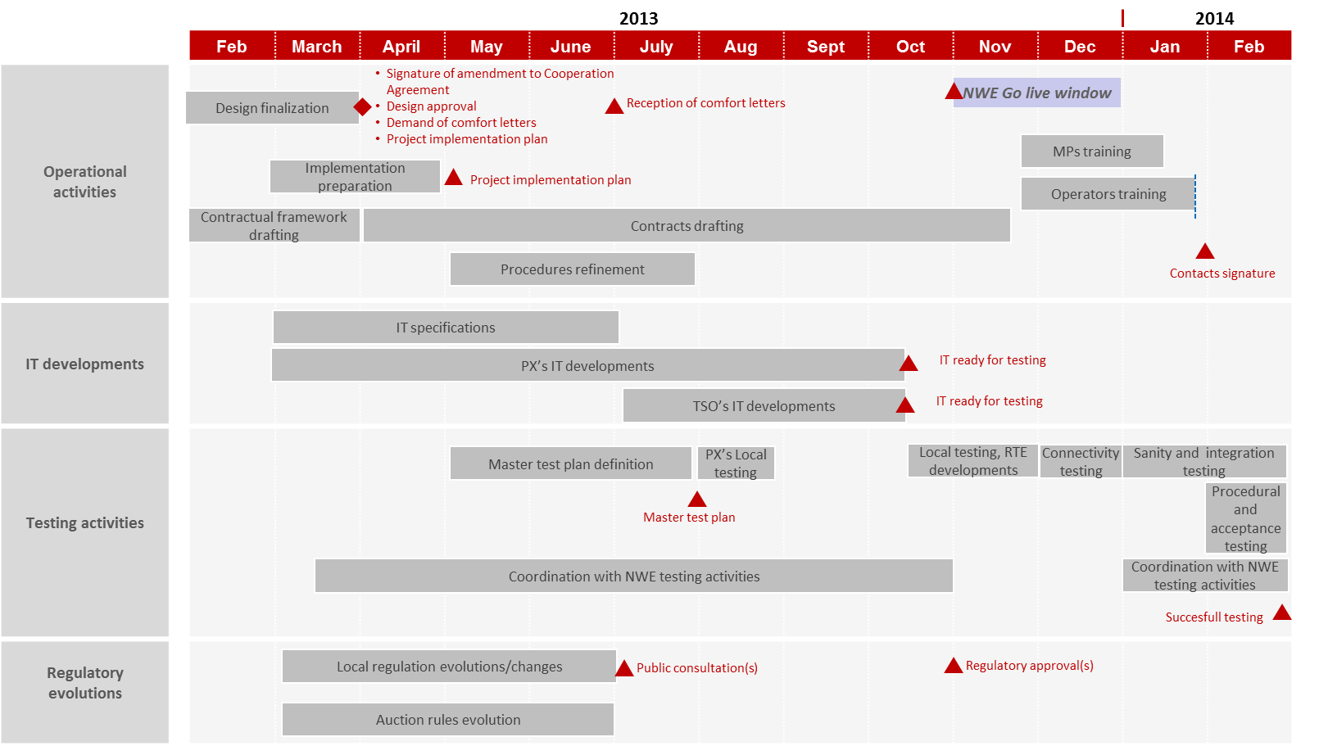
Proposal of the high level planning
Final solution

