Slide 1


52nd IG Meeting
South Gas Regional Initiative
22nd November 2019
Telco

Slide 2
DRAFT AGENDA

Slide 3
2. WP First target: use of infrastructures in the Region
2.1. Follow-up of infrastructure development (PCIs, TYNDP, GRIP…)
  For information by TSOs

Slide 4
2. WP First target: use of infrastructures in the Region
  2.2. Report on use of infrastructures (Oct16-Sept19): state of play and next steps (for information by TSOs)
    Detailed index approved
    Period of analysis was extended: Oct16-Sept19
    The way forward agreed (two deliverables):
      December 2019 draft report for the period Oct16-June 19: status review
      March 2020: final report (updated with Oct16-Sept19 data)
TSOs will periodically inform about the development of the report on the use of the interconnections in the period 1st October 2016 to 30th September 2019
Deadline: March 2020

Slide 5
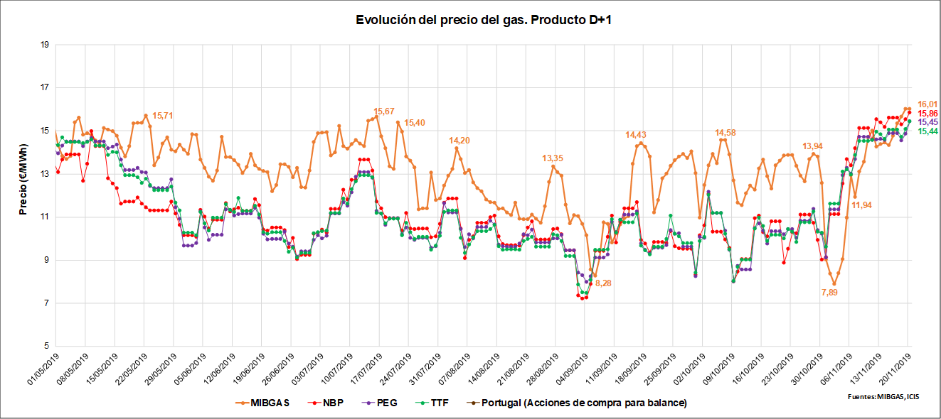
3. WP Second target: market integration
3.1. Follow-up of gas prices SGRI hubs vs. neighbouring hubs
(for information by NRAs and TSOs)
Evolution of prices D+1 (1st MaY 2019- 20th November 2019)

Slide 6
3. WP Second target: market integration
  3.2. Merger of market areas in France: main achievements and challenges after one year of operation
  For information by CRE

Slide 7
3. WP Second target: market integration
  3.3. Progress on the implementation of UIOLI LT mechanism in VIP Ibérico (Portuguese side)
  For information by REN/ENAGAS

Slide 8
3. WP Second target: market integration
  3.3. Progress on the implementation of UIOLI LT mechanism in VIP Ibérico (Portuguese side)
Roadmap for the implementation of UIOLI LT at VIP Ibérico
TSOs presented a joint draft proposal of UIOLI LT to be applied in VIP Ibérico.
NRAs are currently assessing the proposal and will provide common comments.
Once agreed, ERSE will approve the national legislation according to the corresponding procedure, which includes submitting the document to public consultation in Portugal. At the same time, the document will be submitted to public consultation in ACER´s website.
NRAs will evaluate the stakeholder´s responses. In light of the responses, if needed, NRAs will ask TSOs to review the UIOLI LT draft.
Final version of UIOLI LT will be submitted to IG for approval and it will be integrated in Portuguese regulation .

Slide 9
4. WP Third target: contribution of gases to decarbonisation
  4.1. Follow-up
  For information by TSOs and NRAs

Slide 10
5. WP Forth target: other items for discussion
  5.1. Public consultation regarding the functioning of the single gas market area in France
  For information by CRE

Slide 11
5. WP Forth target: other items for discussion
  5.2. Status of Tariff NC implementation in the Region (for information by NRAs)
PORTUGAL

Slide 12
ERSE completed the periodic NRA decision-making before the NC deadline and published transmission tariffs for 2019/2020 according to the new RPM
Periodic NRA decision-making (Art. 27)
Important dates
  Public consultation: 18/08/2018 – 18/10/2018
  ACER report: 13/12/2018
  Motivated NRA decision: 18/03/2019 [NC TAR deadline: 31/05/2019]
  1st Tariff period with RPM: 01/10/2019 – 30/09/2020
Key aspects of motivated decision
  Information regarding ERSE motivated decision on:
  http://www.erse.pt/pt/consultaspublicas/historico/Paginas/66_4.aspx
RPM | Modified capacity weighted distance
Entry-exit split | 28/72
Art. 9 Discounts (storage, LNG) | 100% discount at entry/exit points from/to storage facilities
Art. 16 Discount (interruptible capacity) | Ex-post discount
Not applicable issues | commodity charges, non-transmission services, seasonal factors

Slide 13
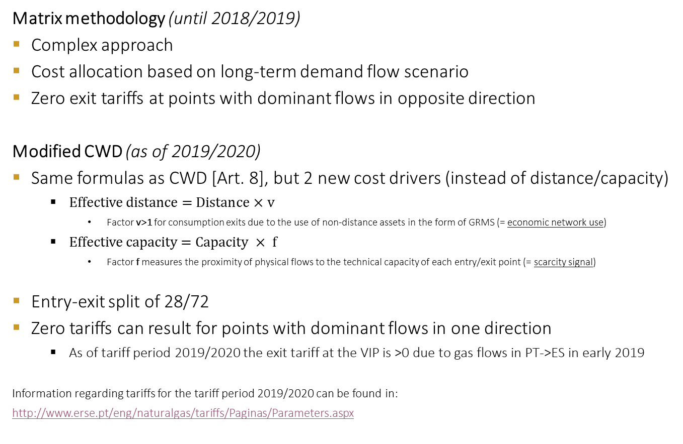
ERSE has moved from a matrix methodology to a modified CWD approach
Reference price methodology
Matrix methodology (until 2018/2019)
  Complex approach
  Cost allocation based on long-term demand flow scenario
  Zero exit tariffs at points with dominant flows in opposite direction
Modified CWD (as of 2019/2020)
Same formulas as CWD [Art. 8], but 2 new cost drivers (instead of distance/capacity)
  $\text{Effective} \text{distance}\text{ = }\text{Distance} \text{×} \text{v}$
    Factor v>1 for consumption exits due to the use of non-distance assets in the form of GRMS (= economic network use)
  $\text{Effective} \text{capacity}\text{ = }\text{Capacity} × \text{f}$
    Factor f measures the proximity of physical flows to the technical capacity of each entry/exit point (= scarcity signal)
Entry-exit split of 28/72
Zero tariffs can result for points with dominant flows in one direction
  As of tariff period 2019/2020 the exit tariff at the VIP is >0 due to gas flows in PT->ES in early 2019
  Information regarding tariffs for the tariff period 2019/2020 can be found in:
  http://www.erse.pt/eng/naturalgas/tariffs/Paginas/Parameters.aspx

Slide 14
5. WP Forth target: other items for discussion
  5.2. Status of Tariff NC implementation in the Region (for information by NRAs)
SPAIN
Public consultation on the methodology in the gas system concerning access tariffs related to transmission network, local networks and LNG facilities closed on 30th September.
Stakeholder´s comments to public consultation have been already published.
Methodology was formally submitted to ACER and ACER´s opinion is expected by the end of this month.
  Past public consultation documents available in the following link (English version available):
  https://www.cnmc.es/ambitos-de-actuacion/energia/consultas-publicas-finalizadas

Slide 15
5. WP Forth target: other items for discussion
5.2. AOB

Slide 16




6. Meeting schedule
RCC
IG
SG
Next IG meeting: XX February (tbd)

Slide 17
Thank you for attending

