Slide 1


56th IG Meeting
South Gas Regional Initiative
9th December 2020
Telco

Slide 2
DRAFT AGENDA

Slide 3
2. WP First target: use of infrastructures in the Region
2.1. Follow-up of infrastructure development (PCIs, TYNDP, GRIP…)
  For information by TSOs

Slide 4
3. WP Second target: market integration
3.1. Follow-up of gas prices and hubs liquidity (SGRI vs. neighbouring hubs) (for information by NRAs and TSOs)

Slide 5
3. WP Second target: market integration
  3.2.Trading of Portuguese products in MIBGAS: status and next steps (for information by ERSE and REN)
  The trading rules in MIBGAS for products delivered in the Portuguese VTP and associated procedures were approved on 7th September;
  MIBGAS, S.A. and REN presented a public timeline for implementation indicating 16th March 2021 as the date for the beginning of negotiation.
  For information by ERSE/REN

Slide 6
3. WP Second target: market integration
  3.3. Proposal of allocation of interruptible capacity in a coordinated way in the VIPs (for information by TSOs)
  For information by TSOs

Slide 7
4. WP Third target: contribution of gases to decarbonisation
  4.1. Follow-up (for information by NRAs and TSOs)
  For information by NRAs and TSOs

Slide 8
4. WP Third target: contribution of gases to decarbonisation
  4.2. Renewable hydrogen roadmap Spain (for information by CNMC)
  The Ministry for Ecological Transition launched two public consultations in April 2020, one for biogas and one for hydrogen respectively, in order to develop a roadmap to boost these types of gases.
  After gathering opinions from stakeholders, the Spanish Government approved in October the "Hydrogen Roadmap: a commitment to renewable hydrogen“ containing a planning to promote the deployment of this sustainable energy vector, which will be key to Spain for achieving climate neutrality by 2050.
  The development of renewable hydrogen will promote the creation of innovative industrial value chains in the country, technological knowledge and the generation of sustainable employment, contributing to the reactivation towards a high added value green economy.

Slide 9
4. WP Third target: contribution of gases to decarbonisation
  4.2. Renewable hydrogen roadmap Spain (for information by CNMC)
  The roadmap is aligned with the 2021 Annual Sustainable Growth Strategy published by the European Commission.
  The roadmap provides a vision for 2030 and 2050

Slide 10
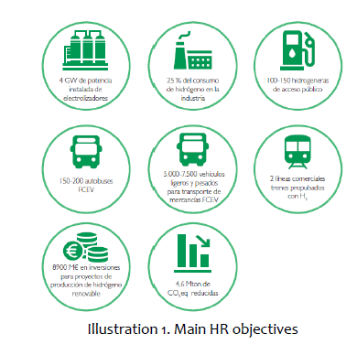
4. WP Third target: contribution of gases to decarbonisation
  4.2. Renewable hydrogen roadmap Spain (for information by CNMC)
  2030 vision specific targets foresees an installed capacity of 4 GW electrolysers and milestones in the industrial, mobility and electricity sector (estimated investment cost: 8.900 M€)
  Based on the evaluation of the progress towards the achievement of the 2030 vision objectives, this roadmap will be updated every three years in order to adapt the plan to technological developments and market evolution.
  For more information:
  https://www.miteco.gob.es/es/ministerio/hoja-de-ruta-del-hidrogeno-renovable.aspx

Slide 11
4. WP Third target: contribution of gases to decarbonisation
  4.3. Organization and functioning of the National Gas System in Portugal (Decree-Law 62/2020) (for information by ERSE)
  For information by ERSE

Slide 12
5. WP Forth target: other items for discussion
  5.1. Draft work programme 2021-2022 (for information by NRAs and for discussion NRAs/TSOs)
  WP 2019-2020. Main achievements and compliance with the targets
  Target 1. Infrastructures (follow-up and deliverable).
  “Report on the use of infrastructures in the Region Oct16-Sept19”
  Target 2. Market integration (follow-up and deliverable).
  Implementation of the UIOLI LT mechanism at VIP Ibérico (April 2020)
  VIP Pirineos (5 years auctioned: capacity to be auctioned)
  Target 3. Contribution of gases to decarbonisation (follow-up)
  Target 4. Any other item for discussion
  Impact of the abolition of summer time changes on gas systems (rolled over to the WP 2021-2022).
  Other issues addressed :
  Implementation of tariff NC in the SGRI member countries.
  Allocation of interruptible capacity in a coordinated way (first draft): to be continued in the WP 2021-2022.

Slide 13
5. WP Forth target: other items for discussion
  5.1. Draft work programme 2021-2022 (for information by NRAs and for discussion NRAs/TSOs)
  WP 2019-2020. Main achievements and compliance with the targets
  Information on public consultations launched in the Region:
    Spain:
      2019: Tariffs, balancing and access to national infrastructures regimes.
      2020: Roadmap on H2 and biogases.
    France:
      2019: Update on the merger of market areas in France
      2019: How to solve congestion episodes in PEG.
      2019 : Tariffs
    Portugal:
      2019: UIOLI LT mechanism and Tariffs
      2019/2020: Trading rules for the inclusion of Portuguese products in MIBGAS
      2020: Balancing rules

Slide 14
5. WP Forth target: other items for discussion
  5.1. Draft work programme 2021-2022 (for information by NRAs and for discussion NRAs/TSOs)
TARGET 1. INFRASTRUCTURES
Follow-up work
- Follow-up of infrastructure development (PCIs, TYNDP, GRIP…).
- Calculation of capacity at VIPs.
- Offer, allocation and use of capacity at VIPs.
- Gas flows in the Region.
- Expiration of LT contracts.
- Secondary market and transfer of use.

Slide 15
5. WP Forth target: other items for discussion
  5.1. Draft work programme 2021-2022 (for information by NRAs and for discussion NRAs/TSOs)
TARGET 2. MARKET INTEGRATION IN THE REGION
Follow-up work
- Market integration in the Region: flows, price spreads and regulated tariffs in interconnections.
- Evolution of gas prices and hubs liquidity.
- Supporting the inclusion of the Portuguese side in MIBGAS and monitoring its well-functioning (interactions between explicit and implicit allocation).
- Impact of market dynamics and national regulatory developments on the use of the VIPs.
- NRAs recommendations and conclusions.
Deliverables
- Implementation of allocation of interruptible capacity in a coordinated way and implicit allocation at VIP Ibérico.
- Study on the viability of cross-border balancing operations in VIP Iberico (or ‘in the region ‘)

Slide 16
5. WP Forth target: other items for discussion
  5.1. Draft work programme 2021-2022 (for information by NRAs and for discussion NRAs/TSOs)
TARGET 3. CONTRIBUTION OF GASES TO DECARBONISATION
Follow-up work
- Sharing good practices/pilot projects (hydrogen for mobility, certificates of origin, impact of renewable gases on gas quality…), as well as related regulatory developments in the member countries.
- Follow-up on discussions on renewable gases implementation.
- Contribution of the SGRI countries to the EU strategies on hydrogen and new gases.
- The role of gases, in particular for mobility.

Slide 17
5. WP Forth target: other items for discussion
  5.1. Draft work programme 2021-2022 (for information by NRAs and for discussion NRAs/TSOs)
TARGET 4. ANY OTHER ITEM FOR DISCUSSION
- Follow up of new gas legislation and potential impact on the Region.
- Development common position papers in the Region, if needed, related to new gas legislation and EU strategies.
- "Abolition of summer time changes" as per new EU Directive proposal - analysis of impacts and implementation (depending on the progress of European regulation to this respect), when the Directive is approved.
  For information by ERSE

Slide 18
5. WP Forth target: other items for discussion
  5.1. Draft work programme 2021-2022 (for information by NRAs and for discussion NRAs/TSOs)
NEXT STEPS
- WP 2021-2022 for comments until the 15th December by noon
Final version of the WP 2021-2022 will be sent for online (deadline: 18th December)
Meeting request to SG to present:
  achievements on the WP 2019-2020
  new WP 2021-2022
  SG meeting by the end of January (date tbd)

Slide 19
5. WP Forth target: other items for discussion
  5.2. AOB

Slide 20

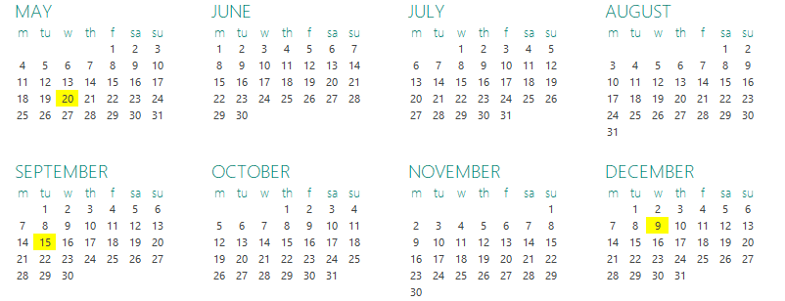


RCC
6. Meeting schedule
IG
SG
Next IG meeting: XX March (tbd)

Slide 21
Thank you for attending

