Slide 1


57th IG Meeting
South Gas Regional Initiative
23th March 2021
Telco

Slide 2
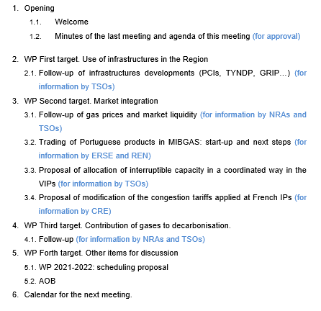
DRAFT AGENDA

Slide 3
2. WP First target: use of infrastructures in the Region
2.1. Follow-up of infrastructure development (PCIs, TYNDP, GRIP…)
  For information by TSOs

Slide 4
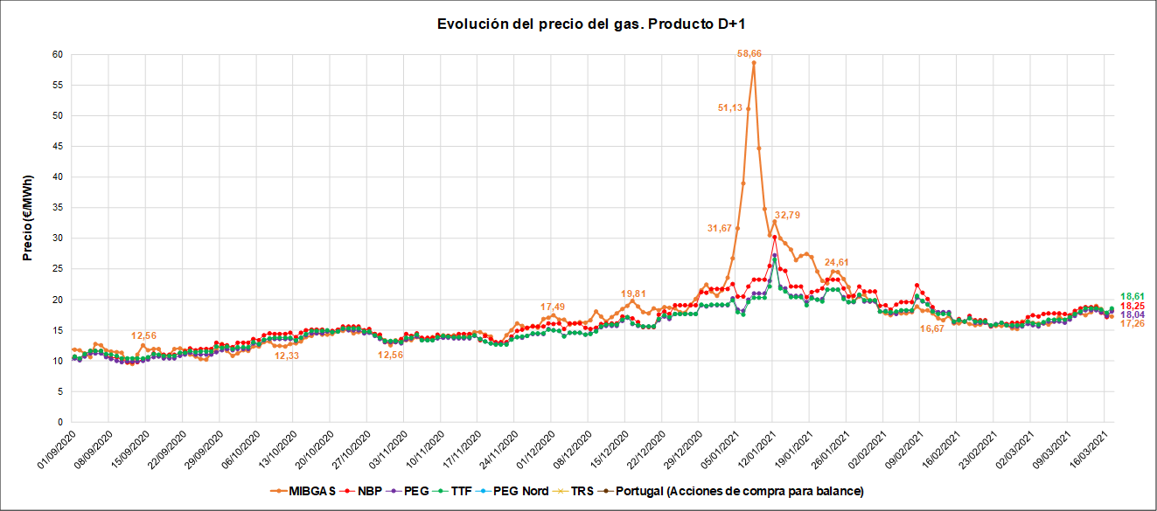
3. WP Second target: market integration
3.1. Follow-up of gas prices and hubs liquidity (SGRI vs. neighbouring hubs) (for information by NRAs and TSOs)
1st September 2020-17th March 2021 Prices D+1

Slide 5
3. WP Second target: market integration
  3.2.Trading of Portuguese products in MIBGAS: start-up and next steps (for information by ERSE and REN)
  The trading rules in MIBGAS for products delivered in the Portuguese VTP and associated procedures were approved on 7th September;
  MIBGAS, S.A. and REN agreed on a roadmap indicating 16th March 2021 as the date for the beginning of negotiation.
  For information by ERSE/REN

Slide 6
3. WP Second target: market integration
  3.3. Proposal of allocation of interruptible capacity in a coordinated way in the VIPs (for information by TSOs)
  For information by TSOs

Slide 7
3. WP Second target: market integration
  3.4. Proposal of modification of the congestion tariffs applied at French IPs (for information by CRE)
  For information by CRE

Slide 8
4. WP Third target: contribution of gases to decarbonisation
  4.1. Follow-up (for information by NRAs and TSOs)
  For information by NRAs and TSOs

Slide 9
5. WP Forth target: other items for discussion
  5.1. Work programme 2021-2022: schedule of deliverables (for discussion NRAs/TSOs)
  Target 1. Infrastructures (deliverable).
    Deliverable 1: Implementation of a common mechanism to offer cross-border day-ahead interruptible capacity.
      Drafters: ENAGAS/REN
      Next steps (proposal):
      - First draft for NRAs´ comments (May/June 2021)
      - Approval (Sept 2021)
  Target 2. Market integration (deliverables).
    Deliverable 2: Study on the viability of cross-border balancing operations in the Region
      Drafters: REN
      Next steps (proposal):
      - Outline for discussion (next IG)
      - First draft for NRAs´ comments (December 2021)
      - Approval (March 2022)

Slide 10
5. WP Forth target: other items for discussion
  5.1. Work programme 2021-2022: schedule of deliverables (for discussion NRAs/TSOs)
  Target 2. Market integration (deliverables).
  Deliverable 3: Study on the role of tariffs to foster market integration of the Spanish and Portuguese markets
      Drafters: ERSE/CNMC
      Next steps (proposal):
      - Outline for discussion (September 2021)
      - First draft for NRAs´ comments (June 2022)
      - Approval (December 2022)

Slide 11
5. WP Forth target: other items for discussion
  5.2. AOB

Slide 12


RCC
6. Meeting schedule
IG
SG
Next IG meeting: XX June (tbd)

Slide 13
Thank you for attending

