Slide 1


57th IG Meeting
South Gas Regional Initiative
23th March 2021
Telco

Slide 2
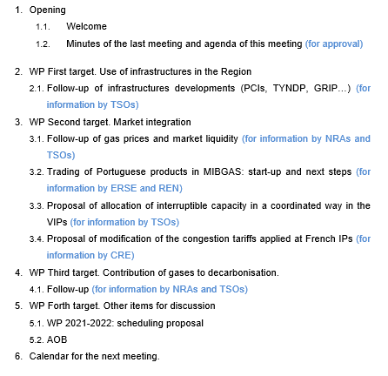
DRAFT AGENDA

Slide 3
2. WP First target: use of infrastructures in the Region
2.1. Follow-up of infrastructure development (PCIs, TYNDP, GRIP…)
  For information by TSOs

Slide 4
Planning TYNDP 2020
The draft TYNDP 2020 was published on 25 November
The public consultation of the draft TYNDP 2020 was closed on the 8 January. The results, based on the answers of 6 stakeholders, where share on the INV WG (February)
After receiving ACER opinion, final TYNDP 2020 will be published in May 2021
Project Assessment
System Assessment
Public consultation
ACER´s Opinion
Approval of MB 6.05
2020
2021
Jan
Feb
Mar
Apr
May
Jun
Jul
Aug
Sep
Oct
Nov
Dec
Jan
Feb
Mar
Apr
May
Publication: PS-CBA Groups
Publication: Scenarios
TYNDP Report
TYNDP: Approval of the Assessment & Infrastructure Reports
Approval of Draft TYNDP by INV WG
Approval of Draft TYNDP by the Board
Approval of Final TYNDP by the INV WG
Publication:
Final TYNDP
Infrastructure & Assessment Reports; Maps; Gas Quality Outlook; Annexes
Publication: Draft TYNDP report & Project Fiches
Internal milestones
Publications

Slide 5
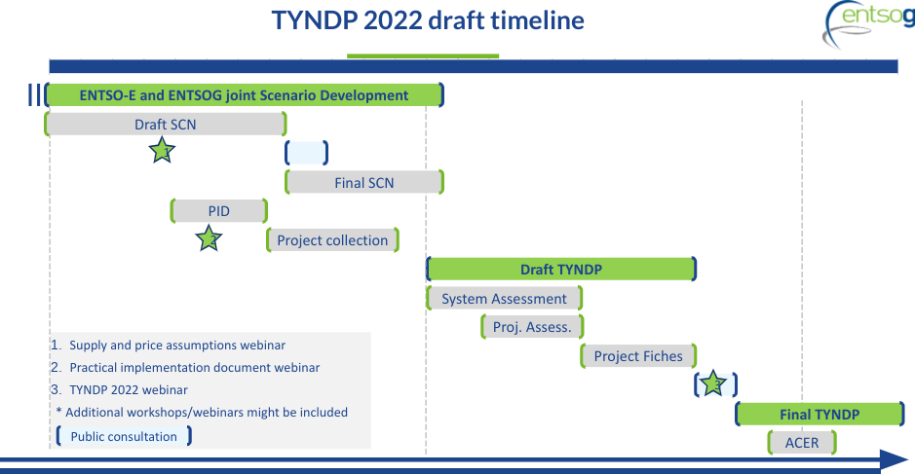
TYNDP 2022 – TYNDP 2022 General Timeline

Slide 6
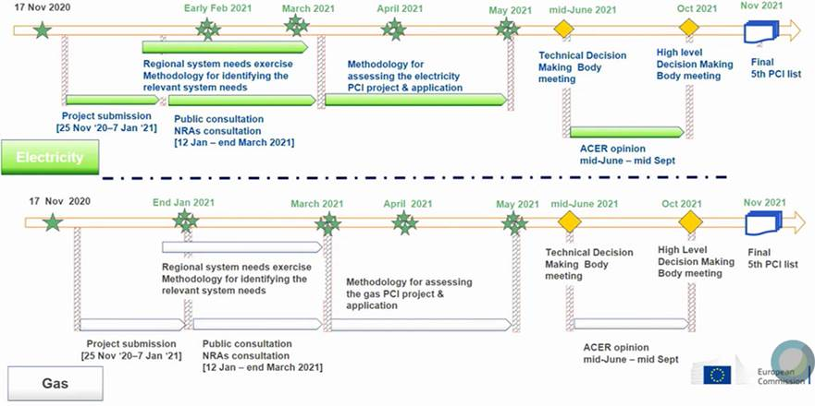
5th PCI list
The 5th PCI list will be prepared in line with current TEN-E Regulation and not with future one. H2 is not in the scope of current regulation.
17 November: Kick-off meeting
10 February: Draft methodology for identification of system needs
15-16 March: Final identification of system needs
10 Feb 2021
15-16 March2021

Slide 7
5th PCI list
Consultation on the list of candidate projects of common interest in electricity and gas – Deadline: 8 April 2021.
List of candidate Projects of Common Interest in gas
PCI candidates for the 5th List in the region:
TYNDP Project number | Name of the project | Country | Promoter | Current phase of the project | Project date of commissioning | Descritption
ETR-N-921 | Circular economy: waste to biomethane | Spain | Reganosa | Feasibility Study (definition of the feedstocks to be treated vs. plant nominal capacity) | 2022
TRA-A-429 | Adaptation L- gas - H-gas | France | GRTgaz and Storengy | Engineering studies | 2025 | Project group is composed by projects to ensure conversion of the existing L-gas infrastructure in Belgium and France into H-gas infrastructure so as to ensure flows of H-gas.

Slide 8
South GRIP
Reganosa is the coordinator of 2021 edition
TSOs Actions:
15th January: Kick-off meeting (online).
Strategy and content 2021 edition proposal: Focus on ETR projects and decarbonization priorities in line with the European Green Deal.
Meetings on 3rd February and 10th March (online): Approval of the index of the South GRIP 2021 document and distribution of the chapters to be elaborated by each TSO.
March: Data exchange between TSOs of the South Region for the drafting of the chapters.
January - September: ENTSOG support.

Slide 9
South GRIP
Approved index for the 2021 edition:
1. Foreword
2. Executive summary/Conclusions
3. Introduction
  a. Preamble
  b. Objectives and enhancements
4. European Union towards net-zero 2050
5. South Region context
  a. Market overview
  b. Demand and supply
6. Gas infrastructure: an efficient and reliable asset to decarbonize the South Region
  a. South Region towards net-zero 2050
  b. Future challenges and opportunities of gas markets in the South Region
7. Energy transition projects in the South Region
  a. Overview of ETR projects in the South Region
  b. ETR projects in France
  c. ETR projects in Portugal
  d. ETR projects in Spain

Slide 10
South GRIP
Planning agreed for the South GRIP 2021 edition:
Publication of the South GRIP 2021 edition expected for December 2021

Slide 11
3.1 Follow-up gas prices

Slide 12
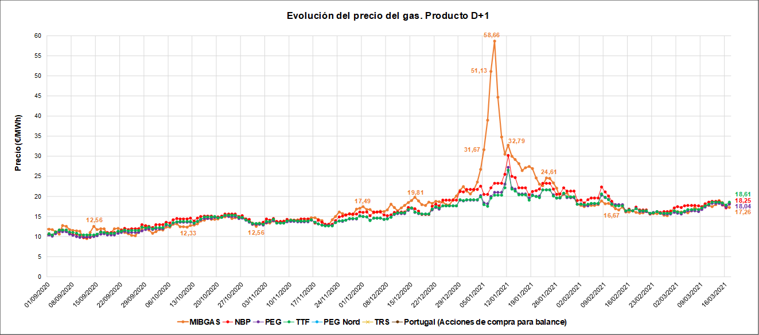
3. WP Second target: market integration
3.1. Follow-up of gas prices and hubs liquidity (SGRI vs. neighbouring hubs) (for information by NRAs and TSOs)
1st September 2020-17th March 2021 Prices D+1

Slide 13
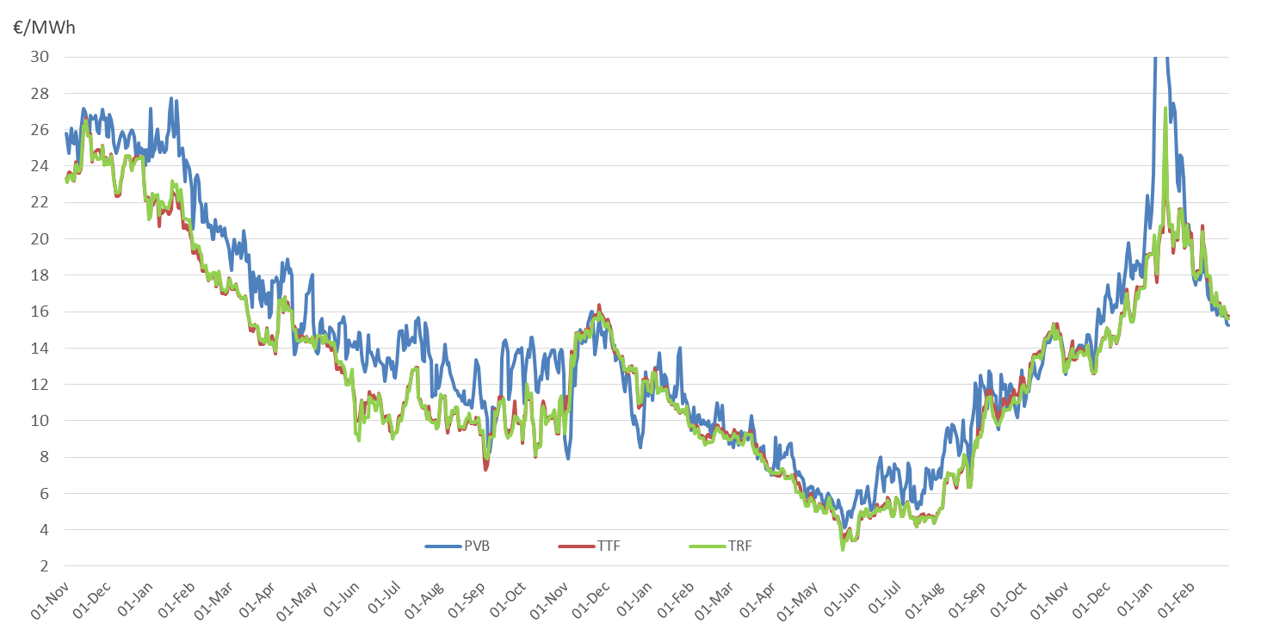
Day-ahead prices France, Spain and The Netherlands

Slide 14
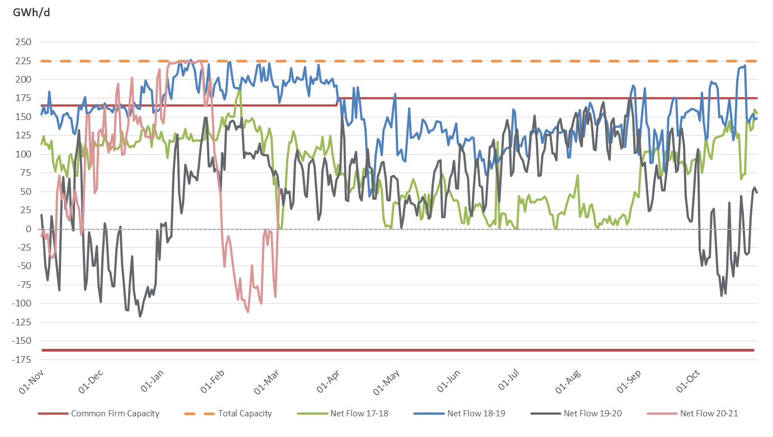
Capacity utilization VIP Pirineos Nov – Nov
17-18 vs 18-19 vs 19-20 vs 20-21

Slide 15
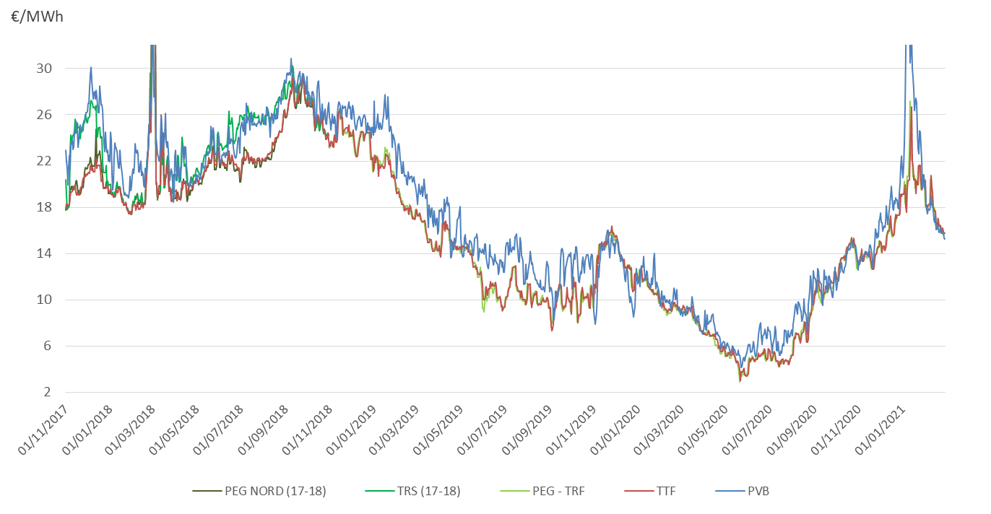
Day-ahead prices France, Spain and The Netherlands

Slide 16
3. WP Second target: market integration
  3.2.Trading of Portuguese products in MIBGAS: status and next steps (for information by ERSE and REN)
The trading in the MIBGAS platform, of products with delivery in the Portuguese VTP was successfully initiated on the 16th of March, 2021.
The initiation of trading was preceded by a period of adaptations of the TSO and MIBGAS systems and tests with market participants.
Market agents' access to trading on the MIBGAS platform is subject to authorization by the TSO based on a daily verification of the agent's position.
MIBGAS platform can now operate as the trading platform under NC Gas Bal.
ERSE launched a public consultation on a process for the acquisition of regulated gas by the Portuguese TSO, which is proposed to run on the MIBGAS platform between April and October, 2021.

Slide 17
3.2. Trading of Portuguese products in MIBGAS:start-up and next steps
The implementation plan of the Organized Market in Portugal, published by MIBGAS and REN on last October 27th, was fully accomplished, with all the activities implemented in the proposed timelines, highlighting:
    The workshop was held on February 23rd and 25th
    The tests with the interested agents took place on March 9th and10th
The Organized Market in Portugal started on March 16th with daily, withinday and weekend products (spot products) available on the MIBGAS platform
One transaction was negotiated on March 16th, for the daily product D+1, in the amount of 50 MWh with a price of 18,85€/MWh
From all market agents qualified by the Portuguese System Manager, 6 agents have already completed the registration process with MIBGAS
REN continues to work with Omiclear to provide prompt products (balance of month and month ahead) on the MIBGAS platform. This products will be settled through the Portuguese Clearing House (Omiclear)

Slide 18
3. WP Second target: market integration
  3.3. Proposal of allocation of interruptible capacity in a coordinated way in the VIPs (for information by TSOs)
  For information by TSOs

Slide 19
3. WP Second target: market integration
  3.4. Proposal of modification of the congestion tariffs applied at French IPs (for information by CRE)
  For information by CRE

Slide 20

IG meeting
Congestion tariffs
at French IPs
CRE

Slide 21
Tariffs at congested Ips
At French borders, congested IPs benefit from the so-called ‘congestion tariff’:
  When yearly auctions close with a premium, multipliers for Quarterly, Monthly and Daily products are brought down to 1.
  Capacity users shall not pay multipliers on non-yearly products if yearly capacity is not longer available
This provision of French regulation has been identified as a potential “windfall” opportunity for some shippers, artificially creating a congestion on yearly products by participating only to the first round of auctions
  Teréga informed CRE of unusual booking behaviours at Pirineos IP over the last years.
 | Tariff multiplier
 | No congestion | With congestion
Quarterly | 1,33 | 1
Mothly | 1,5 | 1
Daily | 1,5 | 1

Slide 22
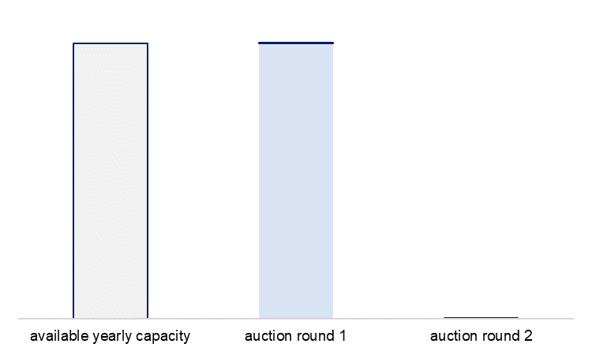
Tariffs at congested Ips
For the last 2 years, premium was reached at Pirineos IP while virtually no yearly capacity was booked:
  At 1st round, 2 shippers requested yearly capacity:
    Shipper 1 requested the whole available capacity
    Sipper 2 requested the minimum unit of capacity (1 kWh/h)
  As requested capacity was above available capacity, a 2nd round was organised, with price increment (premium):
    Shipper 1 did not renew its request for capacity
    Shipper 2 confirmed request for 1 kWh/h
  As per tariff rules, the IP was considered ‘congested’ insofar as a premium occurred, and the ‘congestion tariff’ was applied to Q, M and D products.

Slide 23
Tariffs at congested Ips
CRE consulted upon this issue (public consultation n° 2020-018 of 22 Ocotber 2020) in the view of potentially amending the ‘congestion tariff’ provisions:
  CRE proposed to add a second condition for triggering ‘congestion tariff’:
    Premium + at least 98% of yearly capacity effectively booked
  Responses were overall supportive of CRE’s analysis and proposal:
    Several shippers expressed favourable opinions towards this measure while at the same time requesting outright removal of multipliers
    Operators expressed favourable opinions towards this measure, while requesting the removal of ‘congestion tariff’
    In its deliberation dated 9 December 2020, CRE decided on the implementation of this additional condition for the application of the ‘congested tariff’, with entry into effect as of 1 April 2021.

Slide 24
4. WP Third target: contribution of gases to decarbonisation
  4.1. Follow-up (for information by NRAs and TSOs)
  For information by NRAs and TSOs

Slide 25
4. WP Third target: contribution of gases to decarbonisation
  4.1. Follow-up (for information by ERSE)
  PORTUGAL (1/2)
Decree-Law 62/2020 (Aug 28) approved the new organization of the Portuguese gas sector, to include the production of renewable and low carbon gases
ERSE has published a consultation on the revision of gas codes accordingly (Jan 19th).
The wholesale last resort supplier can purchase renewable gases from producers, by request from retail suppliers, and deliver these gases at MIBGAS prices
The cost difference between renewable gas production and MIBGAS reference price will be paid by public funds (not the gas tariffs)
Regarding network tariffs, gas injections of renewable and low carbon gases connected to the transmission network will pay an entry tariff. Gas injections connected to the distribution network are exempted from the payment of an entry tariff. The same approach is followed in Spain.

Slide 26
4. WP Third target: contribution of gases to decarbonisation
  4.1. Follow-up (for information by ERSE)
  PORTUGAL (2/2)
Transmission system balancing includes green gas injections, while producers have similar obligations to consumers regarding metering, forecasts, nominations.
A general framework for pilot projects in innovation and green gases was established.
Plan to promote the injection of renewable gases, network operators can submitted proposals for projects to adapt the network in order to promote the injection of renewable gases in the network.
Network operators shall establish a tracking tool for gas quality monitoring (DSO and TSO, the latter coordinating), including SW for estimating gas quality parameters throughout the network.
Interoperability issues for gas quality have to be resolved between green gas injection at DSO or TSO (eg compliance with max H2 content)

Slide 27

H2 REN GRID
REN-Gasodutos, S.A.
REN-Armazenagem, S.A.
“H2RENGRID - Enabler for decarbonization”
(application submitted to the Innovation Fund Oct2020)
“To adapt the current natural gas transmission and underground storage infrastructures to become a large green hydrogen storage solution, allowing a growing percentage of green hydrogen to be blended.“
Drivers
Built upon challenging EU and National climate and energy targets
Enabling sustainable energy sourcing and best use of current production at local level,
And benefitting from low renewable electricity production costs
Leveraging on existing national NG system
System preparation and fit to purpose of both infrastructures
Direct replacement of NG with H2, translating into GHG emissions avoidance

Slide 28
5. WP Forth target: other items for discussion
  5.1. Work programme 2021-2022: schedule of deliverables (for discussion NRAs/TSOs)
  Target 1. Infrastructures (deliverable).
    Deliverable 1: Implementation of a common mechanism to offer cross-border day-ahead interruptible capacity.
      Drafters: ENAGAS/REN
      Next steps (proposal):
      - First draft for NRAs´ comments (May/June 2021)
      - Approval (Sept 2021)
  Target 2. Market integration (deliverables).
    Deliverable 2: Study on the viability of cross-border balancing operations in the Region
      Drafters: REN
      Next steps (proposal):
      - Outline for discussion (next IG)
      - First draft for NRAs´ comments (December 2021)
      - Approval (March 2022)

Slide 29
5. WP Forth target: other items for discussion
  5.1. Work programme 2021-2022: schedule of deliverables (for discussion NRAs/TSOs)
  Target 2. Market integration (deliverables).
  Deliverable 3: Study on the role of tariffs to foster market integration of the Spanish and Portuguese markets
      Drafters: ERSE/CNMC
      Next steps (proposal):
      - Outline for discussion (September 2021)
      - First draft for NRAs´ comments (June 2022)
      - Approval (December 2022)

Slide 30
5. WP Forth target: other items for discussion
  5.2. AOB

Slide 31


RCC
6. Meeting schedule
IG
SG
Next IG meeting: XX June (tbd)

Slide 32
Thank you for attending

