Slide 1
The Capacity Allocation & Congestion Management Network Code An overview & status update
Antonio Lopez-Nicolas
Manager - Markets

Slide 2
Outline
Brief background to network codes & ENTSO-E
The network codes required to facilitate the IEM
A focus on the Capacity Allocation & Congestion Management code
Questions and discussion

Slide 3
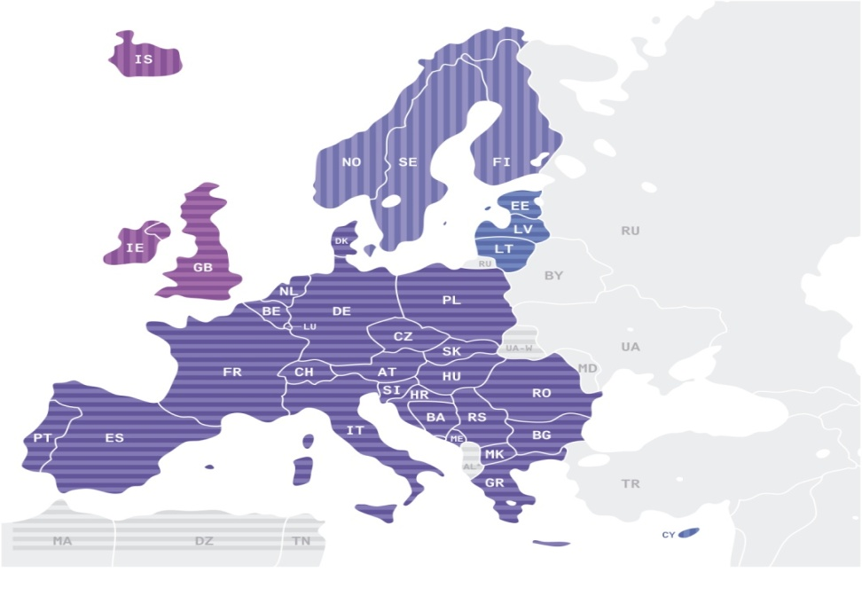
The role of TSOs – ENTSO-E
Mandate for network codes and ten-year plans in Reg. 714/2009
41 TSOs from 34 countries
Fully operational since July 2009
A trans-European network
530 million citizens served
910 GW generation
300,000 km of transmission lines
3,400 TWh/year demand
380 TWh/year exchanges
Replaced former TSO organisations: ATSOI, BALTSO, RTSO, NORDEL, UCTE, UKTSOA
System Development
System Operation
Electricity Market
Research and Development

Slide 4
The objectives of a Network Code
The rationale for network codes as set out in Regulation 714/2009.
Clearly, simply and transparently outline a consistent approach to addressing each issue raised by ACER in relevant framework guidelines.
Achieve this in a proportionate manner which minimises the overlap with national regulation while covering cross-border issues.
Ensure that all obligations are clear and unambiguous and can be clearly understood by all stakeholders.

Slide 5
ENTSO-E’s role according to Regulation (EC) 714/2009
Article 4: ENTSO-E
Charged with working to complete the internal market and cross-border trade.
Article 6: Creating network codes
In line with ACER framework guidelines.
Which become binding.
Article 8: The scope of network codes
Cross border & market integration issues.
Article 8: ENTSO-E’s activities
And involve extensive consultation.
Without prejudice to Member States’ right to establish codes.
Network Codes
Ten Year Network Development Plans.
Generation adequacy.
Winter and summer outlooks.
Work programs and annual reports.

Slide 6
The Network Code Development Process
Request to draft a FWGL
EC
Development of the FWGL (6 month period)
ACER
In consultation with ENTSO-E, stakeholders, with input from Ad-Hoc Expert Group
Period in which ENTSO-E can develop a NC (12 month period)
In consultation with stakeholders according to FWGL
Assessment of NC
ACER
Recommendation of NC to EC
Comitology Process (where appropriate)
EC
In consultation with all stakeholders resulting in legally binding NC
Request for ENTSO-E to draft a network code
EC
According to FWGL submitted by ACER
ENTSO-E
On a topic identified in art.8 (6) of Regulation EC 714/2009
Development of
FWGL
Development of
NC

Slide 7
The network codes required to facilitate the IEM - State of Play
Markets
Capacity Allocation & Congestion Management
Forward Markets
System Operation
Operational Security
Load Frequency Control & Reserves
System Development
Generation Connection
Demand Connection
Operational Planning & Scheduling
Balancing
Black = Final FG Received, Yellow = Final FG Developed, Purple = Scoping Work

Slide 8
CACM Network Code – The challenge
Write a single document setting out the European ‘Target Model’
Consult widely and ensure a range of views are heard and reflected.
Complete development and consultation by the end of September 2012.
Ensure that document is clear, accessible and meets the FWGL

Slide 9
CACM Network Code - Scope
Forward Market design
Intra-Day market design
Capacity Calculation
Day-Ahead market design
The CACM network code describes:
The day ahead target model for market coupling.
The intra-day target model of implicit continuous trading.
Rules for calculating capacity and defining bidding zones.
Forward market design is part of the FWGL but will be addressed later.

Slide 10
CACM Network Code – State of play
Merging 3 sets of text
Legal review
Internal technical review
A single code for consultation
Developing the CACM draft is a real challenge.
We are in the process of merging 3 technical sections.
And dealing with interactions with other areas and codes.
Including reflecting informal comments from stakeholders.
Ahead of a formal consultation.

Slide 11
CACM Network Code – Stakeholder Engagement
Stakeholder Group
Bilateral Meetings
General information on website
Workshops
Formal consultation
A stakeholder group was established in June 2011.
The group will meet throughout the process of developing codes.
Open workshops planned for early 2012.
Bilateral meetings with stakeholders ongoing.
Information is available via entsoe.eu

Slide 12
CACM Network Code - Feedback from 3rd Stakeholder Group meeting
3rd Stakeholder Group meeting of the CACM Network Code took place in Brussels on 8 December
Wide participation of stakeholder organizations. EC and ACER also attended as observers.
Active discussion focused on day-ahead markets and capacity calculation issues.
Next meeting will be hold on 2 February 2012 and will focus inter alia on intraday issues.
Relevant information about the stakeholder group can be consulted at ENTSO-E website.

Slide 13
CACM Network Code – Key milestones
19 Sept 2011
Official request to start received.
Early 2012
Expected public Consultation
September 30
Deadline to submit to ACER
Stakeholder workshops
Apr – May 2012

Slide 14
CACM Network Code – Interaction with ongoing projects
Network codes – A top down approach
Implementation projects – A bottom up approach
Network codes and implementation projects are compliments.
Experience gained via projects is reflected in the codes and the codes facilitate the projects.
But the codes also drive progress in areas where it hasn’t been seen to date.
Both are important for the delivery of the Internal Electricity Market by 2014

Slide 15
From North-West Europe towards a Pan-EU Market
ENTSO-E is fully committed to promote the completion and functioning of the internal electricity market according to its legal duties.
The 20th Florence Forum supported the continuation of the NWE project for both day-ahead and intra-day markets, in order to meet the target date of 2012.
ENTSO-E is ensuring further extendibility of NWE day-ahead and intraday solutions to other regions through the work of the Day-Ahead and Intraday Monitoring Groups where non-NWE TSOs are widely represented.

Slide 16
Conclusions
The network codes will affect market participants.
And could cause changes in local market rules.
It is difficult to develop effective network codes for Europe.
So getting a range of stakeholder views is vital.
We urge parties to monitor progress and provide views.
Codes and implementation projects complement each other.

Slide 17
Antonio.Lopez-Nicolas@entsoe.eu

