Slide 1




Market Coupling as
efficient capacity allocation method
on the France-Spain Interconnection

Slide 2
PLAN
Context: explicit allocation of day-ahead exchange capacities between Spain and France
Driving events: inefficient use of interconnection capacities
Outcome: implementation of market coupling
Observations: improved market efficiency

Slide 3
Context: explicit allocation of day-ahead capacities
In both France and Spain organized wholesale electricity markets exist
Tradable energy products range from long term yearly products to hourly products at day-ahead and intraday horizons
The spot (day-ahead - reference) markets are managed by the Power Exchanges OMIE in Spain and EPEX in France
Both markets are zonal, delivering a single electricity price for the entire country
Only energy products are traded in the Power Exchanges
Exchange capacity between France and Spain (approximately 1200 MW) was allocated through an explicit auctions market mechanism at the yearly, monthly, day-ahead and intraday timeframes

Slide 4
Driving events: before market coupling
The explicit auctions at the daily timeframe were not the highest efficiency capacity allocation method: exchange capacity and energy had to be traded in two different steps
This limitation led to a not always efficient use of the interconnection:
  energy flowing against the market spread in some hours
  price divergence with non-saturated exchange capacity
Cost of these inefficiencies was estimated at ~12 M€ / year

Slide 5
Driving events: non correct use of interconnection
11 %

Slide 6
Outcome: market coupling
The market coupling of zonal markets is the European target model:
    Implicit allocation of Capacity simultaneously with energy allocation, optimizing the use of cross border capacities in line with the Markets results
France had already been coupled with Germany, Belgium, the Netherlands and Luxembourg (Central West Europe - CWE Coupling)
The market coupling was extended to UK and Scandinavian and Baltic countries (North West Europe - NWE Coupling) in February 2014
Spain was already coupled with Portugal (MIBEL Market) since July 2007
In May 2014 the daily explicit auctions on the France-Spain interconnection have been replaced by the European market coupling mechanism
A shared and common algorithm (Price Coupling of Regions - PCR solution) was used

Slide 7
Outcome: market coupling in EU
Multi Regional Coupling (MRC)
 | Project NWE + SWE : may 2014
 | Italy / Slovenia
 | Czech Republic / Slovakia / Hungary
Project NWE+SWE = 2500 TWh/year
(75% European electric consumption)

Slide 8
Observations: methodology
Improved market efficiency measured by the following indicators:
Use of the interconnection
Number of participants competing for capacity
Price convergence between France and Spain
Price volatility
Market resilience
Historical data from 2012 to July 2014
  CWE: period from 1st January 2012 to 4th February 2014 (France coupled with the Netherlands, Belgium and Germany only)
  NWE: period from 4th February 2014 to 13th May 2014 (CWE + UK and Scandinavian countries)
  NWE-SWE: period after 13th May 2014 (NWE + Iberia => MRC)

Slide 9
Observations: efficient use of the interconnection
11 %

Slide 10
Observations: efficient use of the interconnection
0 %

Slide 11
Observations: higher number of participants competing for capacity

Slide 12
Observations: price convergence increased

Slide 13
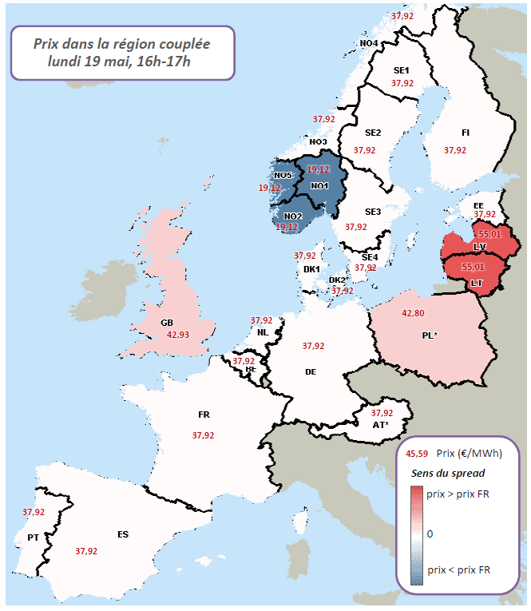
Price (€/MWh)
19th May, 16:00-17:00
Exemple of Price convergence in Europe
Spread
Price > price FR
0
Price < price FR

Slide 14


Observations: price volatility decreased
-66%
-38%
-23%

Slide 15
Observations: price volatility decreased
-66%
-38%
-23%

Slide 16
Observations: market resiliency increased (France)
-22%
-9%
-10%

Slide 17
Conclusions
Proven and confirmed usability of the market coupling model with a shared and common algorithm in an important part of European price zones
Improved efficiency in the use of the interconnection
Increased number of participants competing for capacity
Increased price convergence
Decreased price volatility
Increased market resilience and liquidity
…the way forward: extension of day-ahead market coupling to all EU countries !

