Slide 1

Getting to 2014
A contribution from the Regional Initiatives Process
Christophe Gence-Creux
Head of the Electricity Department, ACER
NWE Stakeholders Group meeting-London

Slide 2
Outline
The Birth of ACER
Role of Framework Guidelines and Network Codes
Role of Regional Initiatives
Progress to Date and Challenges to Come
The Way Forward

Slide 3



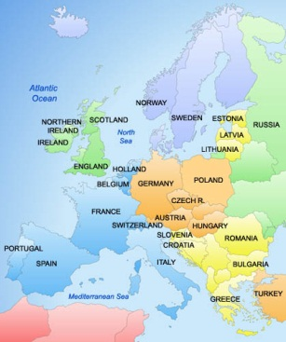
The Birth of ACER
ACER was officially opened in Ljubljana
on 3 March 2011 ...
... at the same time as the Third Energy Package entered into force
In fact, after an initial phase in Brussels, ACER has been operating
in its Seat in Ljubljana
since 1 February 2011
We are here!
09/12/2011
NWE Stakeholders Group meeting-London

Slide 4
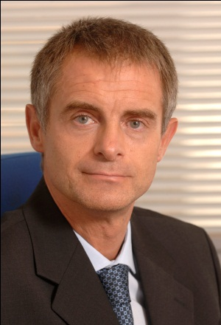

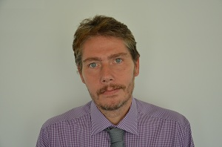

ACER Internal Structure
Director
Alberto POTOTSCHNIG
Electricity Department
Gas
Department
Administration Department
Christophe
GENCE-CREUX
Steven
GORDON
Olga BORISSOVA
09/12/2011
NWE Stakeholders Group meeting-London

Slide 5
Staff Recruitment Plan
09/12/2011
NWE Stakeholders Group meeting-London

Slide 6
Nationality Composition of ACER Staff
(in office or already appointed on 1 December 2011, including SNEs)
09/12/2011
NWE Stakeholders Group meeting-London

Slide 7
ACER’s Mission
ACER is NOT a European Energy Regulator!
Regulatory powers are still in the hands of the National Regulatory Authorities (NRAs)
In fact, the 3rd package has reinforced the role and powers of the NRAs
ACER only has “residual” regulatory powers
“The purpose of the Agency shall be to assist the [NRAs] in exercising, at Community level, the regulatory tasks performed in the Member States and, where necessary, to coordinate their action”.
Article 1(2), Regulation (EC) No. 713/2009
09/12/2011
NWE Stakeholders Group meeting-London

Slide 8
ACER’s Activities
Types of acts which ACER can adopt
TSOs
NRAs
Opinions and recommendations
EP
Council
Commission
Individual decisions in specific cases
(residual power)
09/12/2011
NWE Stakeholders Group meeting-London

Slide 9

Priorities in Electricity for 2012
TYNDP, EIP and Inter-TSO Compensation mechanism
Framework Guidelines and Network Codes
Regional Initiative process
Market Monitoring
Building-up the Internal Electricity Market
09/12/2011
NWE Stakeholders Group meeting-London

Slide 10
A strong momentum…
“The internal market should be completed by 2014 so as to allow gas and electricity to flow freely.”
European Council - 4 February 2011 - Conclusions on Energy (paragraph 4)
09/12/2011
NWE Stakeholders Group meeting-London

Slide 11
…for a clear target
Internal Electricity Market
Capacity Calculation
Long-Term Capacity Allocation
Day-Ahead Capacity Allocation
Intraday Capacity Allocation
Balancing Markets
Adequate Network Development (EU TYNDP and EIP)
TSO/ISO/ITO Unbundling
Strengthened powers and independence for NRAs
Higher coordination requirements (ACER & ENTSO-E)
09/12/2011
NWE Stakeholders Group meeting-London

Slide 12
Outline
The Birth of ACER
Role of Framework Guidelines and Network Codes
Role of Regional Initiatives
Progress to Date and Challenges to Come
The Way Forward
09/12/2011
NWE Stakeholders Group meeting-London

Slide 13
Process description
General timeline as set out in Reg. (EC) 714/2009
09/12/2011
NWE Stakeholders Group meeting-London

Slide 14
Framework Guidelines
SCOPING & DRAFTING
BALANCING
PUBLIC CONSULTATION
SYSTEM OPERATION
FINAL VERSION
GRID CONNECTION (20 July 2011)
CAPACITY ALLOCATION & CONGESTION MANAGEMENT (1 August 2011)
Public consultation ended 15 September 2011
Final version expected for 31st December 2011
24th October: workshop in Ljubljana
Public consultation expected for Q1 2012
Final FG expected for mid-2012
End of August: 1st Exerts group meeting
09/12/2011
NWE Stakeholders Group meeting-London

Slide 15
Framework Guidelines and Network Codes
2011
2012
2013
2014
2015
FG/NC on Grid Connection
FG
NC
EV
COMITOLOGY
FG/NC on Capacity Allocation and Congestion Management
CC, DA, ID
FG
NC
EV
COMITOLOGY
Forward
NC
EV
COMITOLOGY
FG/NC on System Operation
Op. Security
FG
NC
EV
COMITOLOGY
Op. Plann/Sched.
NC
EV
COMITOLOGY
LFC, Reserves
NC
EV
COMITOLOGY
FG/NC on Balancing
FG
NC
EV
COMITOLOGY
WS
FG/NC on Third Party Access
FG
NC
EV
COMITOLOGY
ACER
ENTSO-E
EP - EC
EV = Evaluation on NC
09/12/2011
NWE Stakeholders Group meeting-London

Slide 16
Outline
The Birth of ACER
Role of Framework Guidelines and Network Codes
Role of Regional Initiatives
Progress to Date and Challenges to Come
The Way Forward
09/12/2011
NWE Stakeholders Group meeting-London

Slide 17
Role of Regional Initiatives
A new impetus to the market integration process (1)
More project-oriented, with newly designated project lead regulators
    Focus on the CACM target models implementation : 4 key priority projects
  Stronger Pan-European dimension, with the elaboration of ambitious but realistic cross-regional roadmaps as the main reference for the market integration process, complementing the FG/NC process
  To identify key milestones and accountabilities
  To ensure consistency & coherence
09/12/2011
NWE Stakeholders Group meeting-London

Slide 18
Role of Regional Initiatives
A new impetus to the market integration process (2)
Stronger Stakeholders’ involvement (AESAG and regional consultations) to keep the strong momentum and maintain confidence throughout the process
  More adequate governance to support the implementation process
  Involvement of MS when appropriate and necessary
  Close follow-up to identify any obstacles, delays or inconsistencies with the FG/NC
  More efficient decision-making process (ACER’s residual power for cross-border issues)
09/12/2011
NWE Stakeholders Group meeting-London

Slide 19
Outline
The Birth of ACER
Role of Framework Guidelines and Network Codes
Role of Regional Initiatives
Progress to Date and Challenges to Come
The Way Forward
09/12/2011
NWE Stakeholders Group meeting-London

Slide 20
Progress to Date and
Challenges to Come
Cross-regional roadmap on Market Coupling
Progress to Date | Challenges to Come
ENTSO-E and EuroPEX’s strong commitment to implement a Pan-European Market Coupling solution | Translating this commitment into concrete and detailed implementation project for the implementation of the NWE project by end of 2012
Selection by EuroPEX of the starting point for the PCR algorithm | Validation by ENTSO-E and Endorsement by NRAs of: The starting point for the PCR algorithm The interim flexible NWE high-level governance arrangements The cost-sharing principles between NWE and non-NWE countries
09/12/2011
NWE Stakeholders Group meeting-London

Slide 21
Progress to Date and
Challenges to Come
Cross-regional roadmap on Intraday
Progress to Date | Challenges to Come
ENTSO-E and Europex agreement on detailed technical solution for border-by-border implementation in 2012 | Border-by-border implementation of a common intraday solution, linking the Nordic, Central West, South West and FUI electricity regions in 2012
ENTSO-E and EuroPEX’s strong commitment to implement a Pan-European cross-border Intraday mechanism | Design and implementation of pan-European intraday target model by 2014
09/12/2011
NWE Stakeholders Group meeting-London

Slide 22
Outline
The Birth of ACER
Role of Framework Guidelines and Network Codes
Role of Regional Initiatives
Progress to Date and Challenges to Come
The Way Forward
09/12/2011
NWE Stakeholders Group meeting-London

Slide 23
Key ingredients for success?
  Endorsement of cross-regional roadmaps by the Florence Forum
  True commitment of key stakeholders (NRAs, TSOs, PXs) both at EU and regional level throughout the implementation phase
  Continuous support and involvement of all stakeholders (AESAG process and regional Fora)
  Regular and transparent reporting on progress and challenges: Quarterly reports, Annual Status review and Florence Fora
09/12/2011
NWE Stakeholders Group meeting-London

Slide 24

Thank you for your attention!
www.acer.europa.eu

Slide 25
Regulators’ statement
  Energy Regulators welcome the work made under the Regional Initiatives and AESAG’s umbrella
  Energy Regulators fully support the four priority projects and the designation of project lead-Regulators to steer the implementation process
  Energy Regulators fully support the contents, steps and milestones included in the cross-regional roadmaps as a valuable tool in the push to achieve the single European electricity market
  Energy Regulators express their formal commitment to the effort needed to deliver the cross-regional roadmaps
09/12/2011
NWE Stakeholders Group meeting-London

Slide 26

The IEM: A Clear Vision
Internal Electricity Market
Capacity Calculation
Long-Term Capacity Allocation
Day-Ahead Capacity Allocation
Intraday Capacity Allocation
Balancing Markets
Adequate Network Development (EU TYNDP and EIP)
TSO/ISO/ITO Unbundling
Strengthened powers and independence for NRAs
Higher coordination requirements (ACER & ENTSO-E)
09/12/2011
NWE Stakeholders Group meeting-London

