Slide 1
Joint Presentation from TSOs and PXs from the NWE Region
NWE Day-Ahead Price Coupling
IG meeting March 28th 2012
Amsterdam

Slide 2
Content
Joint Project Planning
Joint Project Organisation
Budget
Cost recovery / Cost Sharing
Status on the APCA
Regulator Questions

Slide 3
Towards a European power market
The Nordic market – 2000
  Including Estonia 2010
Central West Europe – 2010
ITVC – 2011
  Including embedded solution for BritNed cable to GB via APX and Price Coupling on SwePol via NPS

Slide 4
Towards a European power market
The Nordic market – 2000
  Including Estonia 2010 (and full Baltic prel. end 2012)
Central West Europe – 2010
ITVC – 2011
Including embedded solution for BritNed cable to GB via APX and Price Coupling on SwePol via NPS
North West Europe – 2012
Including Price Coupling on SwePol via NPS, and NPSs work with the local TSOs on establishing day-ahead markets in Latvia and Lithuania
2300 TWh

Slide 5
Towards a European power market
The Nordic market – 2000
Central West Europe – 2010
ITVC – 2011
North West Europe – 2012
European solution – 2014
3200 TWh

Slide 6
High level timeline
2012
Feb
Mar
Apr
May
Jun
Jul
Aug
Sep
Oct
Nov
Dec
Design phase
Implementation phase
Go-Live
Preparation
Design Phase
Impact analysis and change specifications, cost and cost recovery, algorithm requirements, algorithm prototype, governance for the operations phase, approvals
2. Implementation Phase
Build/test/commission systems, prepare operations phase, communication to stakeholders
3. Operational phase
Daily operations and maintenance
Operational Phase

Slide 7
Joint TSO/PX Target Planning*
Feb 2012 | Mar 2012 | Apr 2012 | May 2012 | Jun 2012 | Jul 2012 | Aug 2012 | Sep 2012 | Oct 2012 | Nov 2012 | Dec 2012 | Q1 2013
Go live system selection
PX Design phase
PX Development
Algorithm industrialisation
Joint PX and TSO Design
TSO Development
Test preparation
PX and TSO System and Algo Test
Integration & Procedural Tests
Readiness
Dec 2012
Procedures
Contractual arrangements
Contingency
*To be validated
Notes:
TSO Development is assuming minimal changes to TSO systems

Slide 8
Authorities and Stakeholder Target Planning*
Feb 2012 | Mar 2012 | Apr 2012 | May 2012 | Jun 2012 | Jul 2012 | Aug 2012 | Sep 2012 | Oct 2012 | Nov 2012 | Dec 2012 | Q1 2013
Go live system selection
Documentation for solution
approval from NRAs
Market Party Validation
Cost sharing
approval
NRA Algorithm Approval
NRA MC Solution Approval
Auction Rules Consultation
Auction Rules Approval
Readiness
Dec 2012
Auction Rules
Approved
Contingency
*To be validated

Slide 9
Joint Project Organisation
NWE JSC
Joint PMO
(external consultant)
Technical
WG
Corné Meeuwis
Legal, Regulatory
and Market WG
Tjitske Kramer
Common TFs
Common TFs
Common TFs
Common TFs
Common TFs
Common TFs
TSO-only
Sub-Project
PX-only
Sub-Project
Local
Sub-Projects

Slide 10
Budget
Development
The preliminary budgets for the design and implementation of the NWE Market Coupling comprise:
    Combined NWE PX costs of €10.3m
      €3.3m (60%) of PCR Common Costs (commonly procured services: project manager, taskforce leaders, algorithm and system development)
      €7m of local costs (support to PCR/NWE project plus PX-specific changes)
    NWE Common Costs of €0.8m, excluding shipping implementation costs (project office, taskforce leaders)
The budgets assume a go-live at the end of December of NWE Market Coupling based on the PCR/PMB solution
The budgets will be finalised as part of the APCA completion process during April
Any change to this plan and possible budget changes are subject to JSC approval

Slide 11
Cost Recovery
Development
The NWE TSOs propose to reimburse reasonable costs incurred in the NWE market coupling project as follows:
Design:
  100% of each NWE PX’s share of the PCR Common Costs (in total representing not more than 60% of the total PCR Common Cost)
  100% of each PX’s local costs in support of PCR and NWE prior to [1 March]/[completion of NWE Design Phase]
Implementation:
  75% of each NWE PX’s costs in support of the NWE implementation phase after [1 March]/[completion of NWE Design Phase], including share of NWE Common Costs
NWE Common Costs will be shared on a per Party basis (TSOs and PXs)

Slide 12
Cost Sharing/ Recovery
Development - Other
The reimbursement of the PXs’ costs is limited to the approved budget
The costs recovery proposal is based on the agreement between the TSOs to have costs eligible for recovery by TSOs be shared equally between all TSOs (except for CREOS who will half the costs) (same principle as under ITVC)
In the event the budget is insufficient the Parties will negotiate in good faith a resolution, but PXs may restrict expenditure to the agreed budget
Parties may enter into supplementary local cost sharing arrangements
The common and local costs shall be validated, and the sharing arrangements subject to regulatory approval (end of April the latest)

Slide 13
Budget / Cost Recovery
Operations
Operational Common Costs are anticipated to be small, but any will be shared according to keys to be defined/agreed
Specific services required by the TSOs will be provided at cost by the PXs – e.g., shipping
Arrangements for recovery of PXs’ costs from tariffs and/or service fee for capacity allocation may be determined on a local basis, subject to regulatory approval.

Slide 14
Status on the APCA
Negotiation team has agreed on the main body of the contract
  Cost recovery needs to be inserted based on the principles presented in the presentation
  Agreement on the outline of the annexes
  Fine tuning on wording ongoing
  Formal approval by JSC and individual parties pending

Slide 15
NRA Questions
Algorithm requirements – input & output
Input:
  local order books submitted by PXs; PXs shall determine format and content
  network and economic constraints provided for by the TSOs; TSOs shall determine format and content
Output:
  Market Clearing Price (MCP) for each bidding area for each hour,
  shadow price of each constraint (for example flow based constraints)
  Unconstrained prices for specified regions
  set of accepted and rejected orders
  net surplus/deficit (or export/import position) for each bidding area
  Line flows for specified regions
  slack value on each constraint
  Quality of the solution (best indicator still under investigation)

Slide 16
NRA Questions
General algorithm requirements
    Costs e.g. losses
    Ramping constraints
    (on flows and net positions)
    Minimum stable flows on DC lines (pending impact on planning)
    Minimum price differences
Reliability
    Fairness
    Reproducibility
    Simplicity
    Multiple Currencies (requirement on solution, not algorithm)
    Different price boundaries
    Negative prices
    Calculation time/cut-off
    Transparency
    Extendibility
    Different Market Time Units (harmonized as a first step)
    Winter and Summer Time
    Hybrid ATC/FB Model
    Maximize Economic Surplus
    Flow calculations

Slide 17
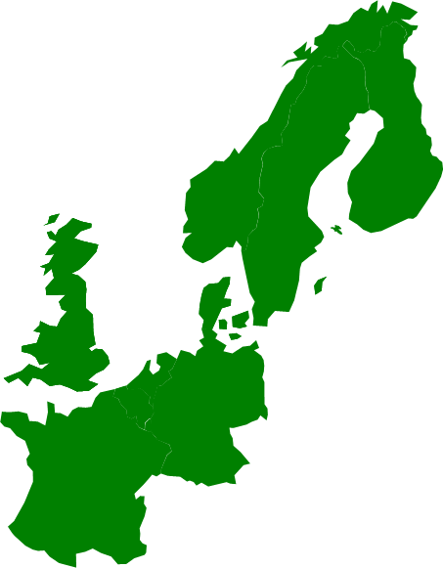
TSO Questions/Requirements for NRAs
    Market coupling solution approval:
      Market coupling is already in place for all NWE countries, except FR-GB
      NWE TSOs suggest to describe the new developments for NWE market coupling, instead of redescribing existing solutions
      The NRAs are asked to provide guidance on what and how much time is required for approval

