Slide 1
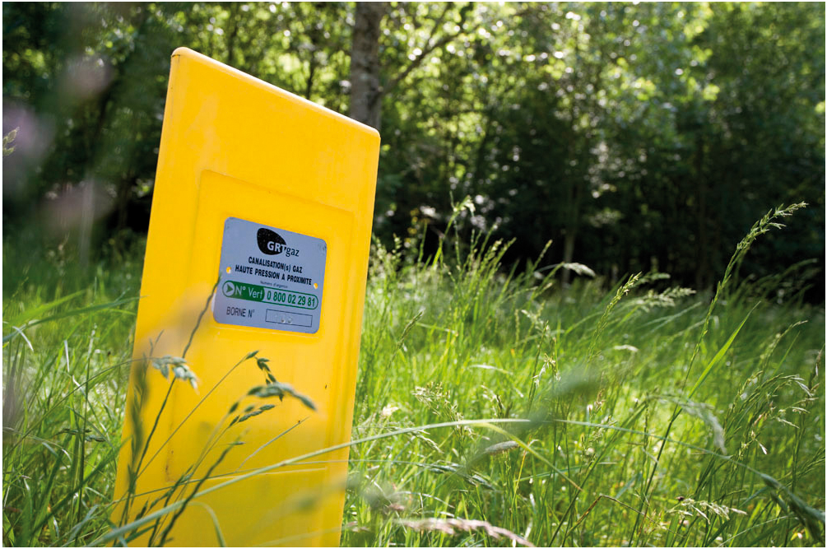
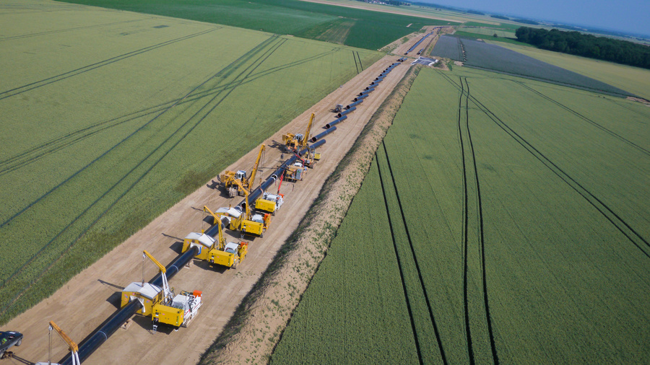
Implementation on PRISMA
26th IG Meeting. South Gas Regional Initiative
23 January 2014

Slide 2
Capacity figures to be offered in March
Taisnières H : No Yearly Capacity proposed at this stage
Obergailbach : Ongoing CRE consultation. CRE deliberation expected by February 2014
PIR Midi : No Yearly Capacity will be proposed
Liaison Nord->Sud : 4 upcoming years -> 125 GWh/d, 76 GWh/d, 38 GWh/d and 38 GWh/d respectively. Specific conditions as per art. 2 of CAM NC

Slide 3
Transferring of existing contracts from physical IPs to the VIP
Not concerned at that stage

Slide 4
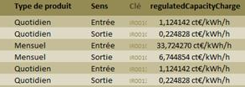
Definition of large and small price steps for each type of product
At that stage
Reserve Price = Regulated tariff
For Obergailbach (only IP proposing Monthly capacity at this stage)
  Large price step = 5% of Regulated tariff
Small price step : 1/5 du large price step
Ongoing CRE consultation to define the price step for Yearly Capacity at Obergailbach and at Liaison Nord-Sud
Deliberation expected by February 2014
Obergailbach
Taisnières

Slide 5
Documents to upload by TSOs: General Terms and Conditions for shippers
Already published

Slide 6
How to offer the capacity (bundled or unbundled) when interruptible capacity is offered on one side and on both sides of the border
Interruptible Capacity will be offered when Firm Capacity is sold out
  Ongoing consultation by CRE to define an adequate level of sold Firm Capacity

Slide 7
          Unbundled capacity sale: VIP, dates....
1st step : Calculation of feasible Bunded Capacity
2nd step : Delta is proposed as Unbundled Capacity, in line with CAM Calendar

Slide 8
Secondary market: when and where trades will take place, public information
Secundary market will be available for GRTgaz on PRISMA by April 2014
A training session is foreseen by February 4, 2014

Slide 9
Exchange of information between TSOs: procedure, type, coordination
Physical meetings with our adjacent TSOs (OGE, GRTgaz Deutschland et Fluxys) to coordinate the products proposed on PRISMA
Bundling agreements have already been signed with Fluxys for Tainsières H and with GRTgaz Deutschland for Obergailbach for already implemented products
New bundling agreements are under finalisation for new products to be proposed

Slide 10
Stakeholders’ information: communication by TSOs
Several shippers’ meeting have already been made
Training session on Primary and Secondary market foreseen the 4th of February 2014
As soon as a new product is proposed, GRTgaz informs the market via en email

Slide 11
Monitoring by NRAs
All new products are validated by CRE

Slide 12
Thank you for your attention!
12

