Slide 1
Enagás and TIGF
Information to NRAs
15th September 2013

Slide 2
Deliverables requested by NRAs

Slide 3
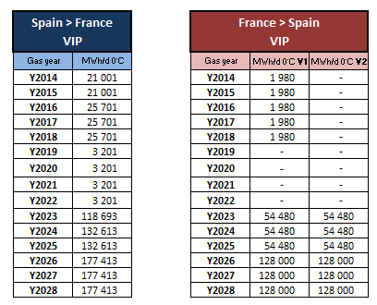
1. Capacities to be offered as from Oct 2014
Yearly auction – March 2014 – bundled capacities to be offered
VIP
V1 vs V2 : In the direction from France to Spain, CRE has already expressed its preference to offer all the available capacity (i.e 11% of the technical capacity) in the rolling quarterly capacity auctions with the consequence that no annual yearly capacity auctions will be carried out; however, on the Spanish side no decision has been taken on this topic.
In Progress

Slide 4
1. Capacities to be offered as from Oct 2014
Quaterly auction – June 2014 – bundled capacities to be offered
VIP
In Progress

Slide 5
1. Capacities to be offered as from Oct 2014
Monthly auction
VIP
15th september 2014
20th october 2014
In Progress

Slide 6
2. Nomination and renomination calendar
Some issues need to be discussed and agreed between TSOs and NRAs
Nomination/Renomination per gas flow and shipperpair
Is there a need that shippers nominate separately each flow direction or just one net nomination? This has several implications:
On the French side, shippers make one net nomination. Shippers are billed based on the contracted capacity only.
On the Spanish side, billing depends not only on the capacity contracted but also on its actual used.
The most common approach is to make one net nomination per shipper pair. However, in order to calculate the capacity to be withdrawn in the application of LT UIOLI procedure, nomination per flow direction might be needed unless NRAs states differently.
Use of Prisma shipper codes (EIC codes). Two options:
Same shipper on both sides of the IP (same EIC code) or
Once capacity has been allocated at Prisma to the same shipper, then when signing the capacity contract with the TSO the capacity can be transferred to an affiliate with license in the country

Slide 7
2. Nomination and renomination calendar
2013
2014
2015
Jul/13
PRISMA decision
Mar/14
CAM NC early implementation for S-GRI
Sep/14
Release production environment (CAM)
Nov/15
CAM NC binding implementation
CAM Implementation (auctions & products)
Sep/13
Kick-off IT specifications (Nominations)
Sep/14
Finalisation of IT specifications (Nominations)
Nov/15
Release production environment (Nominations)
Nominations (nominations & matching process agreed within the S-GRI TSOs )
Interim period
Main milestones
Release environment
Start of auctions
In November 2015 the new nomination/renomination scheme will be implemented:
Single nomination
Nomination and renomination cycles of the Balancing NC
From the date of the early implementation of the CAM NC (October 2014) until November 2015 an interim period will be established

Slide 8
3. Information to be released to the market
Proposed calendar:
Mid December: publication of the relevant documentation*
December/January: training session with Prisma
January/February: publication of the relevant regulation by NRAs
*Documentation : - description of capacity products
- capacities offered
- auction process
- link to Prisma on our websites
- communication to the market
- creation of the VIP
- 2014 calendar for yearly, quaterly, monthly auctions

Slide 9
4. Other regulatory needs (I)
VIP
VIP will be created in March 2014 in the annual yearly capacity auctions for capacity to be used on 1 October 2014
It is a must that existing contracts are transferred to the VIP, then the physical points will disappear
Prices
The reserve price for all auctions will be the regulated price
Short-term multipliers must be higher than 1
Auction premium over the reserved price will be shared 50/50 between TSO.

Slide 10
4. Other regulatory needs (II)
Contracts
Capacity contracts should be signed before the auction starts (similar approach to the auction between Spain and Portugal)?
On the Spanish side, it will be enough if shippers signed the “General Agreement” before the auction and afterwards the specific clauses where price and allocated capacity are detailed.
Contract coordination?
Coordination
It is a must that the development and implementation of the CAM NC and CMP guidelines are simultaneously carried out at all IPs. Thus, coordination between Enagás, TIGF and REN is needed.
Financial guarantees
TSOs are investigating how Prisma handles this aspect.

