Slide 1
Implementation of PCR for Day-Ahead Price Coupling in NWE
Andrew Claxton
NWE Stakeholders’ Workshop
9 December 2012

Slide 2
Current Day-ahead Market Coupling
REGIONAL IMPLICIT AUCTIONS
 | CWE | Price coupling
 | Austria | AT price coupled to GE/CWE (no congestion)
 | BritNed | GB price coupled to NL/CWE
 | Nordic + Estonia | Price coupling, also Poland via Swepol
 | ITVC | Volume coupling CWE - Nordic
 | Italy - Slovenia | Price coupling
 | Mibel | Price coupling
 | Czech - Slovak | Price coupling

Slide 3
Price Coupling Overall Process
Pre Coupling
Coupling
Post Coupling
TSOs calculate firm DA capacity (including UIOSI of forward rights)
PXs receive orders from market parties
PXs jointly calculate prices and net import/export positions of each hub
Welfare maximisation
Price differences where there is congestion*
Shipping:
  Schedule and nominate cross-border flows
  Settle exports and imports on relevant exchange; any gain (“congestion revenue”) to TSOs
PXs nominate and clear local market trades
Local/regional
European
Local/regional
* also if adjustments for losses and flow related charges (e.g., BSUoS)

Slide 4
XXI Florence Forum Conclusions
The Forum regretted that progress of the NWE-project regarding coupling of day-ahead markets had been slower than initially anticipated.
The Forum urged that the NWE project to do its utmost to unblock the situation in order to make swift progress and retain end 2012 for implementation.
The Forum requested the NWE day ahead project actively to keep stakeholders in other regions well informed about the progress with the aim of allowing a pan-European solution to evolve.
The Forum encourages power exchanges to refine options for implementation of NWE day-ahead market coupling for discussion with TSOs in mid December 2011. This would be followed by a single solution in January 2012 for discussion with NRAs, TSOs and the European Commission. ACER offered to act as a facilitator for further progress if needed.
PXs are cooperating and already committing important ressources to fulfill the expectations of stakeholders

Slide 5






Introduction to PCR
Price Coupling of Regions (PCR) is a joint PX project focused on the delivery of a common European price coupling solution (with associated algorithms, systems, procedures and inter-PX co-operation arrangements), where this solution can potentially be implemented in a variety of local regulatory/governance settings
Philosophy is to build on the existing contractual, regulatory and operational solutions, while establishing the necessary harmonization and governance principles at the European level
Solution based on three main principles:
  One single algorithm
  Decentralized operation
  Decentralized governance
Implementation can proceed in parallel in different regions in order to ensure rapid European integration. NWE recognised as a lead region (cf. the cross-regional roadmap)

Slide 6
PCR: Target Coordinated Matching Solution

Slide 7
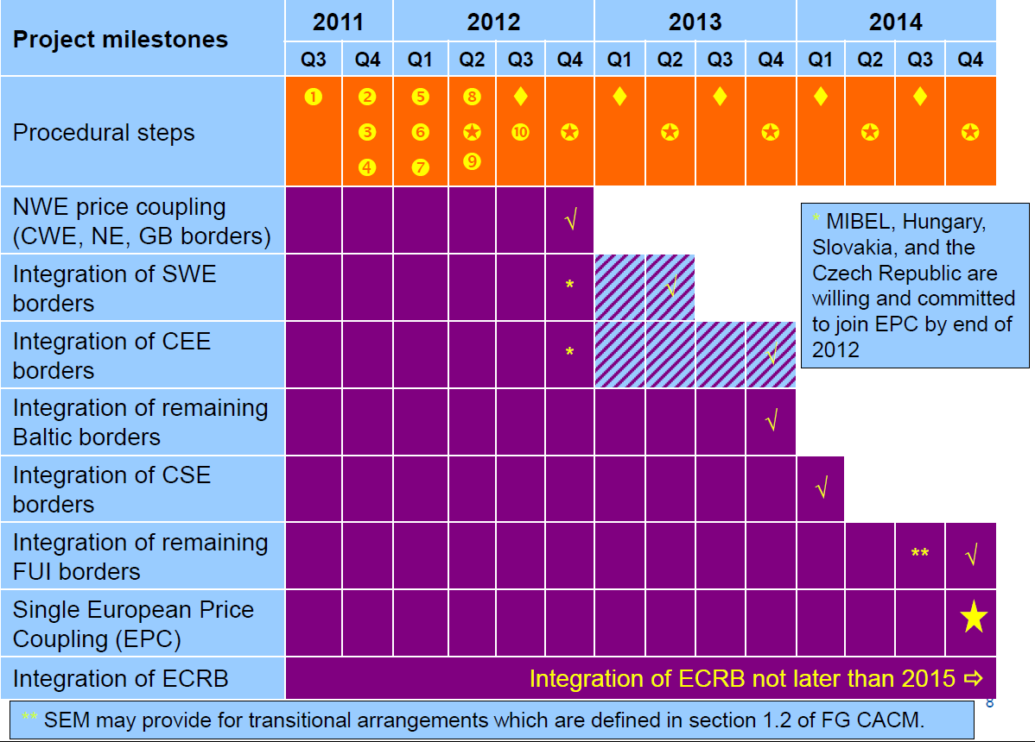
PCR is a key element of the EPC but not the only one!
Day-ahead Cross-regional Roadmap

Slide 8
Progress report on PCR (1)
Design phase started in 2010, now near completion
  Algorithm (the mathematical solution)
    Cosmos chosen as PCR starting point to evolve in to the PCR algorithm
    Good progress on development of PCR Algorithm prototype, able to support all known PCR requirements
  Decentralised solution design
    Simplified high-level architecture agreed
    Procedures progressed (normal and fallback scenarios)
    Quotes from system providers to develop the “broker/matcher” coupling systems are currently being requested, based on existing PCR specifications
  Joint PX agreements nearing finalisation:
    Co-ownership of common assets (i.e. algorithm)
    Enduring co-operation agreement

Slide 9
Main Requirements for PCR Algorithm
Market and Network features
  Order types (e.g. linear/stepwise, blocks, MIC Orders, linked blocks, PUN)
  Network modelling (e.g. ATC, Flow-Based, Ramping, Flow-Related Charges and Losses)
  Price/Network modelling (e.g. in ATC, price difference only if congestion)
Price Calculation Requirements
  Welfare Maximization – Price Coupling Algorithm
  Curtailment and Indeterminacy Rules
  Performance and reproducibility
Outputs of Algorithm
  Prices and Net Positions
  Potential Set of Feasible Flows

Slide 10



2a, 8a,10b
PCR Shadow Algorithm
5
1a
TSO IT Systems
PX IT System
13a
5
11b
6a
4b
4a, 6b
13b
PCR Algorithm
PX Trading System
11a
PCR Matcher
TSO IT Systems
PCR Matcher operator
4b
1a
2b,8b
7b, 10a
PX member
3c
3a
3a
1b
11b
Operator
PCR Broker
2a, 8a,10b
PX IT System
2b, 8b
12a
3b, 7a, 8c, 9b
PCR Broker
7b,10a
PX Trading System
12b
3a,9a
PCR Broker operator
11a
1a
Coordinator
PCR Broker
3c
6c
7b, 10a
2b, 8b,
2a, 8a,10b
4a, 6b
PX IT System
1b
TSO IT Systems
13a
PCR Matcher
PX member
6b
5
11b
4b
6a
PX Trading System
1a
13b
PCR Algorithm
PX Environment
11a
Current PX Systems
PCR Matcher operator
PX member
PCR Systems
TSO IT Systems

Slide 11
Progress Report on PCR (2)
Implementation planned to start early 2012, subject to necessary validation/approvals by TSOs/NRAs/ACER
Depends on resolution of alternative implementation options
Concerning the PCR Matcher/Broker system embedding the algorithm:
  APX-EDEX/Belpex, OMEL and GME are undertaking a negotiated tender (open to all PXs on an equal basis) requesting quotes for a PCR Matcher/Broker system (responses due week 1, 2012)
  EPEX and NPS are requesting a quote for the addition of PCR Matcher/Broker system functionality into an already existing system used in production in CWE
The PCR parties may put in place suitable temporary de-scoping arrangements of PCR, to avoid any risk of delay in the roadmap milestones (NWE and other implementations). The situation will be reviewed in January, as far as the systems procurement is concerned, when the quotes are received
Detailed planning and implementation budget available once implementation approach finalised (January)

Slide 12
Summary
The Roadmap targets are demanding and require a coherent and realistic plan with the full support of all involved PXs
The PCR parties are fully committed to the PCR complete solution development and implementation, and will do necessary efforts for its success
Proposals for the sharing of PCR costs across European regions/countries are also being progressed
Clear commitment that the PCR solution will be the day-ahead coordinated matching solution for Europe

Slide 13
Thank you for your attention!
www.europex.org

