Slide 1
XBID Overview
ERI SWE region
Madrid
06.10.2014
Supported by

Slide 2
Agenda
Joint project approach
High level overview of current project status
Review cycles of Business Blueprint Phase
Tentative project timeline
Update on Shipping and Nominations
Key risks and issues
Stakeholder involvement
Summary and discussion
Eurelectric Proposals on Quick Wins
2

Slide 3
Joint project approach
Delivery of XBID involves 3 areas of distinct focus
Design Implementation
Local /Regional Implementation Projects (LIPS)
Roadmap framework conditions satisfied
Roadmap info from LIPs
Framework for pre- & post coupling
Co-ordinate implementation of Interim Solution
At this meeting we continue the focus on the project under ESA which includes the current Blueprint phase
Coordinate Design & Development of Interim Solution
Blueprint
Agreed
XBID delivered
Project under ESA
Project under contract
3

Slide 4
High level overview of current status
Step 2 Phase 1 successfully completed with sign-off of the Fact Book and agreement on the detailed timeline for the Business Blueprint.
Phase 2 (4th August – 9th December) delivers the Business Blueprint which enables the XBID Solution to be developed.
Power Exchanges (PX’s) and Transmission System Operators (TSO’s) are now reviewing the deliverables, using an agreed approach of review cycles, including:
Functional Description Trading Module and Capacity Management Module (CMM);
Various other IT specifications
As a whole 11 documents, 600 pages.
4

Slide 5
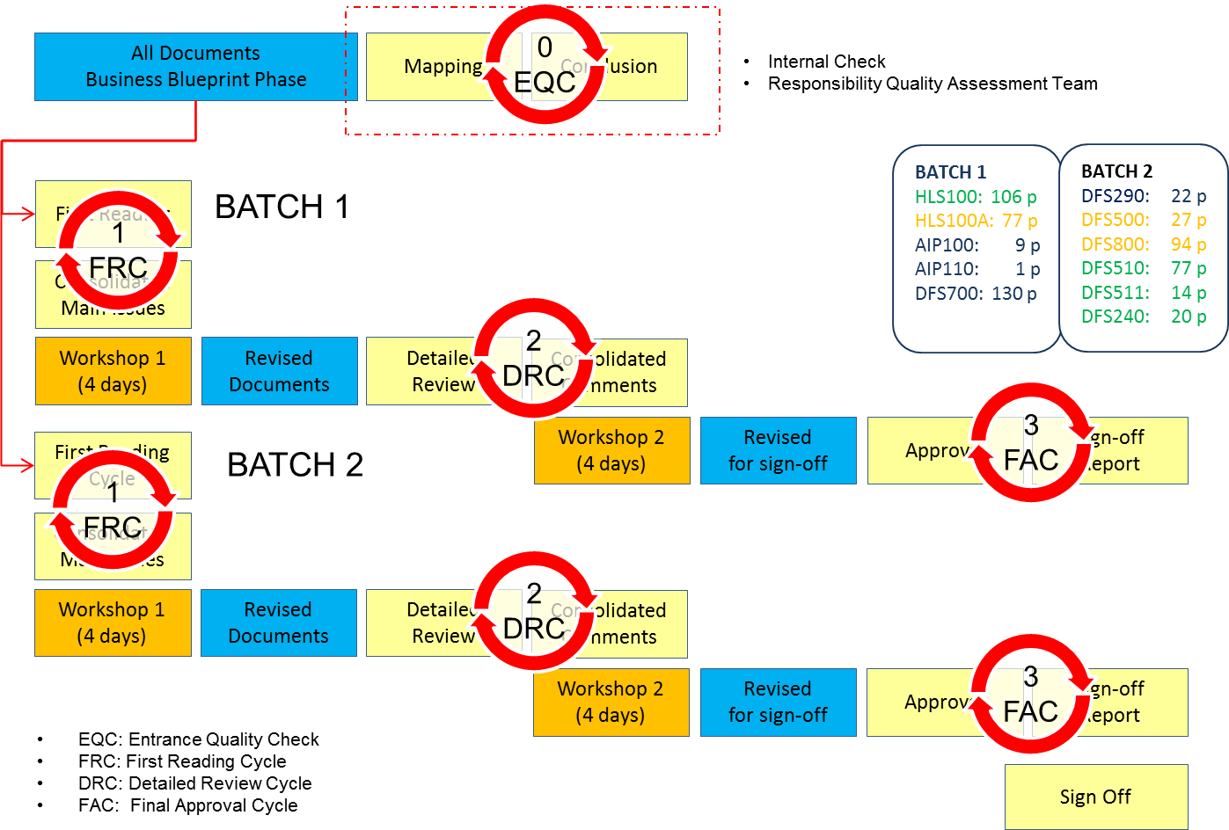
Review Cycles of Business Blueprint Phase
5

Slide 6
High level overview of current status (2/2)
‘All Parties Cooperation Agreement’ (APCA) approved and formal signature process completed. The APCA includes the provisions for costs recovery and validation
Cost reports (September 2012-2013, Q1-Q2 2014 and estimated financial forecasts)
The updated budget for the remainder of the project will be provided to the NRA’s at the conclusion of the Business Blueprint Phase
XBID solution contracts between PXs and DBAG and clarifications on Performance (Quality Plan) and Code Base (Equal Treatment) to be agreed during Phase 2 of the Business BluePrint.
The Realistic Test Scenario (RTS) with a 2 second peak is underway with the test having been run w/c 18th August.
Results from the test will be provided to PX’s on the week of 22th September. A workshop where DBAG will present the results of the RTS and their analysis will be held in early October.
A second test exploring the performance limits of the system will also be arranged. Discussions on this test are due to commence with DBAG in early/mid-September
6

Slide 7
Tentative Project Timeline: May 14 – 4th Quarter 15
03.06.14
04.08.14
09.12.14
3M +
11M +
14M +
??
BBOP previous schedule
Development of the local systems
BBP(ESA Step 2 Phase 1)
BBP(ESA Step 2 Phase 2)
Development
Test
Contin-gency
Go-Live Preparation
ESA Step 2 Phase 1 + 2 take 1.5 months longer then planned
+ refers to on-going activities for integrated planning (not fixed yet)
+ refers to on-going activities for integrated planning (not fixed yet)
+ refers to on-going activities for integrated planning (not fixed yet)
IAT
UAT Emergency
FAT I
UAT Functional
UAT Integration
UAT Performance
UAT Simulation
Contingency
FAT II
Start
3M+
4 M
5,5 M
6M+
7M
8M
11M
Completed
Notes
- High-level planning is subject to optimisation & detailed planning during ESA Step 2
The contingency can be used in any of the testing step (applicable for IAT, FAT, UAT).
*Q4 does not include the contingency
On-going
Pending
7

Slide 8
Update on Shipping and Nominations
The original number of potential options (8) was reduced.
The 3 remaining options undergoing detailed evaluation are:
A(+). Central Counter Parties (CCPs) doing the shipping (XB nomination and financial clearing) [discussed as interim solution]
• Border to Border (B2B) only
• Extension of Day Ahead principles
• On all borders, no cross border nomination is required by the TSOs to the CCPs
B. Central shipper doing the shipping (XB nomination and financial clearing) [discussed as enduring solution option]
• Hub to Hub (H2H) approach
C. Central physical shipper doing the physical shipping, CCPs doing the financial shipping [discussed as enduring solution option]
• (Virtual) Central physical shipper doing XB nomination under an H2H approach
• CCPs in charge of financial shipping under a B2B approach
The selection of the S&N Solution is on the critical path.
8

Slide 9
Key risks and issues
Issue/Risk | Potential Impact | Status / Resolution
a) Potential of delay in agreeing a 2nd Realistic Test Scenario (RTS). In terms of SLA DBAG interprets the RTS as exceeding the RFO/Offer in several areas. b) Also risk that separate Code Base issue (Equal Treatment) is not easily or quickly resolved. | Medium impact on the cost of the project if higher commitment needed | First RTS now underway with 2 second peak. PX’s want to explore the solution’s performance limits with a 2nd test. Due to resource constraints in DBAG in running the 1st RTS discussions on the 2nd test cannot commence until Sept. If agreement is not quickly reached this could impact sign off of the BBP. This has been highlighted to parties involved. Risk 1 b) Additional questions being agreed for legal co. VBB to answer reference competition law compliance
2. Need to agree a joint PX/TSO position on key aspects of Pre- and Post- Coupling & Local Implementation Projects | Lack of coordinated approach/agreement on way forward leads to delay of completing the Business Blueprint | Pre- and Post- Coupling Task Force in place with regular joint meetings and workshops. Plan in place. Discussion and evaluation underway on options and whether an interim step should be taken to achieve the final end state .
3. Interim Steps to implement the Intraday market draw resource and focus away from delivering the XBID main solution. | XBID solution implementation is delayed | Evaluation of potential interim steps including assessment of the impact on the main XBID project, aspects of equal treatment etc. was undertaken – risks were identified Eurelectric quick wins being considered for local borders
Lack of progress in co-ordinated planning of Local Implementation Projects (i.e. NWE+ roadmap) due to : Possible PX competition issues seen by some PXs Lack of agreement on key aspects on pre- and post coupling (see Issue/Risk #2) | Coordination issues leading to delayed local go-live dates | TSO’s help facilitate development of the Local Implementation Projects taking into account the PX’s competitive environment Early agreement on the key aspects of the pre- and post-coupling design (see Issue/Risk #2) Identify and mitigate any competition law restrictions applying in the context of any Local Implementation and their consequences in terms of overall NWE+ co-ordination/subsequent roadmap creation
No timely (before 25/09) decision on the Shipping and Nomination solution, means that the PPC TF has to continue evaluating options in parallel. | Less time for a) detailing the final S&N solution and b) providing a thorough review of the DBAG deliverables | The remaining three S&N solutions are being evaluated in terms of quality, costs and time to market. A distinction is made regarding potential interim and enduring solutions.
9

Slide 10
Stakeholder involvement
A communications Task Force has been established.
User Group meetings are planned to be organized starting mid-October in order to inform and involve stakeholders on project developments on:
Project status and timeline
Solutions for Shipping and Nomination
Elaboration on the XBID platform
The AESAG meeting participants are welcomed to provide their interest for participating in the User Group meetings, by sending and email to:
tbus@e-bridge.com
10

Slide 11
Summary and discussion
Delivery of ESA Step 2 Phase 1 has been successfully concluded.
ESA Step 2 Phase 2 has commenced with detailed review of Business Blueprint deliverables underway
Regulatory reports of historical and current year costs are being prepared together with an estimated forecast. Submission to NRA’s on 9th September
Further work has been completed on evaluation of Shipping & Nominations options
Quick win proposals by Eurelectric on specific borders has been evaluated by local parties
Risks/issues continue to be identified and managed
The project remains on track to complete the Business Blueprint phase by 9th December although this is dependent on:
Reaching agreement with DBAG on the contract
Reassurance on solution performance from the Realistic Test Scenarios
Agreement on the separate code base issue/competition law compliance
11

