Slide 1
Draft survey LNG & Storages settings GRI SSE Prag
Alessandro Ischia
07.06.2018

Slide 2
Main topics
Legal framework (TPA, regulated or negotiated regime) and characteristics of the system
General sector statistics (utilisation)
Network capacity allocation/booking
Network system charges
Specific services offered (e.g. strategic reserves, bunkering, etc.)
Average service costs

Slide 3
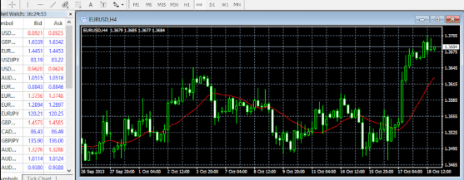
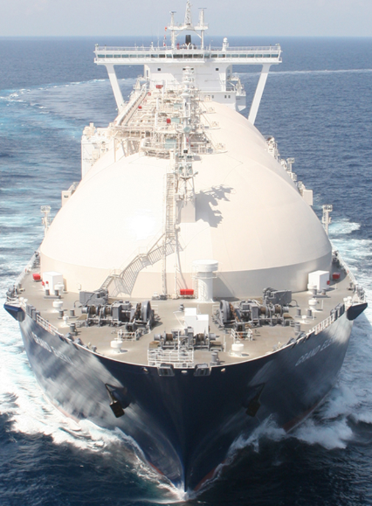
LNG liquefaction costs to VTP
VTP
Entry tariff in to
the gas network
IP
VTP
Cost per MWh?

Slide 4
Storage costs
VTP
Storage charge per bundled product
Cost per MWh?
IP
Entry tariff in to
the gas network
Bundle product
Firm working gas capacity for booking capacity in MWh (e.g. 20.000 MWh):
Injection period in days (e.g. 171 days):
Injection capacity kWh/h (e.g. 5.600 kWh/h):
Withdrawal period in days (e.g. 150 days):
Withdrawal capacity kWh/h (e.g. 10.000 kWh/h):

Slide 5
Alessandro Ischia
810
alessandro.ischia@e-control.at

