Slide 1
Common FUI Portal
FUI IG Meeting
Ofgem, 30th September 2011

Slide 2
Regional Coordination
Two auction platforms in use, one in development
  IFA, BritNed, Moyle, EWIC
Differing regional market structures
Recent work on Rules harmonisation has highlighted the need for more regional coordination.
  Transparency
  Publications
  Focal point for TSO coordination
Unicorn were requested to develop the previously presented option of a regional ‘Portal’ further to demonstrate potential functionality
Today’s presentation is the result of this preliminary work

Slide 3
FUI Portal Concept
Not a single auction platform, but a regional facility for coordination
Stand-alone benefit to whole FUI region
Common portal for FUI interconnectors brings advantages
  Centralised facility for:
    Publishing, consulting, updating of access rules
    Auction schedules, timing, updates, results, etc
    Regional market data
    Focal point (at regional level) for interconnector users, market participants and stakeholders
Optional to be in addition to, or instead of local website publication
An important step toward further regional development

Slide 4
Portal Development
4
Early development prototype up and running
Website: http://fui-portal.eu/
Information about cross-border capacity auctions on DC interconnectors in FUI
  BritNed (UK – Netherlands)
  IFA (UK – France)
Data available:
  Long-term Auction Calendar
  Long-term Auction Results
  Publications
  Login Area

Slide 5
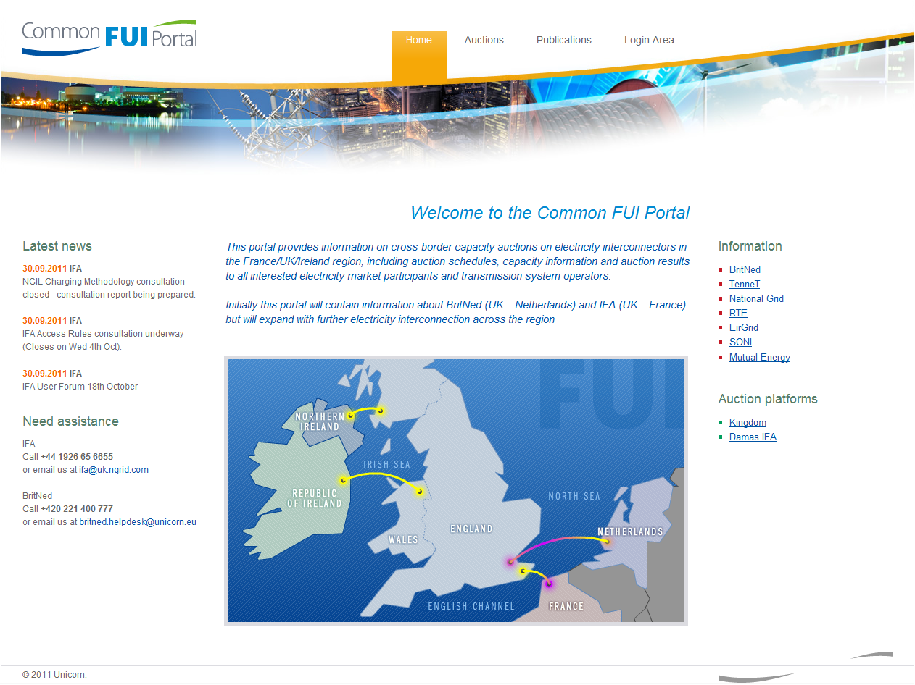
Main Page
5

Slide 6
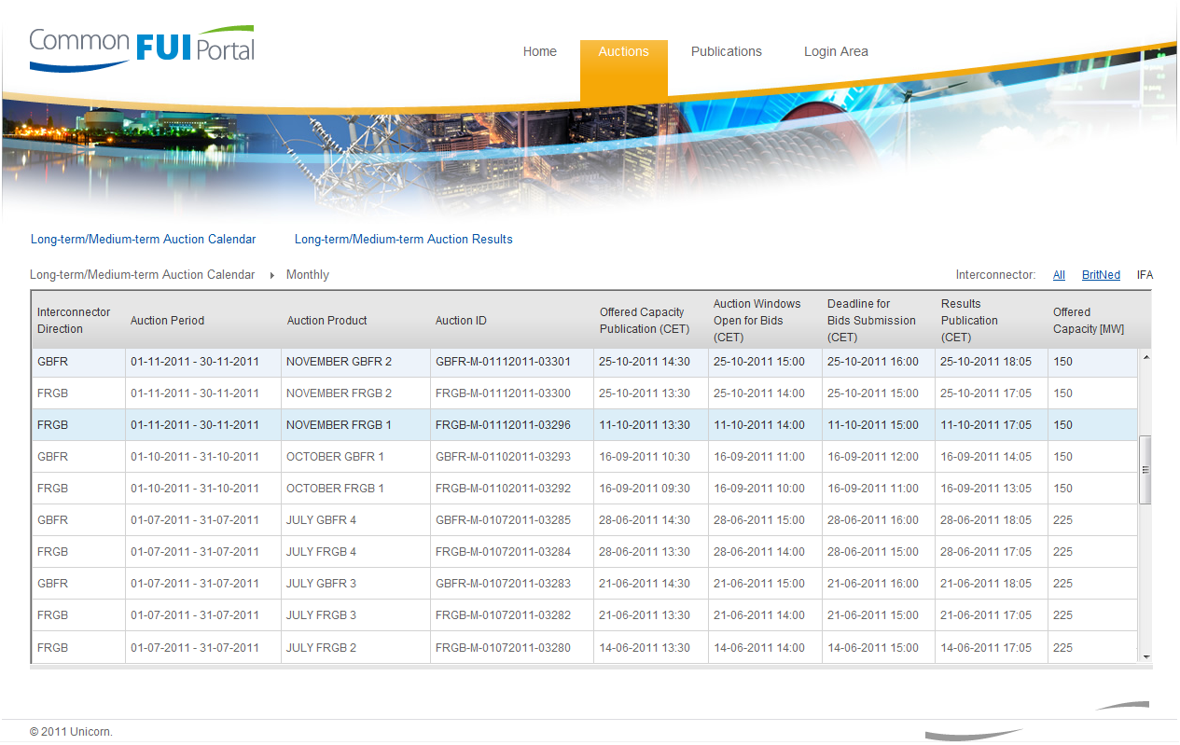
Long-term Auction Calendar
6

Slide 7
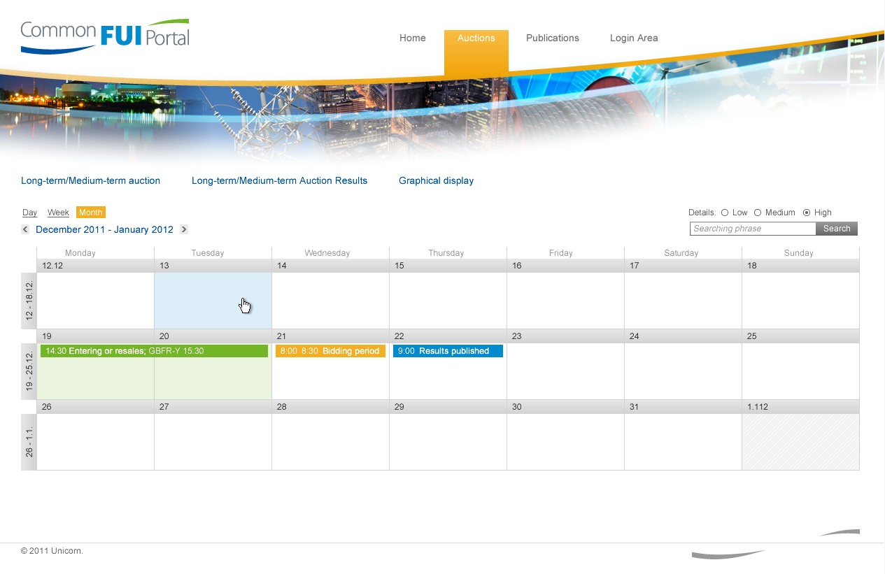
Long-term Auction Calendar
7

Slide 8
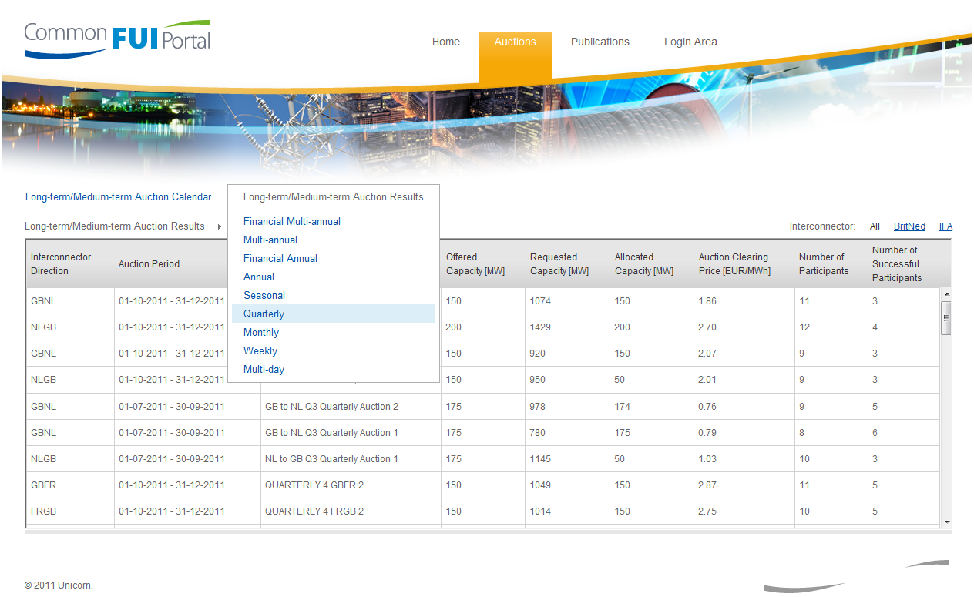
Long-term Auction Results
8

Slide 9
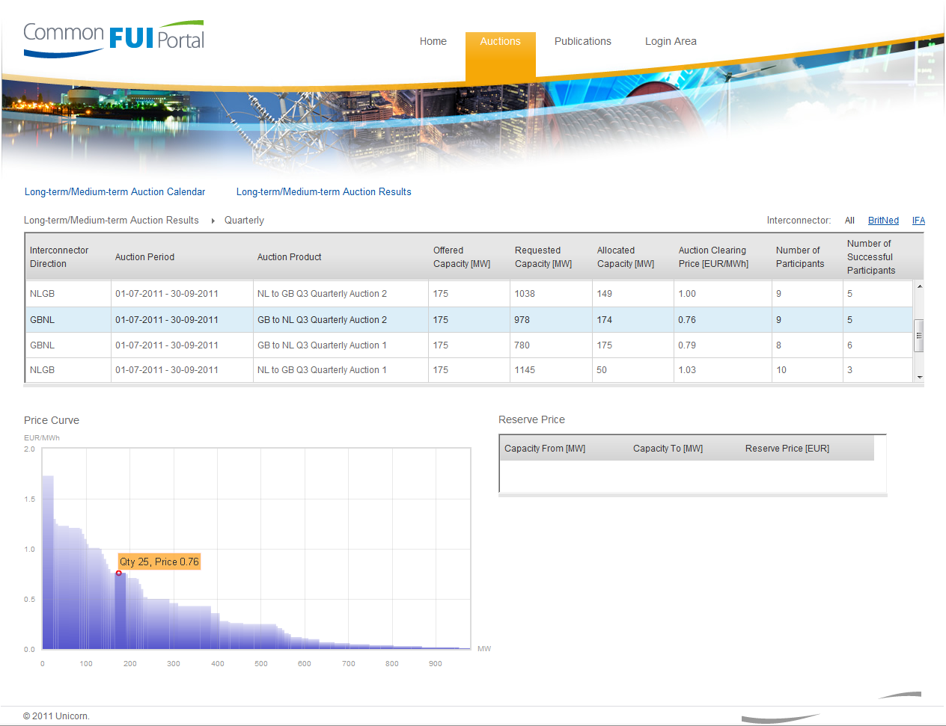
Long-term Auction Results
9

Slide 10
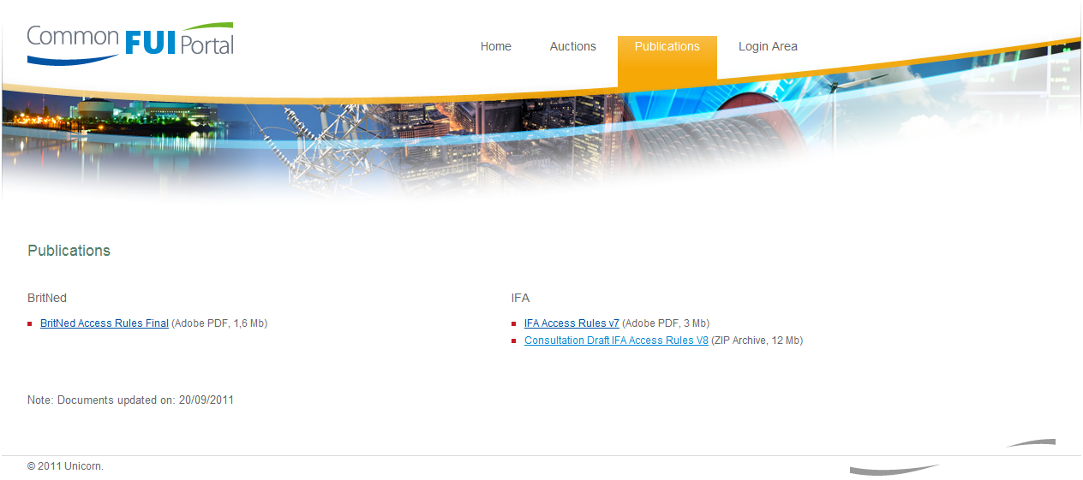
Publications
10

Slide 11
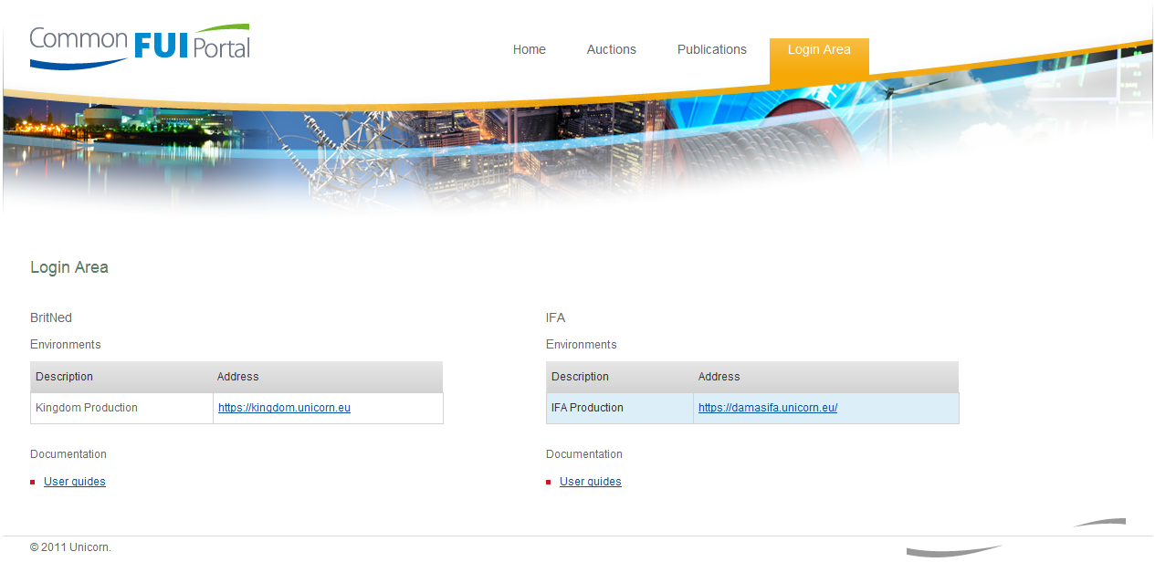
Login Area
11

