Slide 1
NWE Intraday
- Joint TSO and PX presentation -
2011-12-09
London

Slide 2
Content
Setting
Introduction
Technical Solution
Governance Arrangements
Roadmap
NWE Implementation
Challenges ahead

Slide 3
1. Setting
The target model for intraday is acknowledged by all stakeholders: Continuous implicit allocation
Europex and ENTSO-E are committed to implement a pan-European cross-border Intraday mechanism:
A Shared Order Book (SOB), performing continuous cross-border implicit intraday matching, and
A Capacity Management Module (CMM) allocating the cross-border intraday capacity in a continuous manner
In a One-to-One relationship between SOB and CMM
Objective: Pooling of intraday liquidity to maximize economic benefit in capacity allocation
Member X
Member Y
Local Order Book A
Local Order Book A
SOBF
CMM
TSO A
TSO B

Slide 4
2. Introduction
There are a number of aspects to the further development of cross-border Intraday
Rapid implementation of an interim solution
Support to Elbas-like solution for SOB/CMM
Aim to cover at least NWE by end 2012, if feasible, but open to other Regions if ready
Strong involvement of other regions and countries (e.g. TSOs Monitoring group)
Design and implementation of Target Model
Target end of 2014 launch
Finalize requirements, with the participation of relevant stakeholders:
reliable pricing of intraday transmission capacity reflecting congestion
automatic matching of all bids, including appropriate block bids
sophisticated products
Development of the governance framework for interim and enduring solution
Interim solution to be kept simple to avoid delay and reflecting simplicity of the interim solution
Target Model possibly more complex and may be impacted by Governance Guideline (link to Governance Guideline and to Network Codes still unclear)

Slide 5
3. Technical Solution (i)
ELBAS
Integrated SOB-CMM solution
Platform is used in Nord Pool Spot and APX-Endex ID markets
Currently operated in 8 countries and in total of 19 market areas
Includes parameters set up for individual areas. For example:
Gate closure per area
Trade start time for next day
Easy configuration of new market areas, connections and PX’s
Includes most of the key features for the interim solution
During 2012 at least following new features are planned to be implemented:
HUB to HUB matrix presentation
Explicit ID capacity reservation and allocation
API for external PX’s (not using Elbas as the trading system)
Elbas is the potential system to be developed to become the foundation of the enduring solution

Slide 6
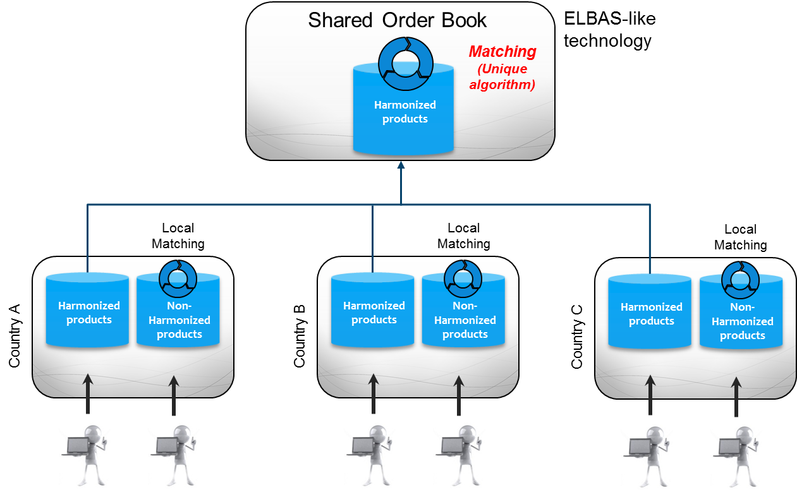
3. Technical Solution (ii)
ELBAS-like technology – integrated CMM/SOB functions
Available capacitiy
integrated CMM/SOB functions
All cross-zonal capacity will be allocated though the platform
Regional auctions may complement the implicit continuous mechanism and has to be coordinated with and linked to the solution
Explicit access (OTC and Balancing) provided by SOB/CMM platform, under TSO terms of access

Slide 7
4. Governance Arrangements
Intraday capacity calculation and allocation (including explicit access for OTC/Balancing) are governed by TSOs according to TSO rules, subject to regulatory approval
Intraday shared order book is governed by PXs according to PX rules, subject to direct regulatory oversight applicable to markets and market places
TSOs will take part in evaluation of starting point against TSO requirements, further algorithm development work and later on in change management of algorithm: TSO involvement limited to the extent allocation issues are concerned
After implementation of the interim solution:
Further SOB system and product evolutions to be proposed and developed by PXs in close cooperation with TSOs, in consultation with market parties, and subject to approval by the NRAs concerned
Further evolutions of capacity allocation requirements to be proposed by TSOs, in consultation with market parties, subject to approval by the NRAs concerned and implemented by PXs

Slide 8
5. Roadmap
2011
2012
2013
2014
MoU ENTSO-E - Europex
TSO specification
TSO requirements
Clearing and settlement
Interim Solution
CMM/SOB concept
NWE CMM / SOB delivery
Local implementation
Go-Live
Design Phase
Enduring
Solution
Implementation
Go-Live

Slide 9
6. NWE Implementation
The local / multi-party projects will aim to change the current capacity allocation mechanism on several NWE borders into an Elbas-like mechanism
Open to other borders or regions when ready
Current allocation schemes:
Implicit and explicit continuous
capacity allocation
Explicit continuous capacity allocation
Explicit capacity allocation
No capacity allocation

Slide 10
7. Challenges ahead
Finalization of SOB/CMM concept and implementation of the single SOB/CMM solution including shipping arrangements
Compatibility of the interim solution with the GB trading arrangements to be further evaluated
Improvements for the enduring solution have to be designed
Sophisticated products
Pricing of intraday capacity
Recalculation of intraday capacity
European governance approach is under discussion and development
Perform several local implementation projects in parallel considering the overall high level design

Slide 11
Thanks for your attention!

Slide 12
Situation as of May 2011
NO
FI
EE
NL
DK
LV
(W)
S
DK
LT
(E)
IR
UK
B
L
L
D
PL
2
PXs
CZ
F
CH
A
SK
H
RO
ES
SL
BG
P
I
G
XBID capacity allocation and energy
trading
National ID Market
Continuous IDXB (integrated SOBF-CAF system)
Continuous IDXB
Continuous IDXB (SOB system connected to a CMM)
FCFS allocation of capacity obligations
Continuous IDXB
Implicit ID auctions
Continuous internal ID (not cross-border)
Explicit ID auctions
Cross border ID auctions
Allocation methods based on ID sessions (Pro rata, FCFS)
No
PX ID Market
No intraday allocation method in place
Not congested interconnection

