Slide 1
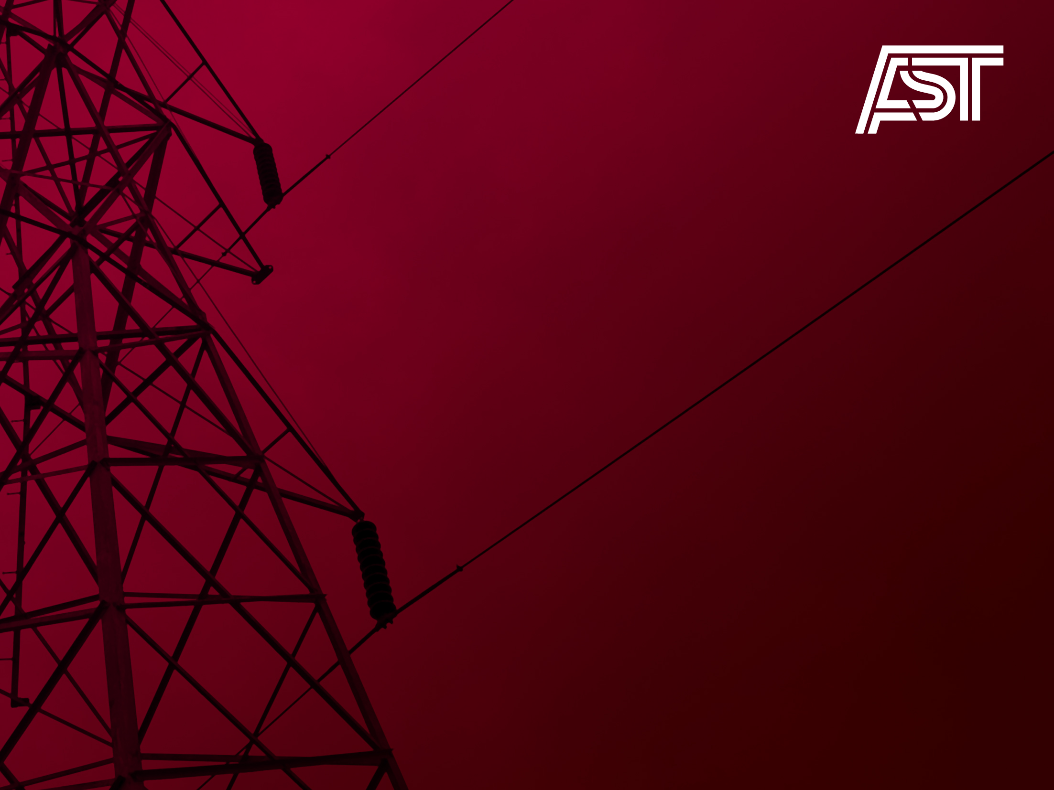
Projects with an impact on the Baltic countries – BEMIP and the 10 year network development plan
14th Baltic Electricity Market Mini-Forum
Riga, 2012 September 21
2012.09 | www.ast.lv

Slide 2

General points
Energy Infrastructure Package
  List of Projects of Common Interest for Baltic.
  New regulation “Energy Infrastructure Package” adoption.
Pan-European Ten Year Network Development Plan 2012
  Final package with all strategic transmission network projects in Baltic with interconnections and local networks reinforcements.
  A dense 2-year long study process.
Pan-European Ten Year Network Development Plan 2014
Cost Benefit Analyses – CBA
Macro-procedure for TYNDP 2014
2012.09 | www.ast.lv

Slide 3
Energy Infrastructure Package
HV interconnections development in Europe and European Commission financing allocation will be based on EC Directive and Regulation, named “European Infrastructure Package”.
On process: draft Regulation of the European Parliament and of the Council on guidelines for trans-European energy infrastructure and repealing Decision No 1364/2006/EC and amending Regulations (EC) No 714/2009 and 715/2009;
According new regulation the project financing allocation will be based on union list of Projects of Common interest (PCI);
PCI projects will be evaluated according to “Energy infrastructure priority corridors and areas”. Priority corridor for Baltic:
Baltic Energy Market Interconnection Plan in electricity ("BEMIP Electricity"): interconnections between Member States in the Baltic region and reinforcing internal grid infrastructures accordingly, to end isolation of the Baltic States and to foster market integration in the region;
Member States concerned: Denmark, Estonia, Finland, Germany, Latvia, Lithuania, Poland, Sweden.
2012.09 | www.ast.lv

Slide 4
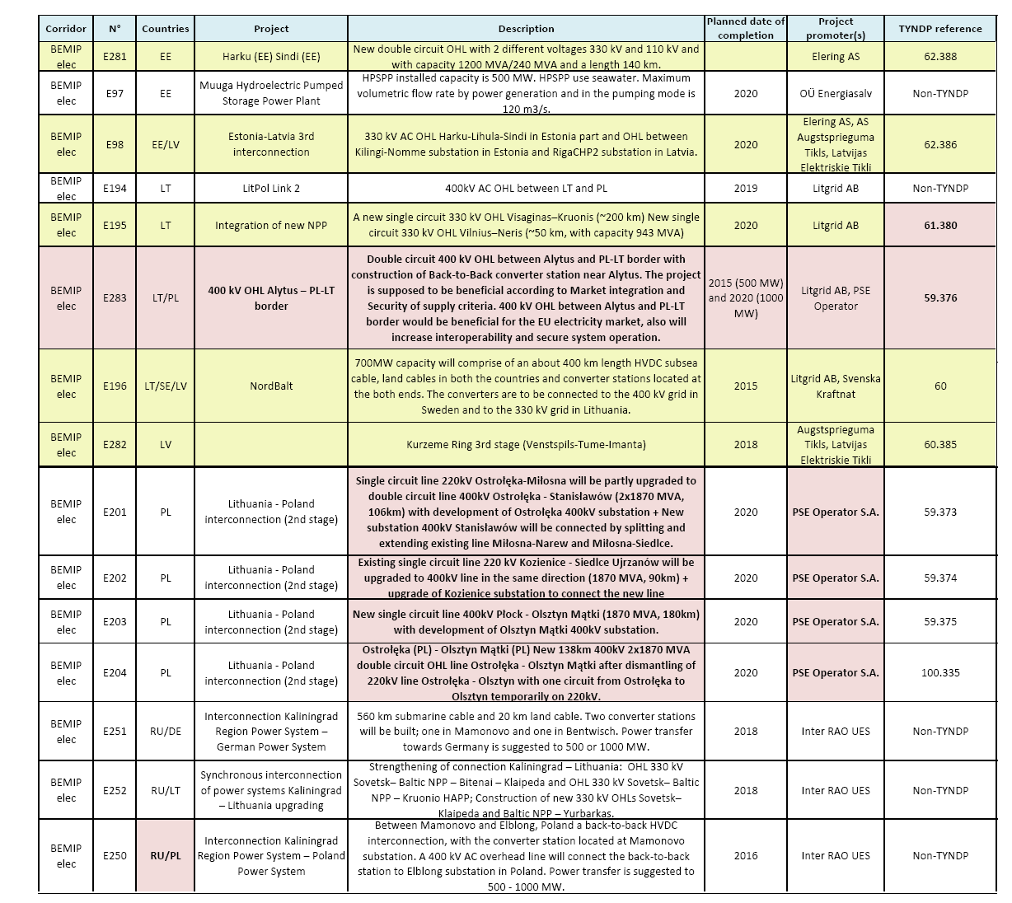
PCI in Baltic
2012.09 | www.ast.lv

Slide 5
EIP Regulation
PCI projects of electricity shall contribute significantly to at least one of the following specific criteria:
market integration, inter alia through lifting the isolation of at least one Member State; competition and system flexibility;
sustainability, inter alia through the transmission of renewable generation to major consumption centers and storage sites;
security of supply, inter alia through interoperability, appropriate connections and secure and reliable system operation.
PCI projects of electricity valuation will be based on the energy system-wide cost-benefit analysis (CBA) methodology, including network and market modeling. Methodology will be elaborated by ENTSO-E.
CBA calculation will be prepared on the Regional level.
The new EIP regulation will be adopted in the 2013;
Financing allocation for the each PCI project will be decided by EC;
On the national and regional level PCI projects are worked out by TSOs, NRAs and representative of Member States.
2012.09 | www.ast.lv

Slide 6
EIR Regulation
Indicators for PCI for Electricity transmission:
Increasing of cross-border grid transfer capacity, by at least 500 MW;
Energy infrastructure categories for PCI for electricity:
High-voltage overhead transmission lines, if they have been designed for a voltage of 220 kV or more, and underground and submarine transmission cables, if they have been designed for a voltage of 150 kV or more;
Cost Benefit Analysis for PCI electricity projects:
shall be based on a common input data in the years n+5, n+10, n+15, and n+20, taking into account scenarios for demand, generation capacities by fuel type and their geographical location, fuel prices, transmission network and generation development.
2012.09 | www.ast.lv

Slide 7
TYNDP-2012 transmission network projects in Baltic
Estlink2 (Project Nr.63). Commissioning in 2014
Interconnection Estonia-Finland:
Püssi (EE) – Antilla (FI) (Investment label Nr.391);
Local 330kV network reinforcement in Estonia:
Eesti- Püssi (Inv.l.Nr.389) and Balti- Püssi (Inv.l.Nr.390)
NordBalt (Project Nr.60). Commissioning in 2015
Interconnection Lithuania-Sweden:
Klaipeda (LT) – Nybro (SE) (Investment label Nr.383);
Local network reinforcement in Lithuania:
Klaipeda-Telšai(Inv.l.Nr.377) and Paņevežys-Muša (Inv.l.Nr.378);
Network reinforcement in Latvia:
RigaCHP1-Imanta (Inv.l.Nr.384) and Grobina-Imanta (Inv.l.Nr.385);
Network reinforcement in Sweden:
Ekhyddan- Nybro/Hemsjö (Inv.l.Nr.A52).
Network reinforcement for VisaginasAES (Project Nr.61). Commissioning in 2020
Local network reinforcement in Lithuania:
Visaginas-Kruonis (Inv.l.Nr.380);
Vilnius-Neris (Inv.l.Nr.382).
2012.09 | www.ast.lv

Slide 8
TYNDP-2012 transmission network projects in Baltic
Estonian-Latvian third inerconnection (Project Nr.62). Commissioning in 2020
Interconnection Estonia-Latvia:
KilingiNomme(EE) – RigaCHP2(LB) (Investment label Nr.386);
Local 330kV network reinforcement in Estonia:
Tartu-Sindi(Inv.l.Nr.387)
Harku-Sindi(Inv.l.Nr.388)
LitPol link (Project Nr.59). Commissioning in 2015(1 part), 2020 (2 part).
Interconnection Lithuania-Poland:
Alytus(LT)–LT-PL border (Investment label Nr.376) in Lithuania,
Elk(Pol)-PL-LT border (Investment label Nr.368) in Ploand.
Local network reinforcement in Lithuania:
Kruonis-Alytus(Inv.l.Nr.379);
Local network reinforcement in Poland:
Siedlce Ujrzanów- Miłosna (Inv.l.Nr.36),
Ełk- Łomża(Inv.l.Nr.370),
Ostrołęka- Narew(Inv.l.Nr.371),
Ostrołęka-Stanisławów (Inv.l.Nr.373),
Kozienice-Siedlce Ujrzanów(Inv.l.Nr.374),
Płock- Olsztyn Mątki (Inv.l.Nr.375).
2012.09 | www.ast.lv

Slide 9
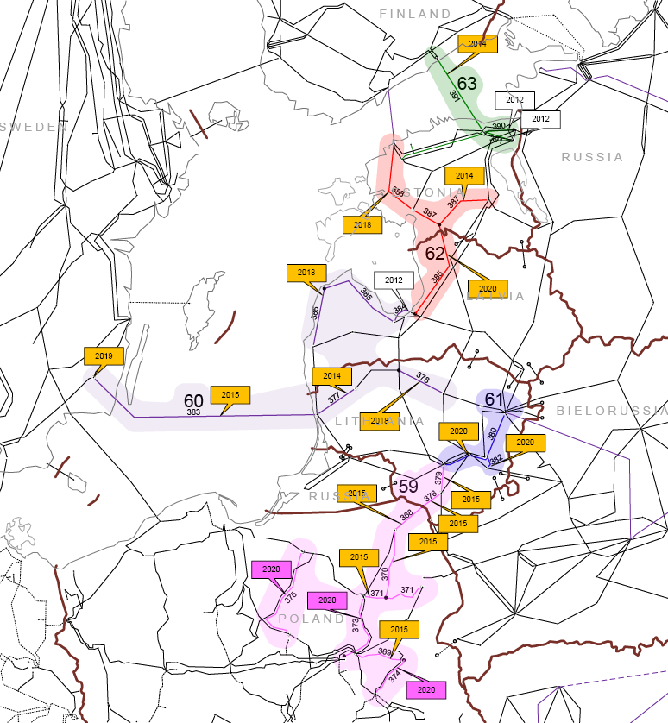
TYNDP-2012 transmission network projects in Baltic
Each of project cluster is depicted by separate colour
2012.09 | www.ast.lv

Slide 10
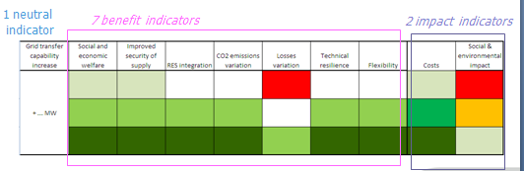

Cost benefit analyses (CBA) for TYNDP 2014
The goals of the methodology, as stated in the draft Regulation, are the fallowing
  Assessment of PCIs and other TYNDP projects;
  Cost allocation/incentives and grants;
  Transparency.
Cost benefit indicators and methodology:
  Social and economic welfare;
  CO2
  Losses
  Security of Supply
  RES integration
Without modification
compared to TYNDP 2012.
But is possible quantify:
Losses
SoS
Cost benefit analysis assessment presents the following limits:
  Single criterion provides less information (less transparency)
  Some benefits are difficult to monetize (technical aspects, social & environmental impact, …)
2012.09 | www.ast.lv

Slide 11
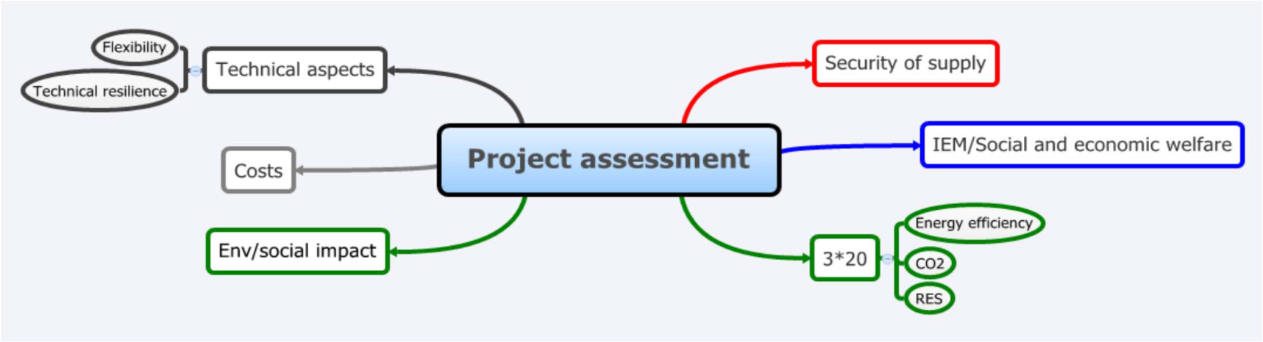
Cost benefit analyses (CBA) for TYNDP 2014
The assessment framework is a combined Cost-Benefit and Multi-Criteria Assessment
The goal of Project Assessment is to:
  Characterize all impacts of transmission projects in terms of added value for society
  Measure of project costs and environmental/social impacts
The methodology will be used for:
  Common projects carried out for the TYNDP
  Individual projects (undertaken by TSOs or project promoters)
2012.09 | www.ast.lv

Slide 12
Pan European TYNDP-2014 Macro-procedure structure
Background
Principles and basic description of processes
Key Principle 1: robustness
Based on the principles decided during the 19th June TYNDP workshop
Key Principle 3: efficiency and flexibility
Key Principle 4: consistency
Key Principle 5: compliance and transparency
2012.09 | www.ast.lv

Slide 13
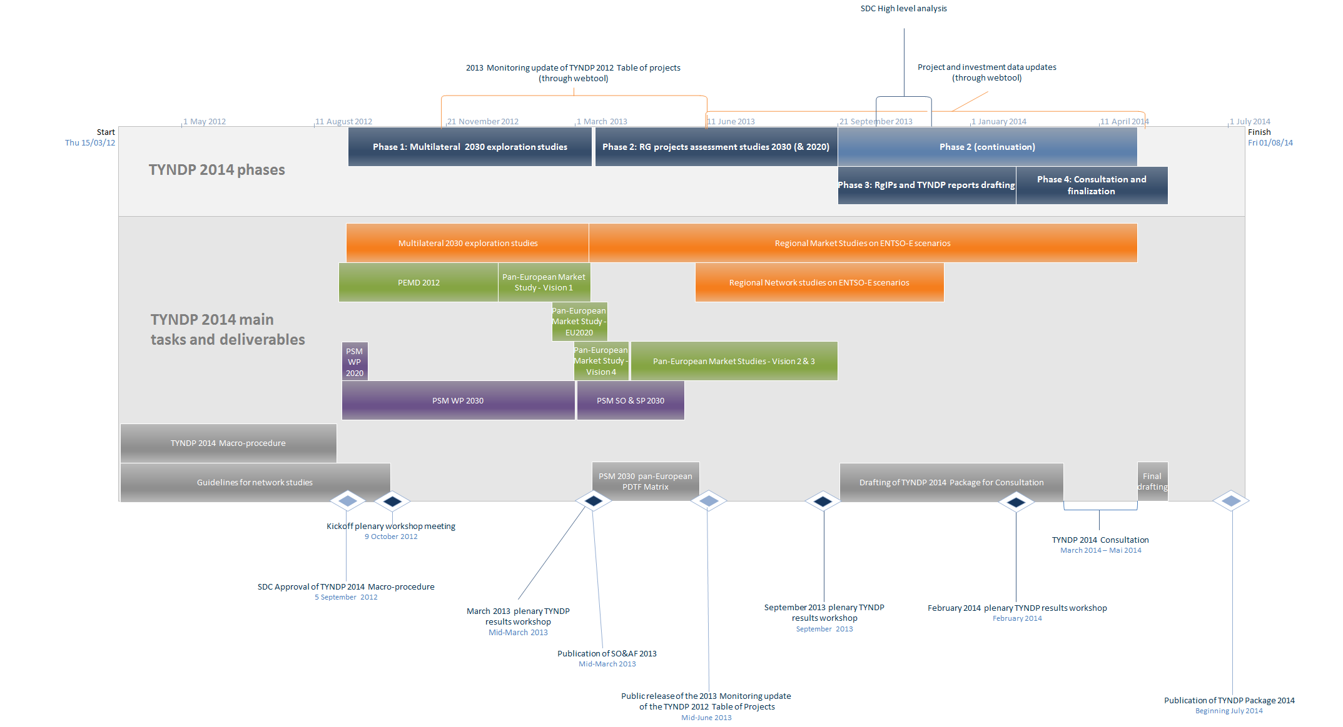
TYNDP-2014 Macro-procedure structure
3. Schedule
Organization and roles
Risks and mitigation
2012.09 | www.ast.lv

Slide 14

Latvijas elektroenerģijas pārvades sistēmas operators
AS AUGSTSPRIEGUMA TĪKLS
Dārzciema iela 86, Rīga, LV-1073
T: (+371) 67728353
F: (+371) 67728858 ast@ast.lv www.ast.lv
Thanks for attention!

