Slide 1
ROHU(AT) – Mosonmagyarovar – HUSKAT
GRI SSE Prag
Alessandro Ischia
07.06.2018

Slide 2
1. ROHUAT status on 27 April 2017
2. ROHU status on 12 October 2017
3. HUAT (Mosonmagyarovar) status on 06 June 2018
4. HUSKAT status on 06 June 2018
5. Conclusion

Slide 3
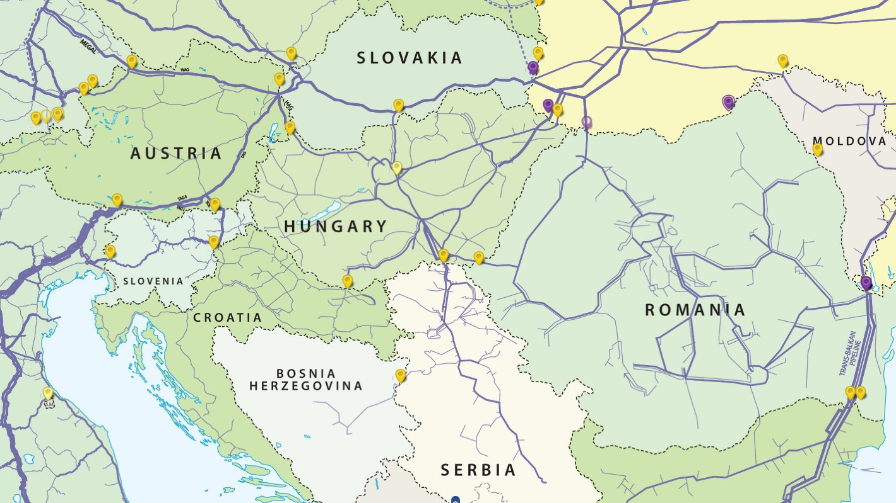


TSOs: new gas route - ROHUAT
Development from 2014 till 2017
3

Slide 4



Tariffs overview ROHUAT
(in local currency) status 18.05.2017
23,47 €/kWh/h/y
Entry
0,77 €/kWh/h/y
3,31 €/kWh/h/y
33,3 %
Exit
631,25 HUF/kWh/h/y
786,52 HUF/kWh/h/y
70%
Entry
1483,63 HUF/kWh/h/y
0,0 HUF/kWh/h/y
70%
Exit
631,25 HUF/kWh/h/y
0,0 HUF/kWh/h/y
70%
Exit
22,45 RON/kWh/h/y
22,67 RON/kWh/h/y
70%
Reserve price
Minimum Premium
Minimum booked incremental capacity threshold
98,72 HUF/MWh
Entry
22,89 RON/kWh/h/y
23,12 RON/kWh/h/y
0%
12,28 €/kWh/h/y
Termination fee for Transgaz, GCA and FGSZ is 0.033% of the respective value of the individual Bid
4

Slide 5
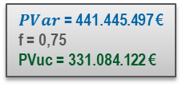
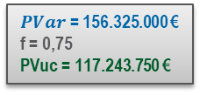
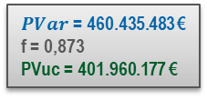
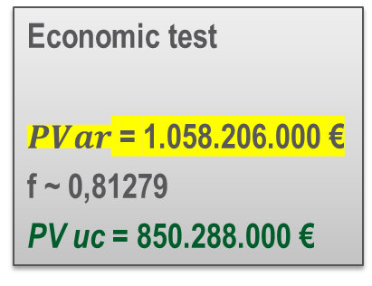
Project costs overview ROHUAT
(in €) status 18.05.2017
2,69 % m3
$PVar$ = 156.325.000 €
f = 0,75
PVuc = 117.243.750 €
$PVar$= 460.435.483 €
f = 0,873
PVuc = 401.960.177 €
$PVar$ = 441.445.497 €
f = 0,75
PVuc = 331.084.122 €
Economic test
$PVar$ = 1.058.206.000 €
f ~ 0,81279
PV uc = 850.288.000 €
5

Slide 6
1. ROHUAT status on 27 April 2017
2. ROHU status on 12 October 2017
3. HUAT (Mosonmagyarovar) status on 06 June 2018
4. HUSKAT status on 06 June 2018
5. Conclusion

Slide 7
Tariffs overview ROHU
(in local currency) status 12.10.2017
18,6 €/kWh/h/y
Entry
1483,63 HUF/kWh/h/y
1166,99 HUF/kWh/h/y
70%
Exit
631,25 HUF/kWh/h/y
0 HUF/kWh/h/y
0%
Exit
22,45 RON/kWh/h/y
22,67 RON/kWh/h/y
70%
98,72 HUF/MWh
Entry
22,89 RON/kWh/h/y
23,12 RON/kWh/h/y
0%
Reserve price
Minimum Premium
Minimum booked incremental capacity threshold
~ 12,28 €/kWh/h/y
7
Termination fee for Transgaz and FGSZ is 0.033% of the respective value of the individual Bid

Slide 8
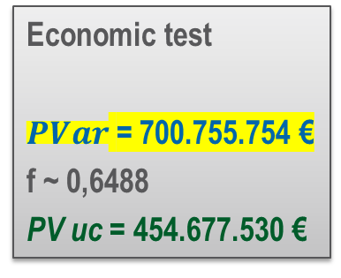
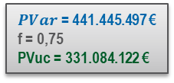
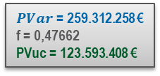
Project costs overview ROHU
(in €) status 12.10.2017
2,69 % m3
$PVar$= 259.312.258 €
f = 0,47662
PVuc = 123.593.408 €
$PVar$ = 441.445.497 €
f = 0,75
PVuc = 331.084.122 €
Economic test
$PVar$ = 700.755.754 €
f ~ 0,6488
PV uc = 454.677.530 €
8

Slide 9
1. ROHUAT status on 27 April 2017
2. ROHU status on 12 October 2017 Musterabschnitt
3. HUAT (Mosonmagyarovar) status on 06 June 2018
4. HUSKAT status on 06 June 2018
5. Conclusion

Slide 10


Goal: to reach the Austrian VTP
But the interest of the market for the corridor from black Sea to Austrian VTP is still present
VTP
PCI 6.24
10
10

Slide 11

Goal: to reach the Austrian VTP
VTP
HUSKAT AA
HUAT IC
ROHU OS
11
11

Slide 12
Capacity HUAT (Mosonmagyarovar)
Offer levels for bundled capacity:
Offer level 1: 5,740,470 kWh/h (as per ROHUAT)
    Operational from 2022 for Austria
    Operational from 2024 for Hungary
Offer level 2: 10,007,100 kWh/h
    Operational from 2022 for Austria
    Operational from 2024 for Hungary
  10% of technical capacity has already been deducted for short-term allocation.
  Offer levels will start in separate auctions (competing projects).
12

Slide 13
Tariffs overview HUAT offer level 1
(in local currency) status 06.04.2018
31,97 €/kWh/h/y
AT: 2,17 €/kWh/h/y
HU: 29,8 €/kWh/h/y
Entry
0,77 €/kWh/h/y
1,40 €/kWh/h/y
33 %
Exit
631,25 HUF/kWh/h/y
8607,69 HUF/kWh/h/y
?? %
98,72 HUF/MWh
Reserve price
Minimum Premium
Minimum booked incremental capacity threshold
Termination fee for GCA is 0.033% and FGSZ is 10% of the respective value of the individual Bid
13

Slide 14
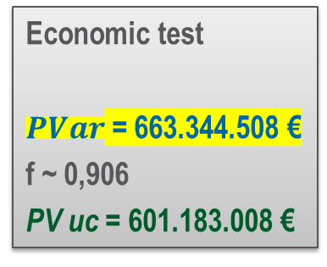
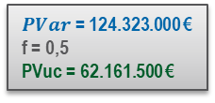
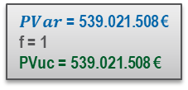
Project costs overview HUAT offer level 1
(in local currency) status 06.04.2018
$PVar$ = 124.323.000 €
f = 0,5
PVuc = 62.161.500 €
$PVar$= 539.021.508 €
f = 1
PVuc = 539.021.508 €
Economic test
$PVar$ = 663.344.508 €
f ~ 0,906
PV uc = 601.183.008 €
14
14

Slide 15
Tariffs overview HUAT offer level 2
24,88 €/kWh/h/y
AT: 2,04 €/kWh/h/y
HU: 22,84 €/kWh/h/y
Entry
0,77 €/kWh/h/y
1,27 €/kWh/h/y
33 %
Exit
631,25 HUF/kWh/h/y
6451,64 HUF/kWh/h/y
?? %
98,72 HUF/MWh
Reserve price
Minimum Premium
Minimum booked incremental capacity threshold
15
Termination fee for GCA is 0.033% and FGSZ is 10% of the respective value of the individual Bid

Slide 16
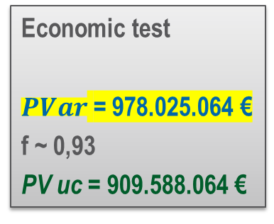
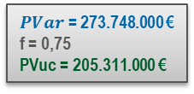
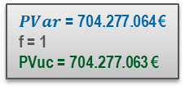
Project costs overview HUAT offer level 2
2,69 % m3
$PVar$ = 273.748.000 €
f = 0,75
PVuc = 205.311.000 €
c
$PVar$= 704.277.064 €
f = 1
PVuc = 704.277.063 €
Economic test
$PVar$ = 978.025.064 €
f ~ 0,93
PV uc = 909.588.064 €
16

Slide 17
1. ROHUAT status on 27 April 2017
2. ROHU status on 12 October 2017 Musterabschnitt
3. HUAT (Mosonmagyarovar) status on 06 June 2018
4. HUSKAT status on 06 June 2018
5. Conclusion

Slide 18

Tariffs overview HUSKAT
Exit
4,467 €/kWh/h/y
0,0 €/kWh/h/y
?? %
Entry
2,604 €/kWh/h/y
0,0 €/kWh/h/y
?? %
Entry
0,77 €/kWh/h/y
0,0 €/kWh/h/y
0 %
Exit
631,25 HUF/kWh/h/y
0,0 HUF/kWh/h/y
49,9 %
9,87 €/kWh/h/y
Reserve price
Minimum Premium
Minimum booked incremental capacity threshold
Notes:
Offer level : IP Velke Zlievce 5.724.000 kWh/h/a IP baumgarten 4.648.063 kWh/h/a

Slide 19
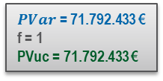
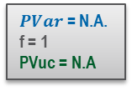
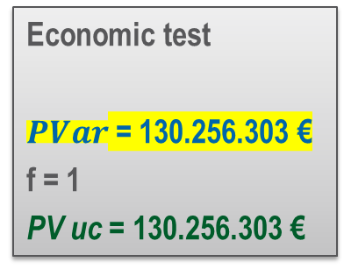
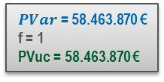
Project costs overview HUSKAT
$PVar$ = 71.792.433 €
f = 1
PVuc = 71.792.433 €
$PVar$ = N.A.
f = 1
PVuc = N.A
$PVar$ = 58.463.870 €
f = 1
PVuc = 58.463.870 €
Economic test
$PVar$ = 130.256.303 €
f = 1
PV uc = 130.256.303 €

Slide 20
1. ROHUAT status on 27 April 2017
2. ROHU status on 12 October 2017 Musterabschnitt
3. HUAT (Mosonmagyarovar) status on 06 June 2018
4. HUSKAT status on 06 June 2018
5. Conclusion

Slide 21
Total investment costs

Slide 22
Total transportation costs

Slide 23
Status of the projects
ROHUAT: abandoned by Hungarian side
ROHU: "successor" for parts of ROHUAT; first bidding round with oversubscription; currently phase with shipper right to step back from contracts
HUAT: positive decision on Austrian side, no decision on the Hungarian side yet, but negative opinion. Incremental auction will not be carried out
HUSKAT: market consultation of the Rulebook of TSOs ongoing, comments by 25 June
Notes:
HUSKAT Shipper Meeting, 05.06.2018, Budapest
Roolebook ready for end of June
Customer registration closing 10 August
Economic test 1 : 28 September
Step back right by 28 December

Slide 24
Links
HUSKAT:
https://www.gasconnect.at/netzzugang/fernleitungsnetz/kapazitaetsprojekte/hu-sk-at-korridor/
http://www.eustream.sk/en_media/en_news/consultation-binding-alternative-allocation-procedure-for-the-hu-sk-at-route
http://www.gaztranzit.hu/en/Lapok/default.aspx
ROHU:
https://fgsz.hu/en-gb/partnereinknek/kapacitaskereskedelmi-informaciok/open-season
HUAT:
https://www.gasconnect.at/en/network-information/network-development/network-development-plan/
https://fgsz.hu/en-gb/Documents/Incremental_project_proposal_Mosonmagyarovar_FGSZ.pdf
ROHUAT:
https://www.gasconnect.at/netzzugang/fernleitungsnetz/kapazitaetsprojekte/gca-mosonmagyarovar/

Slide 25
Disclaimer
Potential errors in reporting and aggregating data from official documents are made in absolute good faith.
Stakeholders are invited to report potential errors to E-Control

Slide 26
Alessandro Ischia
810
alessandro.ischia@e-control.at

Slide 29
Total investment costs
50% booking rate and 100% nomination

Slide 30
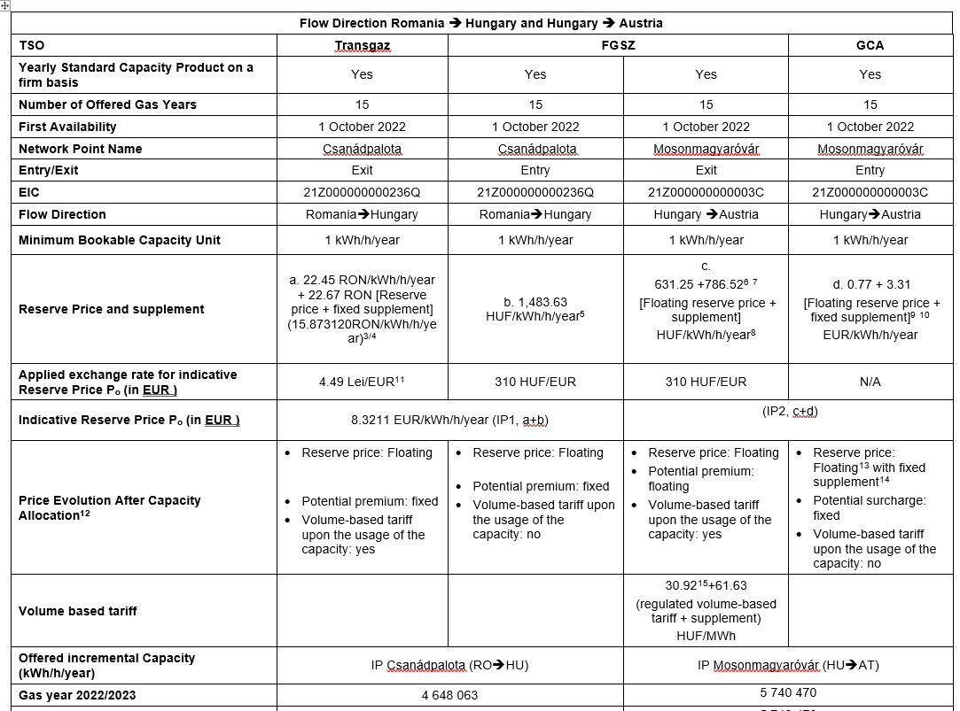
Capacity products & tariffs ROHUAT
30

Slide 31
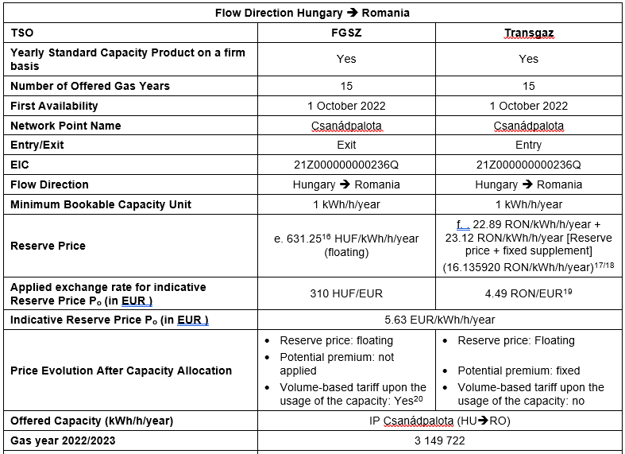
Capacity products & tariffs ROHUAT
31

Slide 32
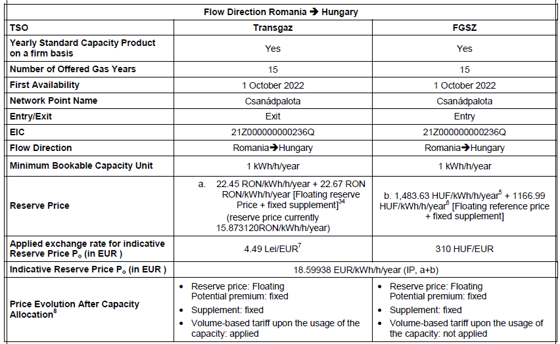
Capacity products & tariffs ROHU
32

Slide 33
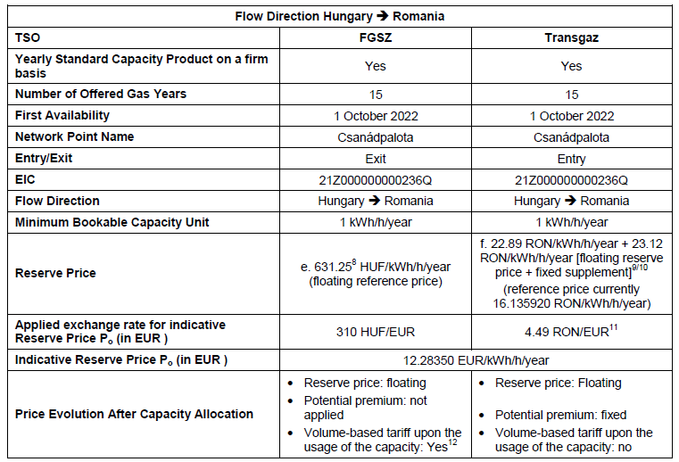
Capacity products & tariffs ROHU
33

Slide 34
CAPEX HUAT (Mosonmagyarovar)
CAPEX estimations Austria:
Total CAPEX estimation for offer level 1 :
94,117,500 EUR (incl. 25% contingencies)
Total CAPEX estimation for offer level 2 :
202,000,000 EUR (incl. 25% contingencies)
CAPEX estimations Hungary:
Total CAPEX estimation for offer level 1:
485,628,000 EUR (incl. 25% contingencies)
Total CAPEX estimation for offer level 2 :
634,514,000 EUR (incl. 25% contingencies)
34

