Slide 1
Redesigning the Austrian balancing system GRI SSE Prague
Alessandro Ischia
07.06.2018

Slide 2
Status quo
Austria’s current balancing regime, introduced on 1 January 2013, is a complex two-system construct:
ex-ante balancing at market area level, run by the market area manager and with mandatory exchange procurement
ex-post balancing at distribution level, which is handled by the clearing and settlement agents
Methodology (ex-ante balancing, separation of balancing areas) has been the object of international criticism
EFET and ACER believe that the Austrian balancing regime is not fully in line with the Gas BAL NC
Notes:
that means contractual and operational challenges for market participants: ex-ante balancing at market area level, run by the market area manager and with mandatory exchange procurement, co-exists with ex-post balancing at distribution level, which is handled by the clearing and settlement agents.
Some EU-level organisations (such as EFET and ACER) believe that the Austrian balancing regime is not fully in line with the Gas BAL NC;

Slide 3
General goals
Reacting to this criticism, E-Control submitted a proposal for a redesigned Austrian balancing system.
Consultation with all market participants to collect views from a wide pool of respondents was closed on 15 Mai
it will encompass the entire market area, i.e. it will no longer systematically distinguish between market area and distribution level balancing and clearing (the legal basis for this step was already laid in section 41 Natural Gas Act 2011);
it will fully put the provisions of Commission Regulation (EU) No 312/2014 (the Gas Balancing Network Code, Gas BAL NC) into practice in Austria.

Slide 4
Specific goals
an integrated balancing zone (including market area and distribution) with a single clearing entity that takes on the clearing tasks which are currently exercised by the clearing and settlement agents and the market area manager
a daily balancing regime with centralised balancing and daily financial clearing of balance groups
a within day incentive mechanism that optimises linepack use by way of within day obligations
frequent information provision with respect to allocations and hourly updates of market area information
incentives for BRPs to keep their portfolios balanced
swift and efficient financial settlement that uses established processes
a neutrality charge for balancing that is calculated daily
centralised ex post clearing including allocated quantities and metered consumption on transmission and distribution level
the mechanism that is already in place for curtailing BGs if market-based measures are insufficient
increased transparency

Slide 5
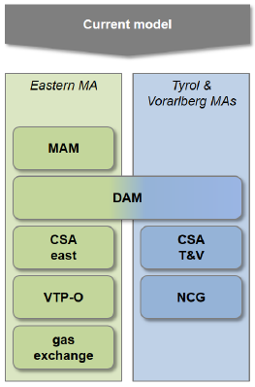
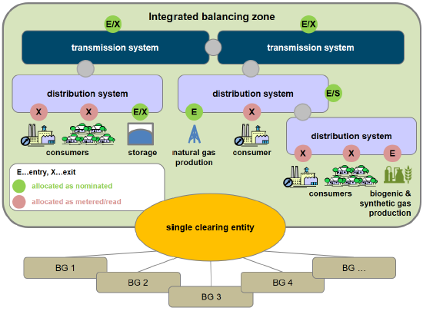
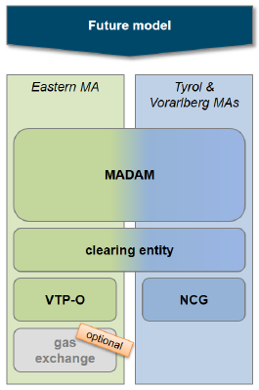
Schematic representation

Slide 6
Outcomes of the stake holders consultation
Shippers welcome in general E-Control´s efforts to aggregate the two balancing systems
Storage System Operators see potential changes of the present system critical. The main reason is represented by the potential competition of the linepack usage towards storage products for daily balancing purposes
Distribution System Operators see the related additional investments to go beyond any potential benefit for the market
Notes:
32 responses

Slide 7
Next steps
Based on the results of the consultation, working groups will be created in order to analyze in depth potential issues related to the proposed new balancing model. Results of the discussion are expected by end 2019
According to the present legal setting described in the GWG (natural gas act), starting with October 2021, E-control can nominate directly the CSA (clearing and settlement agent)

Slide 8
References
Consultation document:
https://www.e-control.at/documents/20903/443907/20180302+Konsultationsunterlage+Bilanzierungmodell+180301+ECA_EN.pdf/41a9823c-66e4-167c-3aaa-f42367185d85
Responses to the consultation:
https://www.e-control.at/recht/aktuelle-begutachtungsentwuerfe#p_p_id_56_INSTANCE_h6uAThBqc5V4_

Slide 9
Alessandro Ischia
810
alessandro.ischia@e-control.at

