Slide 1
SEM & Target Model Update
22nd FUI Implementation Group Meeting
London, 30 September 2011

Slide 2
FG CACM
FG CACM aims to create an internal market through price ‘coupling’ bids/offers submitted through power exchanges using available cross border capacity
SEM transition to target model acknowledged in Section 1.2 FG CACM:
transitional arrangements in place by 2014
full compliance by 2016
Network Codes to give legal effect to arrangements
SEM Project to address these issues has begun

Slide 3
SEM and Delivery of EU integration
Integrating SEM in present form into EU target model is a significant challenge
Target model based on predominant European market design of bilateral self commitment markets with voluntary, organised day ahead and intra day trading thorough power exchanges
SEM is a gross mandatory pool with:
ex post pricing
centralised unit commitment and dispatch, based on complex bids from generators
explicit capacity payments

Slide 4
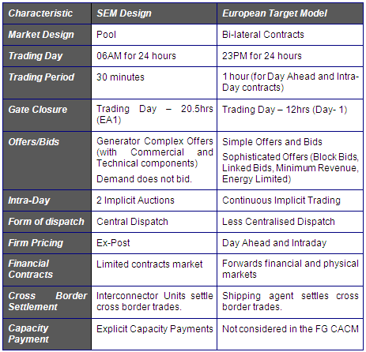
Market Characteristics

Slide 5
SEM Market Integration Project
Project Team Established
RA, MO and TSO members
Project plan published
Industry Engagement
Industry presentation in June (Ofgem and APX)
Bilateral meetings with market participants
Meetings with APX, OMEL, CNE and National Grid
Technical Workshop on 3rd October
Breakout sessions on key issues such as Day Ahead and Intra Day

Slide 6
Key Issues
Transitional arrangements for 2014 (FG CACM 1.2) involve minimum change to SEM design, deliver benefits of integration at minimum cost
Possible day ahead coupling using contracts market as a transition
Evolution of intra day trading solution as a transition
Enduring arrangements for 2016, potentially new market design or extensive changes to SEM
Key issue currently under consideration by the project team
Other Framework Guidelines to be kept in mind
e.g. Balancing and System Operation

Slide 7
Project Timetable
Date | Deliverable | Responsible
August – October 2011 | TSOs / MO options for 2014 RA work on day ahead contracts market | RAs / TSOs / MO
October 2011 | Industry engagement
SEMC Dec 2011 | Report from project team on potential options to pursue | SEMC
January 2012 | Consultation on next steps | RAs
February 2012 | SEMC decisions on transitional arrangements to pursue 2016 forward workplan | SEMC

