Slide 1
Day-ahead market coupling
Functioning of MRC in IFE
Madrid, 6th October 2014

Slide 2
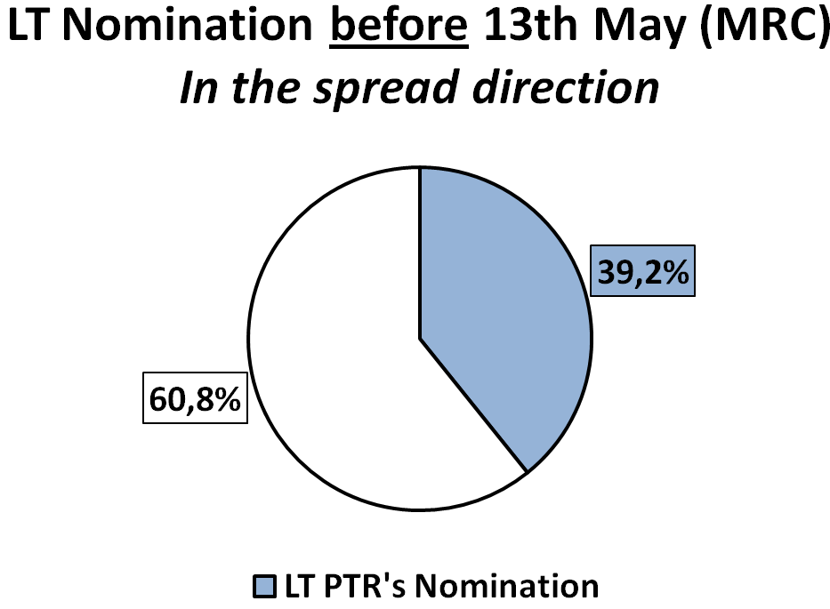
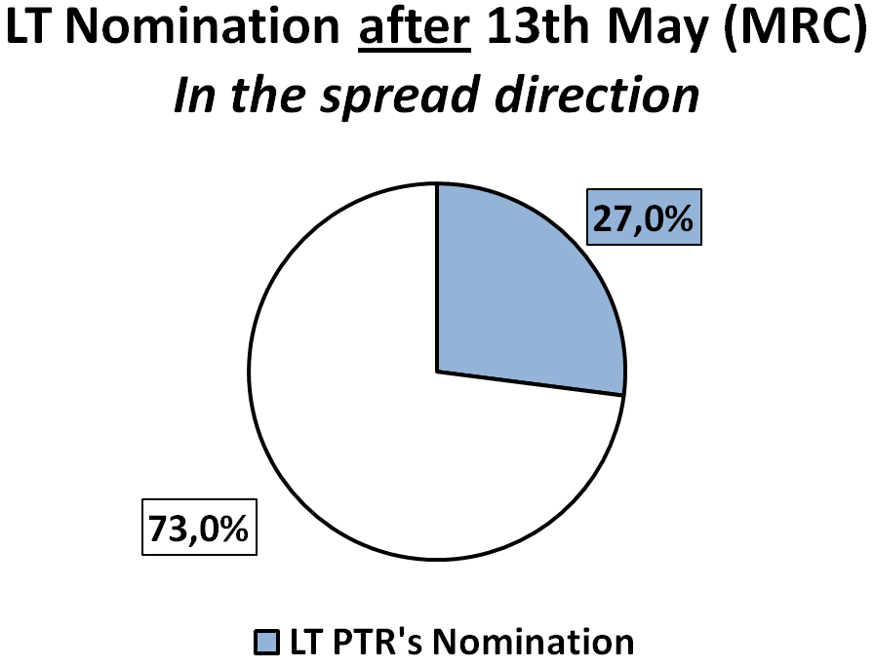
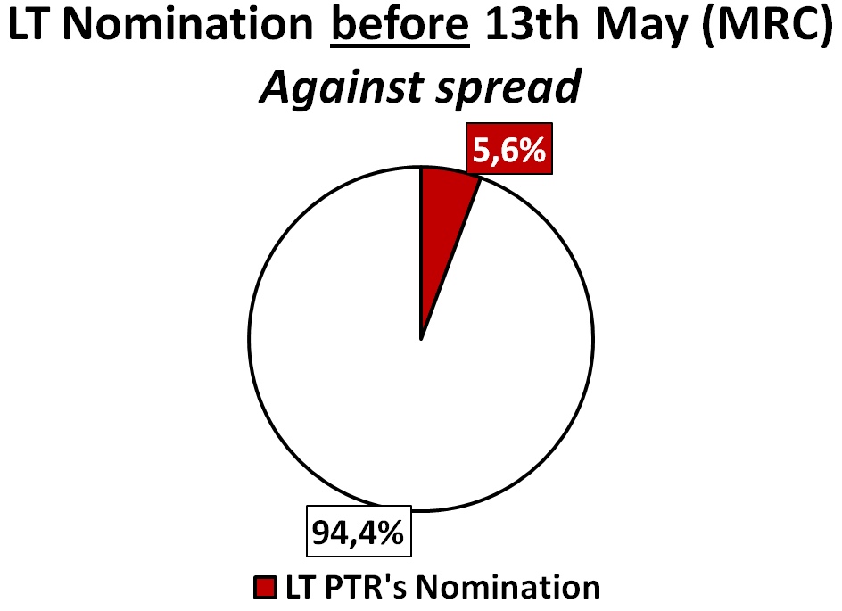
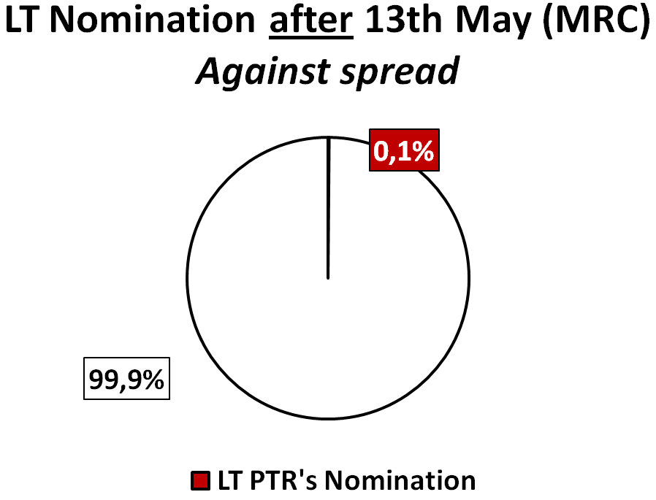
Evolution of long term nomination
 | 01/01/14- 13/05/14 | 14/05/14- 30/09/14
In spread direction | 39,2% | 27%
Against spread | 5,6% | 0,1%
12,2%
  After MRC:
  ↓12,2% Nomination of LT PTR’s in spread direction
  No nomination of LT PTR’s against spread

Slide 3
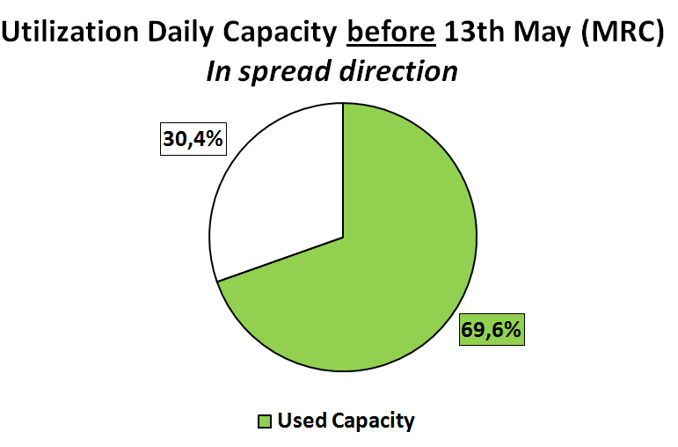
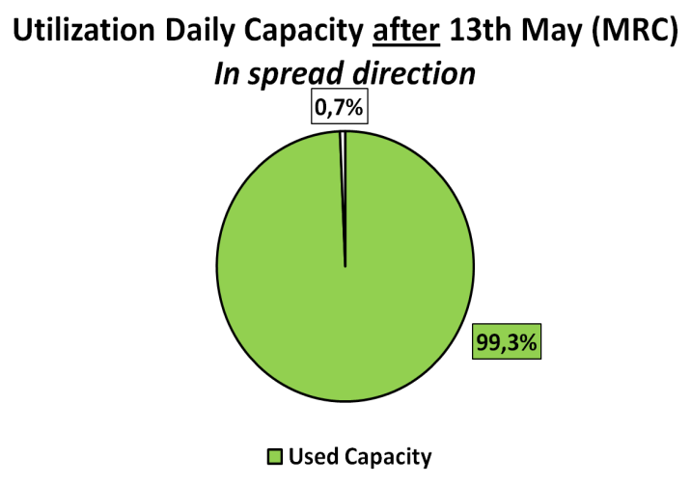
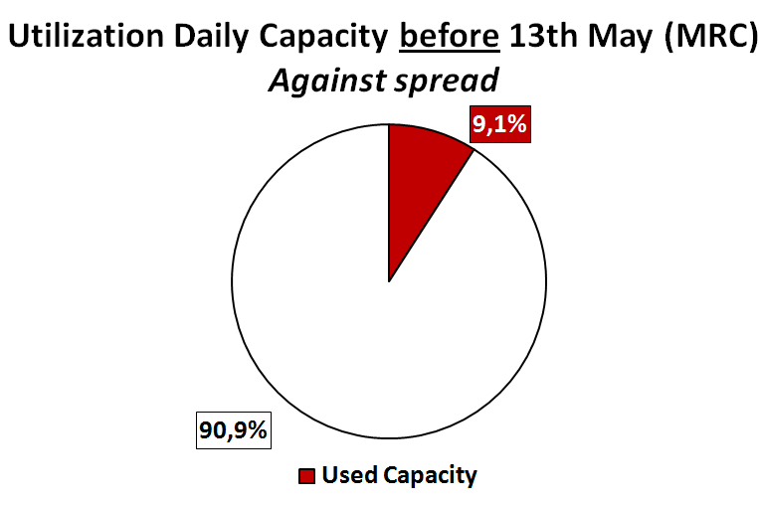
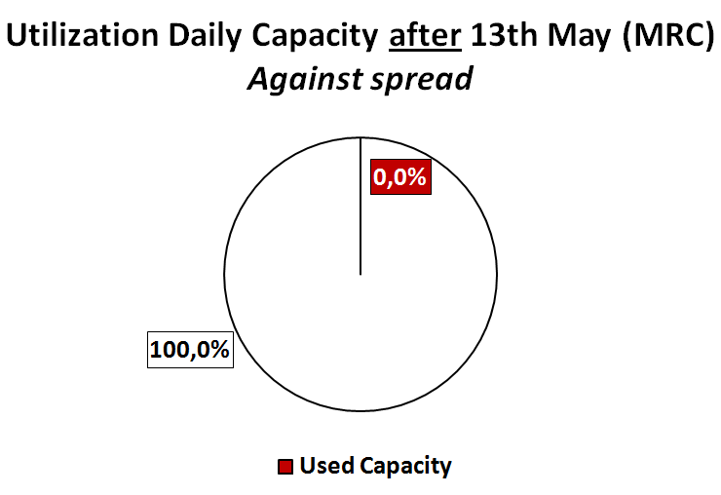
Utilization of net transfer capacity after day-ahead market*
 | 01/01/14- 13/05/14 | 14/05/14- 30/09/14
In spread direction | 69,6% | 99,3%**
Against spread | 9,1% | 0,0%
29,7%
  After MRC:
  Nearly 100% capacity used in the spread direction
  0% use of capacity against market spread
*Spread ≠0
** 100% utilization without 18/5/14 (Decoupling)

Slide 4
Utilization of net transfer capacity after day-ahead market*
  Before MRC:
  1 hour with price convergence
  After MRC:
  97 hours with price convergence (<1,5% of hours)
*Spread =0

Slide 5
Evolution of 1st id auction: volumes and prices*
In spread direction | 01/01/14 - 13/05/14 | 14/05/14 - 30/09/14
Average offered capacity (MW) | 301 MW | 0 MW **
Weighted average price (€/MW) | 2,45 €/MW | -
  After MRC**:
  - Non available capacity in the spread direction
* Spread ≠0
** Not included 18/5/14 (Decoupling)

Slide 6
Evolution of 1st id auction: volumes and prices*
Against spread direction | 01/01/14 - 13/05/14 | 14/05/14 - 30/09/14
Average offered capacity (MW) | 1561 MW | 1837 MW
Weighted average price (€/MW) | 0,06 €/MW | 0,01 €/MW
  After MRC**:
  - More capacity available against spread direction
* Spread ≠0
** Not included 18/5/14 (Decoupling)

Slide 7
Evolution of 1st id auction: volumes and prices*
After 13th May 2014 (MRC)
* Spread = 0

