Slide 1
SELF-ASSESSMENT AND DEVELOPMENT OPTIONS FOR
THE SLOVENIAN GAS WHOLESALE MARKET
Vinko Nedelko
41st GRI Coordination Group Meeting
Ljubljana, 18 May 2018

Slide 2
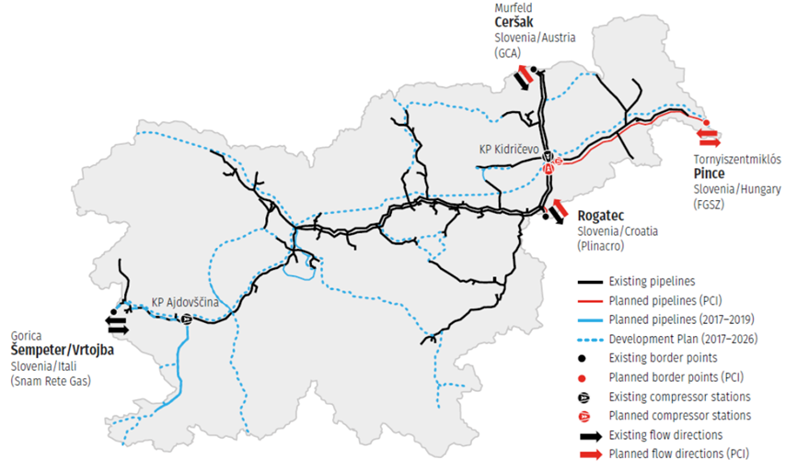

Content of the Slovenian self assessment
Overview of Slovenian gas market characteristics
Expected development of regional wholesale markets
Market development options for Slovenia
Assessment of gas market scenarios for 2021 (CBA with REKK’s European Gas Market model)
Conclusions
SELF-ASSESSMENT AND DEVELOPMENT OPTIONS FOR
THE SLOVENIAN GAS WHOLESALE MARKET

Slide 3
Overview of Slovenian gas market
Small market dominated by industrial consumption and significant transit activity
  0.9 bcm domestic consumption and 1.3 bcm transit
  Little prospect for a liquid trading platform because of small volumes
Minor role of gas in the primary energy supply (around 10%)
  Electricity generation and space heating are dominated by other fuels/resources
  AGTM metrics indicate poorly developed wholesale market
  HHI 8256 - indicating heavy dependence on Russian sources (LTC)
  Adequate number of supply sources (3)
  Residual Supply Index (RSI) of 95%
  Gas prices paid by Slovenian
  industrial customers have converged
  to regional average
SELF-ASSESSMENT AND DEVELOPMENT OPTIONS FOR
THE SLOVENIAN GAS WHOLESALE MARKET

Slide 4
Expected development of regional wholesale markets
Important infrastructure projects in the region
Croatian LNG may contribute to supply source diversification and more competition
Turkish Stream
  Second string to bring Russian gas to the region may be in place by end 2019
  Competing routes: with the IT-SI-HU project in place, Slovenia could benefit
Black Sea gas production
  Slovenia could only access this new source once the SI-HU interconnector is built
Trans-Adriatic pipeline (TAP)
  Another diversification option for Slovenia through the currently unutilised IT-SI interconnector
  Italian „liquidity corridor”
  The goal is to increase liquidity; prices may decline
SELF-ASSESSMENT AND DEVELOPMENT OPTIONS FOR
THE SLOVENIAN GAS WHOLESALE MARKET

Slide 5
Market development options for Slovenia
SWOT analysis for various development options:
Development in the current regulatory framework
  All NC to be fully implemented (Integrating IPs into a virtual IP, dynamic recalculation of technical capacity, overpriced short-term capacities, ...)
Market merger & Trading region
  May remove some market inefficiencies by facilitating trade, but at the cost of additional financial and administrative burden on TSOs and NRAs; inter-TSO compensations; tariffs would be less transparent and less cost-reflective
Satellite market
  SI to join AT-IT integrated market until SI can import significant quantities of gas from market other than AT and IT
Market Coupling
  MC may increase the liquidity of the market. Cost and complexity of implementation is limited, but as capacity hoarding and contractual congestion is not prevalent on Slovenian IPs, the potential benefits are also limited
Security of supply considerations
  No market integration option would help when the gas flows are interrupted due to technical reasons (e.g. explosion in Baumgarten)
  Assessment of gas market scenarios for 2021 (CBA with REKK’s European Gas Market model)
The following scenarios were modelled for the year 2021:
Slovenian gas demand changes (+/- 10%, +/-20%, +20% with higher seasonal swing)
Non-availability of the AT-SI interconnector
Commissioning of Krk LNG terminal with the reverse flows on the SI-HR IP
Slovenian tariffs increase
SI-HU interconnector (first phase) built
SELF-ASSESSMENT AND DEVELOPMENT OPTIONS FOR
THE SLOVENIAN GAS WHOLESALE MARKET

Slide 6
Conclusions
  Slovenia performs poorly if measured by AGTM metrics, but
  The proper functioning of the regional market is acknowledged by the EC
  Stakeholders did not raise any serious barrier to trade during the consultation
  Several regional infrastructure projects are on the table that may contribute to more diversification and competition
Strong interconnections with large import capacities and proximity to liquid hubs
  Trading points (CEGH, PSV) within easy reach of market players
  Slovenian traders are able to take advantage of the products and services available on these hubs
  Price conversion between AT, IT, SI and HU markets in recent years is evident
  Spot trading activities are increasing
  All market integration options are linked to many open issues and related risks and require extensive TSOs and NRAs cooperation and harmonisation efforts (resources!?)
At least in the short term, Slovenia should not pursue any formal market integration
Priority should be given to the proper implementation of the NC
SELF-ASSESSMENT AND DEVELOPMENT OPTIONS FOR
THE SLOVENIAN GAS WHOLESALE MARKET

Slide 7
Thank you for your attention!
vinko.nedelko@agen-rs.si

